Slide 1
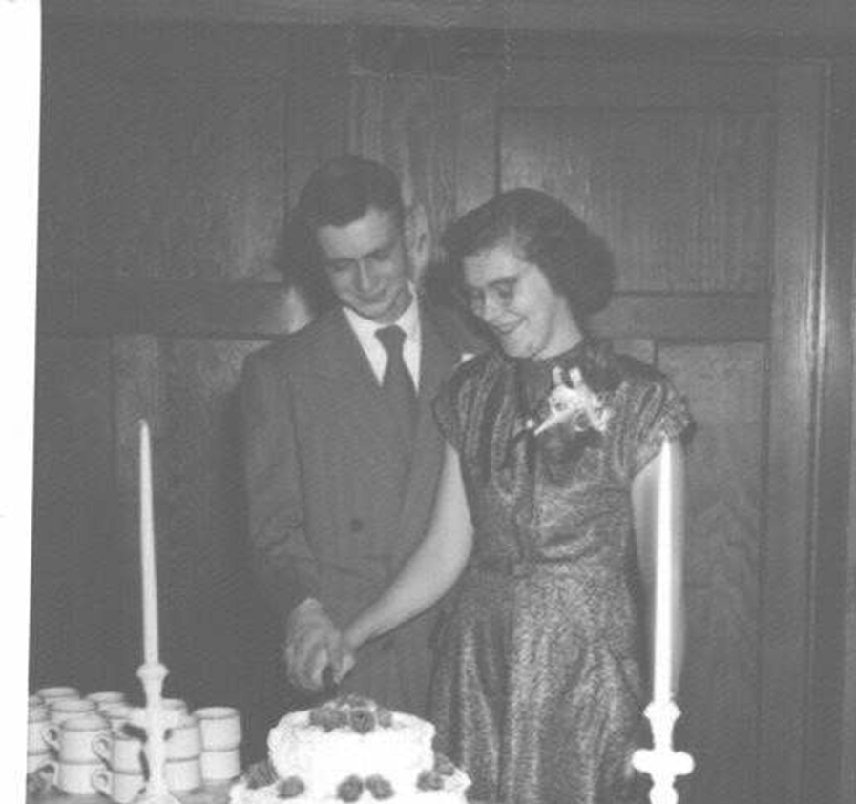
Walter and
Katie VanRaden
1930-2008

Slide 2
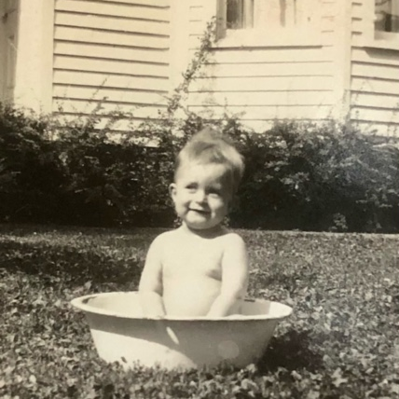
1931
Walter at 15 months
Forreston, IL

Slide 3
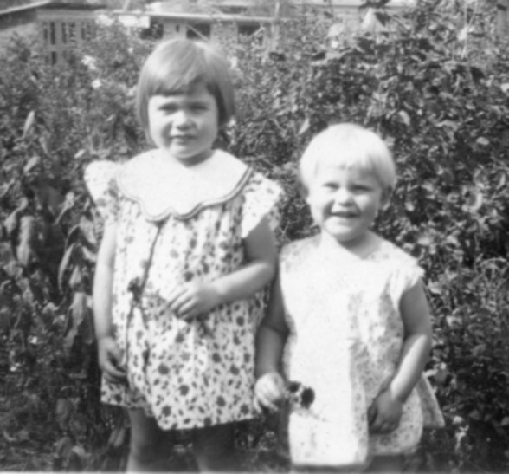
1933
Rosemary and Katie Ellis
Winslow, IL

Slide 4
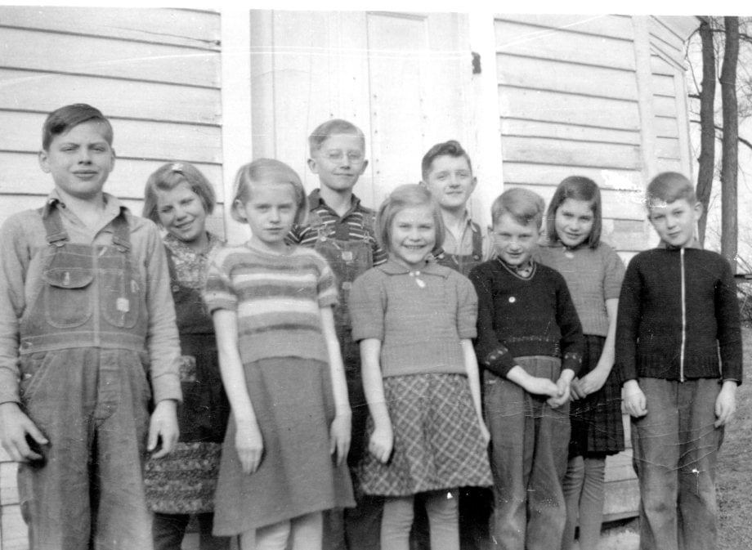
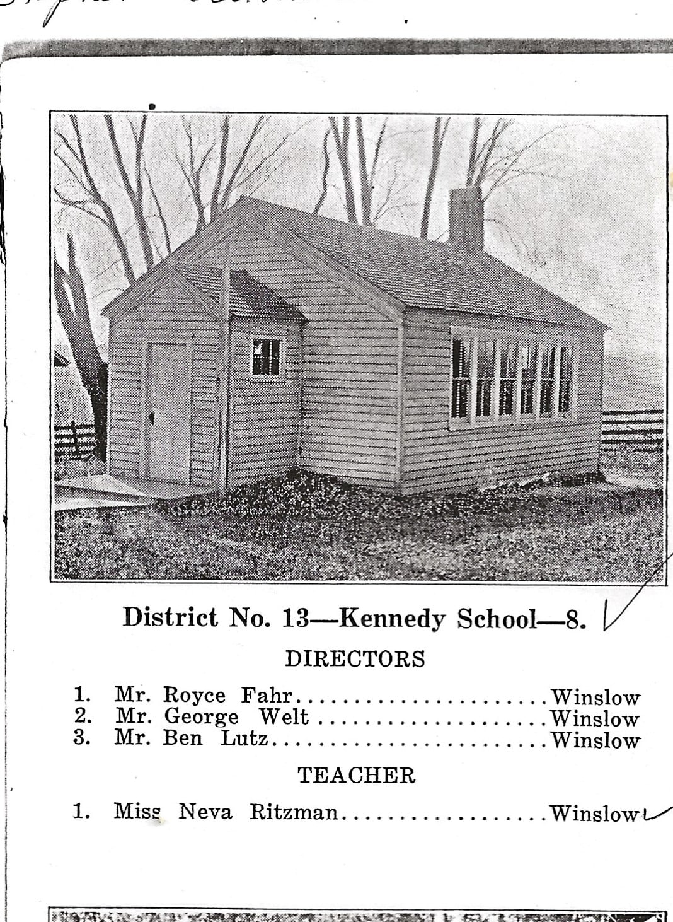
Katie (center) and her class-mates, and their 1-room school in Winslow, IL, ~1937

Slide 5
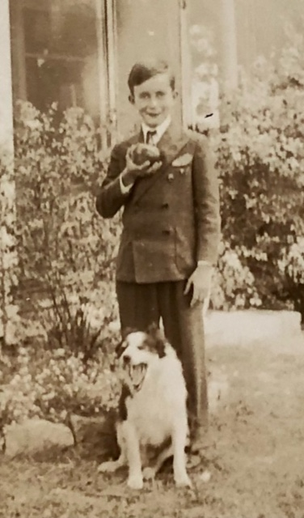
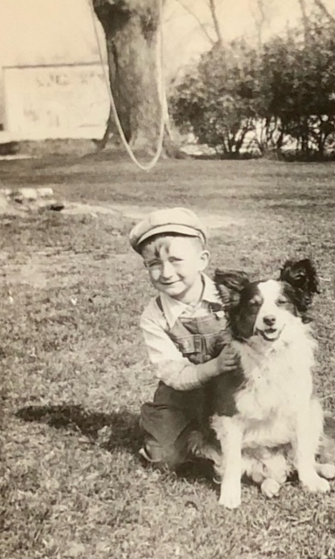
Walter with dog

Slide 6
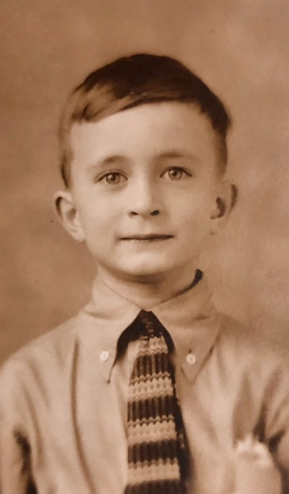
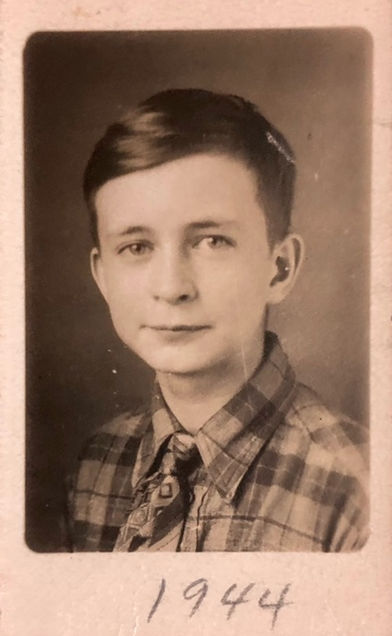
Walter early photos

Slide 7
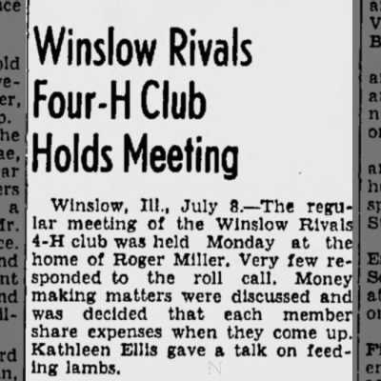
1942
Katie gives 4-H talk about feeding lambs

Slide 8
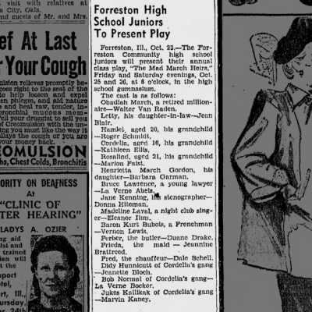
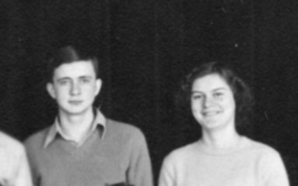
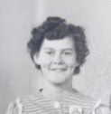
Walter and Katie star in 1946
Forreston High school play
(1945 photo of Katie)

Slide 9
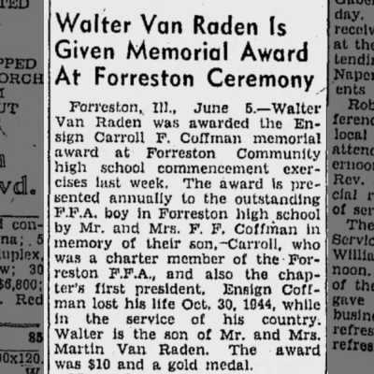
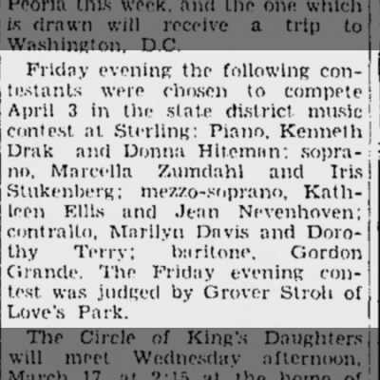
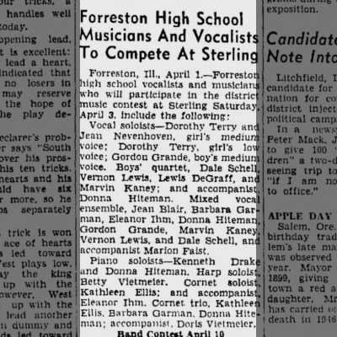
Walter wins top FFA student in Forreston, Katie competes in district Music contests
1948

Slide 10
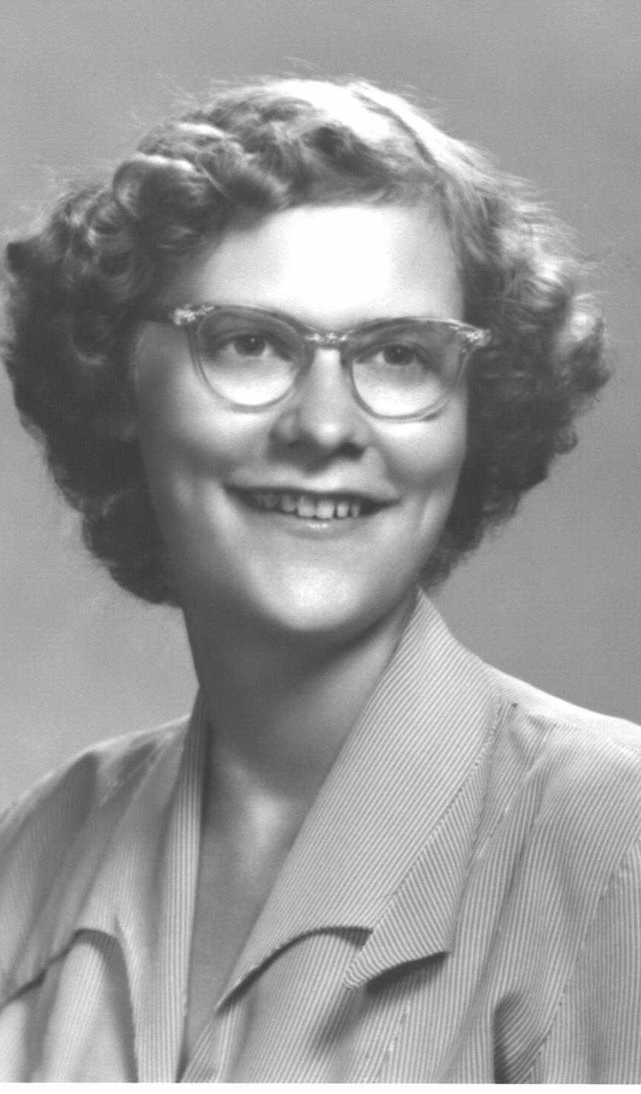
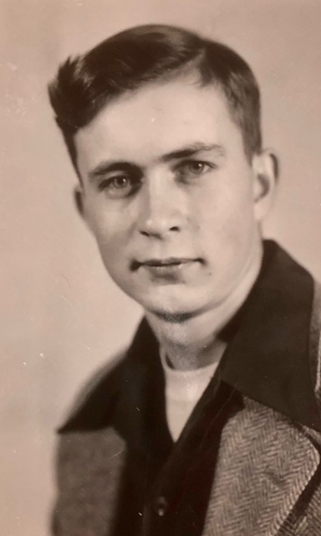
Forreston High senior photos
1948

Slide 11
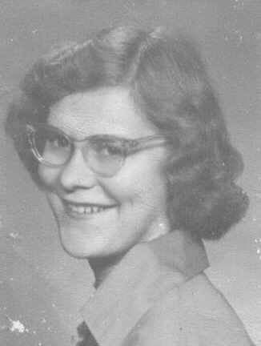
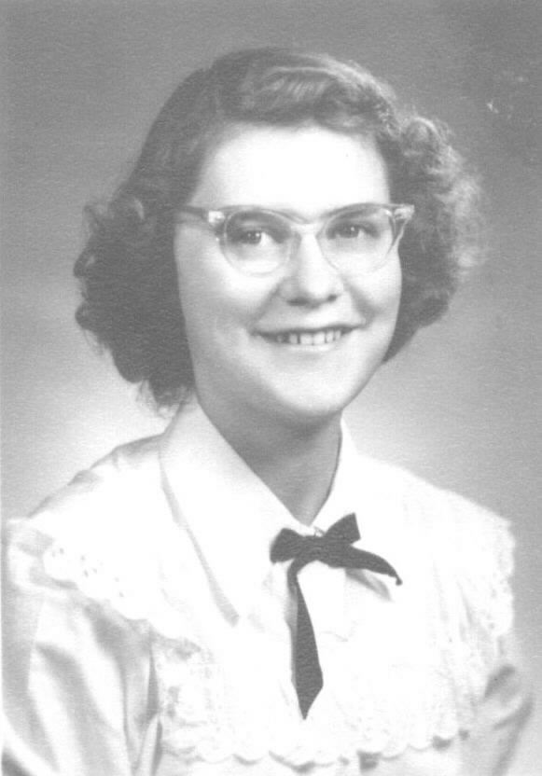
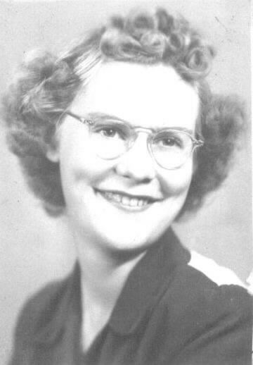
Katie photos

Slide 12
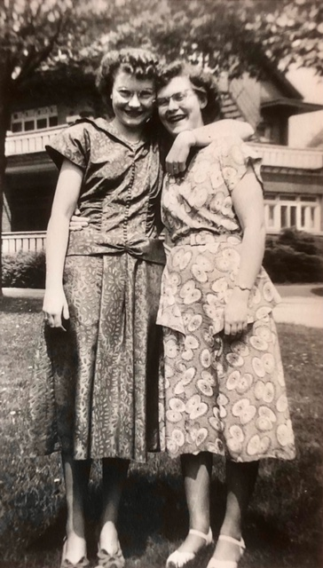
1949
Rosemary and Katie

Slide 13
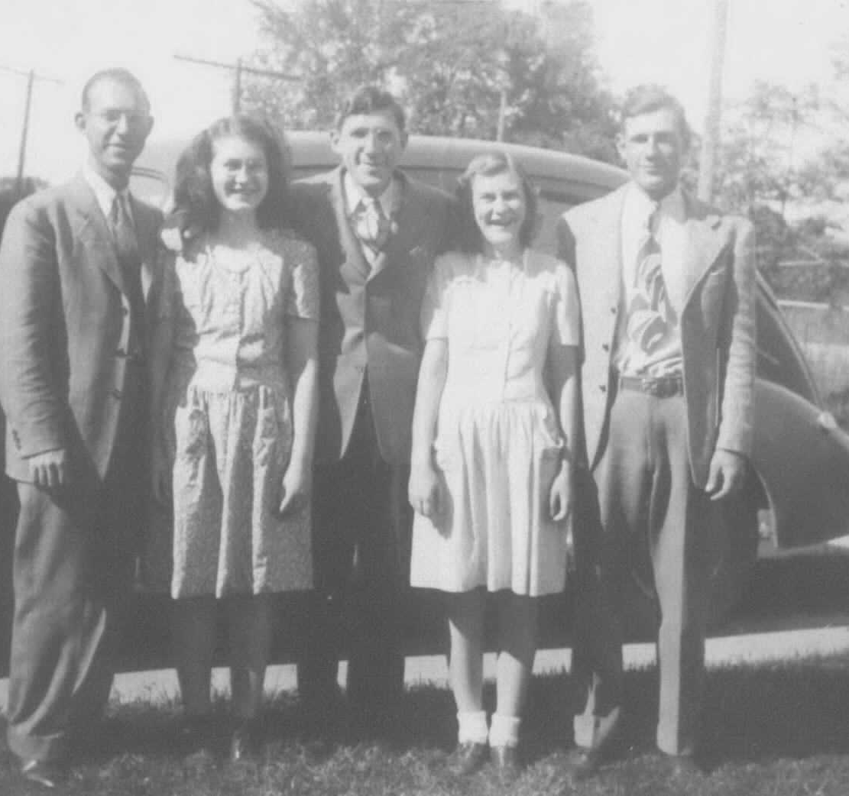
Siblings:
Leroy, Rosemary, Harold, Katie, and Robert Ellis

Slide 14
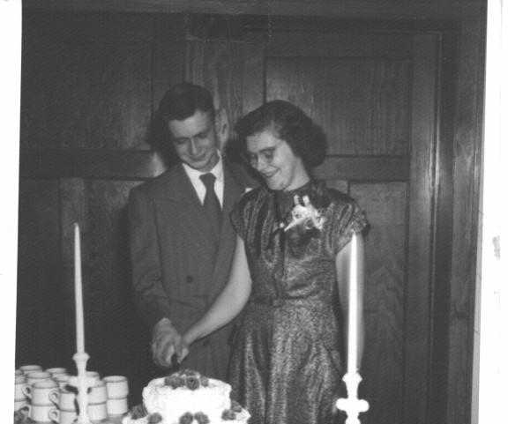
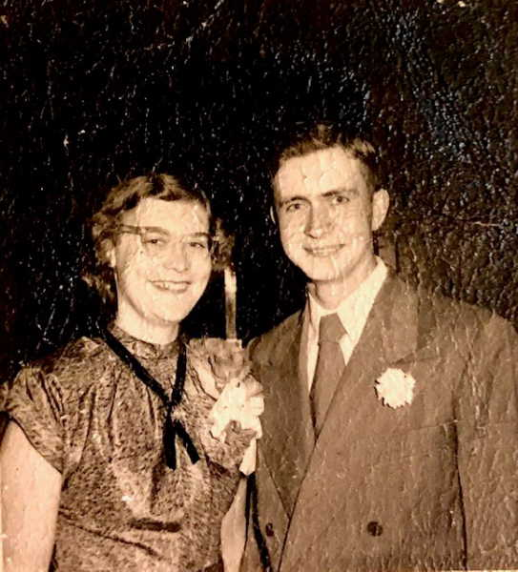
Wedding, Dec 17, 1950

Slide 15
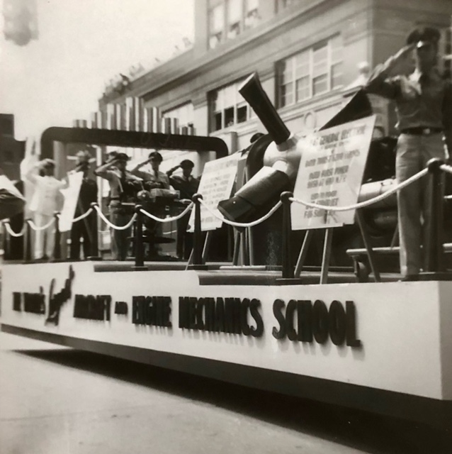
1951
Walter graduates top of class
Engine Mechanics School
Shepherd Air Force base, Texas

Slide 16
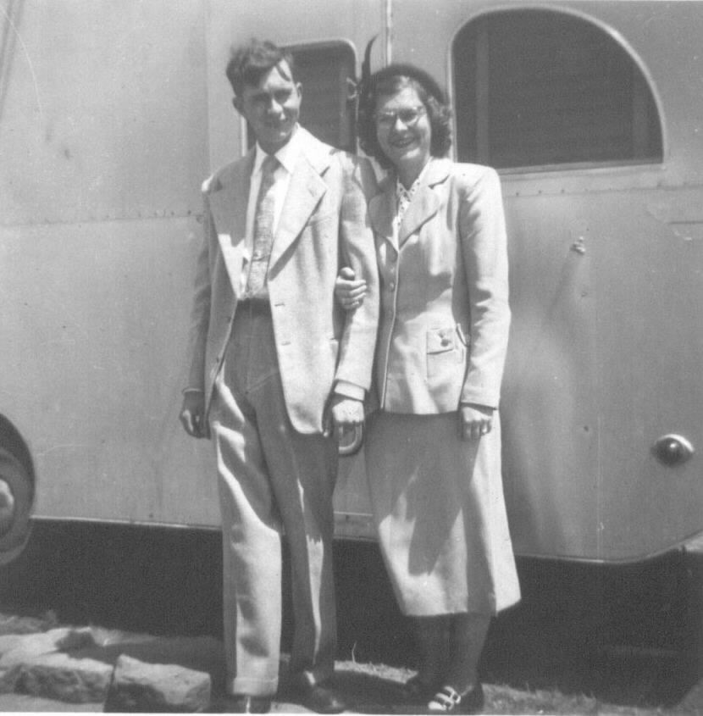
1952 Tampa, FL

Slide 17
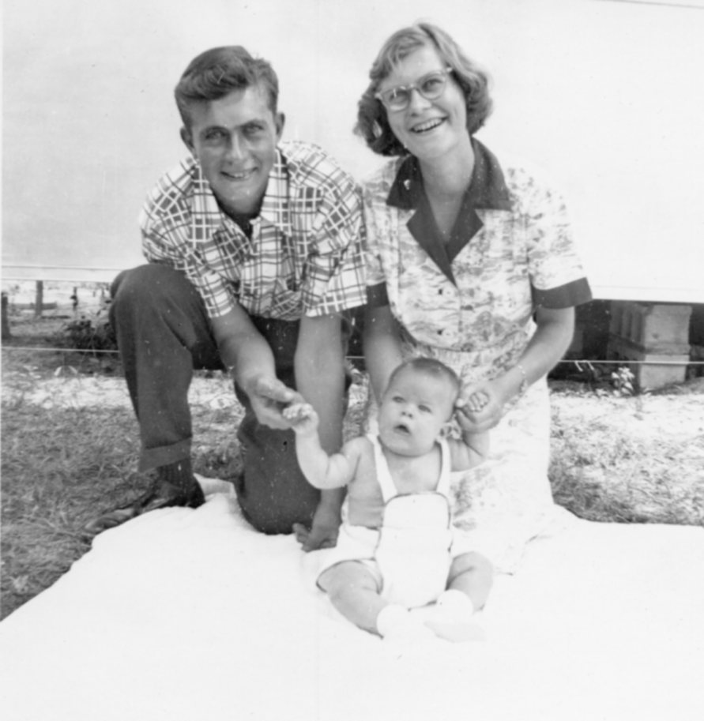
1952
Birth of first child - Mark

Slide 18
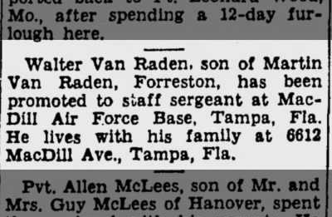
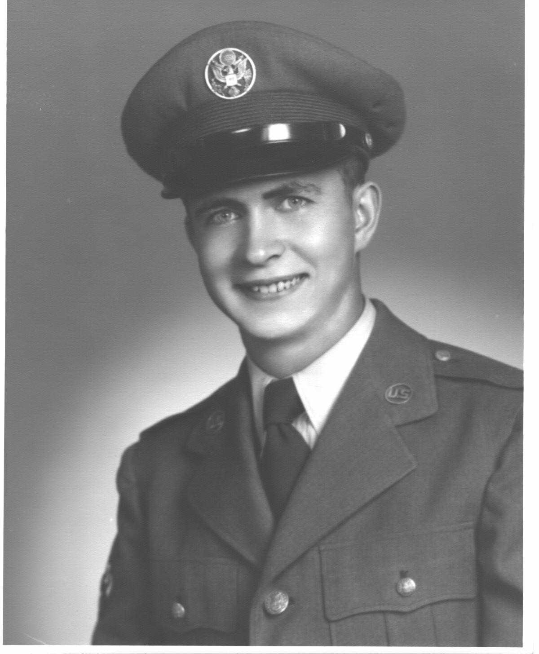
1954 Air Force promotion

Slide 19
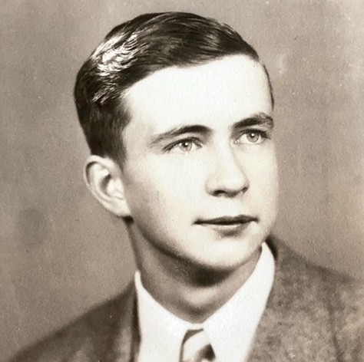
Bud photo

Slide 20
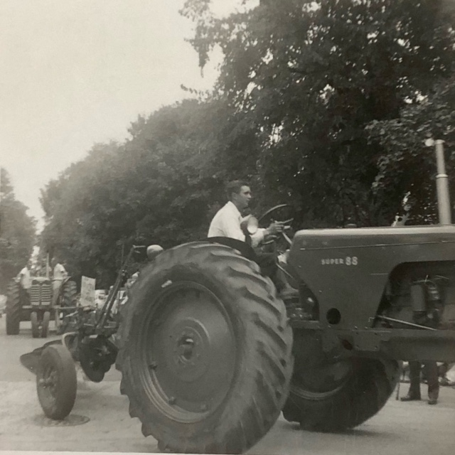
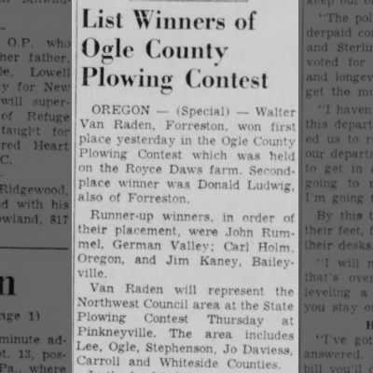
1956
Walter wins plowing contest

Slide 21
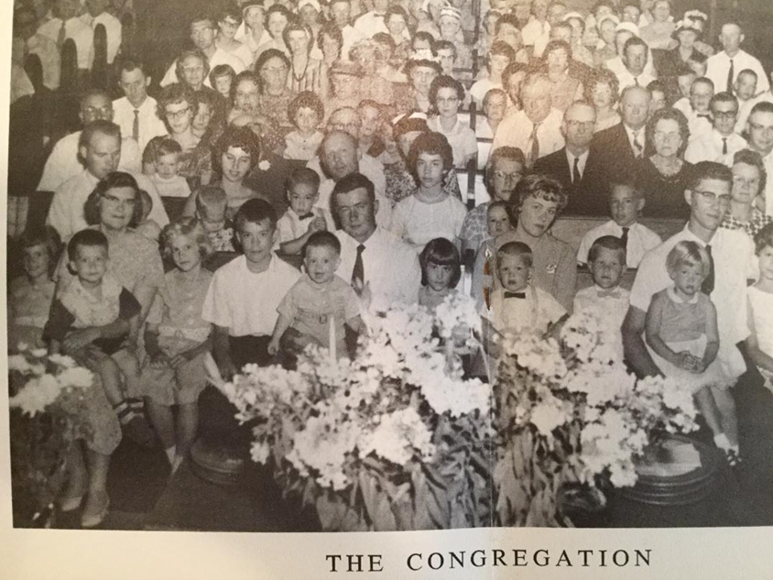
Sunday morning, 1963
From the 100-year celebration of the Forreston, IL Reformed Church.
Front row left to right:
Judy Paul Katie Miriam Mark Dave Bud Deb

Slide 22
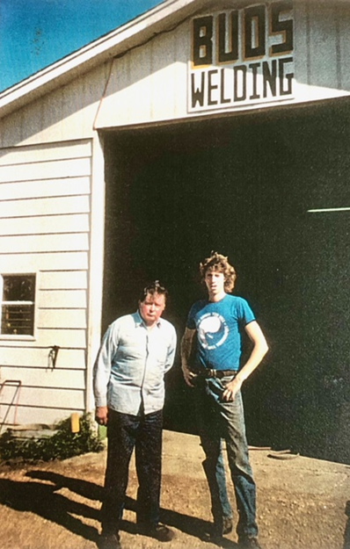
~1985
Bud’s welding, with son Dave,
Forreston, IL

Slide 23
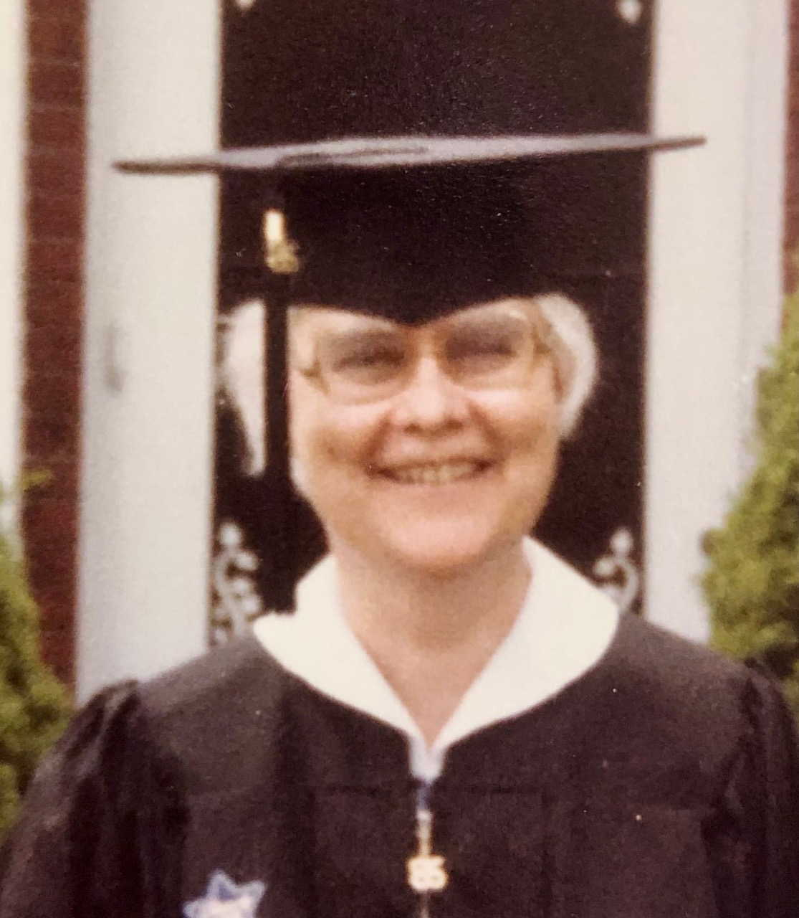
1985
Katie’s
Bacheller of Arts, Rockford College

Slide 24
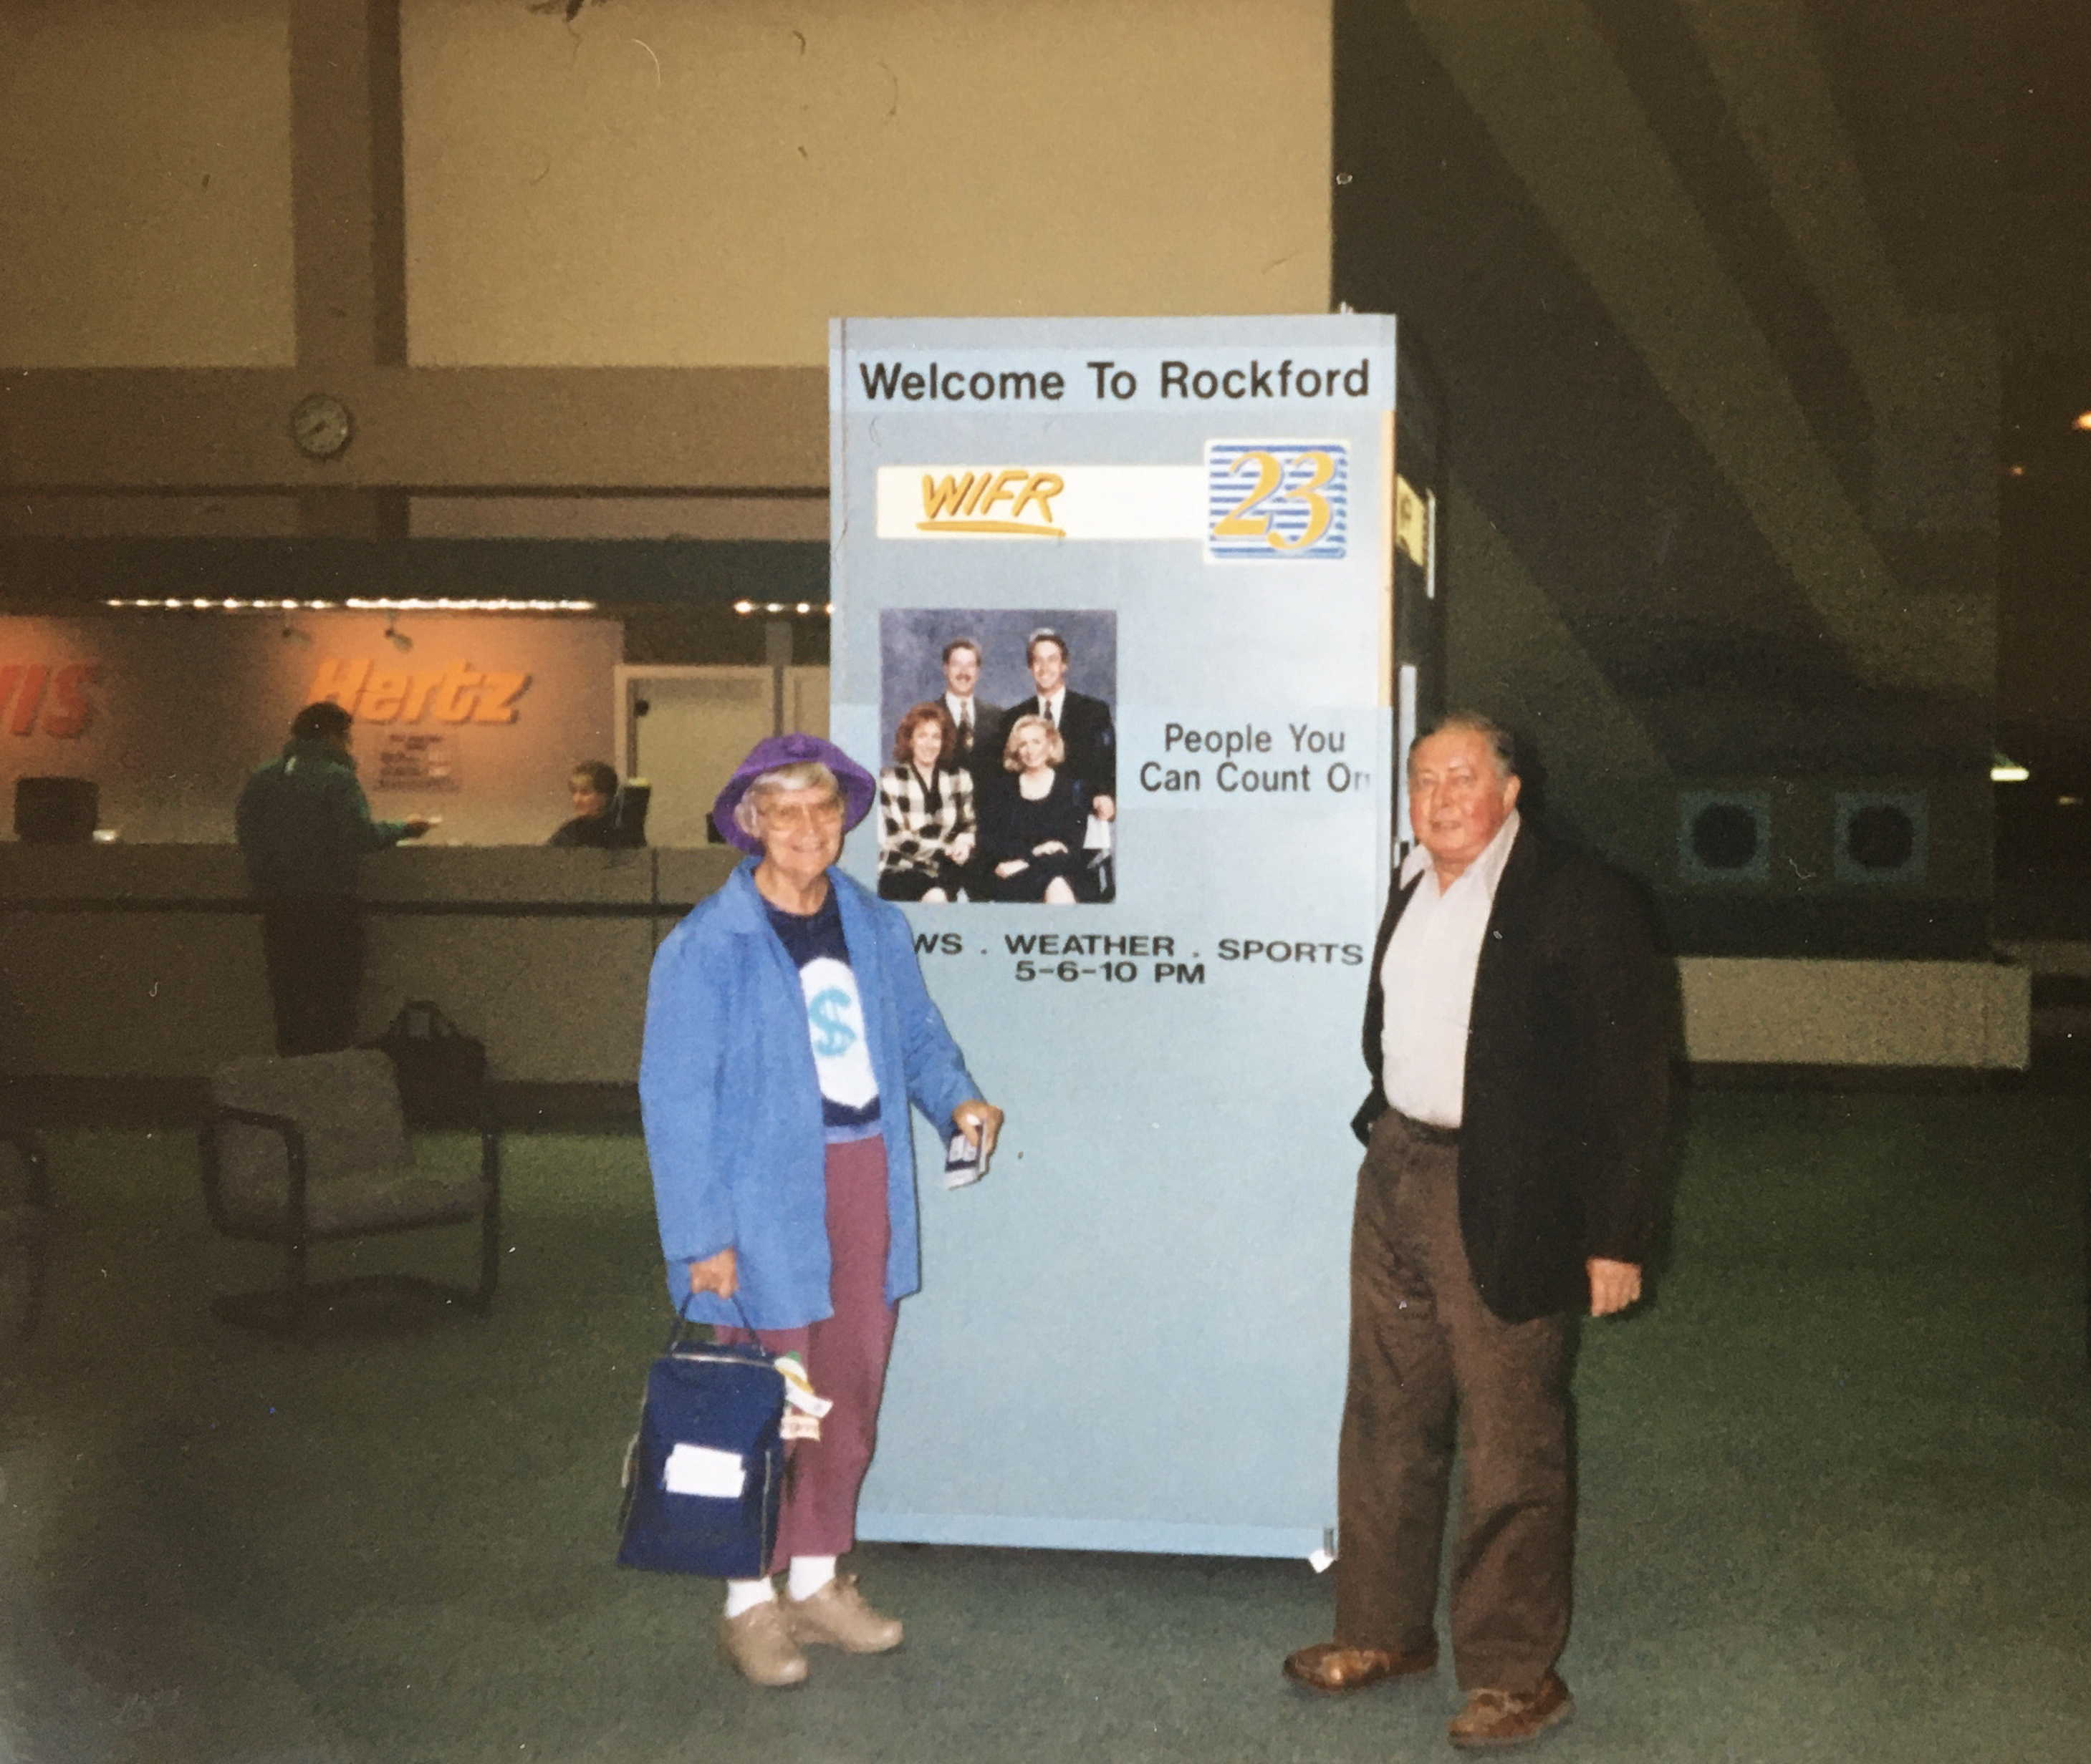
1994

Slide 25
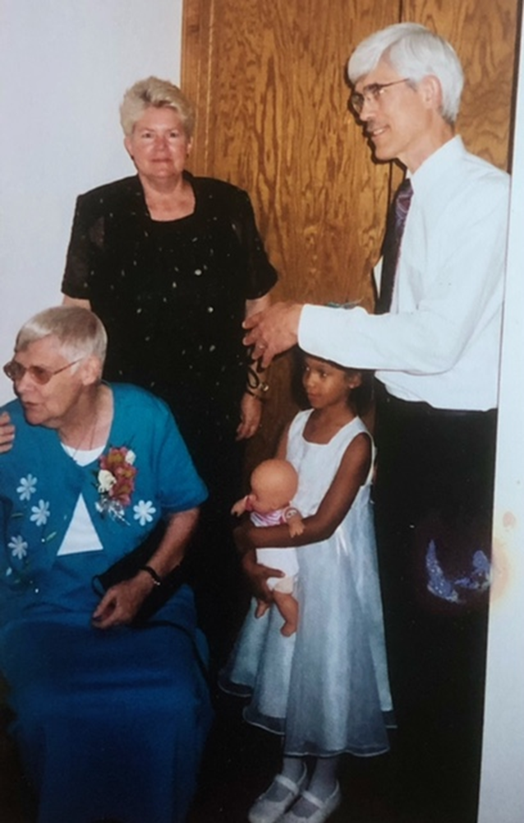
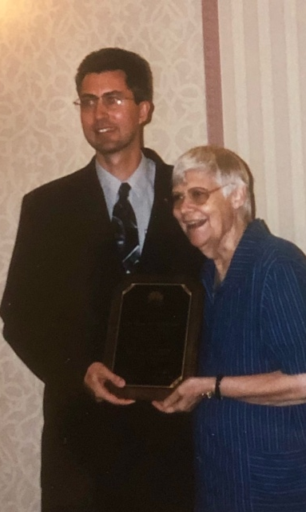
Katie VanRaden with Miriam, Mark, and Angel, and with Paul in 2000

Slide 26
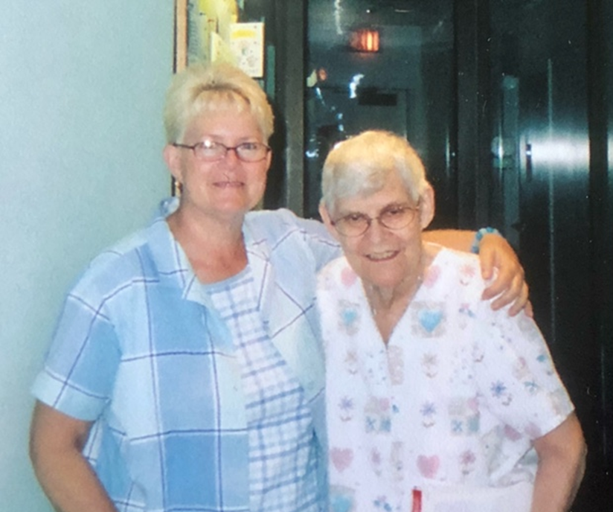
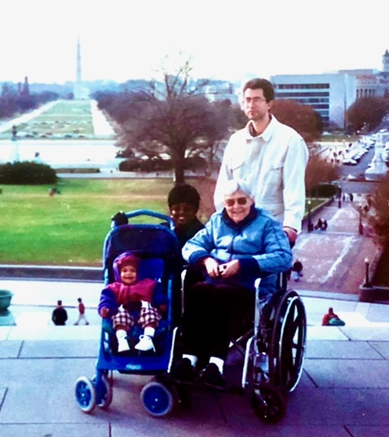
Katie VanRaden photos with Miriam and Paul’s family in DC

Slide 27
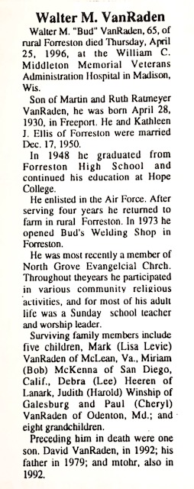
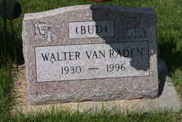
1996 Walter obituary

Slide 28
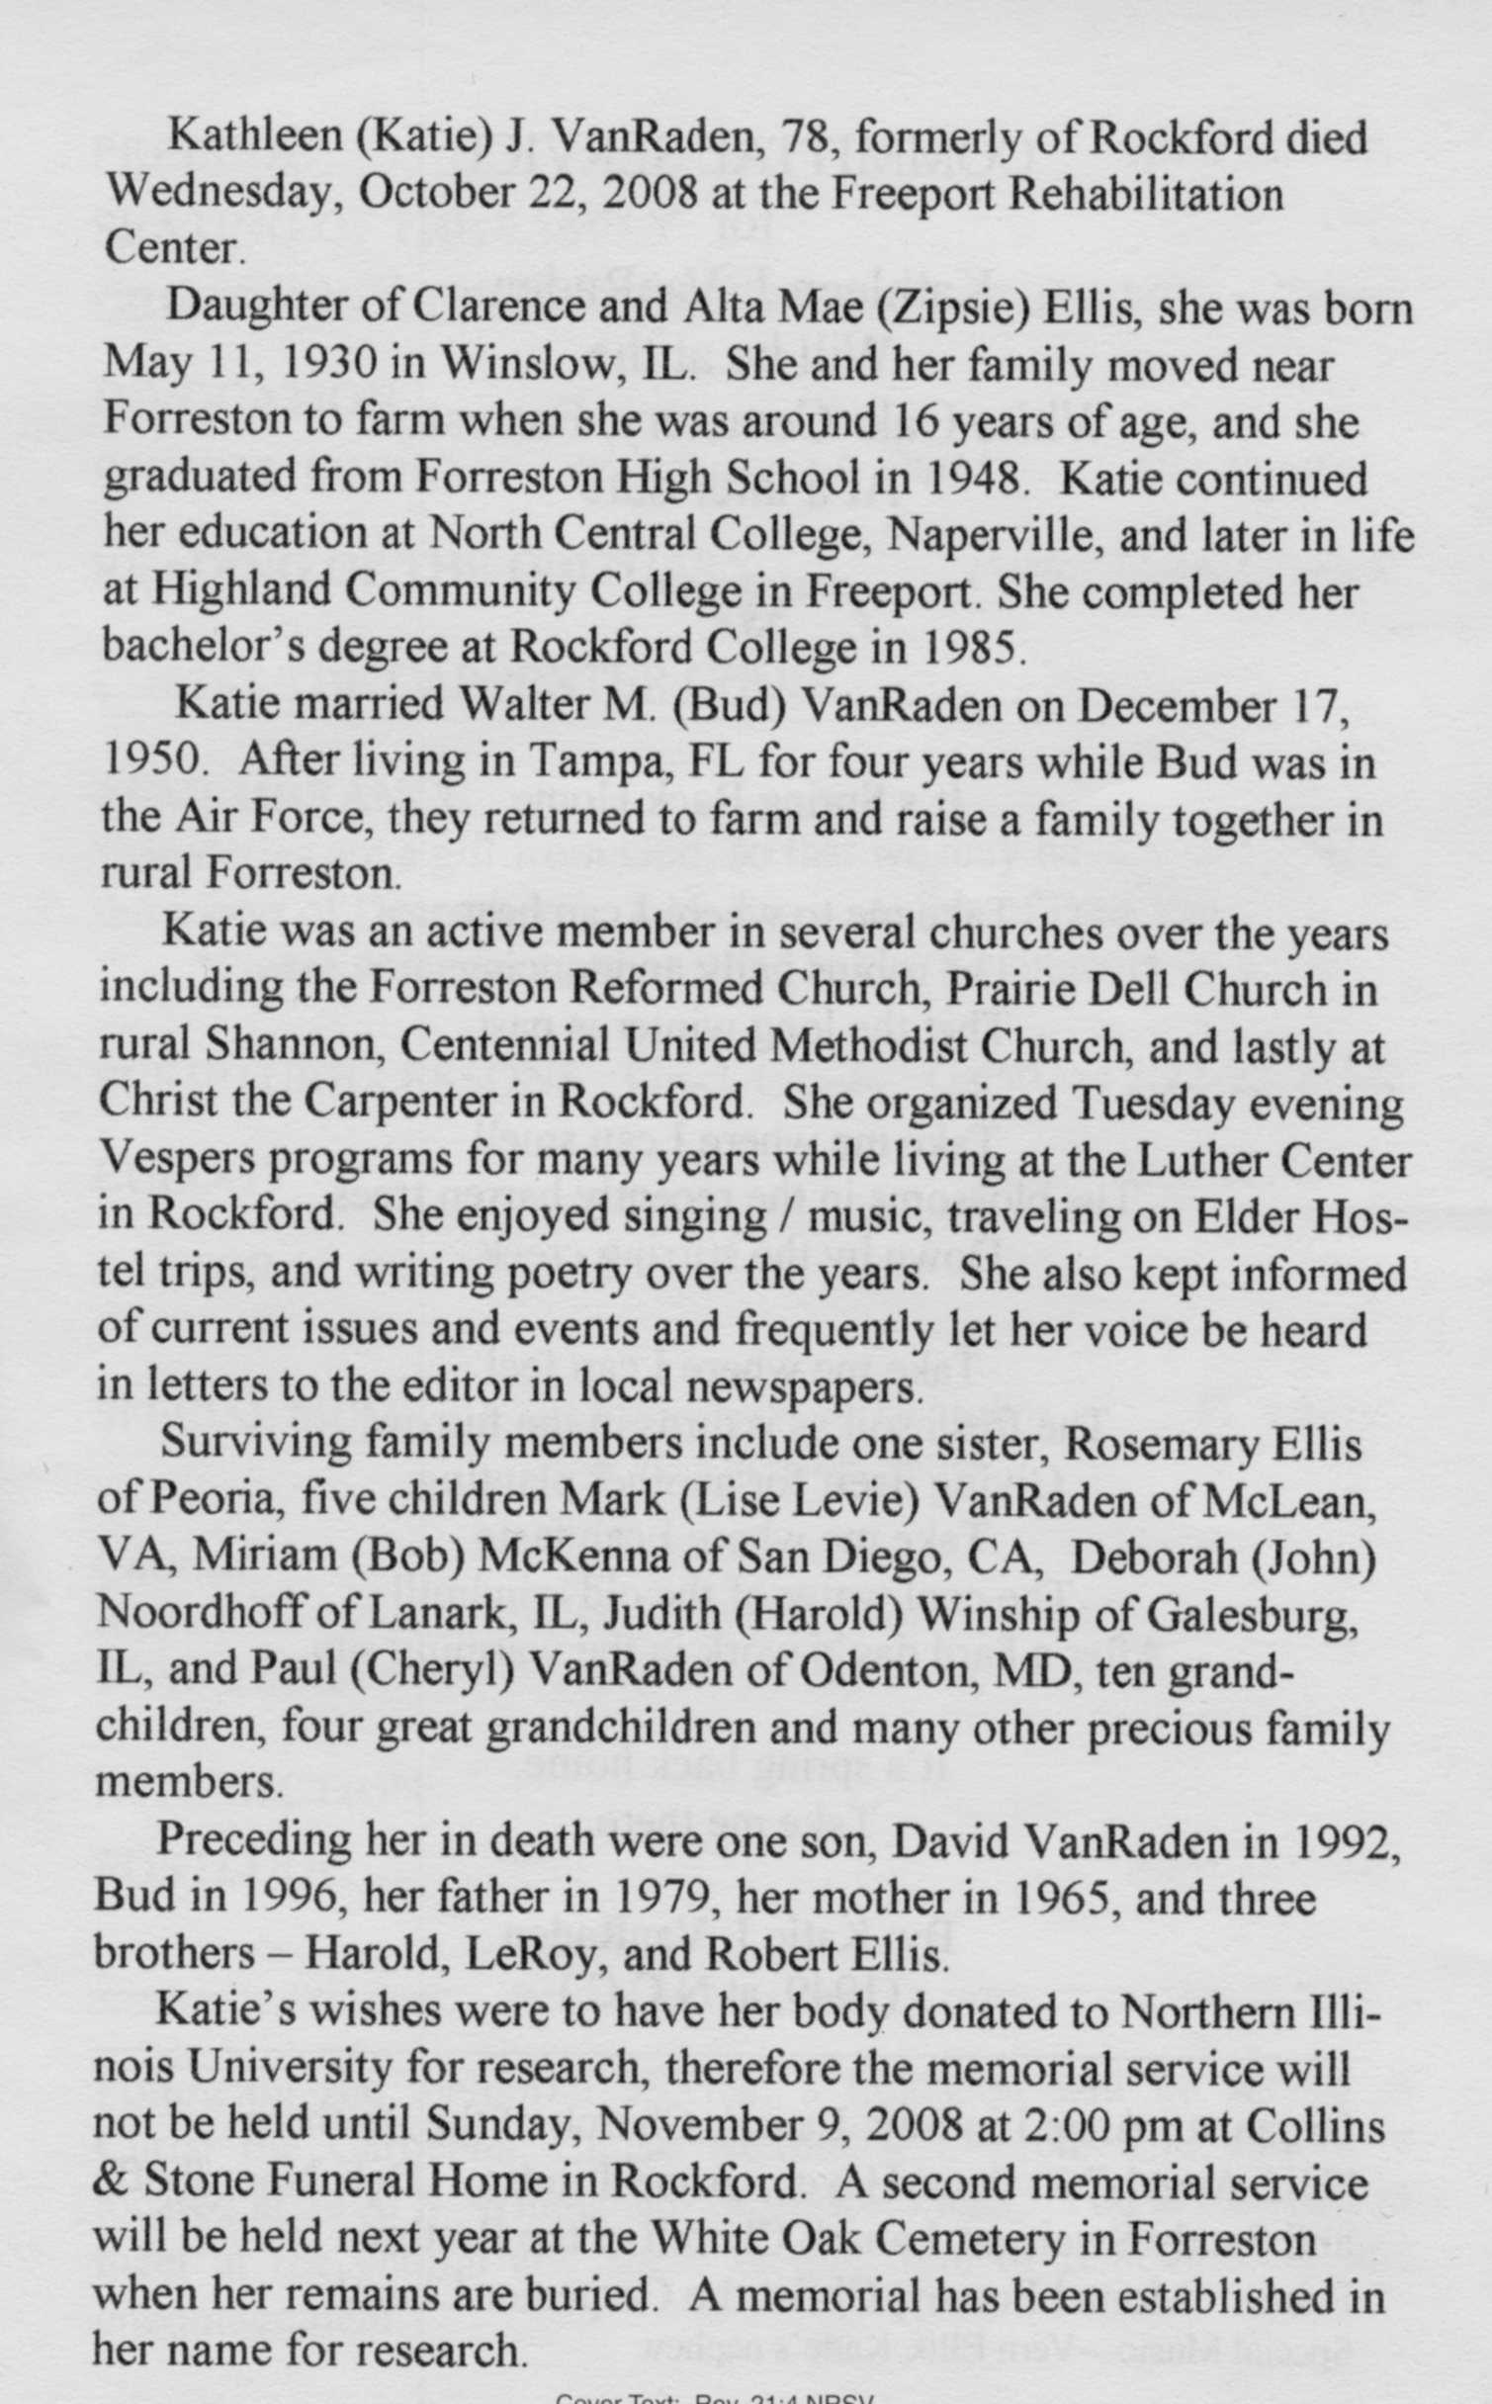
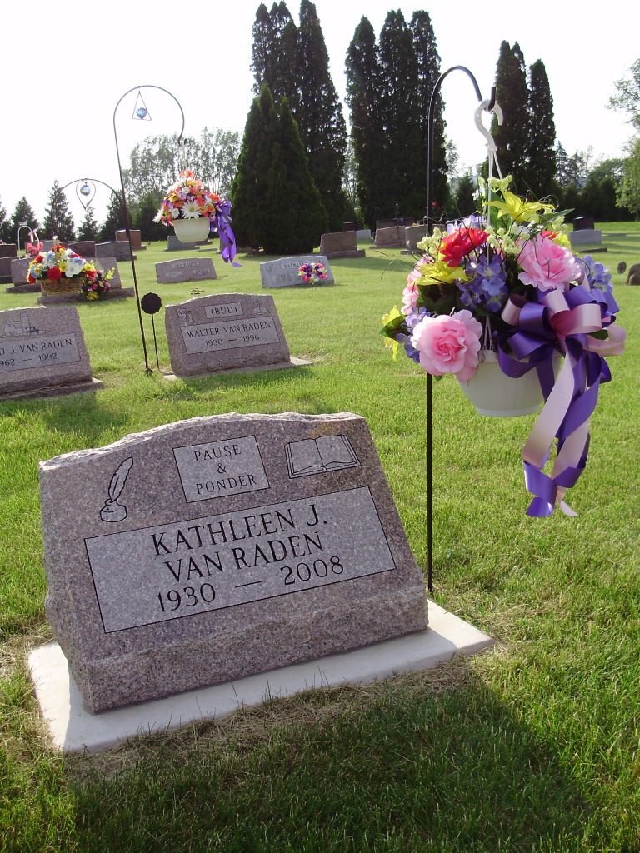
2008 Katie obituary

Slide 29
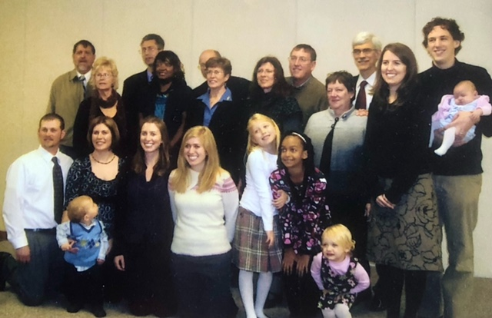
Children, spouses, and grandchildren at Katie’s memorial service
2008

Slide 30
To: Mom
From: Your Children
We loved you Mom. We know you always loved us.
You gave us life. You shared your life with us.
You sang God’s praise. You taught us peaceful ways.
We are amazed! From us you get all A’s.
You soothed our cries, when others didn’t care.
You gave advice, and taught us how to share.
When we were down, you were the first to call.
We thank you Mom, for thinking of us all.
And you should know, you said nice words worth sharing.
To everyone, to people everywhere.
And as we live, we’ll give your words to others.
We love you Mom. We really miss you Mother.
And others here, are also glad they knew her.
She helped us all, to find a happy future.
In honor of Katie J. VanRaden
May 11, 1930 - October 22, 2008

Slide 31
Earlier generations of ancestors
For Walter VanRaden’s parents and ancestors, see:
  http://www.paulvanraden.com/Martin_Ruth_VanRaden.pptx
For Katie VanRaden’s parents and ancestors, see:
  http://www.paulvanraden.com/Clarence_Alta_Ellis.pptx

