Slide 1
Recent VanRaden Vacations / Events
Cheryl, Paul, Charlee, Angel, Cesar, etc. (2021-25)
For more slides see http://www.paulvanraden.com/InteractingWithFamily.htm

Slide 2
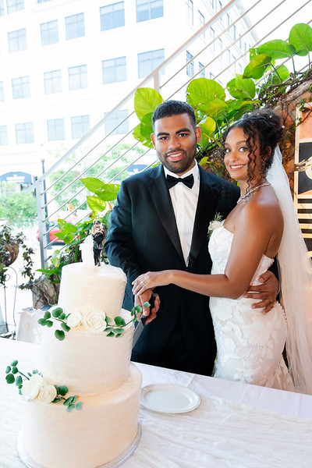
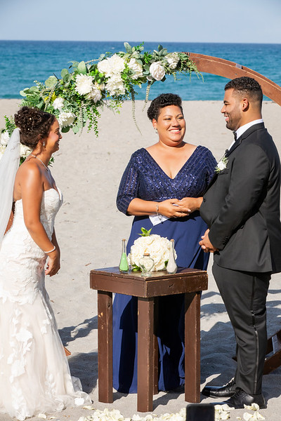
Wedding of the Year:
Angel and Cesar
June 9, 2025

Slide 3
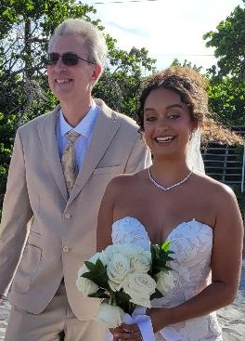
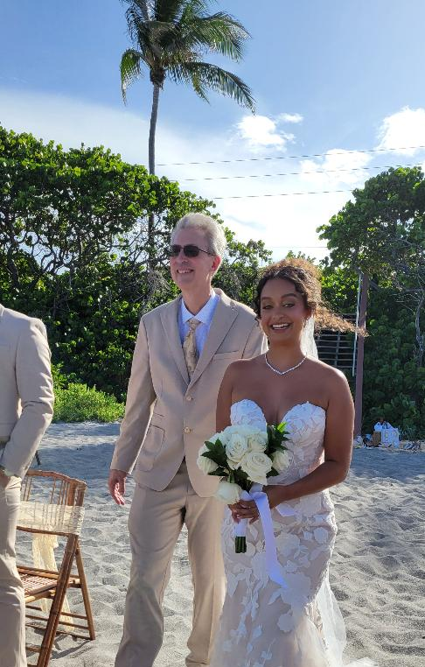
Let’s get this wedding started

Slide 4
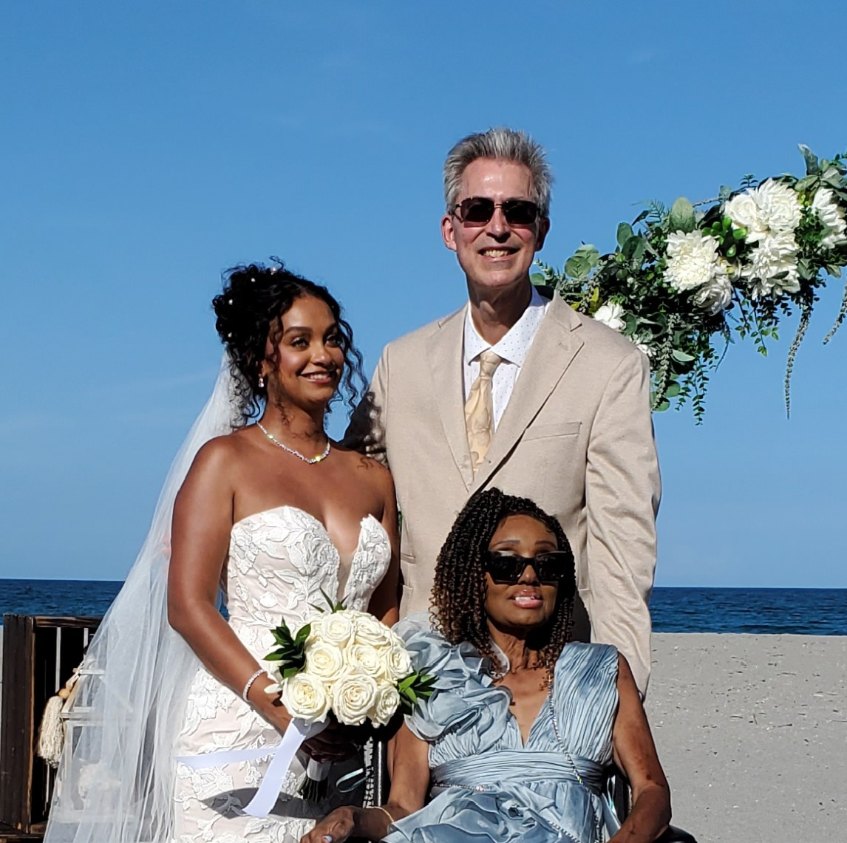
Bride with parents

Slide 5
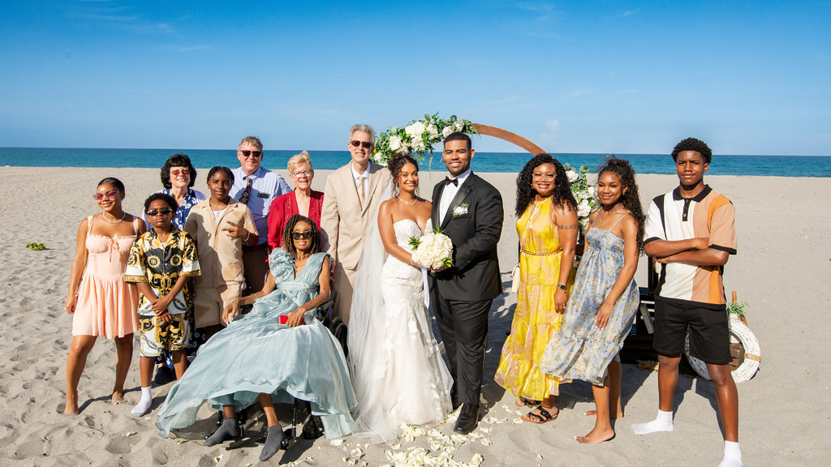
Newlyweds with Angel’s family

Slide 6
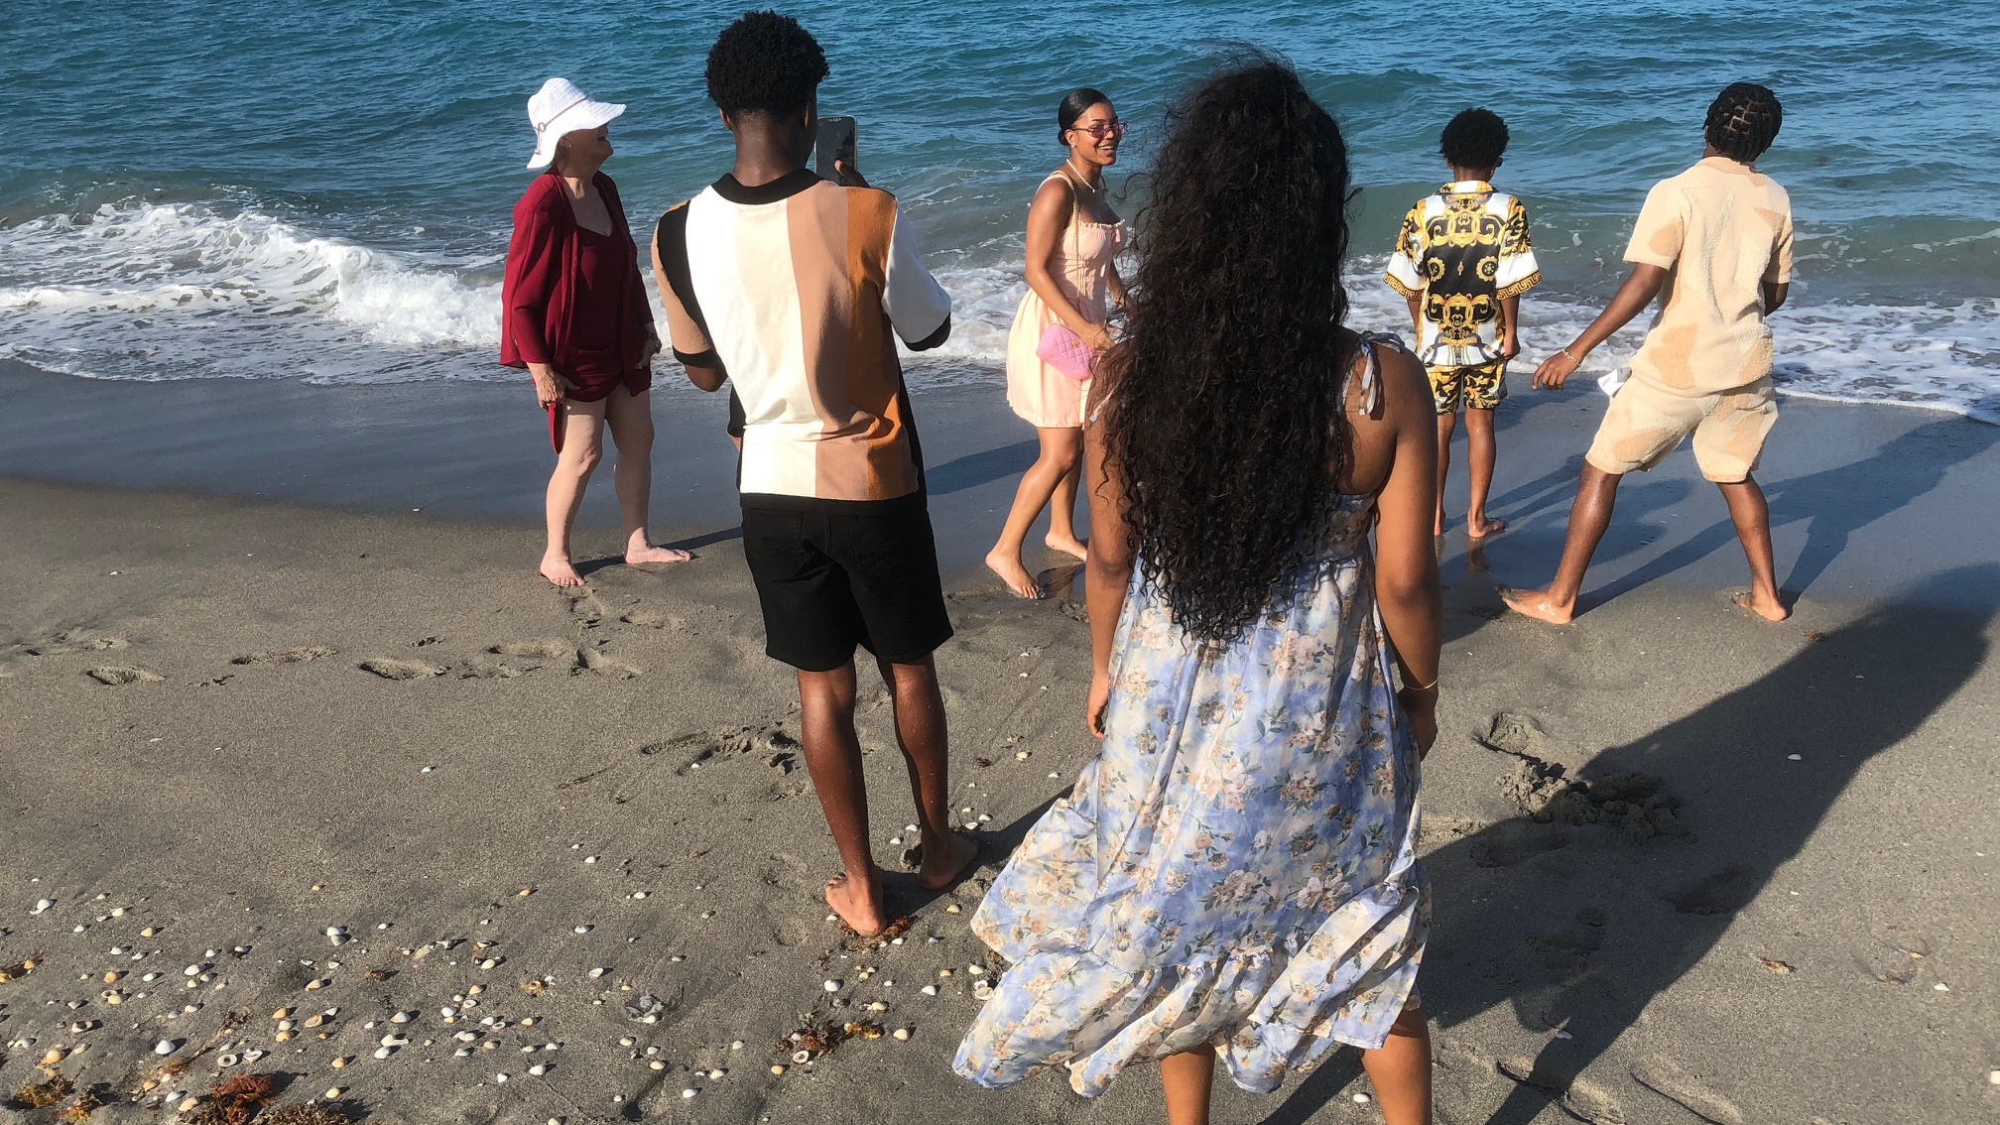
Headed to the beach – Miriam with Charlee’s kids

Slide 7
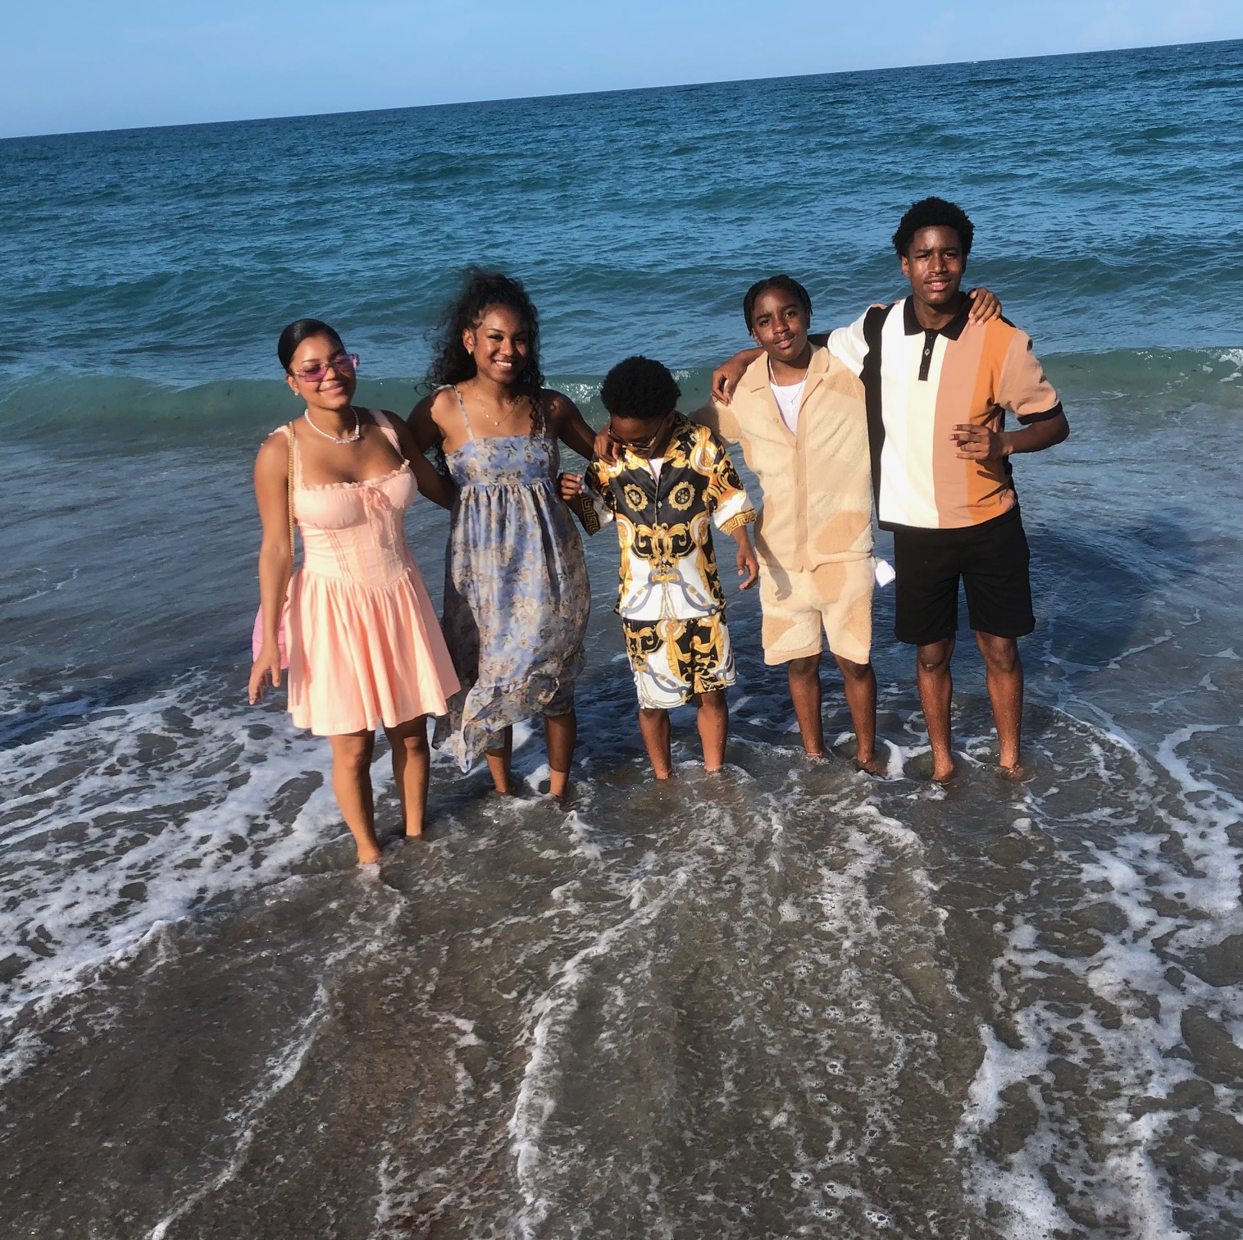
Charlee’s kids, Jupiter beach, after wedding:
Samira, Elexys, Jeremiah, Brandon, BJ

Slide 8
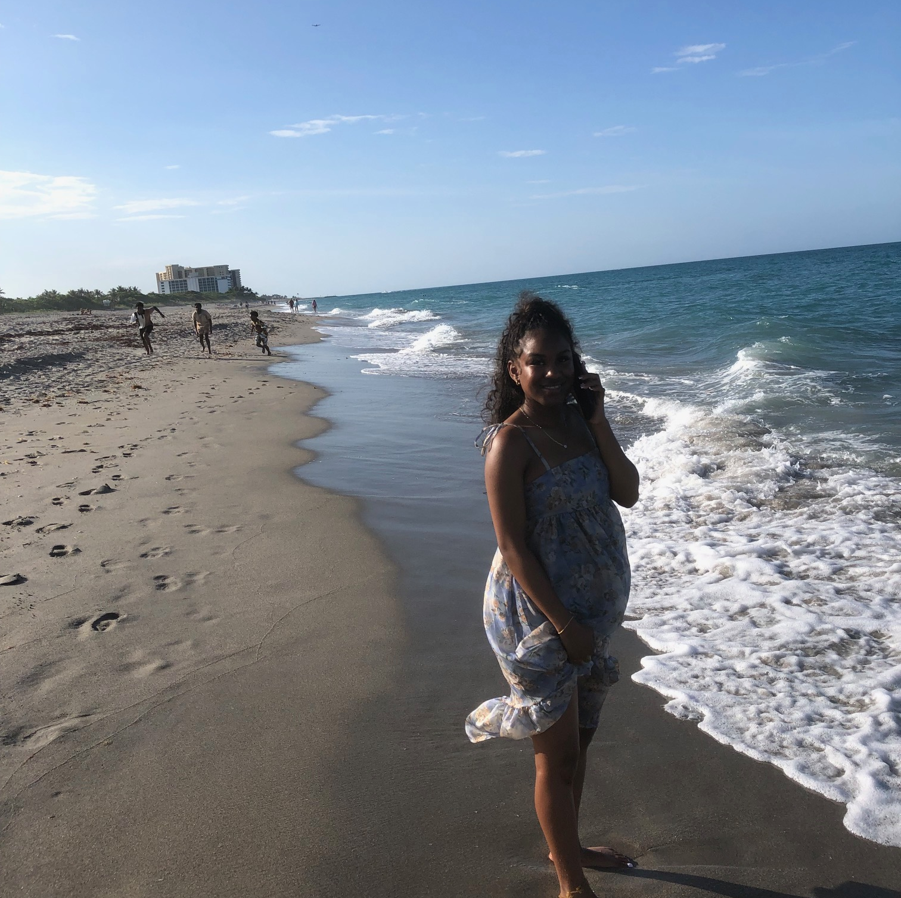
Her brothers racing, Elexys reporting

Slide 9
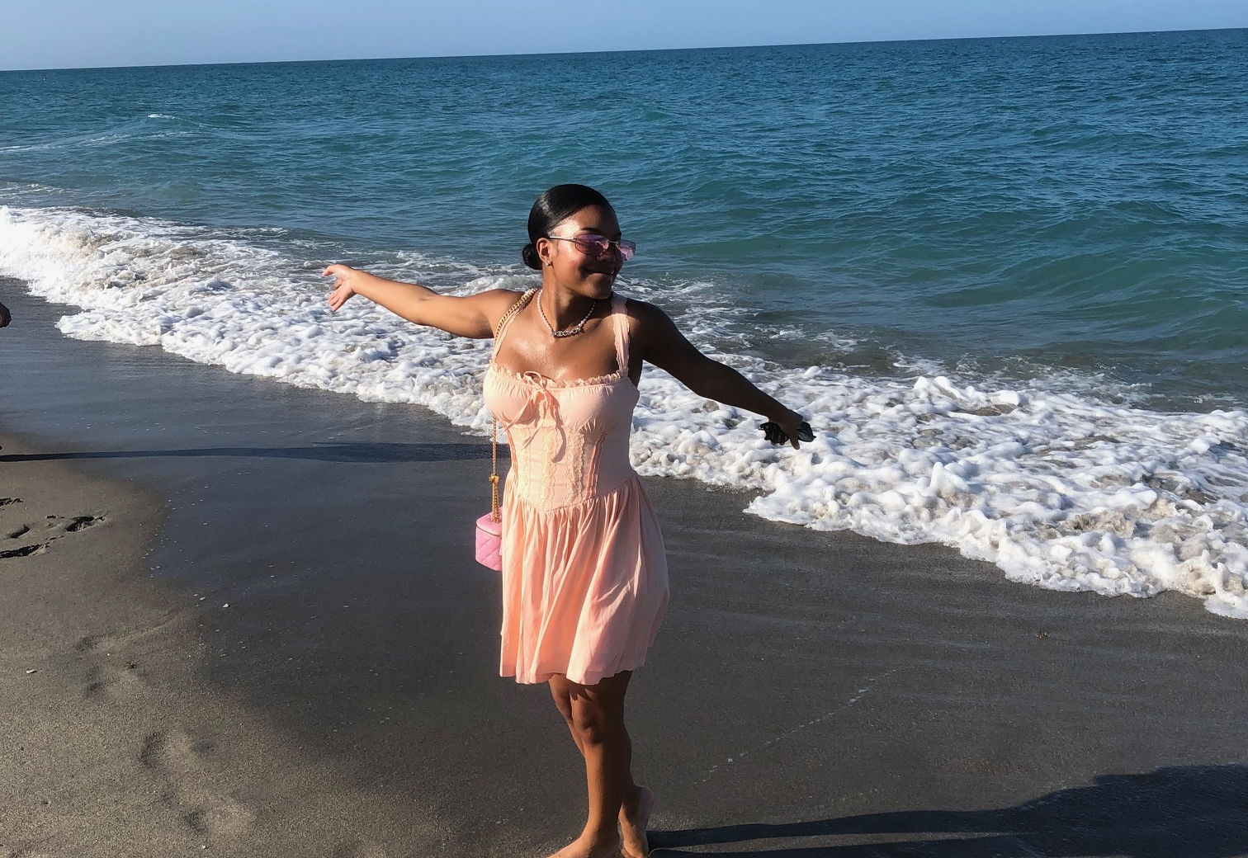
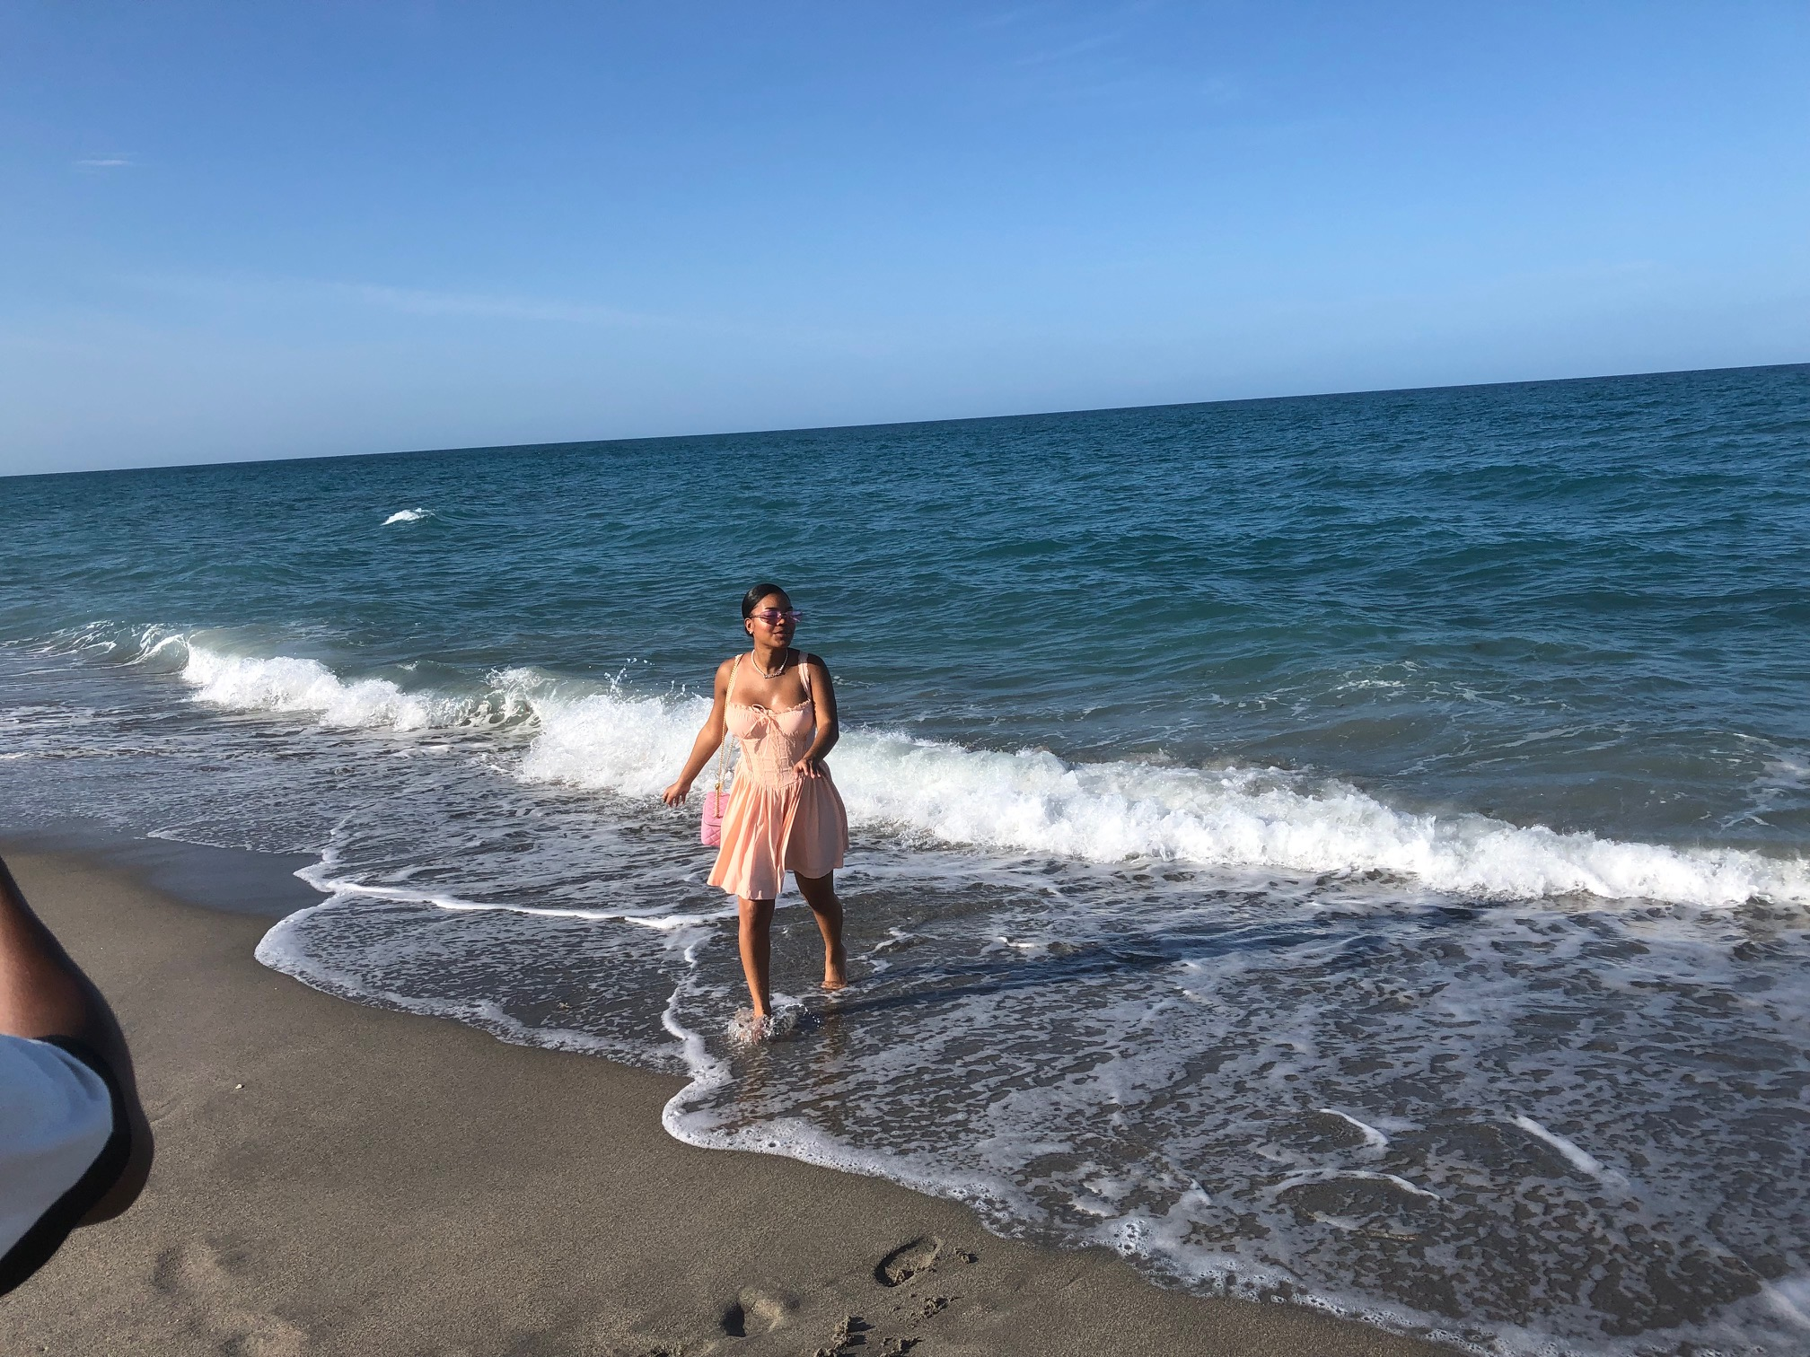
Samira enjoying life

Slide 10
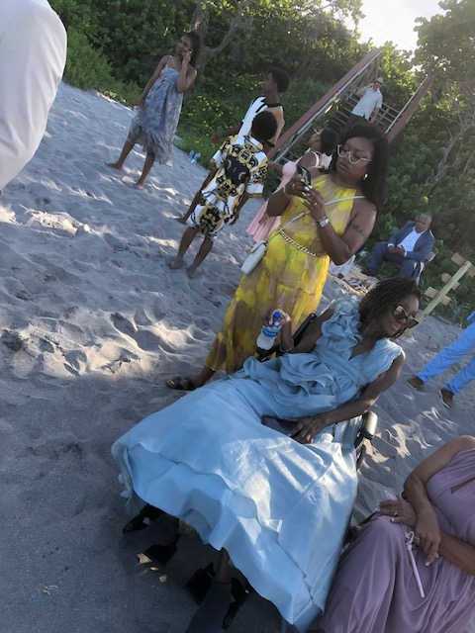
Relaxing in the shade after the wedding

Slide 11
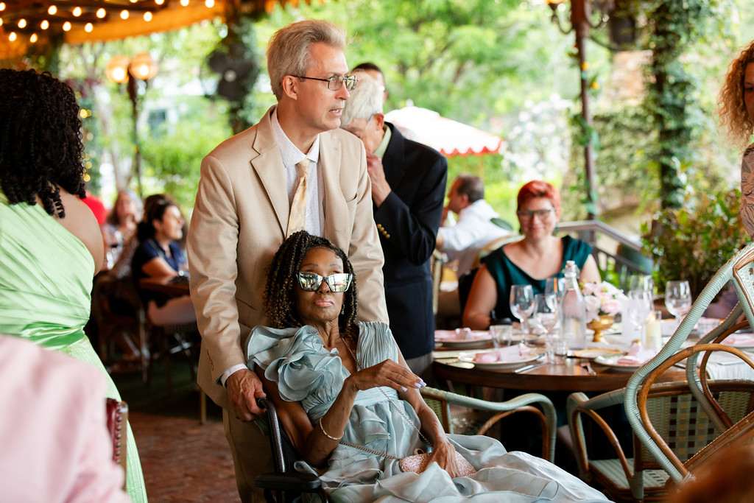
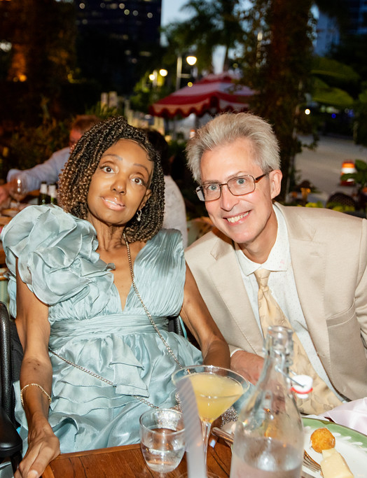
Later, at the reception…

Slide 12
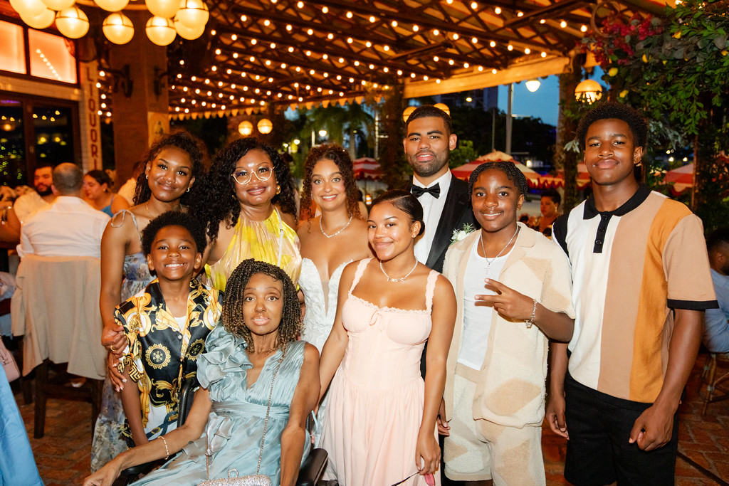
Cheryl’s family

Slide 13
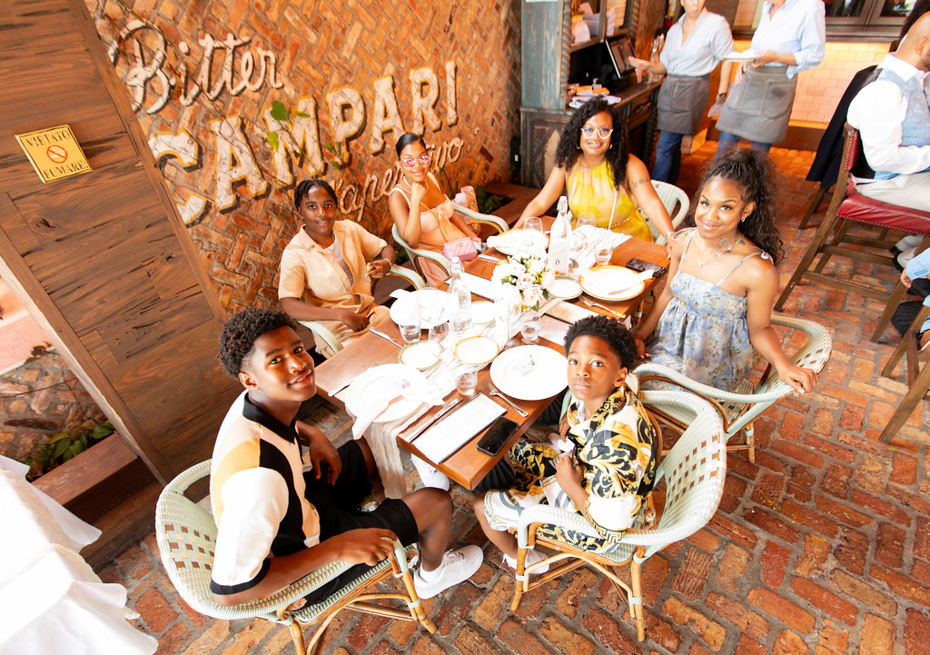
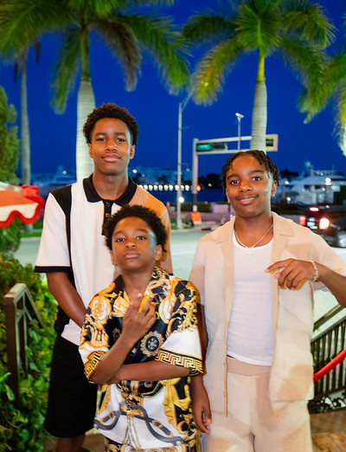
Charlee’s family

Slide 14
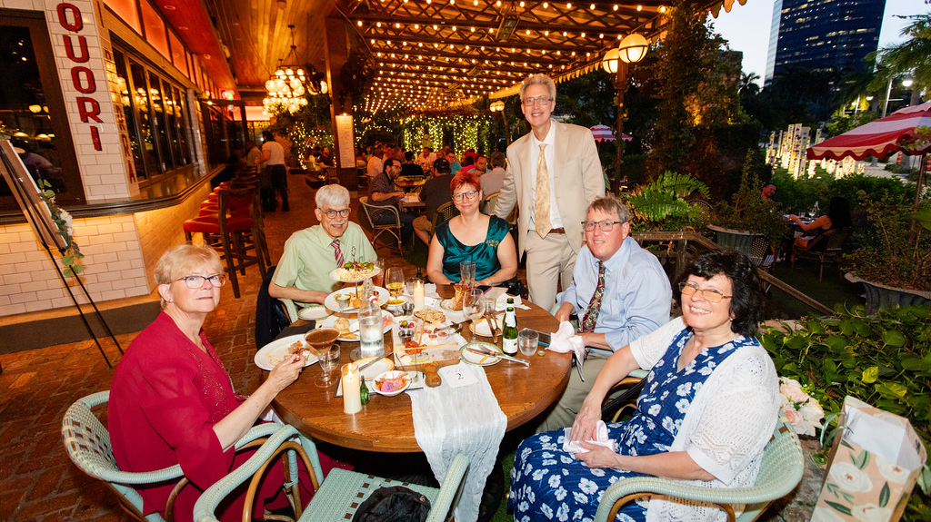
Paul’s family

Slide 15
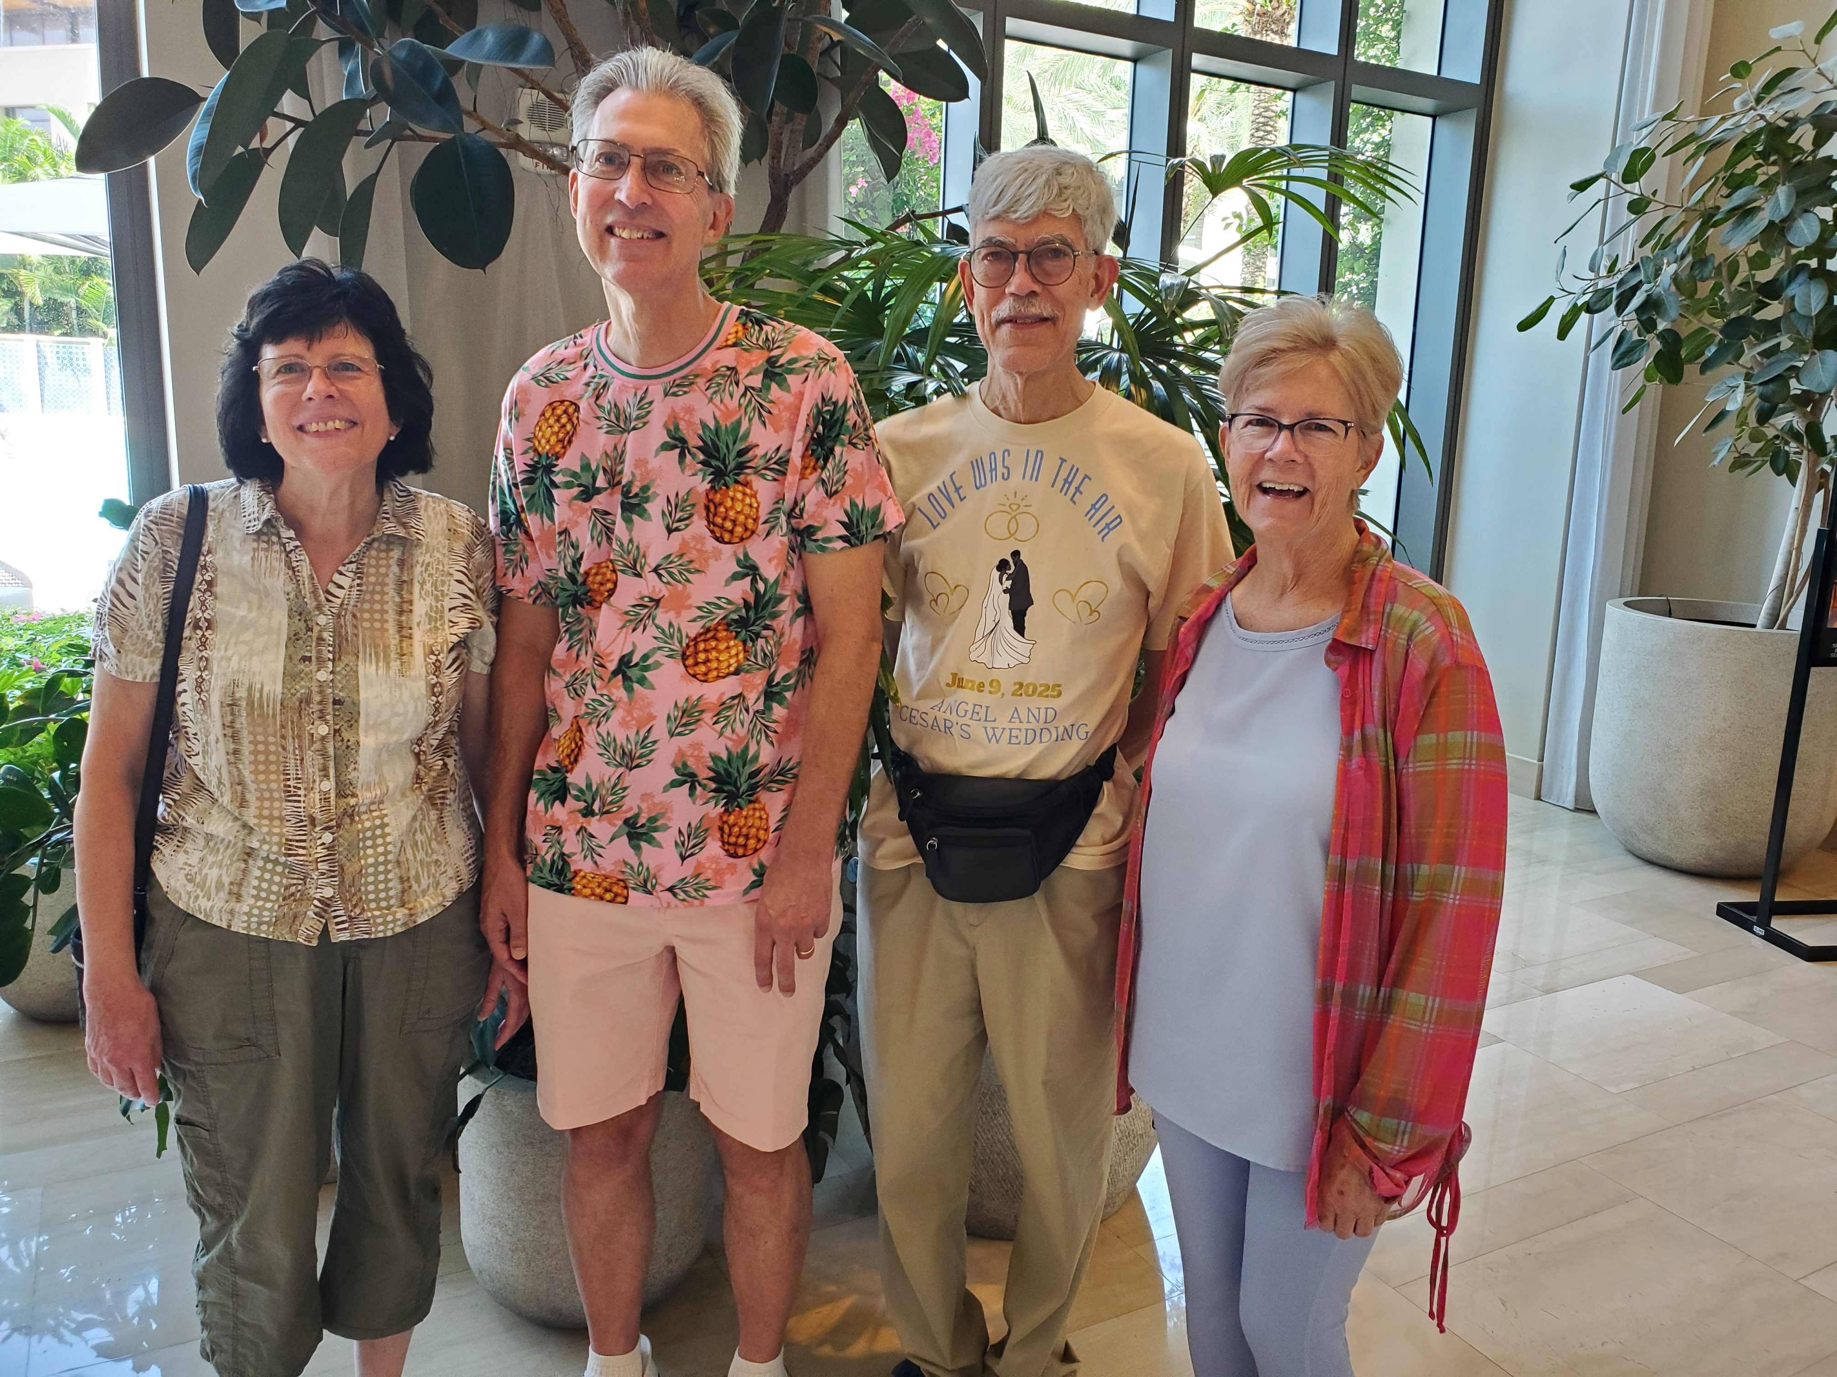
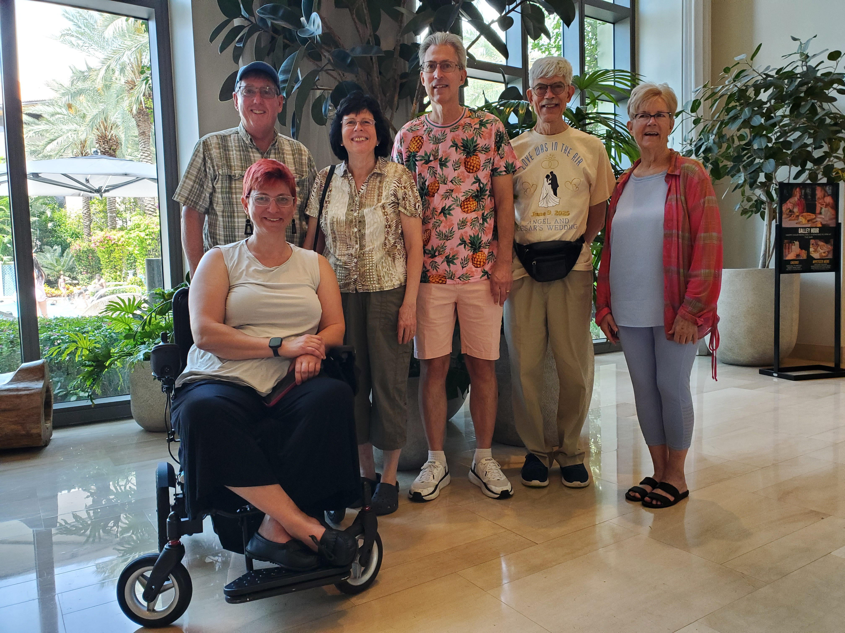
VanRaden sib reunion at wedding

Slide 16
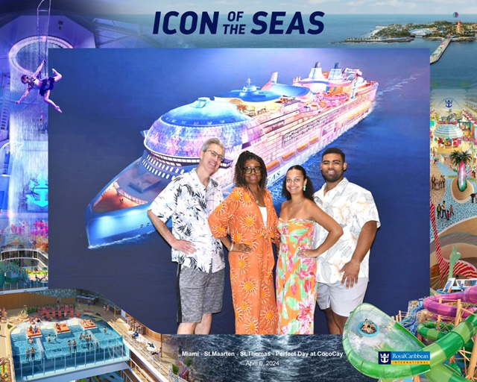
Cruise
Miami to
E. Caribbean
April 2024

Slide 17
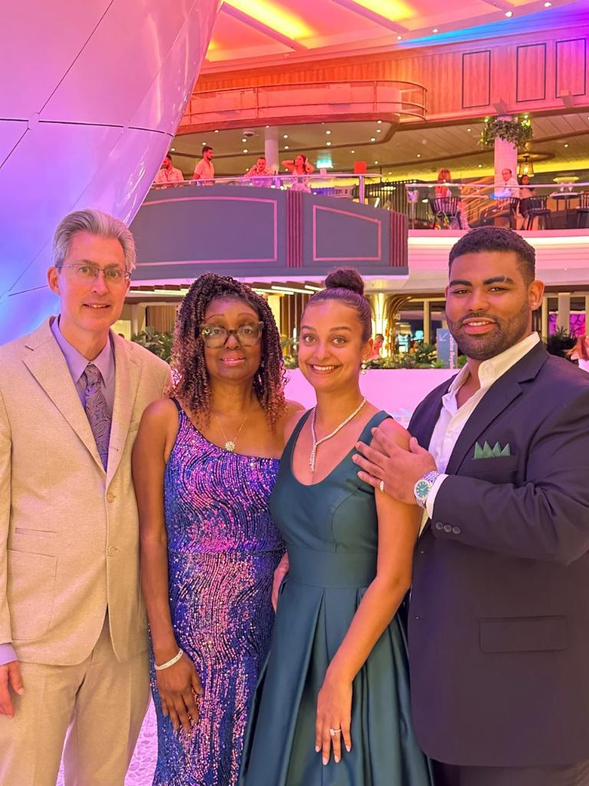
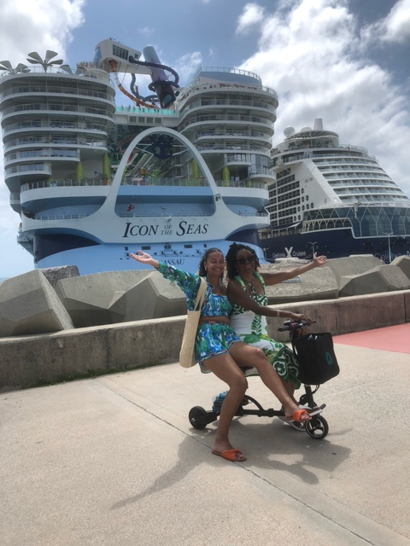
Cruise Apr 2024

Slide 18
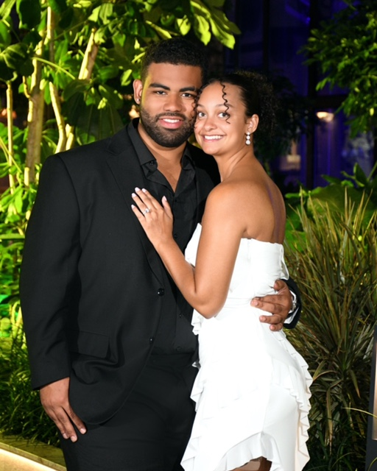
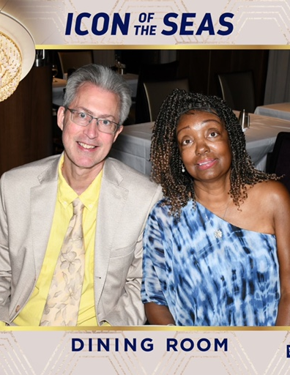
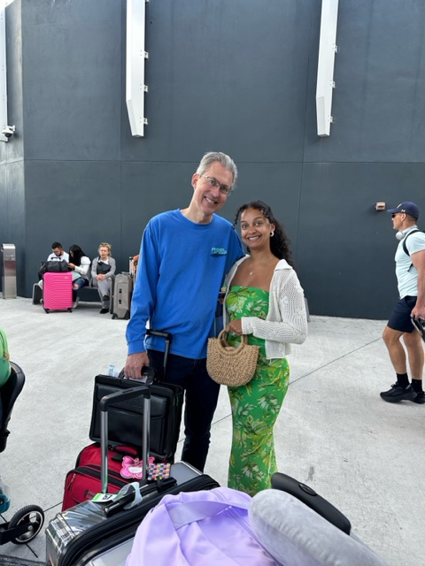
Cesar & Angel – Just engaged!

Slide 19
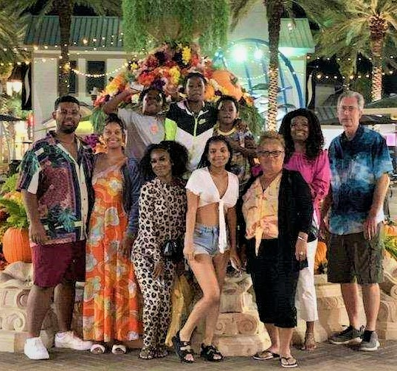
Destin, FL
Oct 2022

Slide 20
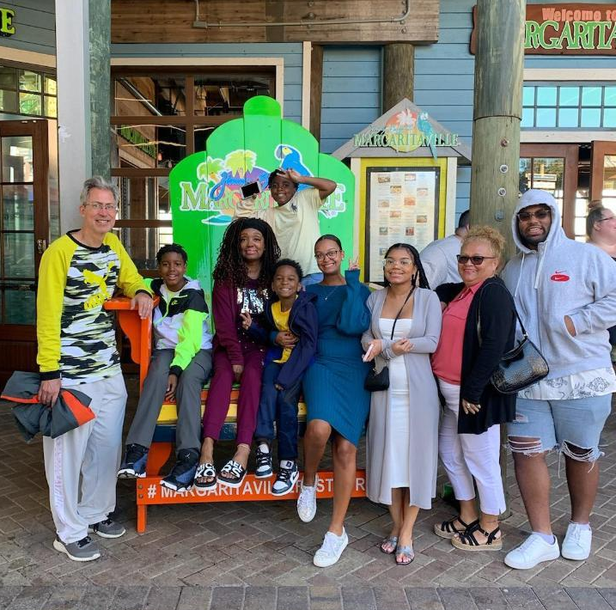
Destin, FL
Oct 2022

Slide 21
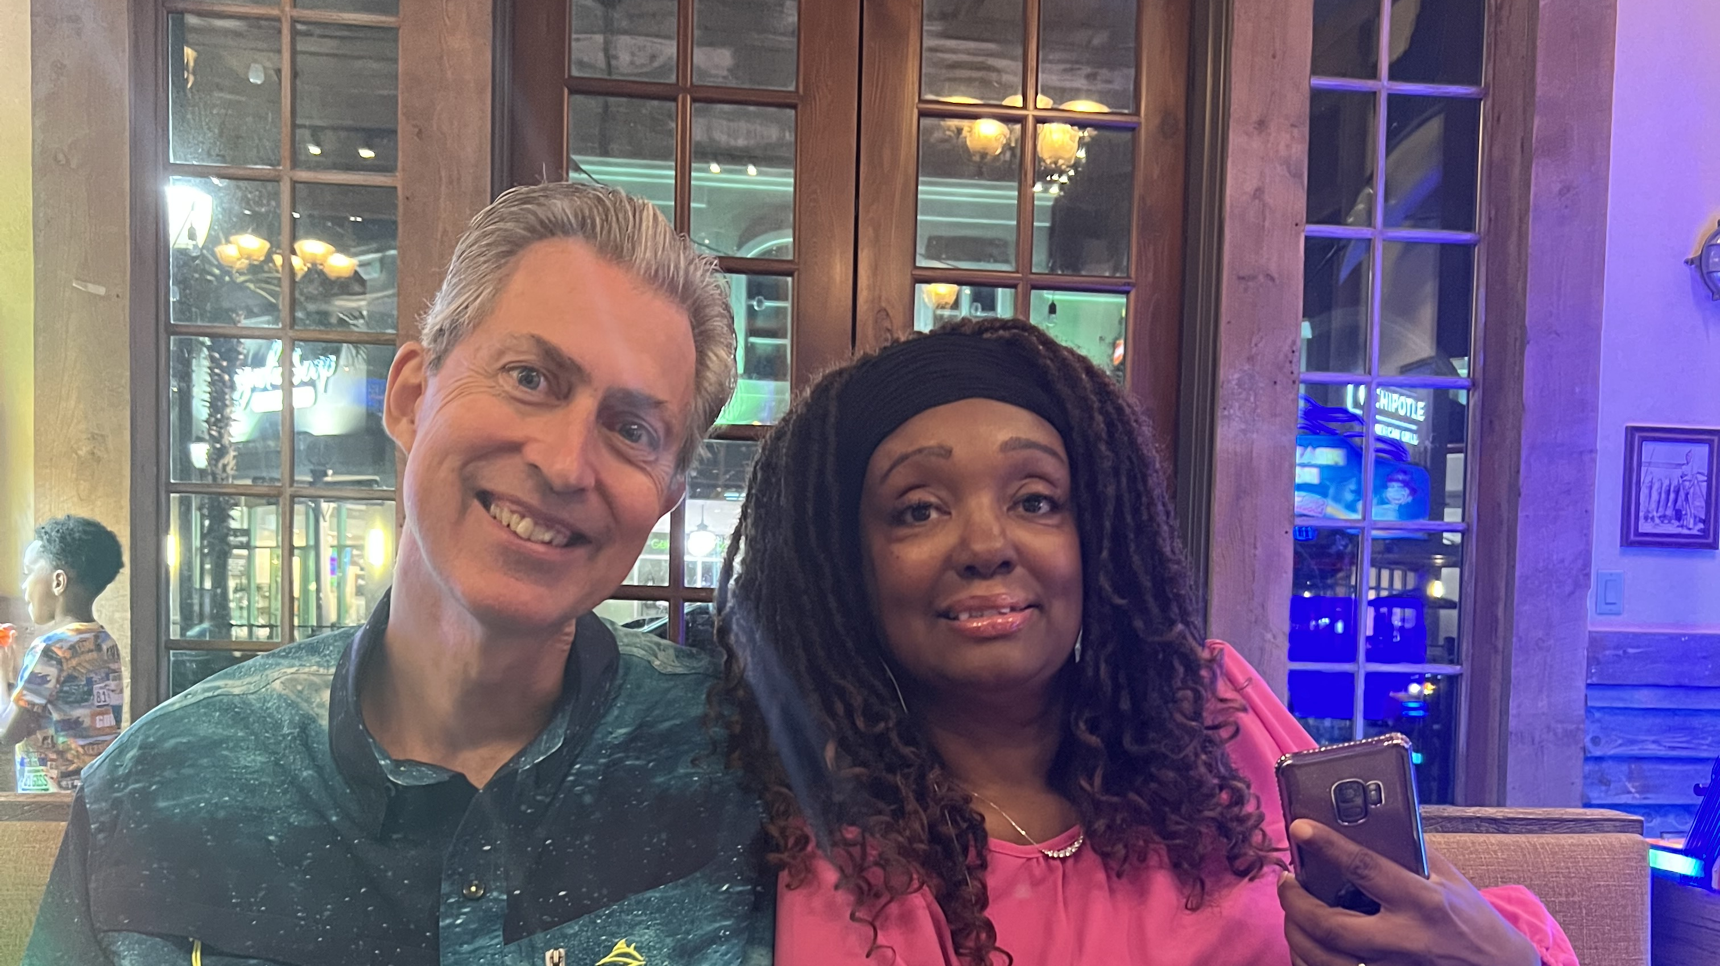

Slide 22
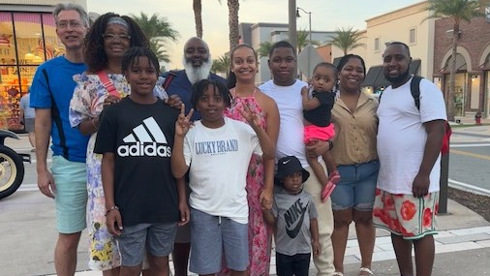
With Chambers family, 2023, Orlando

Slide 23
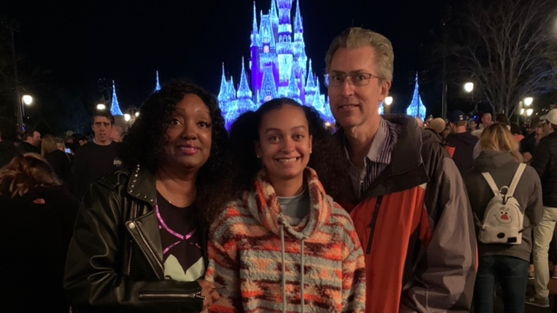
New year’s eve, 2021, Disney

