Slide 1
Paul VanRaden
Picture biography
1960-present
For life stories of Paul’s parents see:
http://www.paulvanraden.com/Walter_Katie_VanRaden.pptx
For additional pictures and stories see:
https://www.paulvanraden.com/InteractingWithFamily.htm

Slide 2
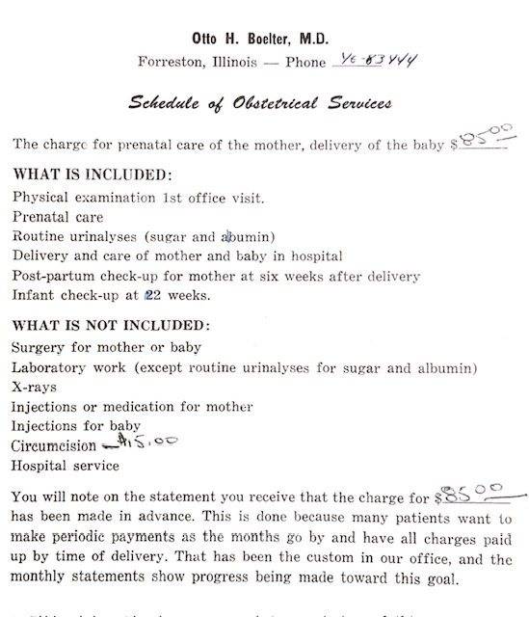
1959 contract for prenatal care, delivery of baby Paul, and 1 infant check-up: $85
Circumcision was extra: $15
Dr. Otto Boelter, Forreston, IL

Slide 3
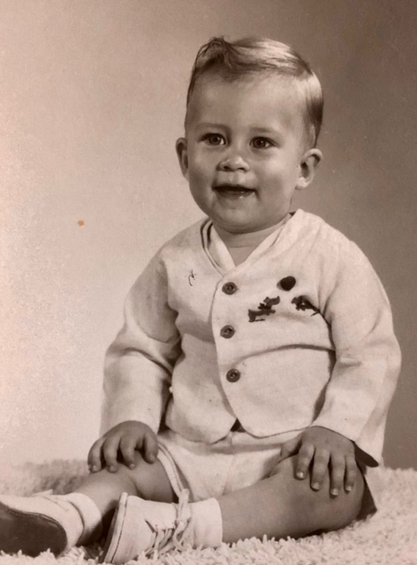
1960: Born on his mother’s
30th birthday.
No extra fee for that.

Slide 4
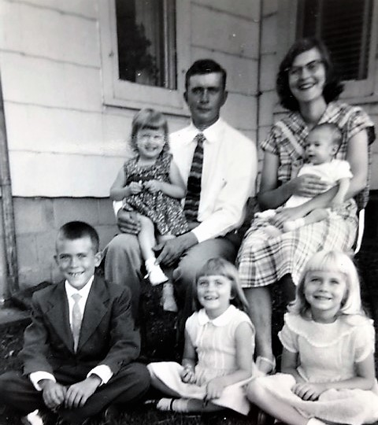
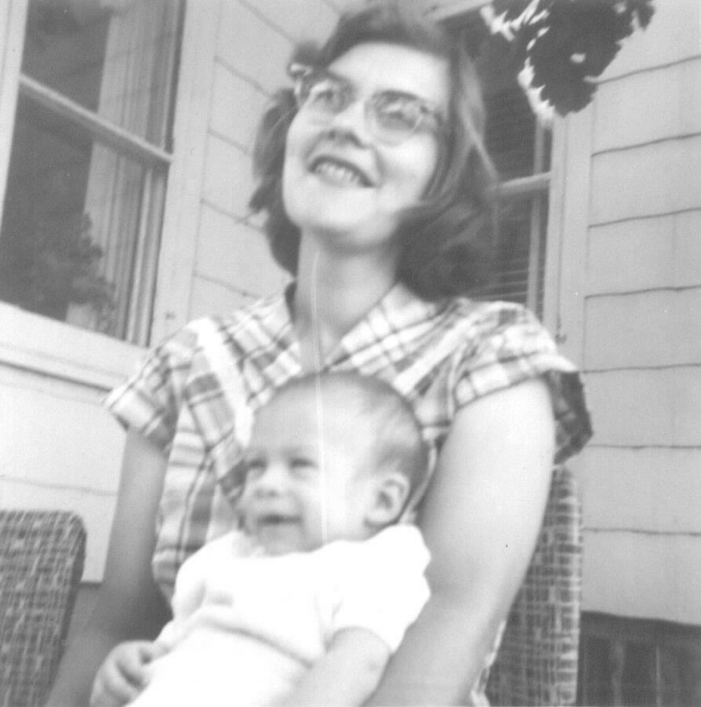
On Mommy’s lap
1960

Slide 5
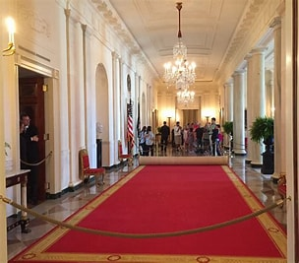
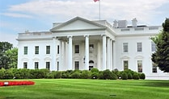
1960
Slept in the White House while his family took the free tour during a DC summer vacation to visit Uncle Harold and Aunt Alice Ellis family

Slide 6
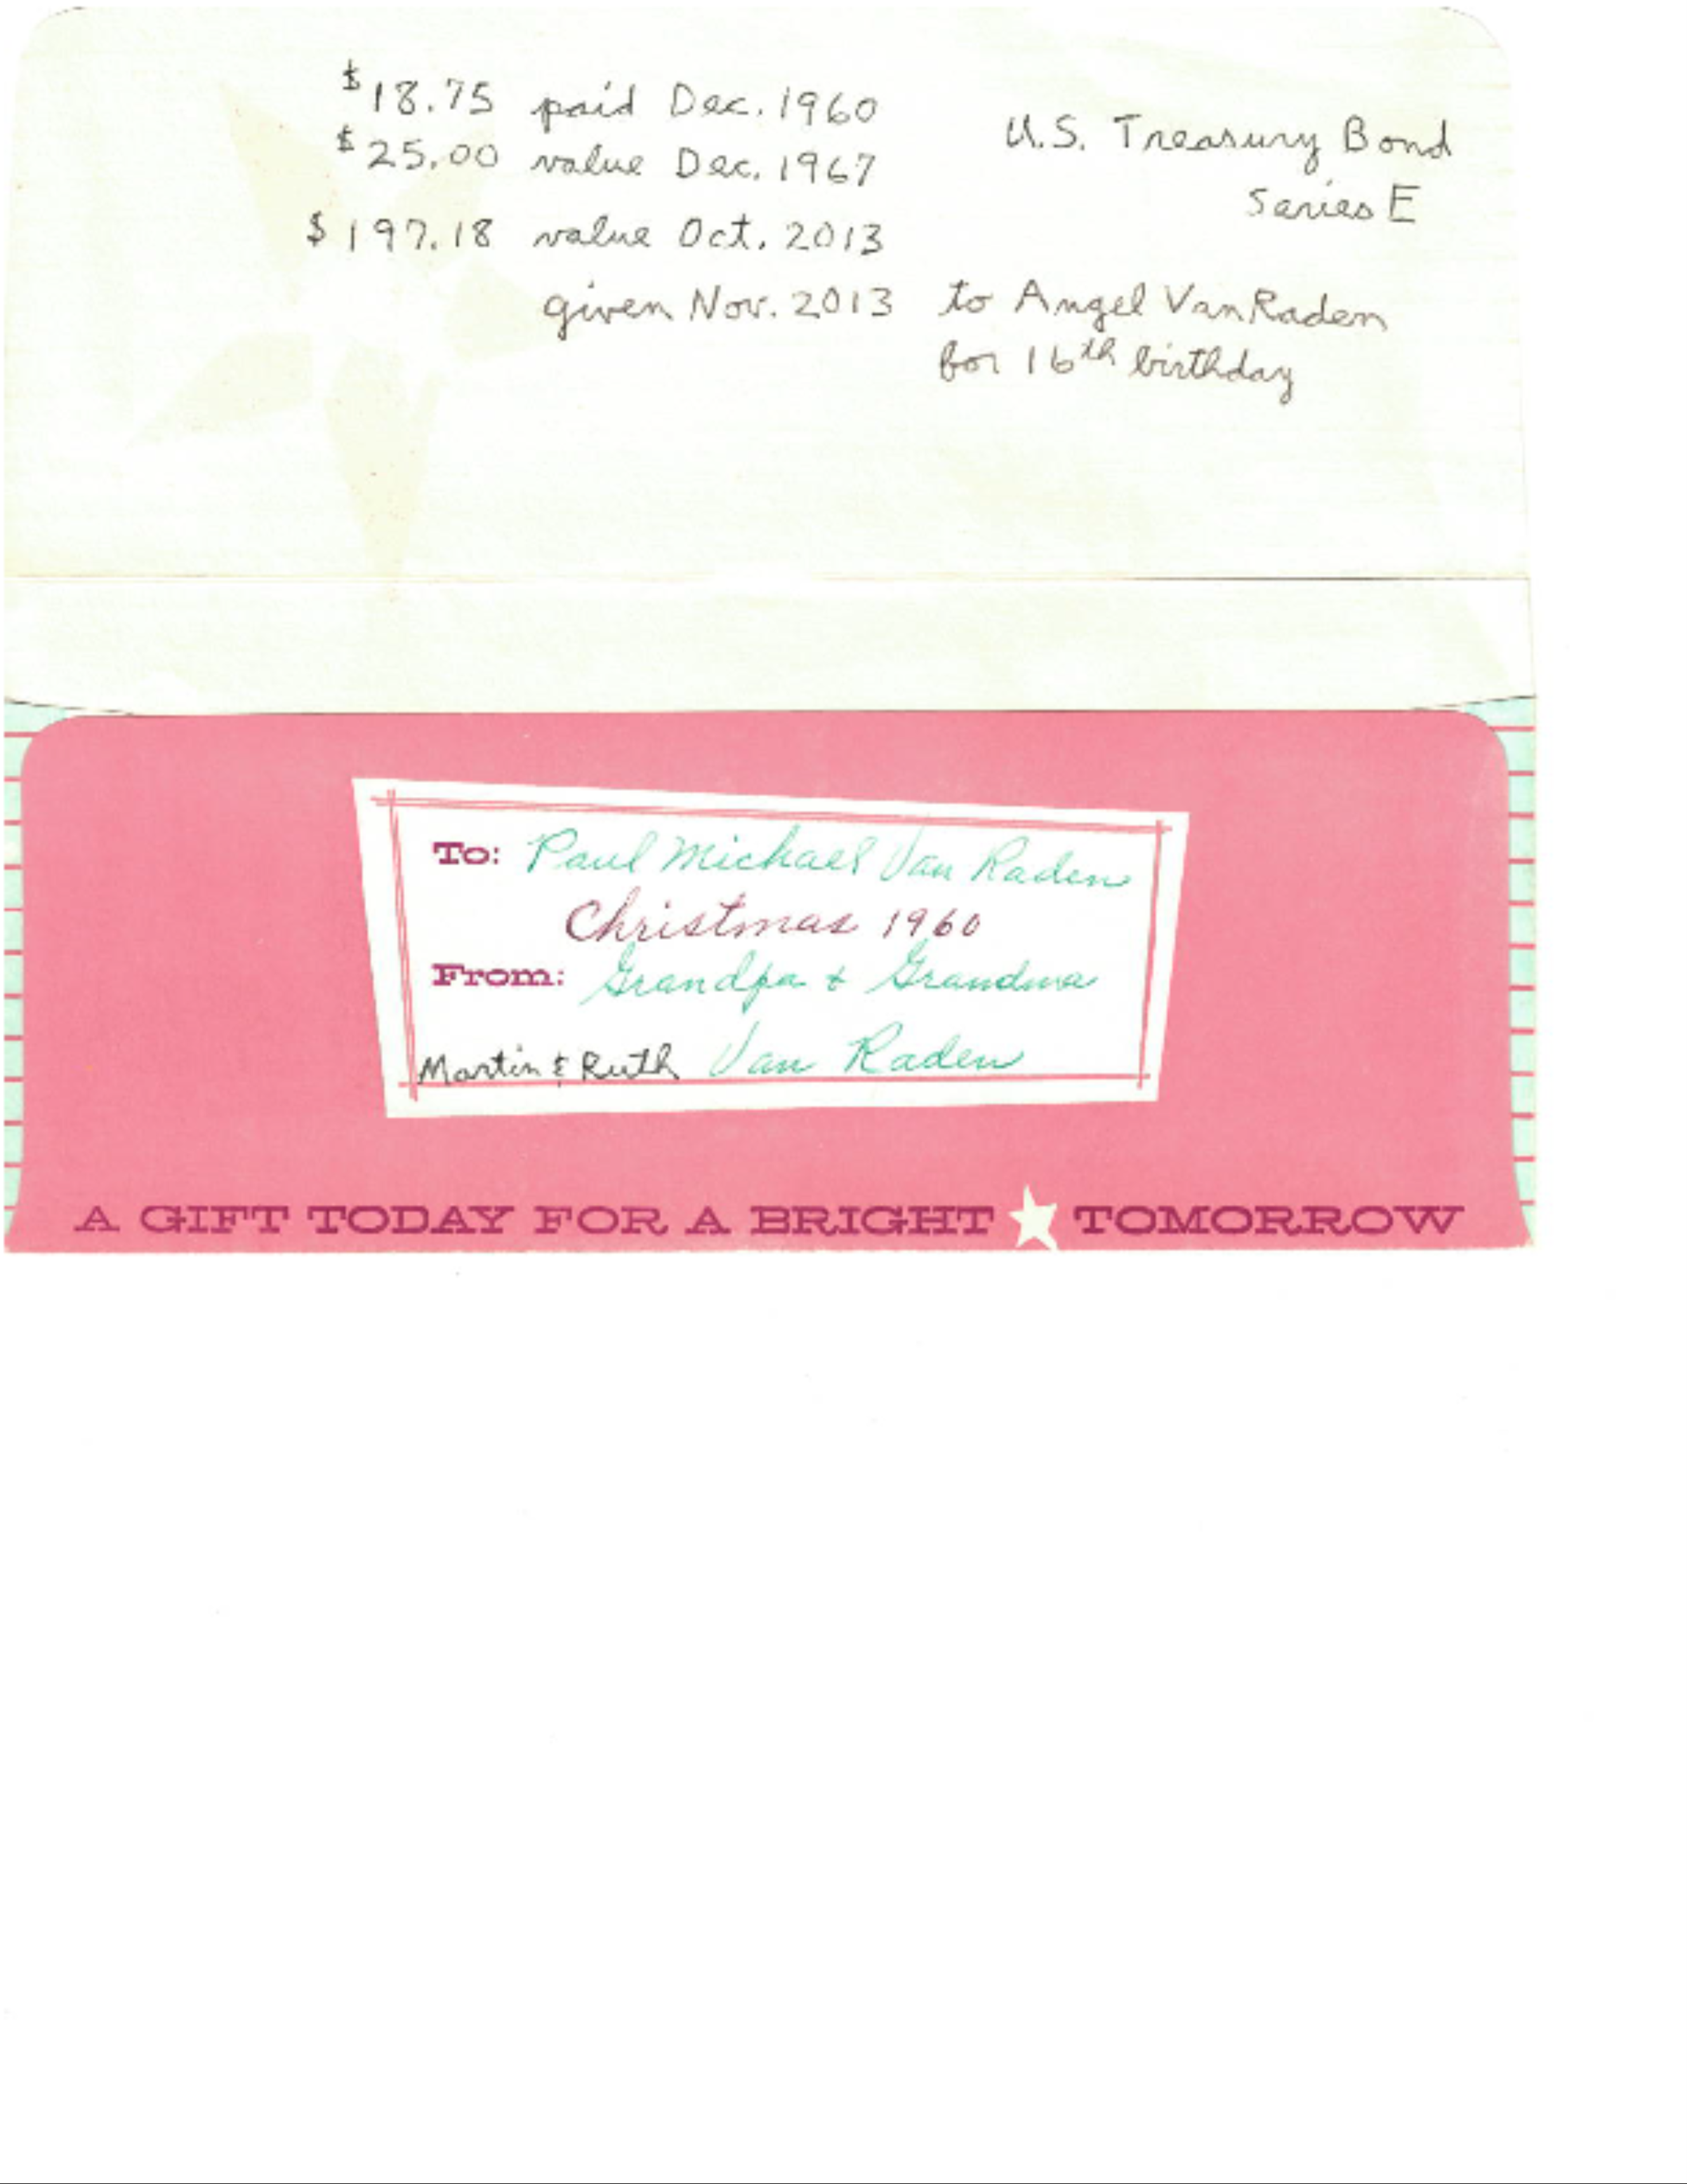
December 25, 1960
Paul’s first
Christmas present was a $25 savings bond from grandparents Martin and Ruth VanRaden, cashed in Nov. 2013 by their great grand-daughter Angel for $197.18

Slide 7
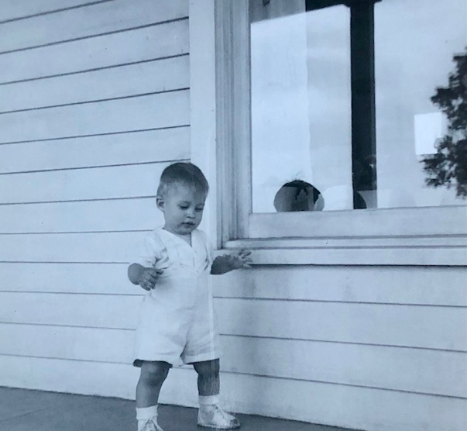
First steps
1961

Slide 8
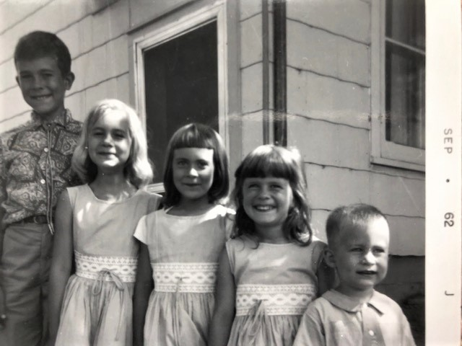
Mark
Miriam
Deb
Judy
Paul
1962

Slide 9
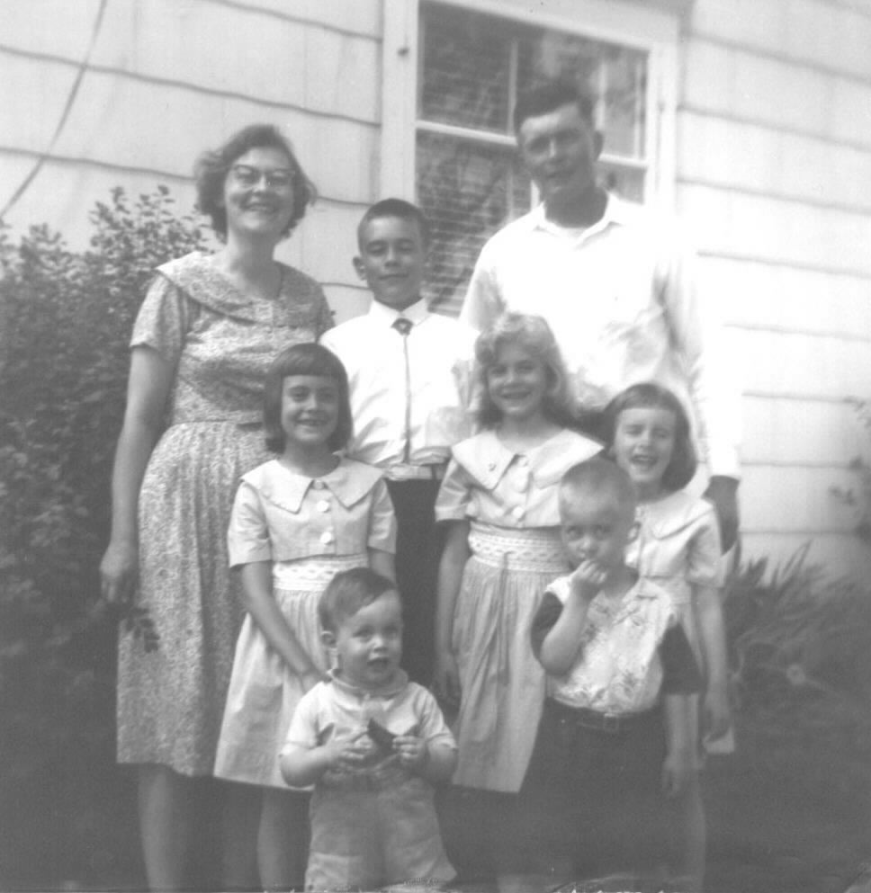
VanRaden family
1963
Front:
Dave and Paul

Slide 10
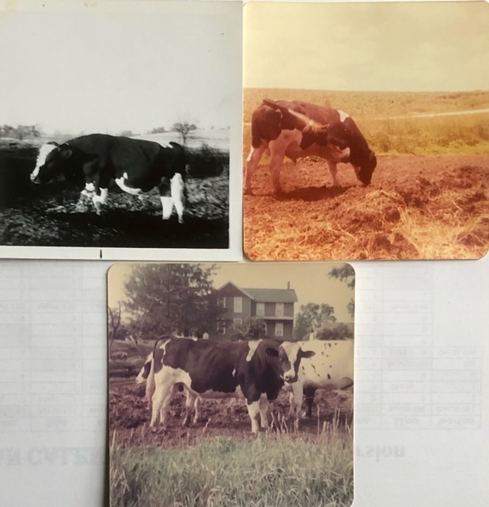
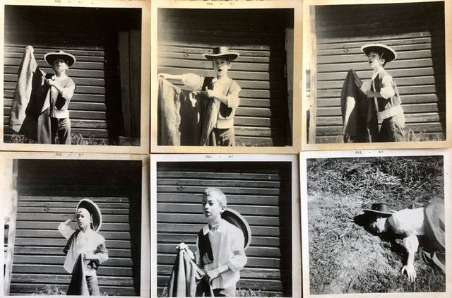
1967: Bull wins, Paul loses.
4-H photography project by sister Miriam

Slide 11
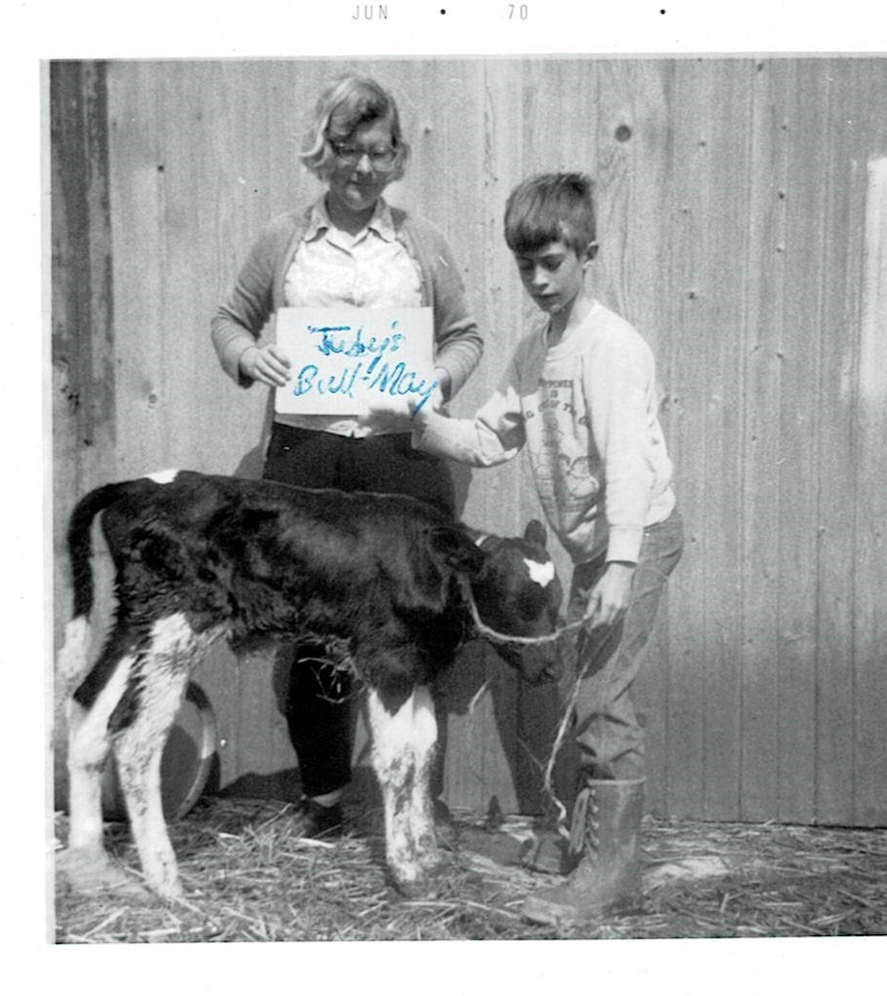
Katie and Paul
1970
Keeping a pedigree record for sister Judy’s bull calf

Slide 12
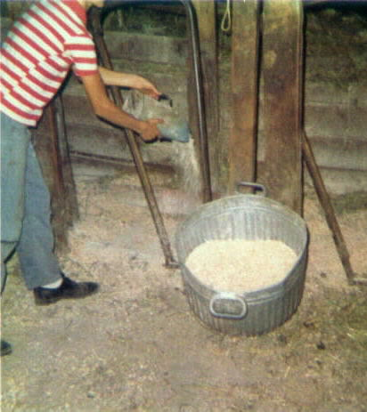
Paul feeding cows, 1973

Slide 13
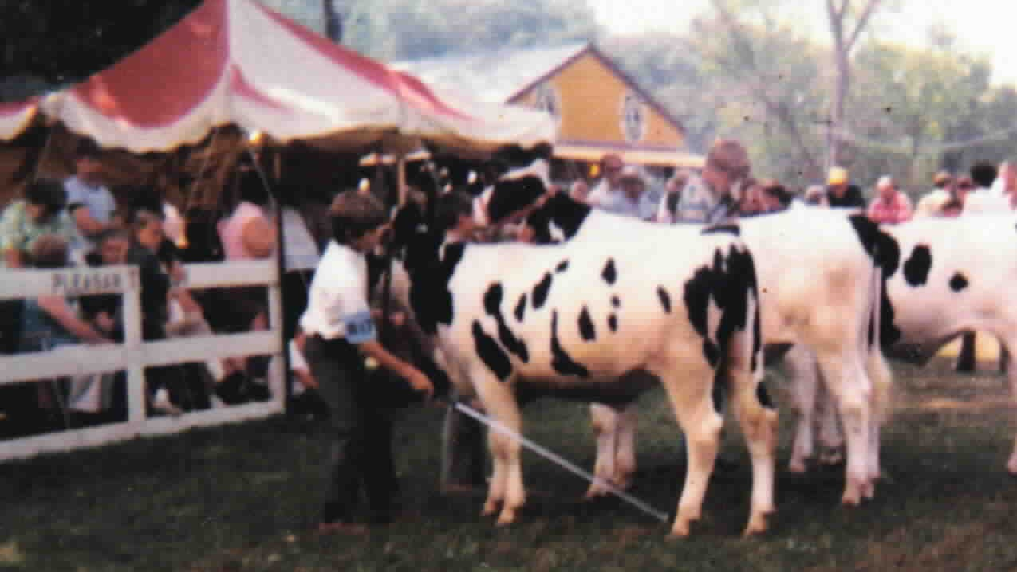
Paul’s steer Spot
1973

Slide 14
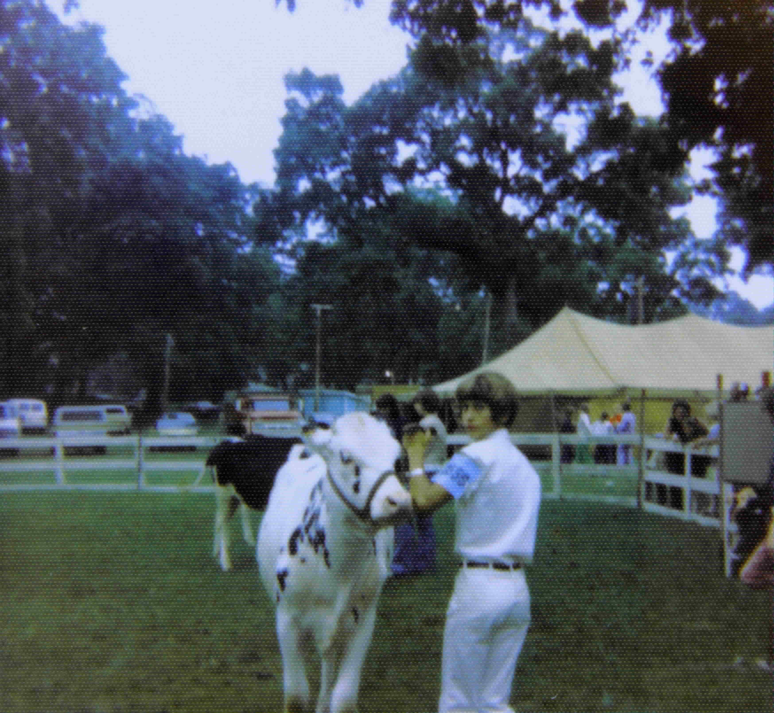
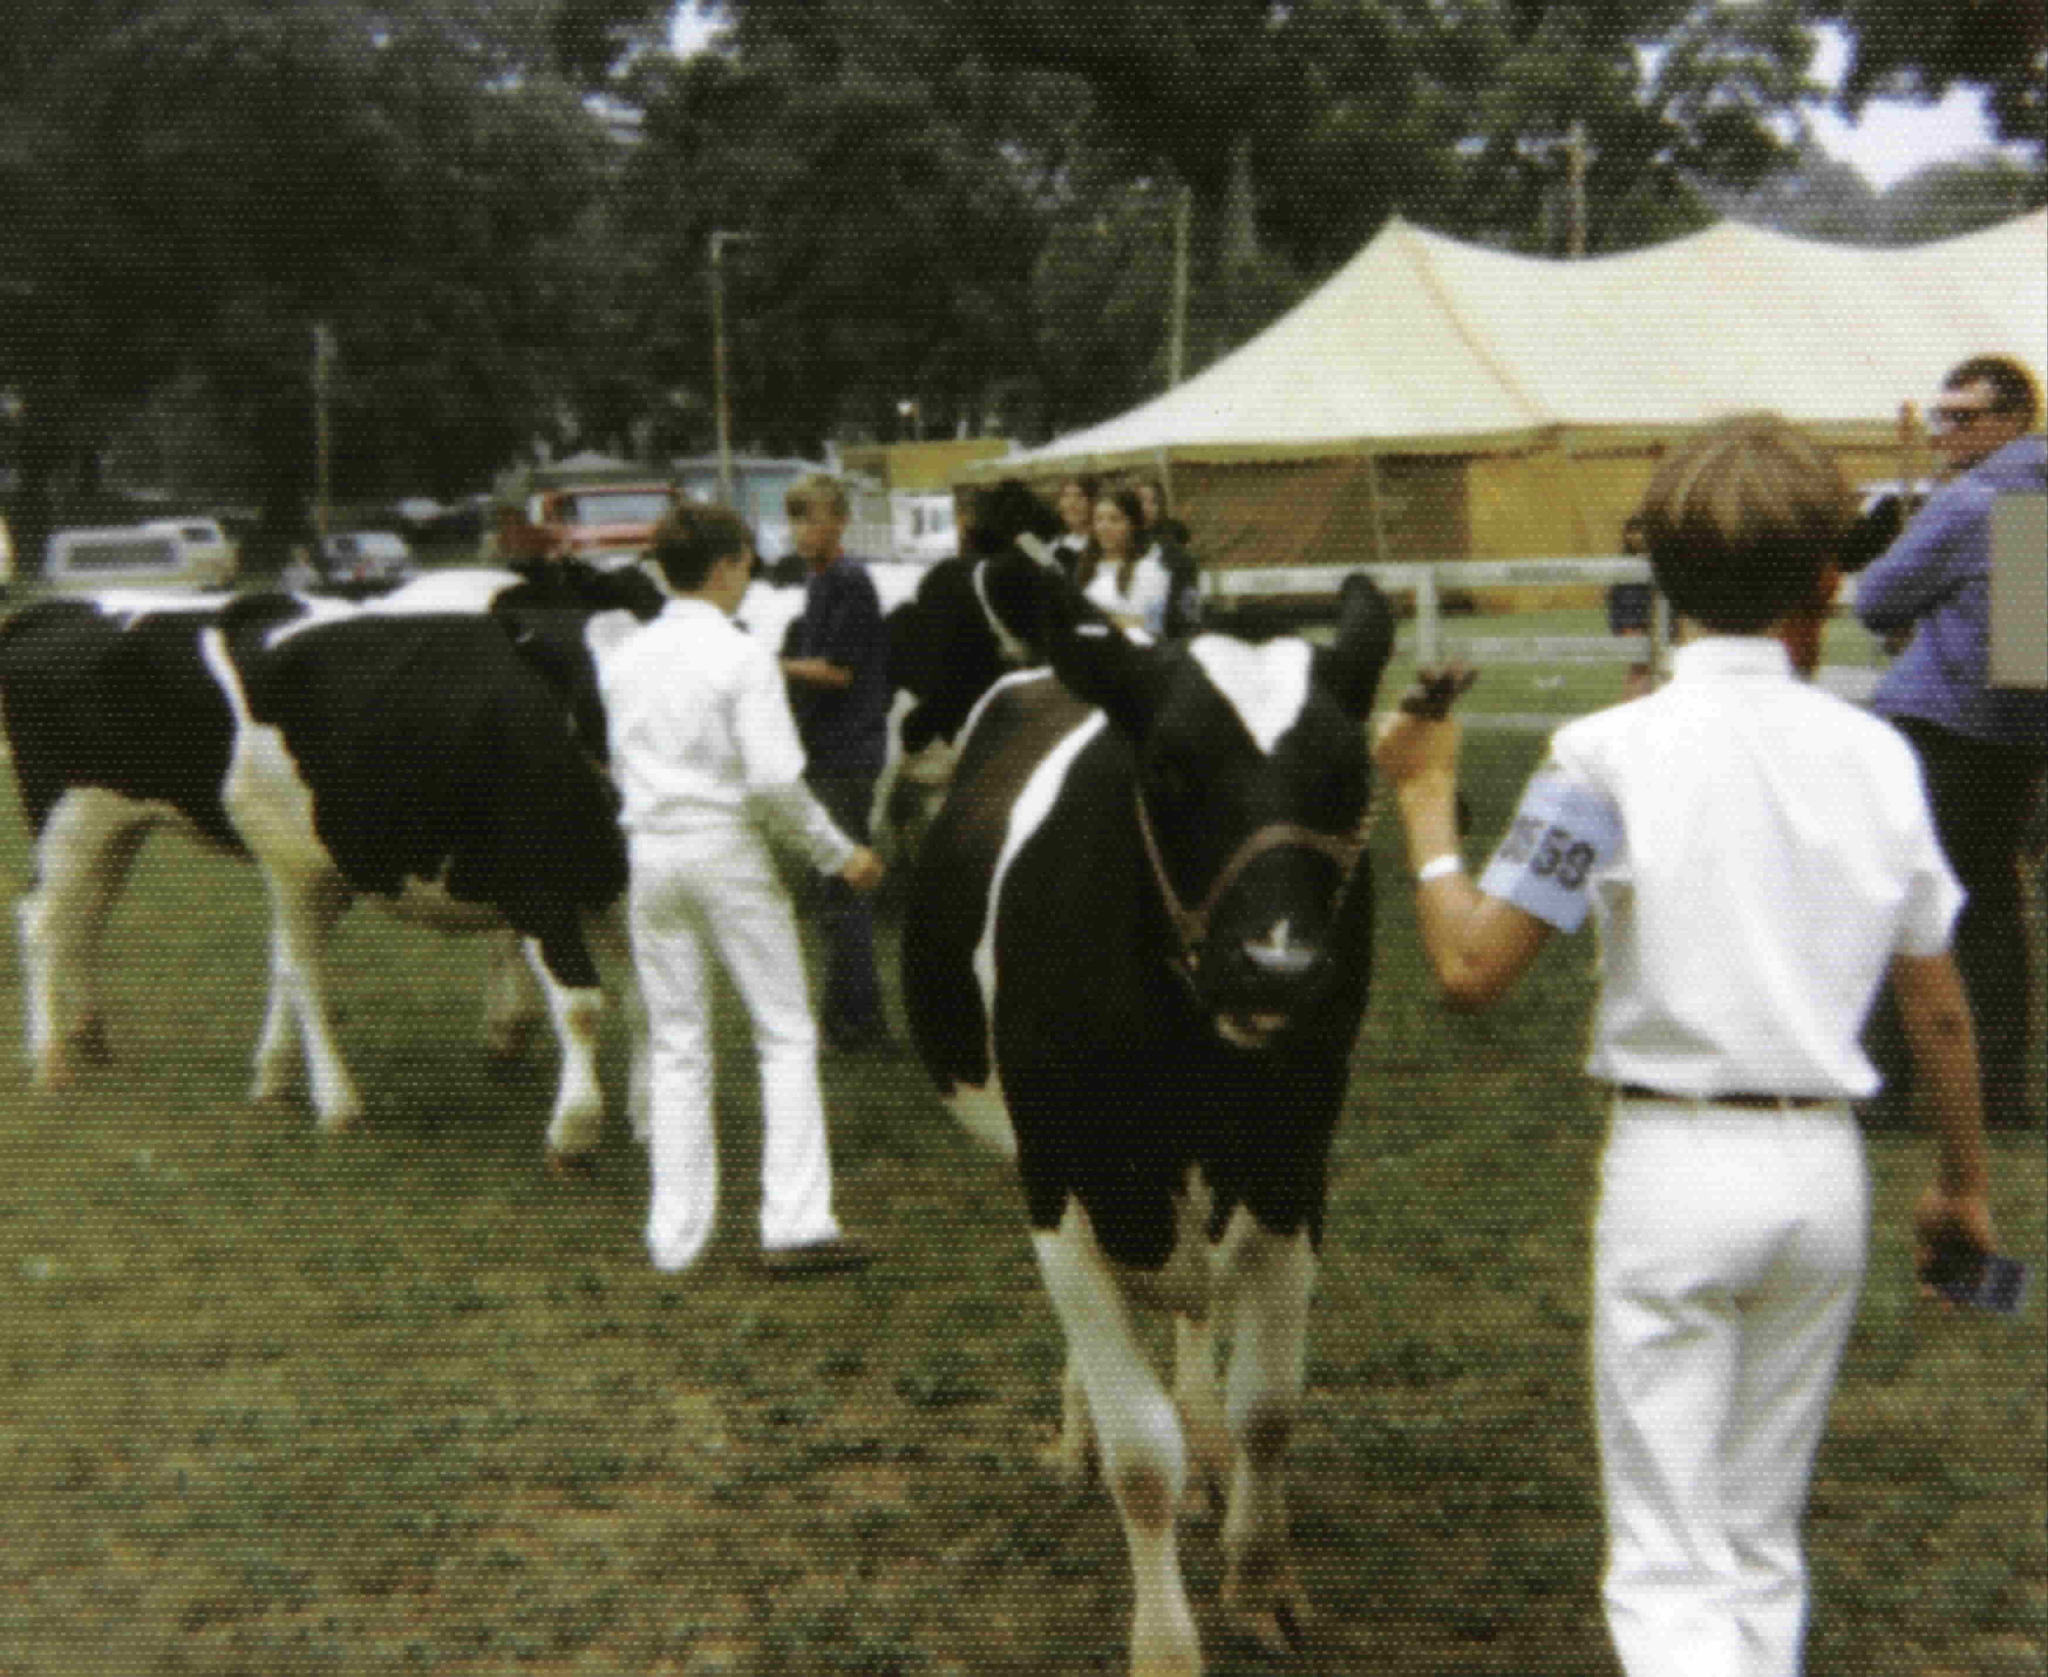
Ogle County, IL fair 1974

Slide 15
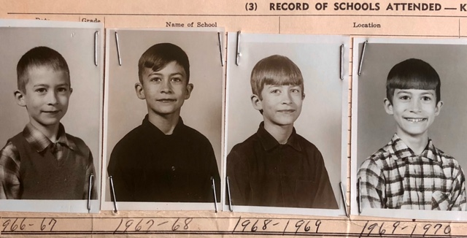
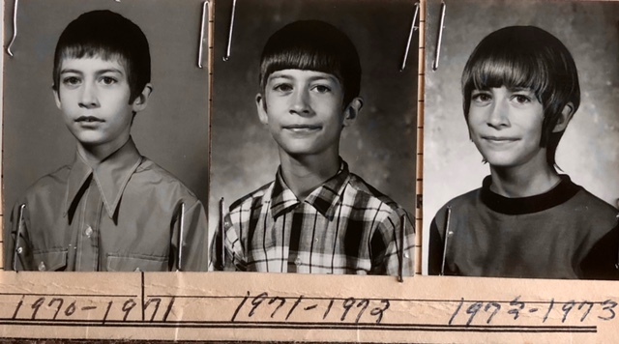
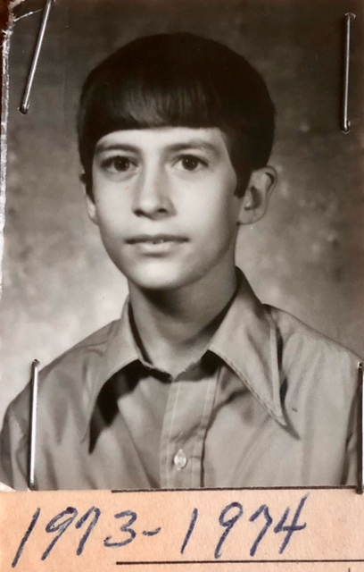
Grade school pictures

Slide 16
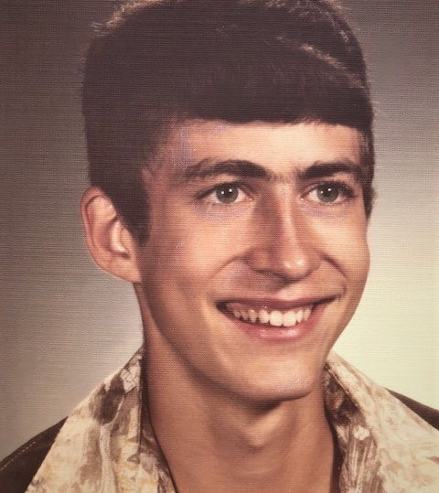
High school graduation
1978

Slide 17
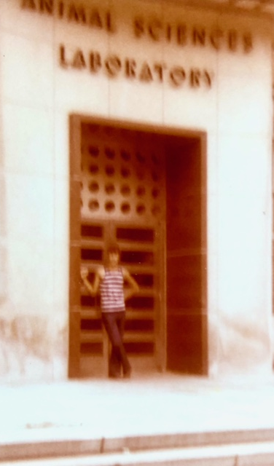
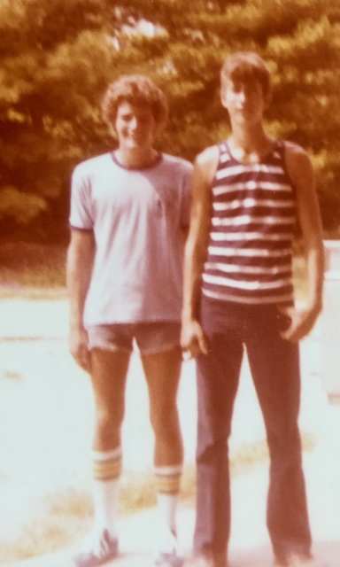
First day of college, 1978 at Animal Sci Lab, U of IL, and with roommate
Tony Vore

Slide 18
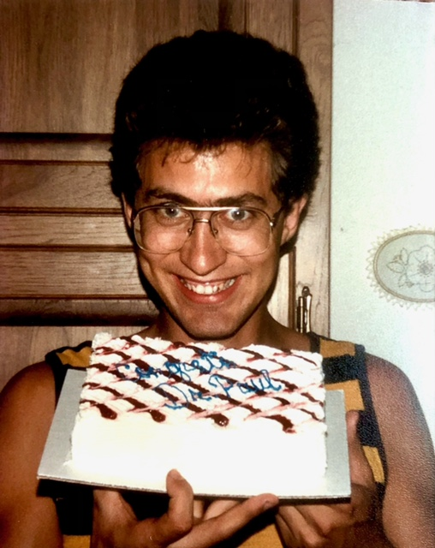
Last day of college, 1986, with PhD from
Iowa State U:
Congrats Dr Paul

Slide 19
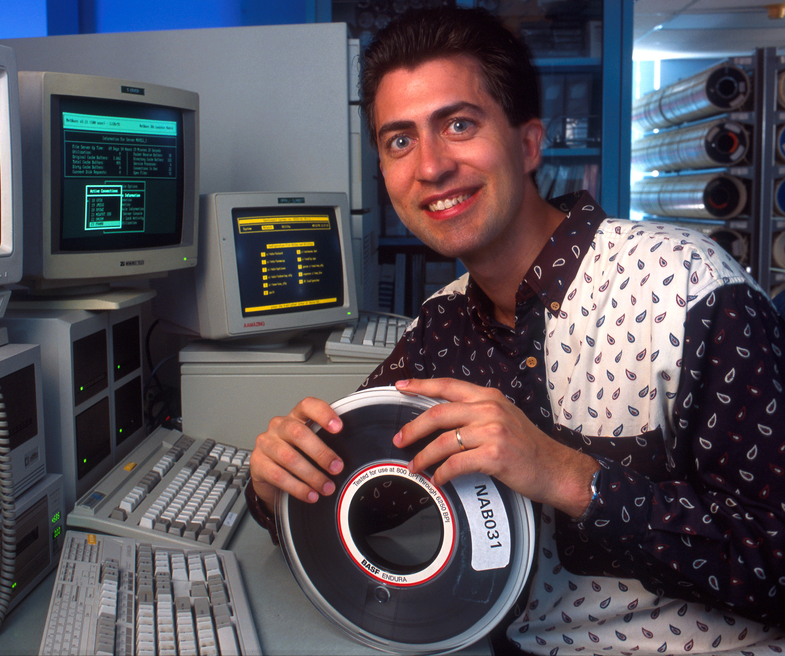
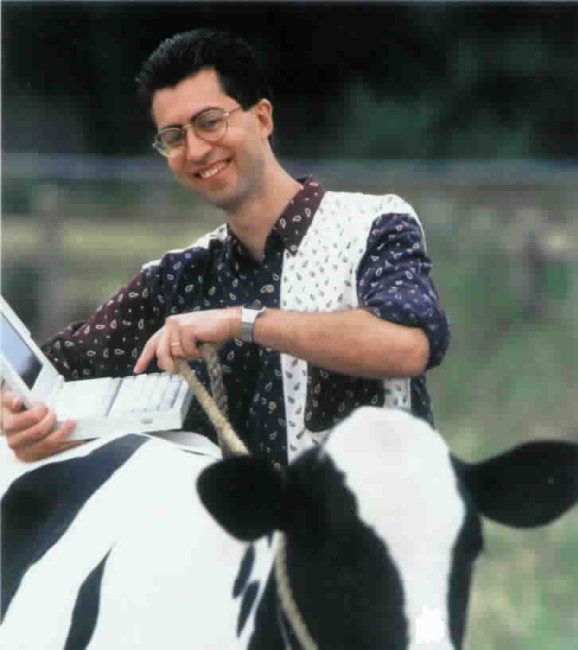
Collecting and analyzing data
1995, USDA, Beltsville

Slide 20
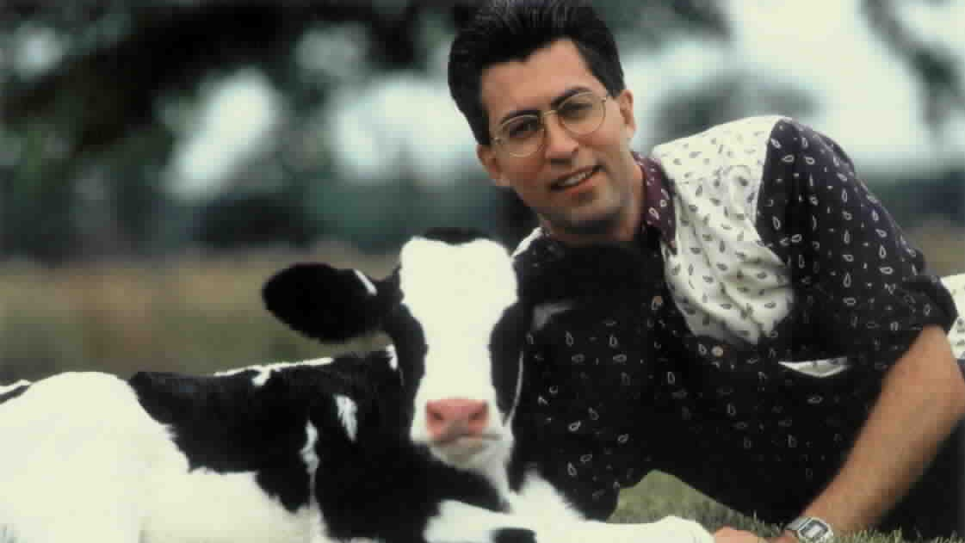
Improving the next generation, 1995

Slide 21
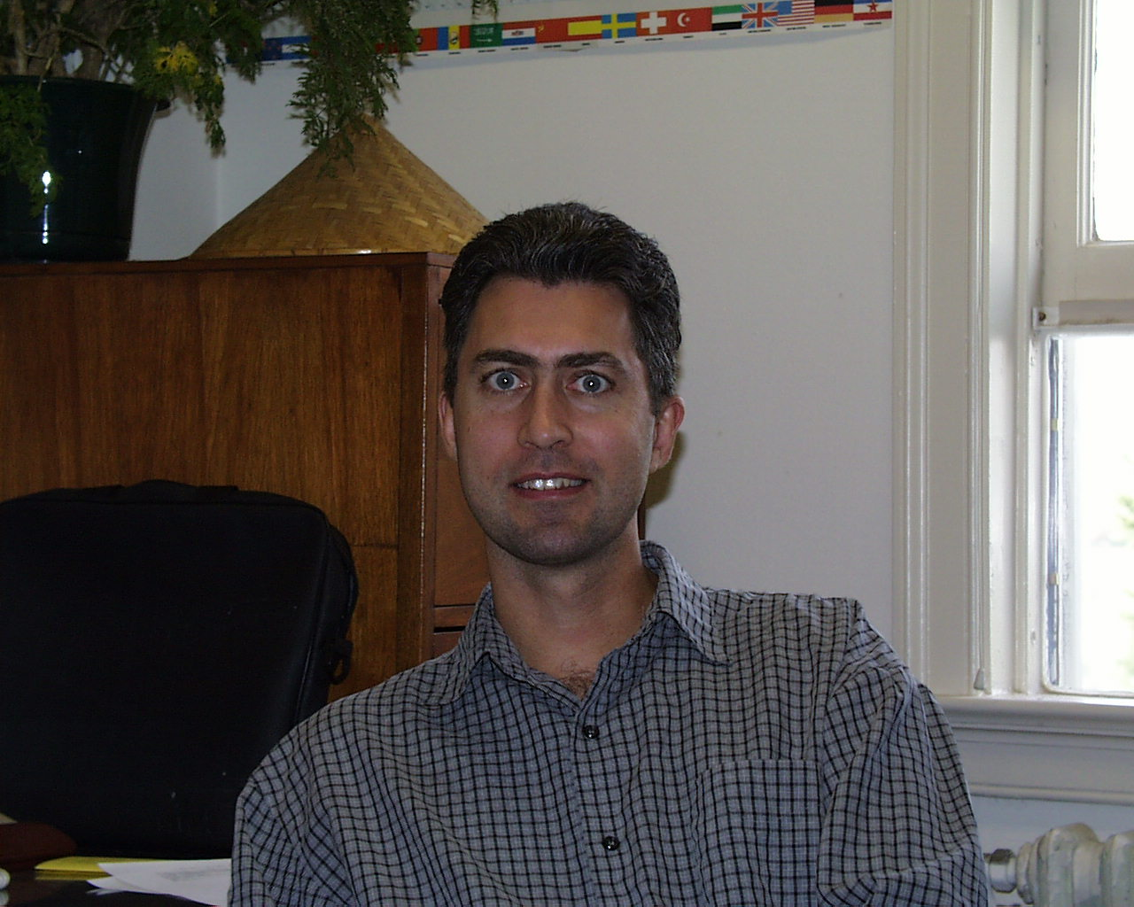
~2002 in USDA office, Beltsville, MD

Slide 22
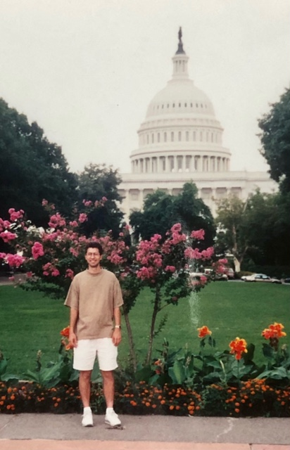
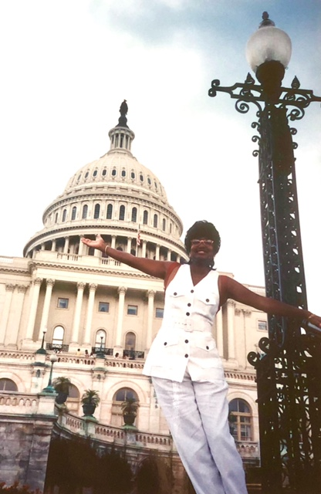
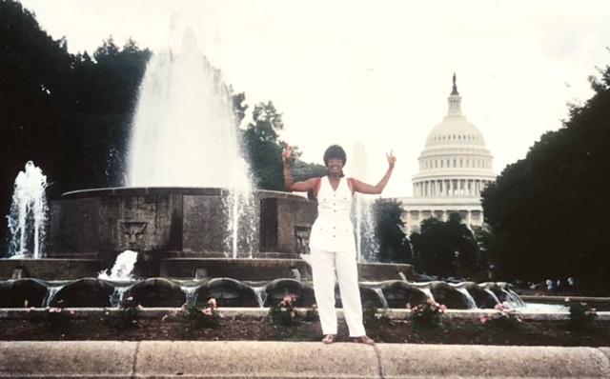
Enjoying the DC area with Cheryl

Slide 23
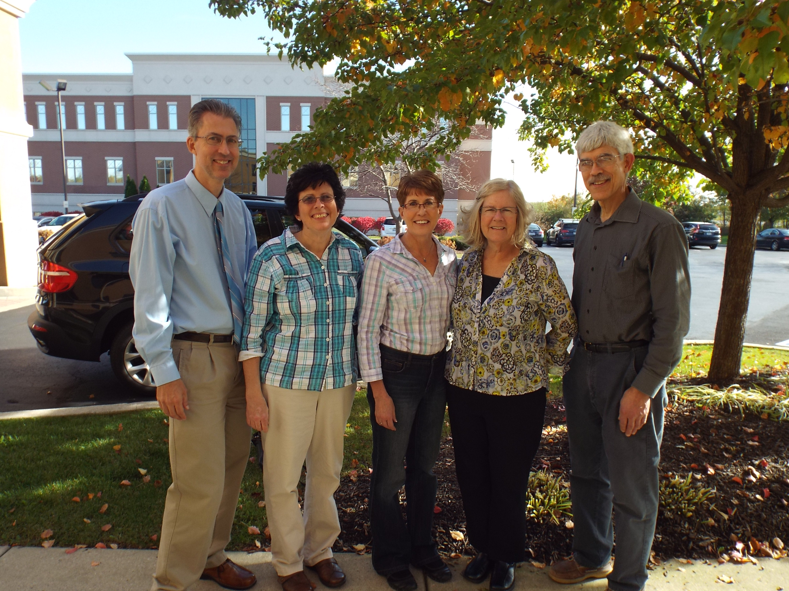
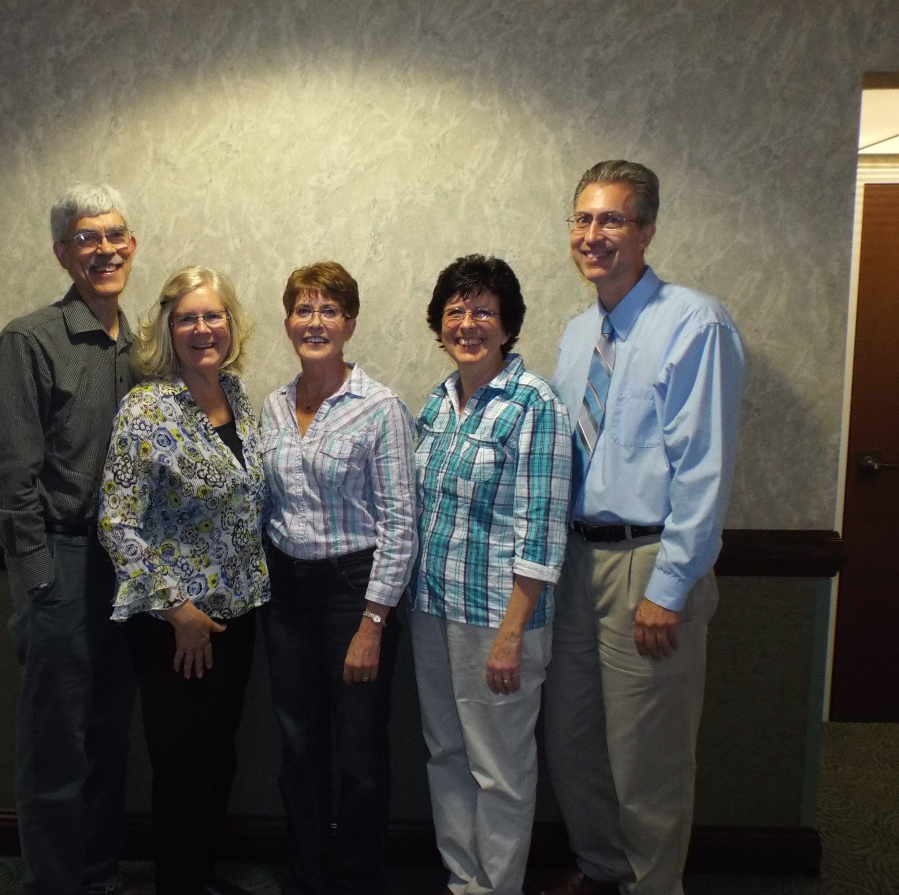
with sibs, Nov 2017 at Tiffany Heeren and Mark Bohling wedding

Slide 24
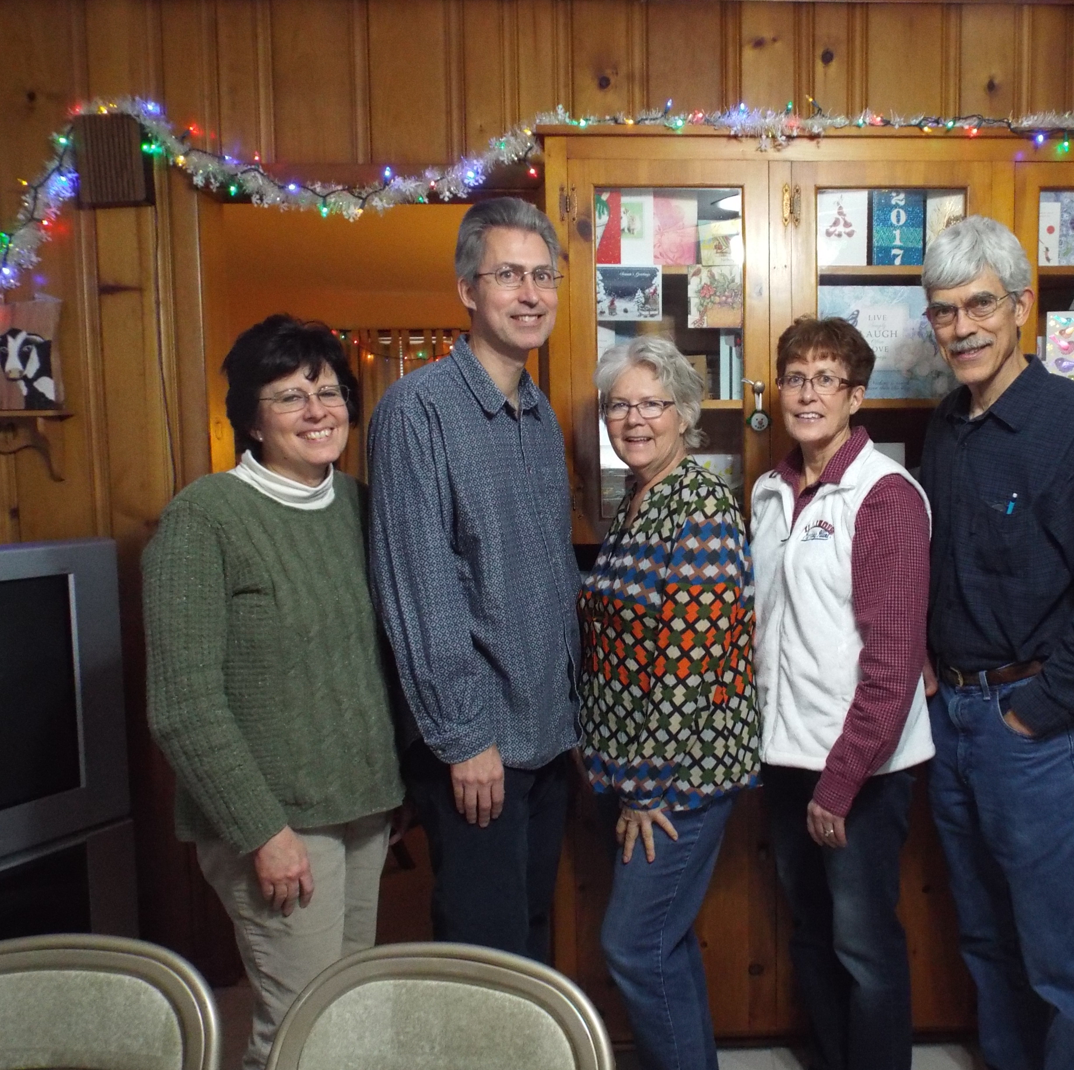
Sib Reunion
Dec 9, 2017
Shannon, IL

Slide 25
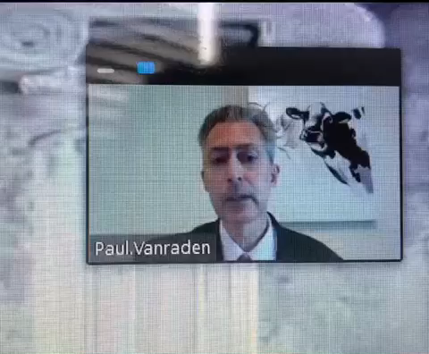
Hall of Fame speech as filmed by Angel,
2020

Slide 26
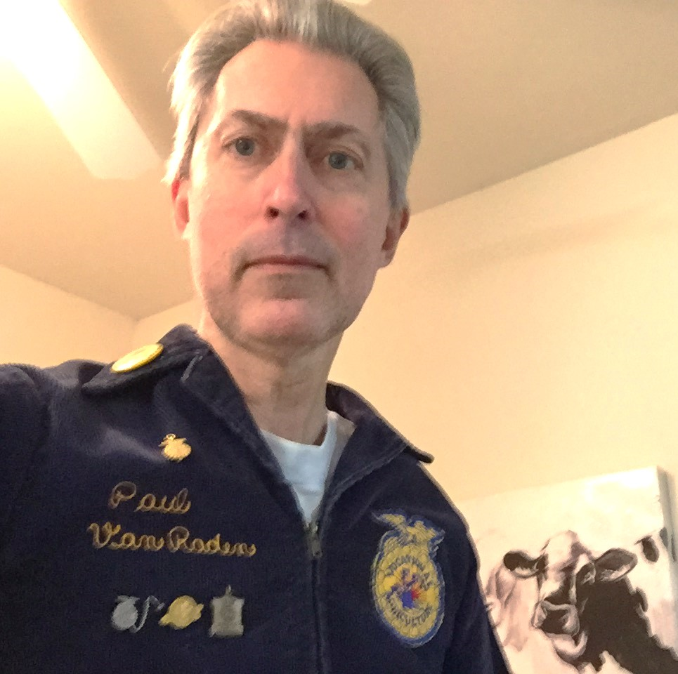
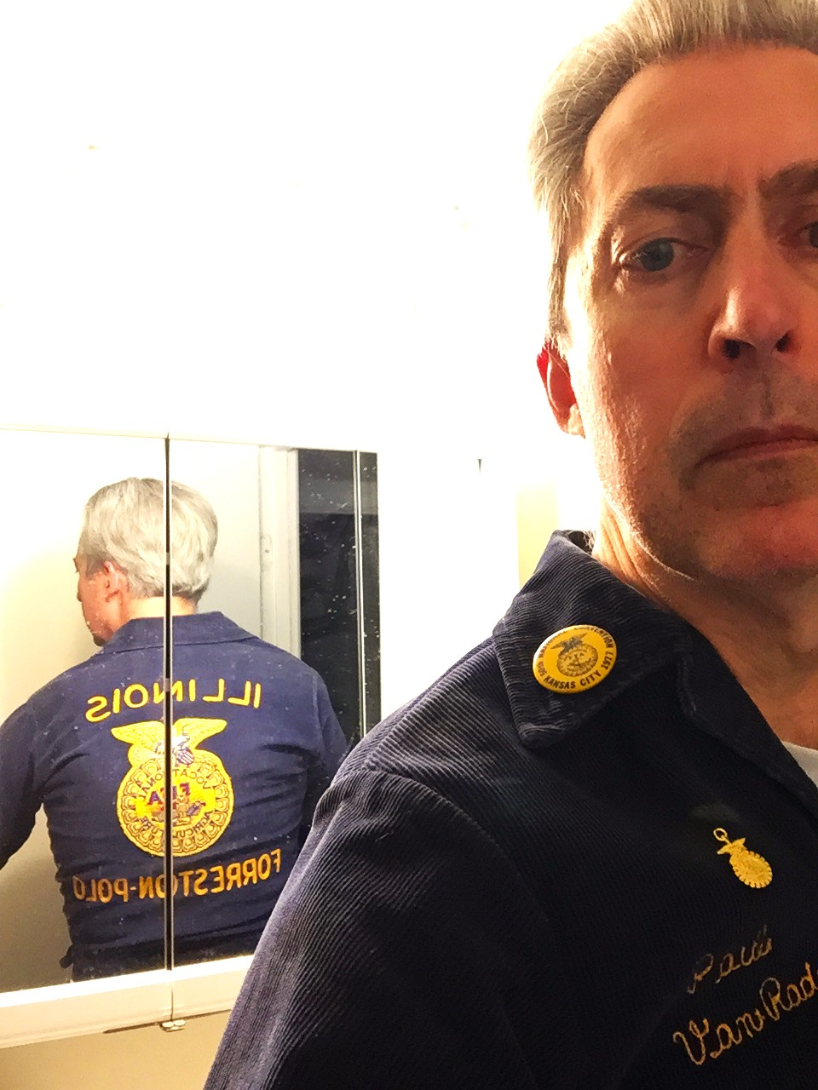
FFA jacket still fits 50 years later

Slide 27
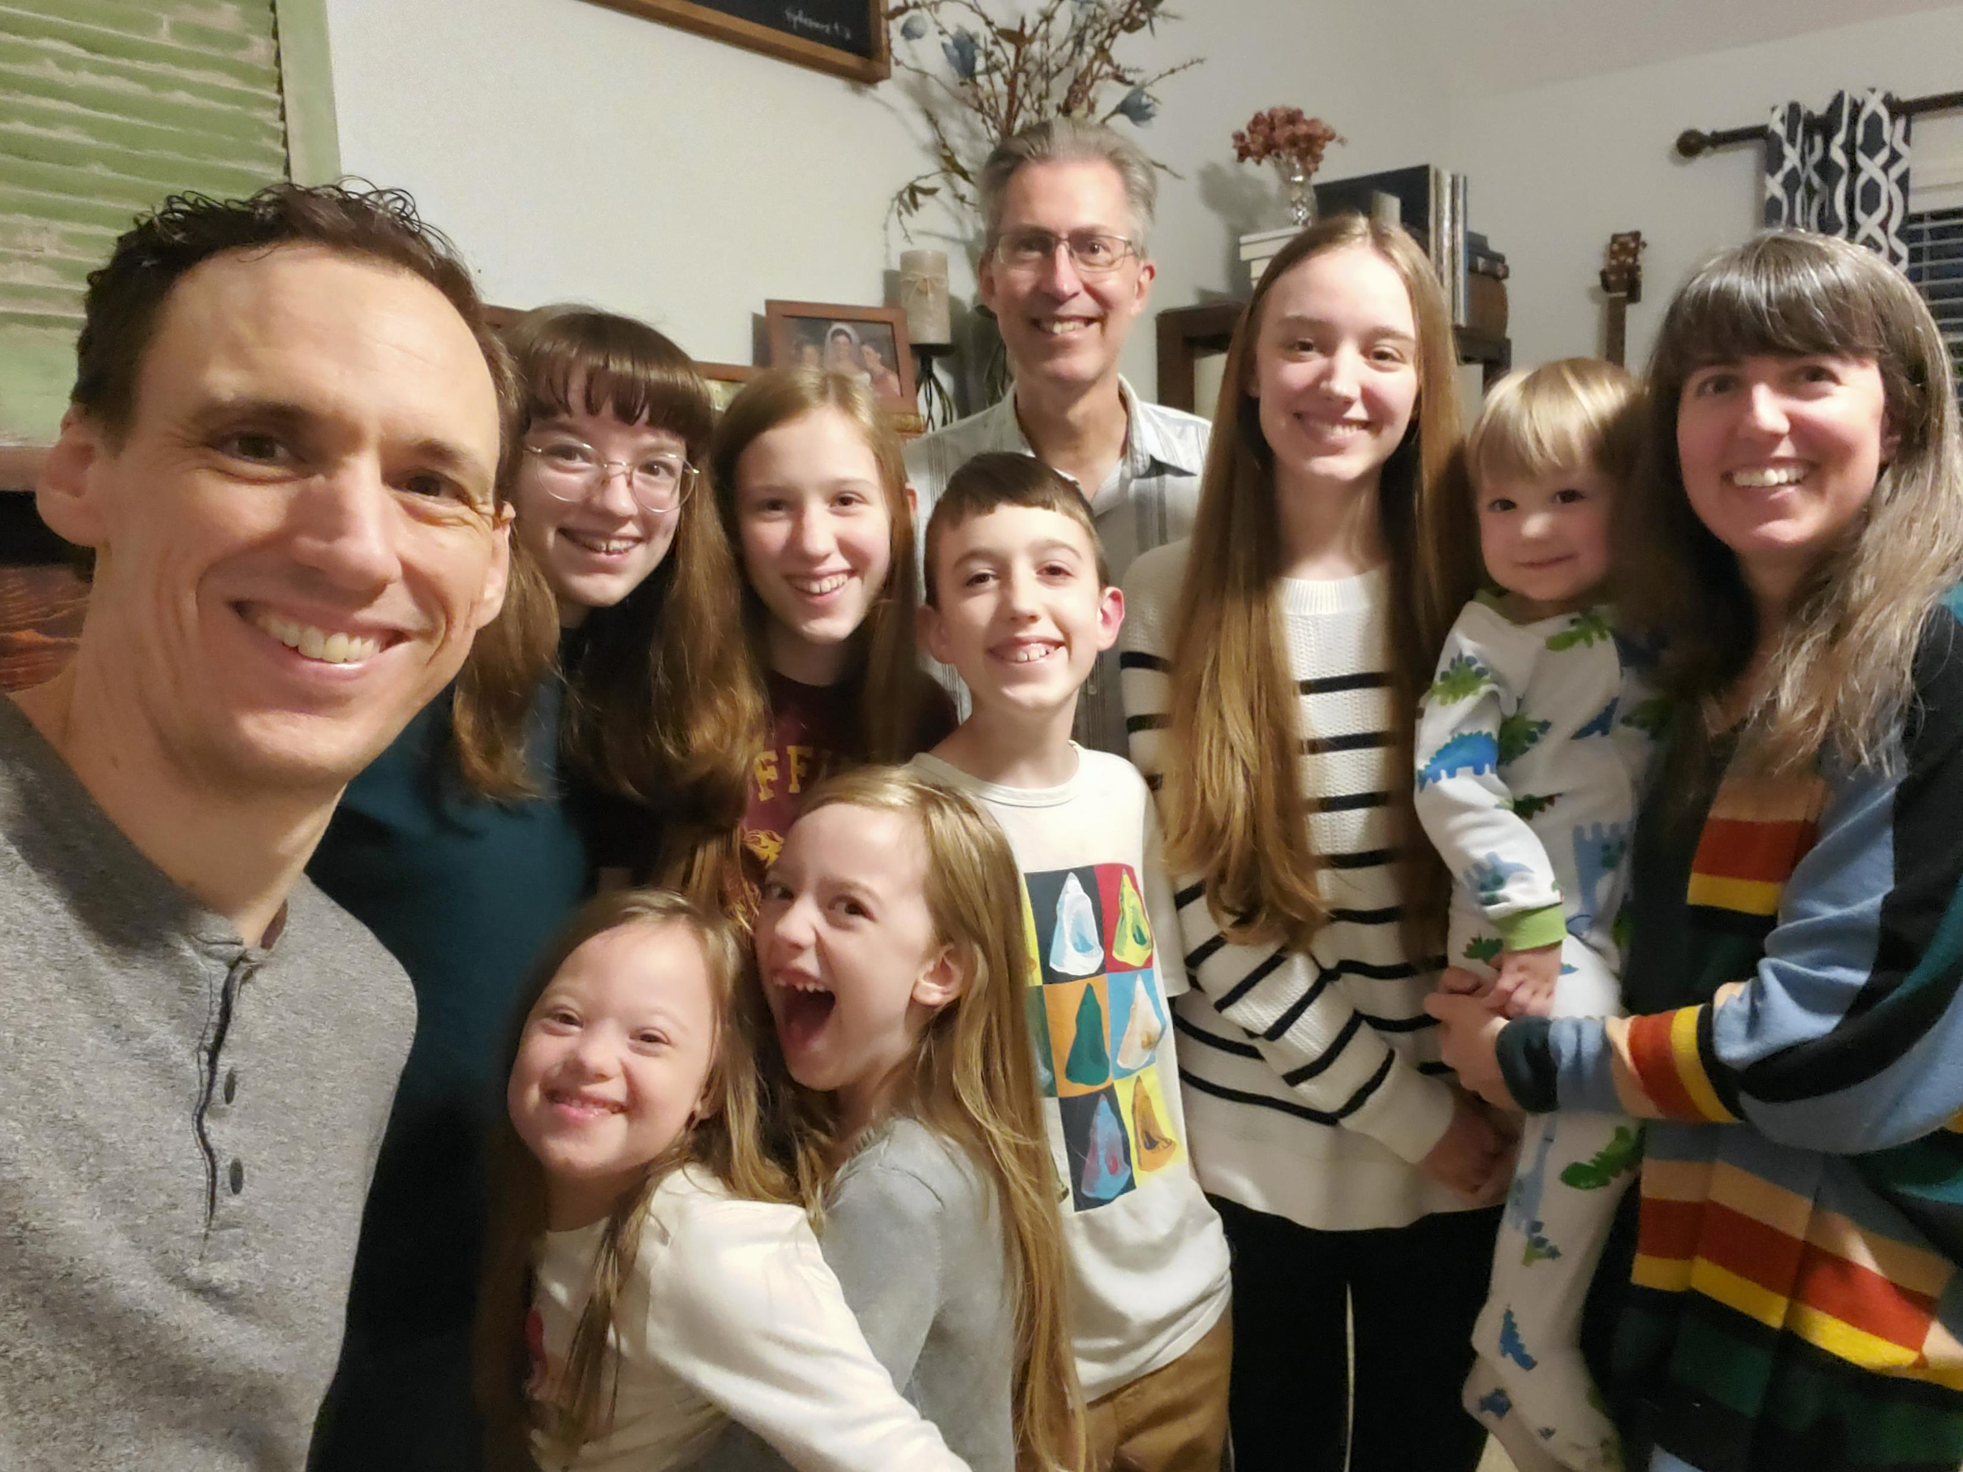
Andy & Andrea
Sabaka family,
Louisville, KY with Paul, 2023

Slide 28
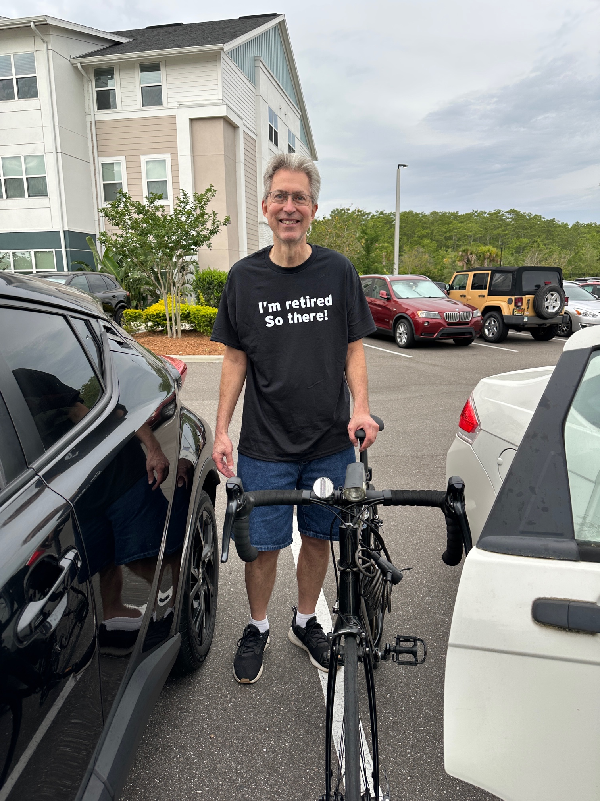
First day of retirement, May 4, 2025

Slide 29
Paul’s investment strategy birth to present

Slide 30
Paul’s net worth: Birth-present (1960-2025)

