Slide 1
Awards
Paul VanRaden
For life story see:
https://www.paulvanraden.com/Paul_VanRaden.pptx
For relatives and other personal pages see:
https://www.paulvanraden.com/InteractingWithFamily.htm

Slide 2
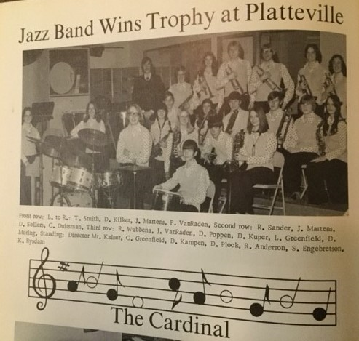
1975
Jazz band wins award at Wisconsin contest.
Paul on bongo

Slide 3
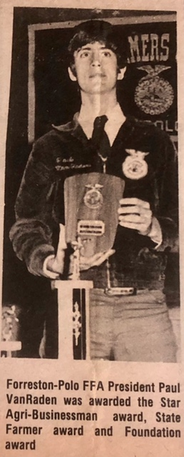
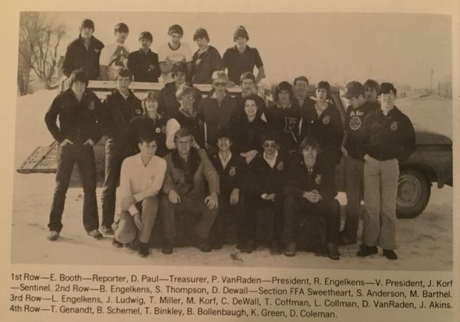
1978 FFA club and president
Paul’s truck
←

Slide 4
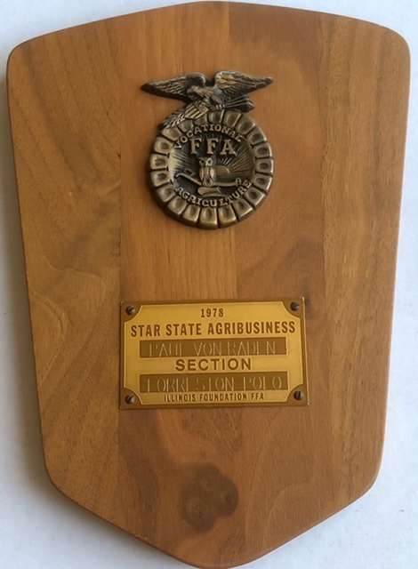
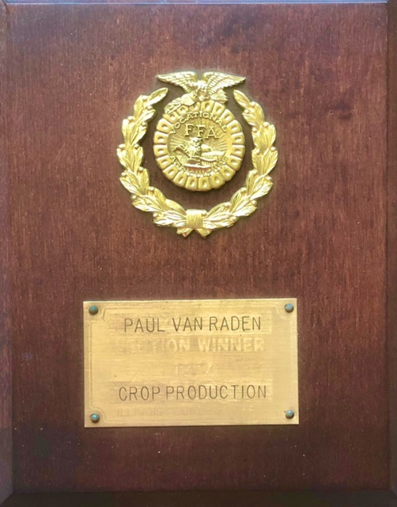
FFA Awards
1978 Star
State Agri-
Business
1977 Section winner, Crop
Production

Slide 5
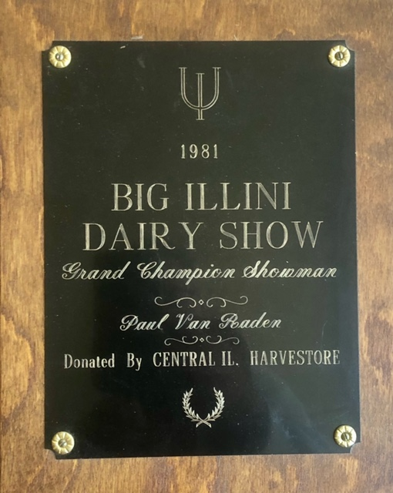
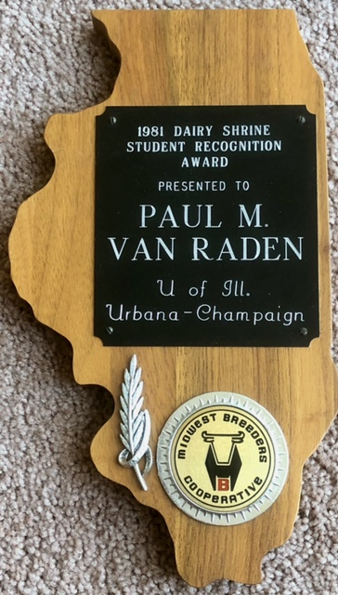
U Illinois
1981 Showman- ship
1981 Student
Achievement

Slide 6
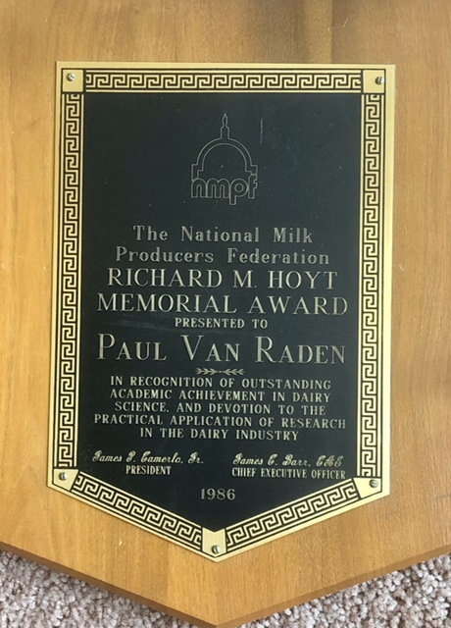
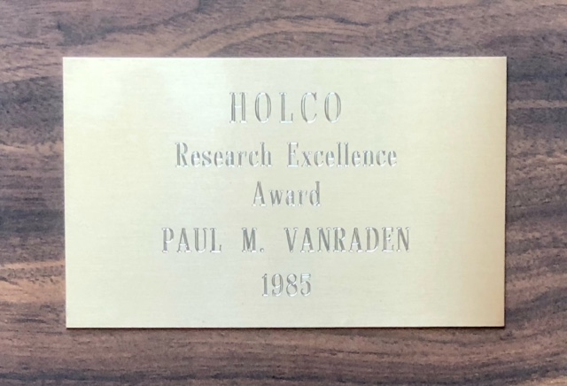
Iowa State
1985 animal science research
1986 PhD research

Slide 7
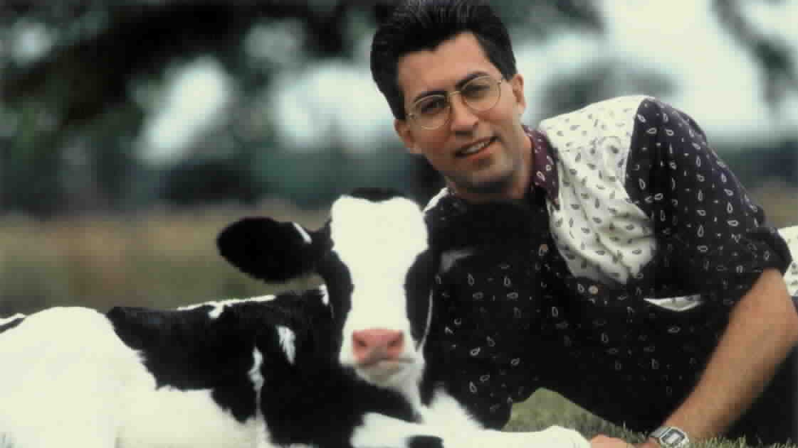
1995

Slide 8
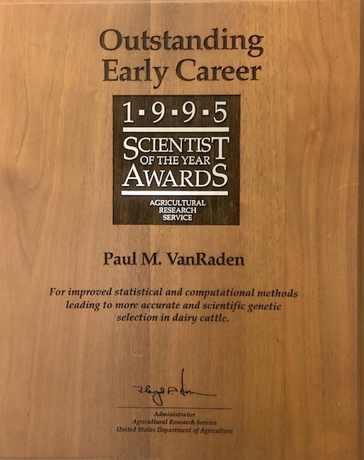
USDA-ARS
1995 Outstanding Early Career

Slide 9
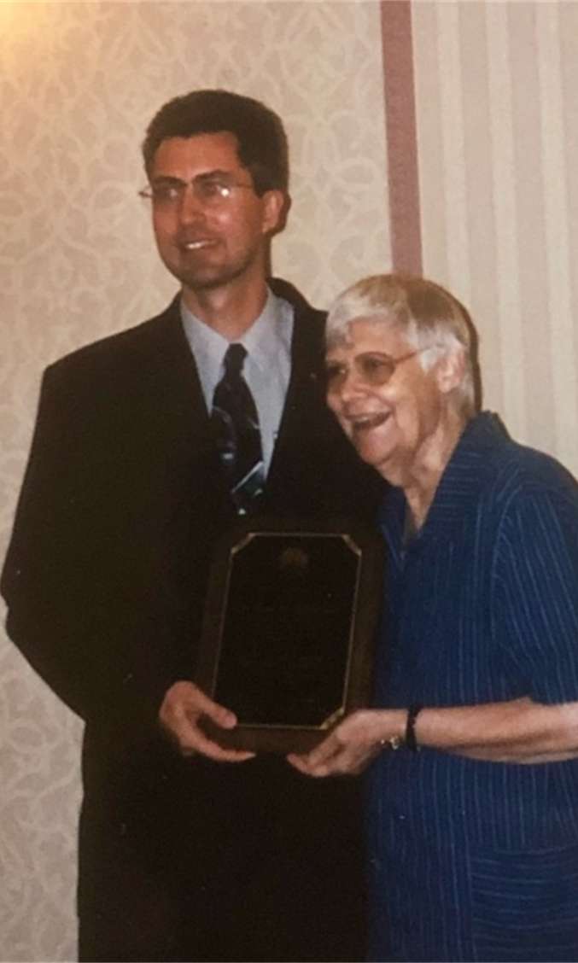
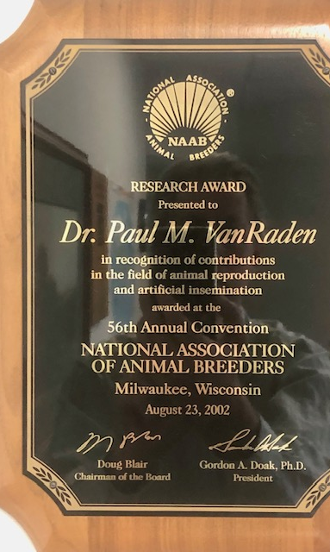
2002 NAAB
Research Award (with Mom helping)

Slide 10
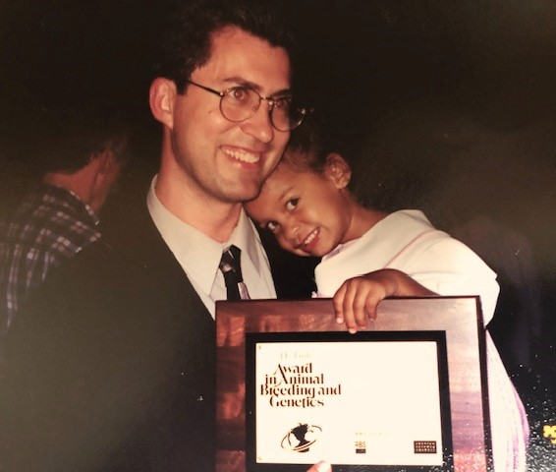
2000 ADSA Animal Breeding Award (with Angel helping)

Slide 11
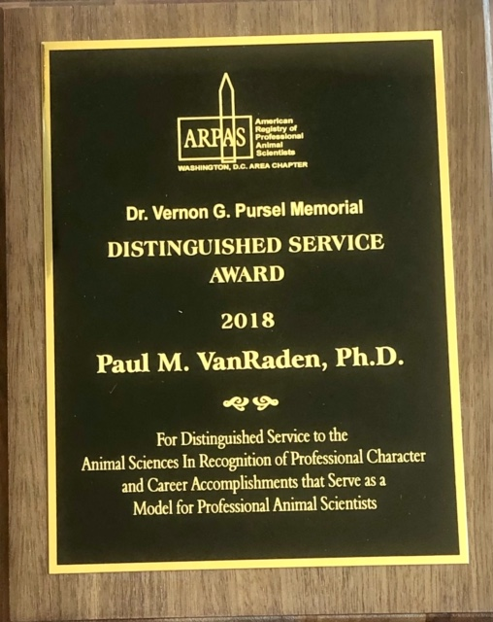
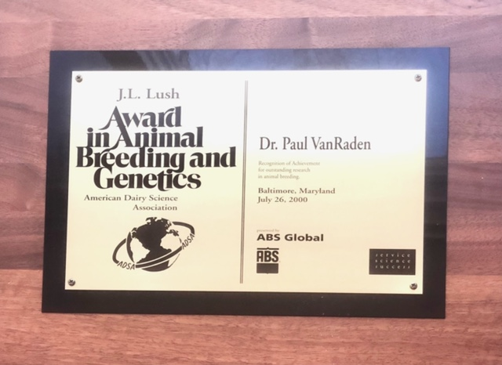
USDA research
2000 genetics from ADSA
2018 service in animal science

Slide 12
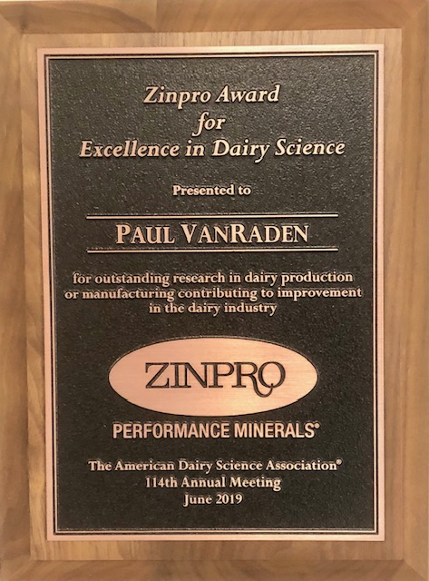
2019 ADSA Zinpro Award, best dairy research

Slide 13
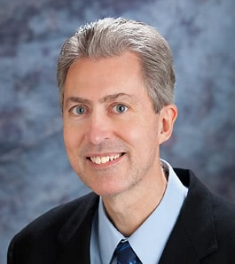
Agriculture Research Service Hall of Fame
2020

Slide 14
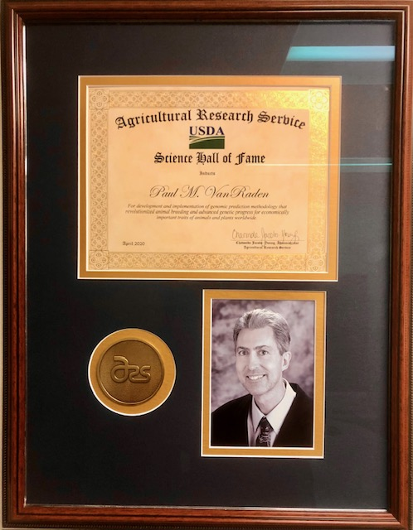
USDA-ARS 2020 Hall of Fame Scientist

