Slide 1
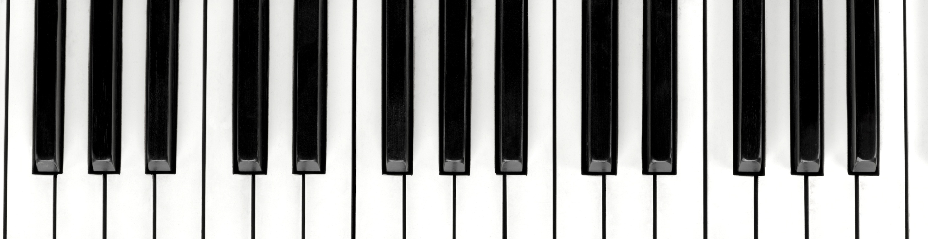
Musical Scales
Paul VanRaden
©2023

Slide 2
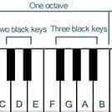

Piano scales are confusing
7 white keys are standard
  A, B, C, D, E, F, G
5 black keys are optional
  Called sharps if to right of letter
  Called flats if to left of letter
  Skip white key if playing black key
  Or call white key a natural
Choose simpler tones and scales using numbers and frequencies instead of letters, sharps & flats
Doubles instead of octaves

Slide 3
Audio examples of differing scale choices
Differing numbers of evenly spaced tones per doubling of frequency
  1, 2, 3, 4, 6, 8, 12, up to 48 tones per double
  Examples going up the scale, down the scale, and both together
Different math to tune the keys
  Log₂ tuning setting frequency of note n to 2^{(n/w)} where w is tones per double
  Linear tuning setting frequencies to (1 + n/w) for better harmony
  Reciprocal tuning setting frequencies to 2w/(2w-n)
Different types of harmony
  Intersecting, parallel, or crossing lines
  Reciprocal harmony by varying the denominator instead of numerator

Slide 4
Scales with different numbers of equally spaced tone frequencies per double

Slide 5
Scales going down to 0.5 instead of up to 2 with different numbers of tone frequencies per double

Slide 6
Intersecting linear harmony on frequency scale
With 8 evenly spaced tones per double

Slide 7
Crossing linear harmony on the frequency scale
With 8 evenly spaced tones per double

Slide 8
Parallel linear harmony on the frequency scale
With 8 evenly spaced tones per double

Slide 9
Parallel equal-spaced linear harmony,
Starting frequency 1:2:3:4:5, ending 8:9:10:11:12

Slide 10
Log₂ scales have ratios of roots such as 1.4142
Linear scales have simple ratios such as 1.5

Slide 11
Log₂ Tuning with 48, 32, 24, 16, 12, 8, 6, 4, 3, 2, or 1 Tone per Double

Slide 12
Key scaling across doubles using formulas for reciprocal, log₂, and linear tuning

Slide 13
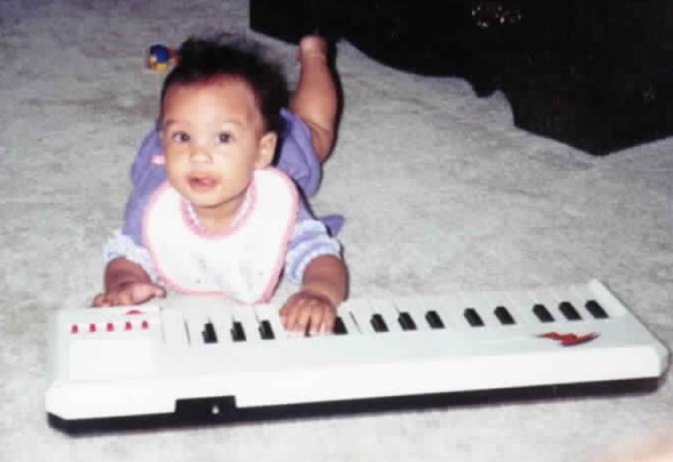
Conclusions
Musical scales with more or fewer tones per double are easy to make
Musicians could easily accept these evenly spaced tones
Harmony sounds better with linear (1 + n/w) than log tuning functions
Reciprocal harmony also sounds good using 2w/(2w –n)
Multi-part linear harmony sounds good because all tones have the same denominator, giving simple ratios
Multi-part reciprocal harmony also sounds good because all tones have the same numerator, giving simple ratios in the opposite direction
Children could easily learn math and music at the same time

