Slide 1
Martin and Ruth VanRaden
1904-1992
And their ancestors

Slide 2
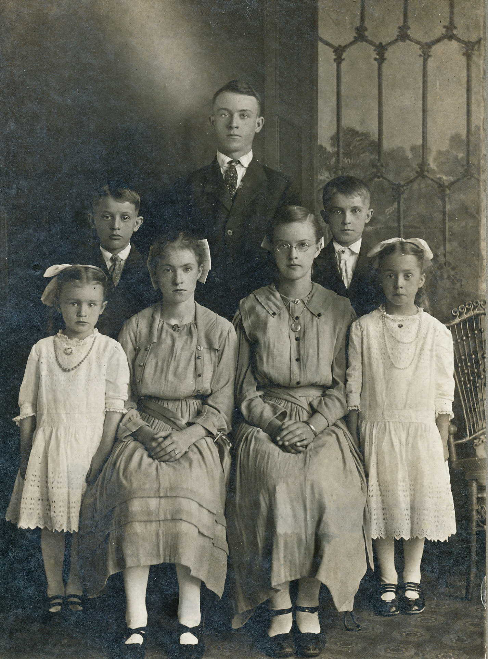
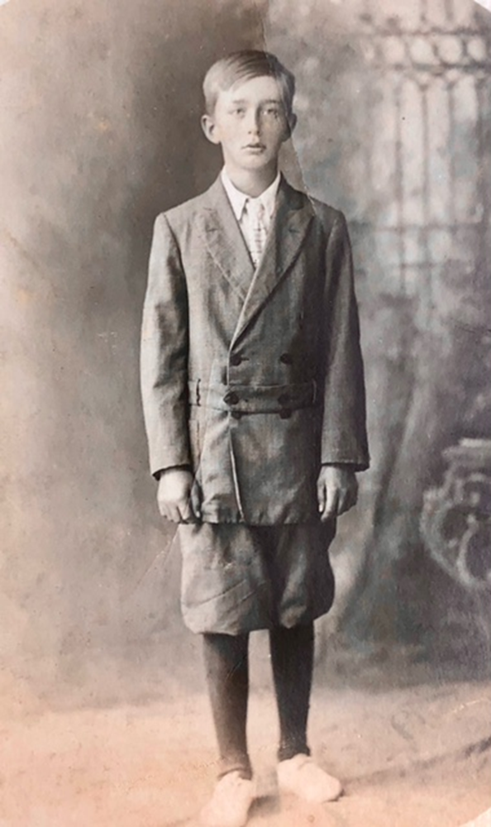
Ratmeyer siblings: Back - Clarence, Earl, Walter. Front - Bertha, Ruth, Lydia & Susan.
Martin VanRaden

Slide 3
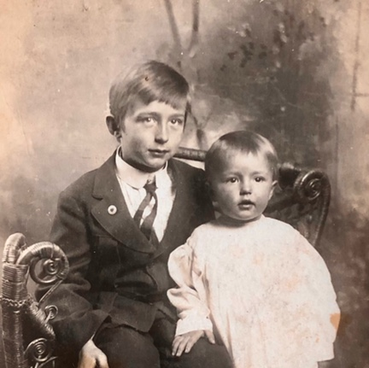
1914, age 8
Martin with sister Margaret

Slide 4
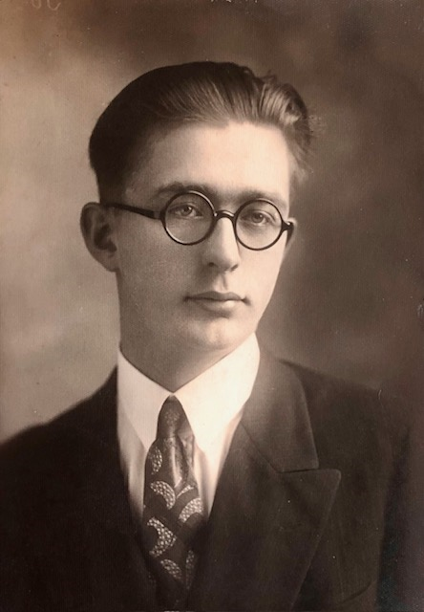
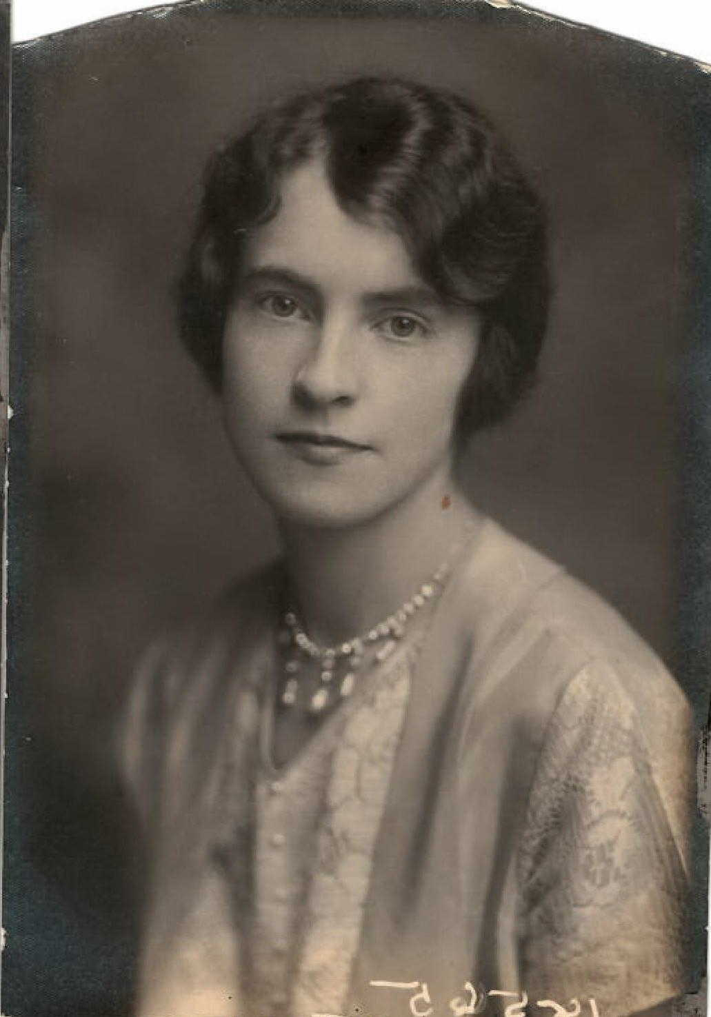
1924 – Martin age 18
1922 – Ruth age 18

Slide 5
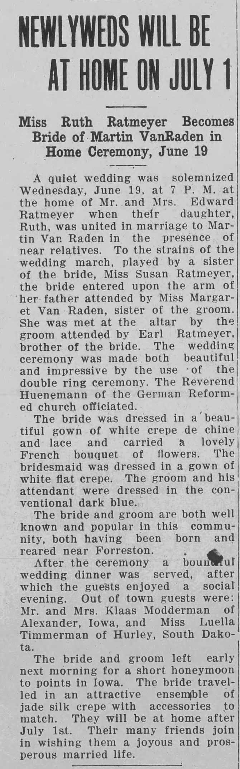
Martin and Ruth wedding
1929
Forreston, IL
Honeymoon in Iowa

Slide 6
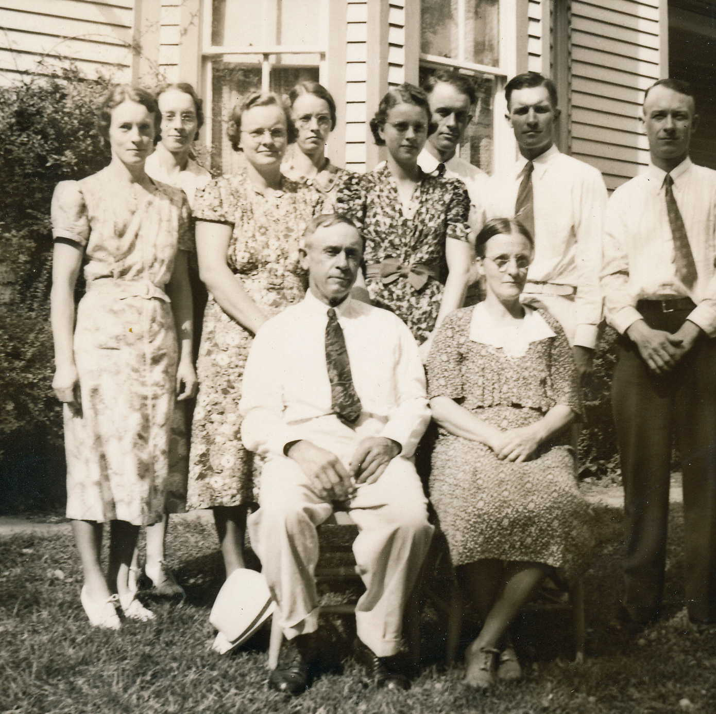
Ratmeyer family:
Back - Susan, Lydia, Earl, Walter, Clarence; Center - Ruth, Bertha, Florence;
Front - Edward and Elizabeth (parents)

Slide 7
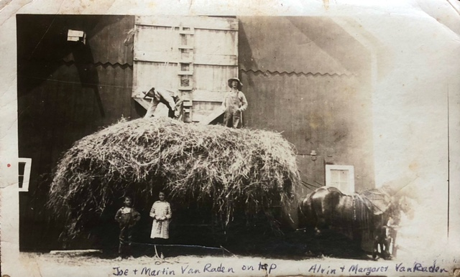
Joe and Martin VanRaden loading hay into barn, Alvin and Margaret in front, ~1920

Slide 8
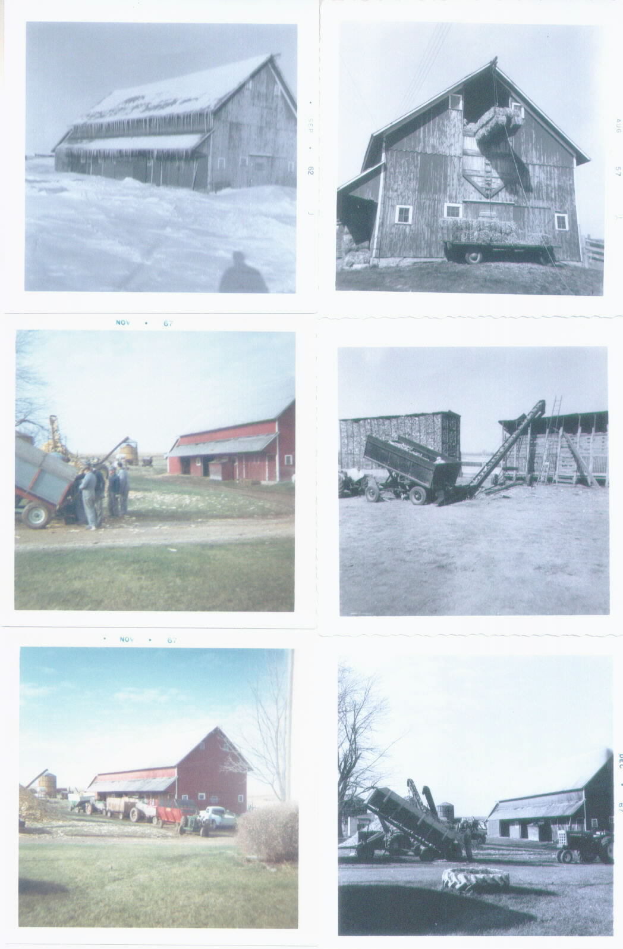
Martin and Ruth VanRaden’s farm
Forreston, IL photos 1952-67

Slide 9
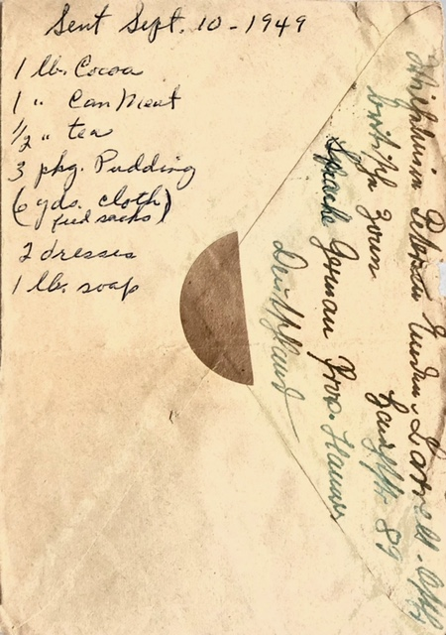
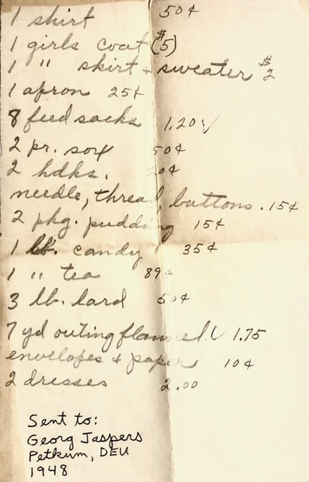
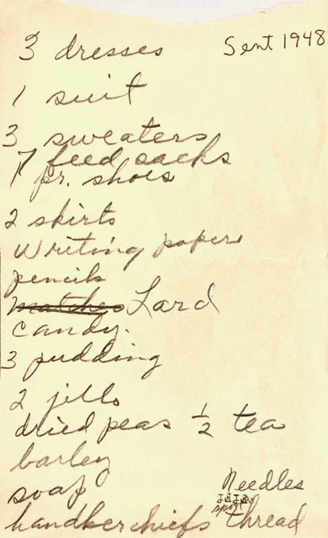
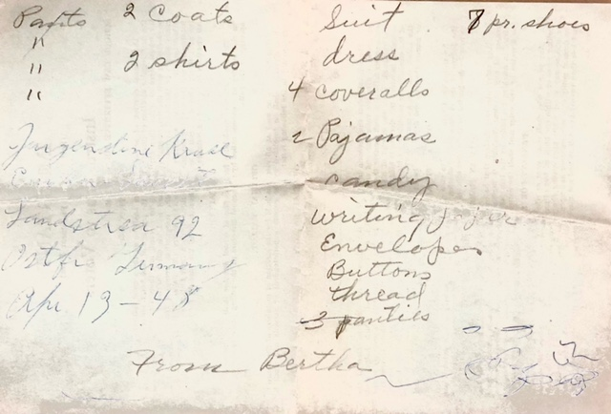
Care packages sent to
German relatives,1948-49

Slide 10
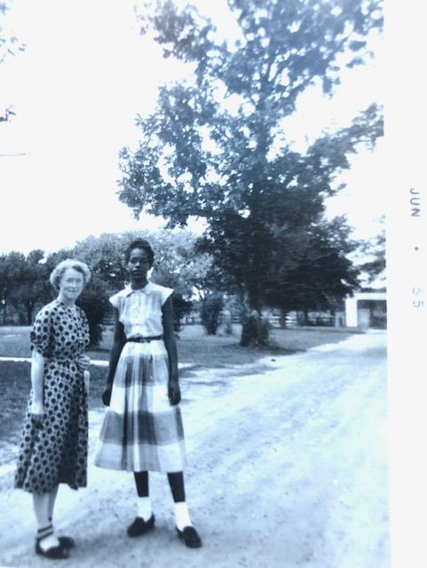
1955
Ruth and friend

Slide 11
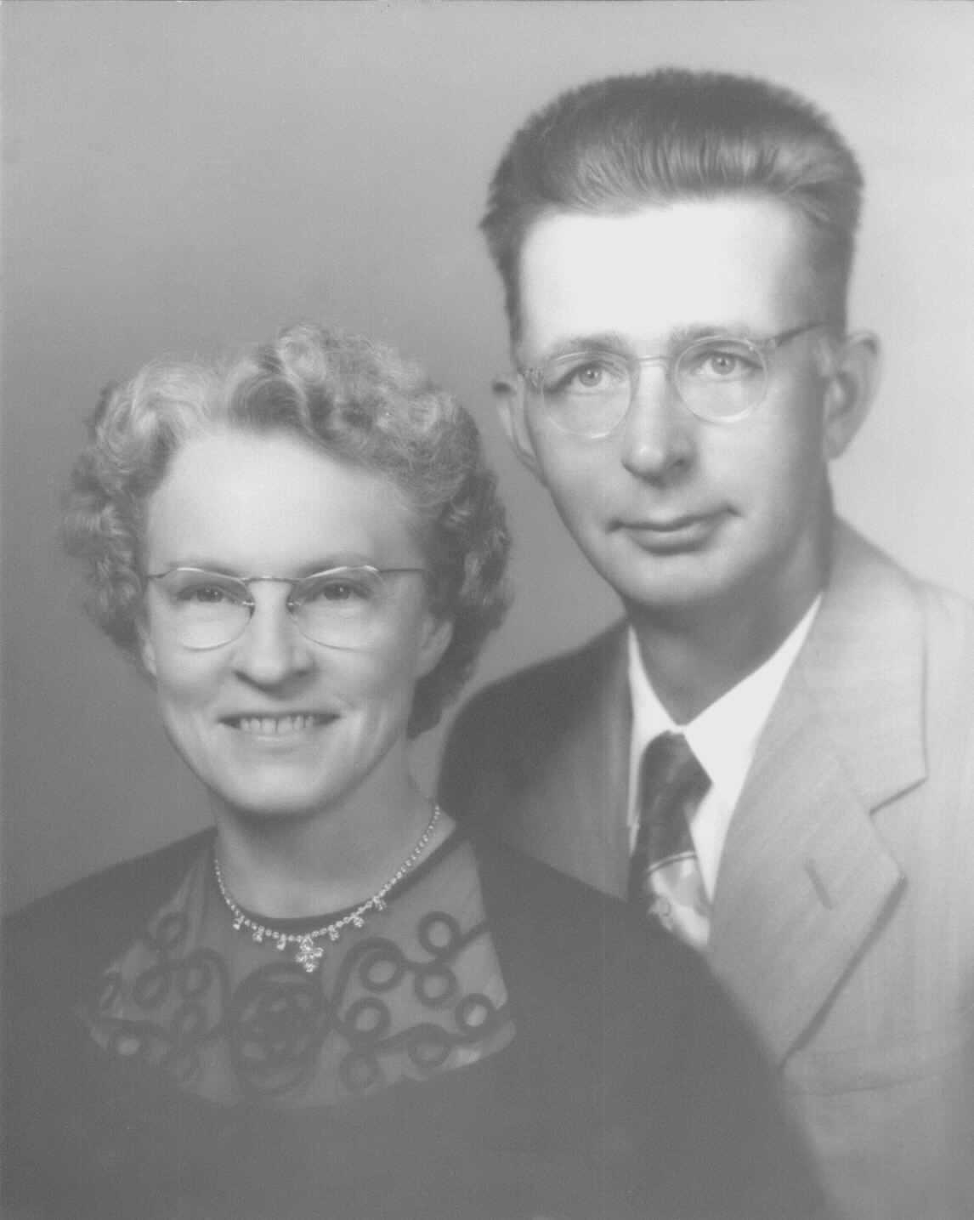
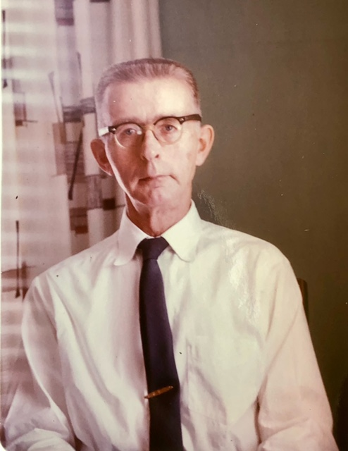
Ruth & Martin

Slide 12
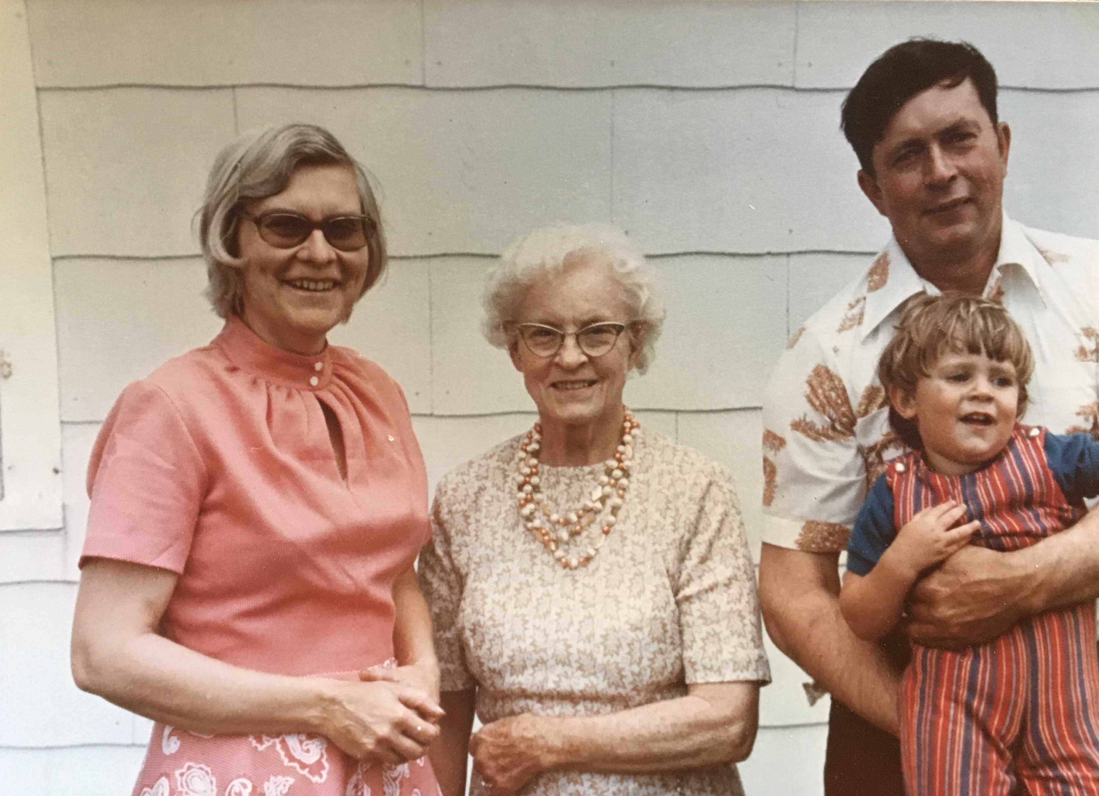
March 1978
Katie, Ruth and Bud Van Raden and Joel Van Laven

Slide 13
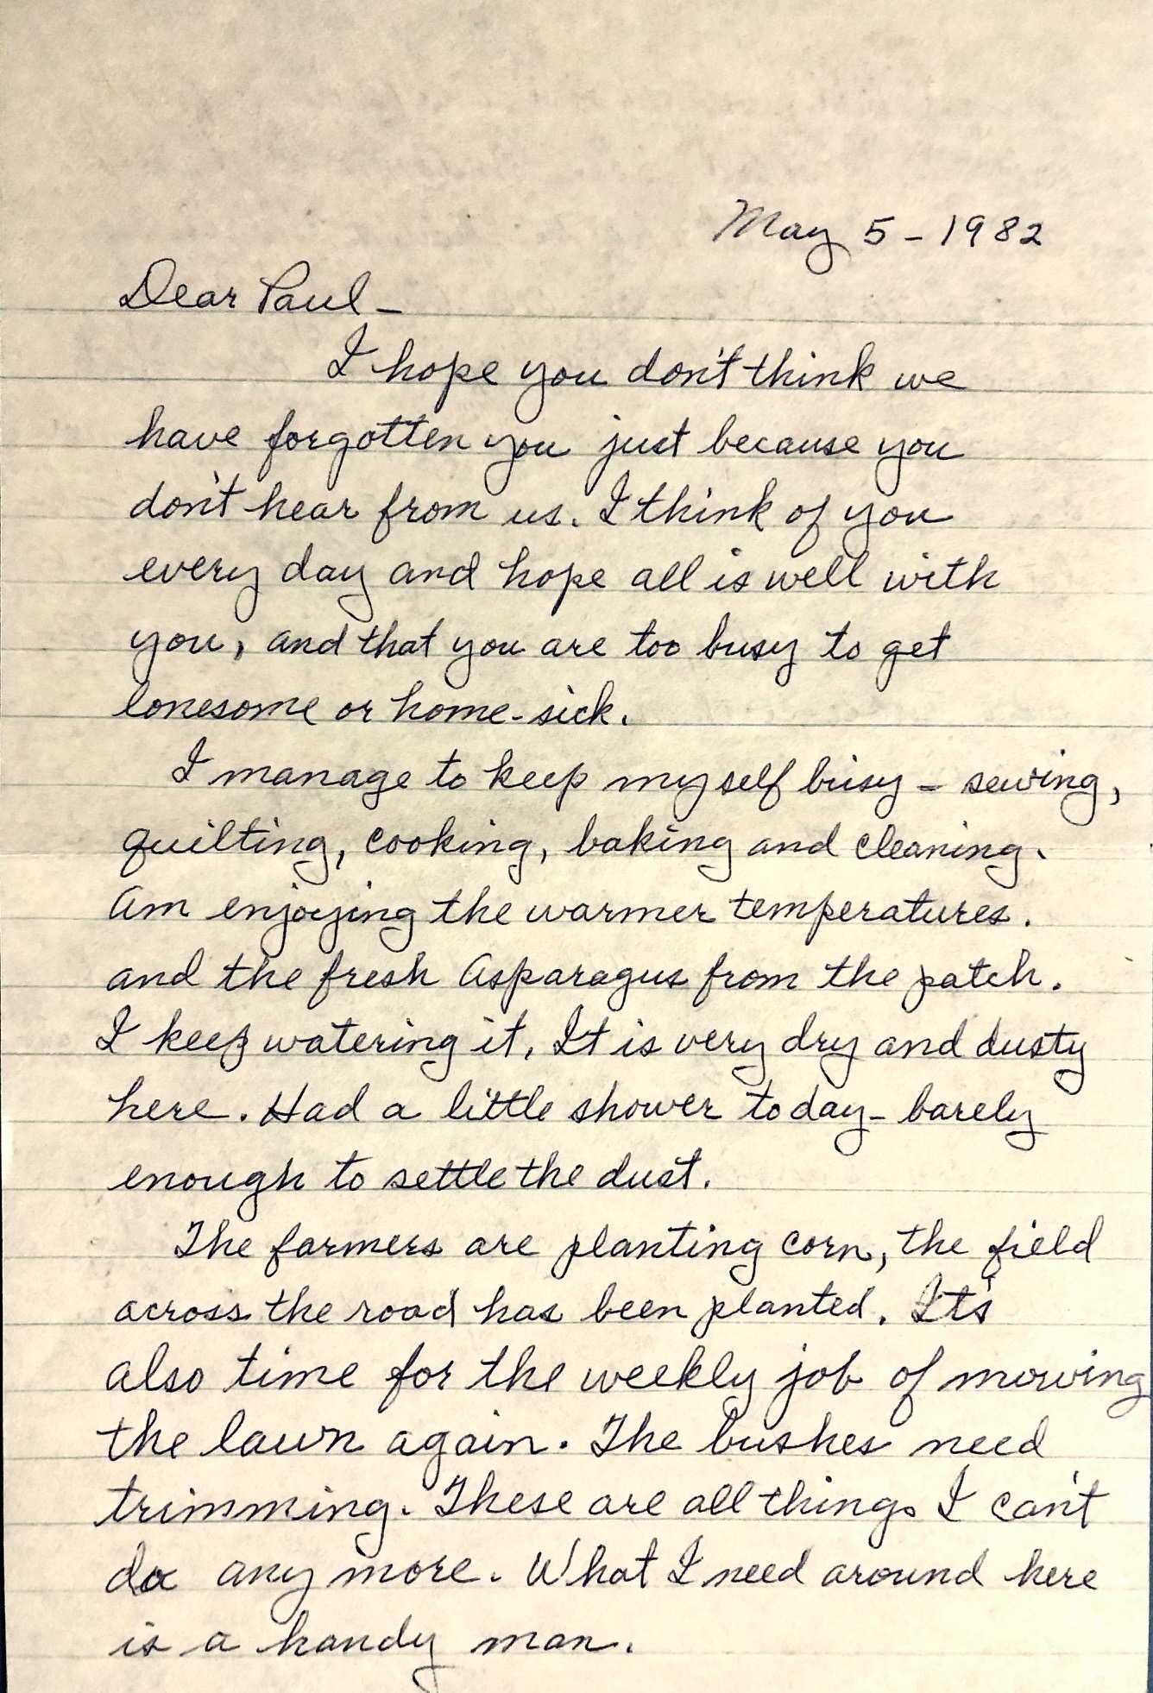
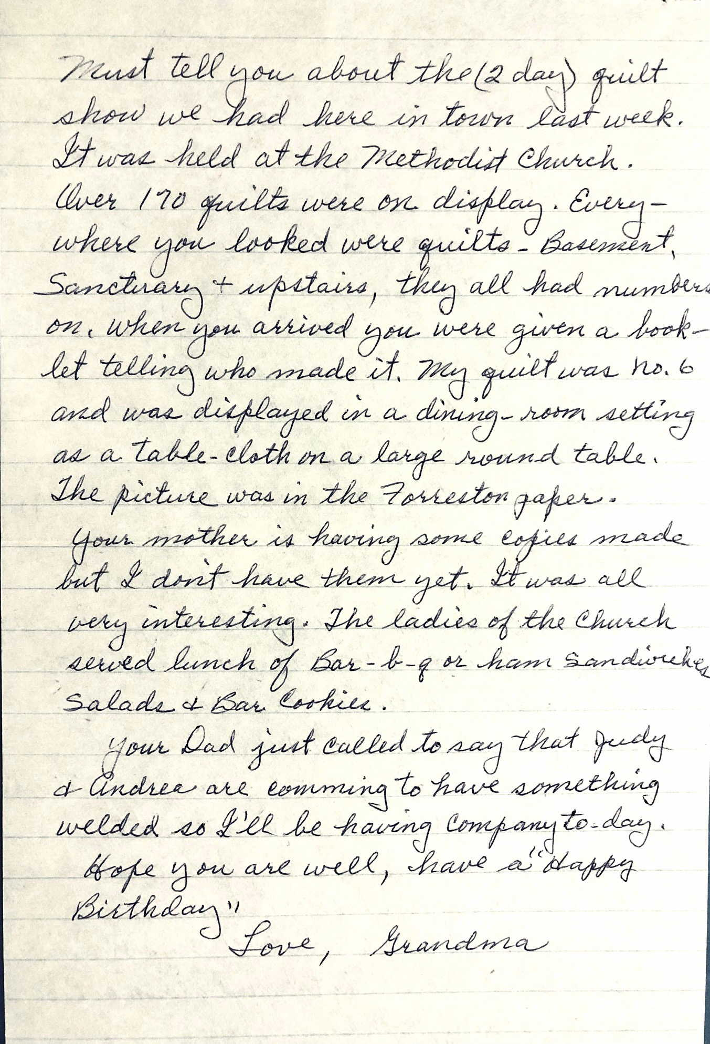
May 5, 1982
Letter from Grandma Ruth

Slide 14
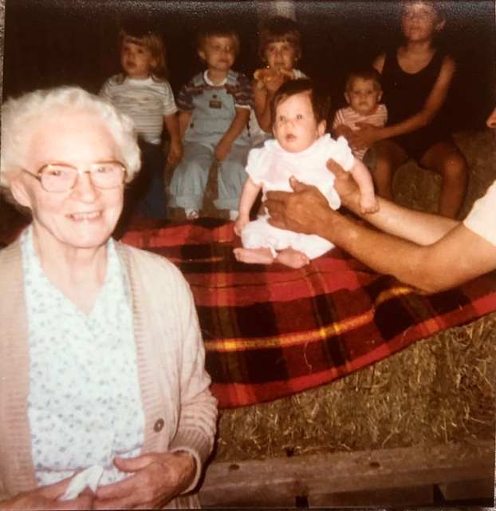
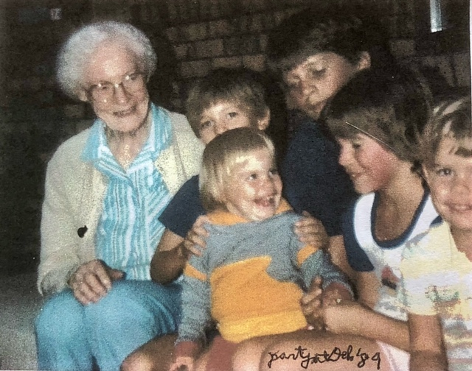
Ruth with grandkids,
1989 left, 1983 right

Slide 15
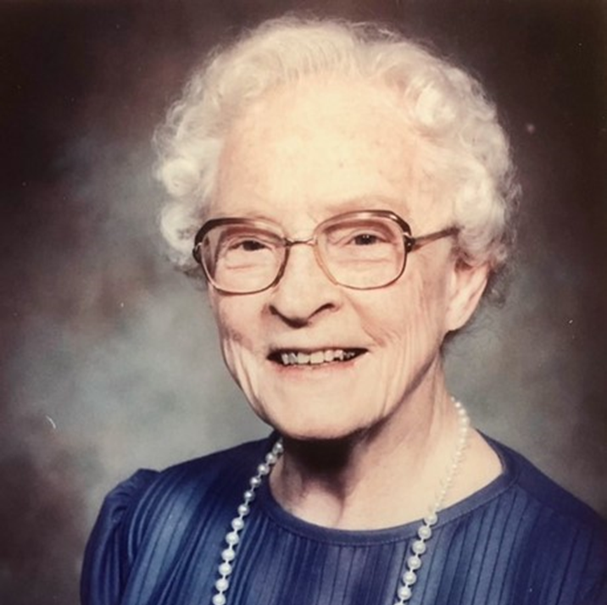
Ruth
~1988

Slide 16
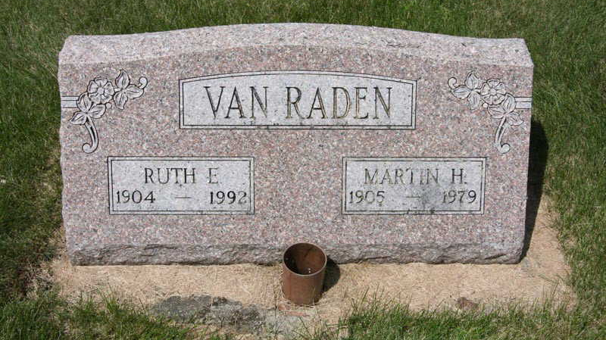
Ruth 1904-1992, Martin 1905-1979

Slide 17
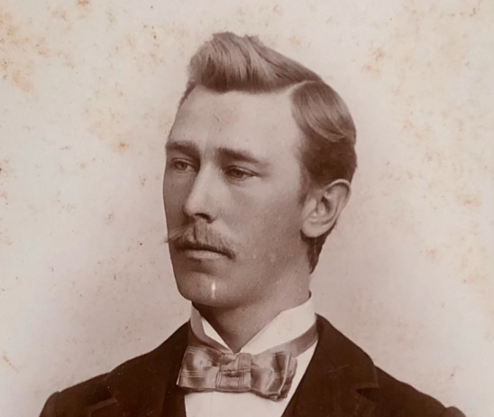
1890
Joe VanRaden father of Martin

Slide 18
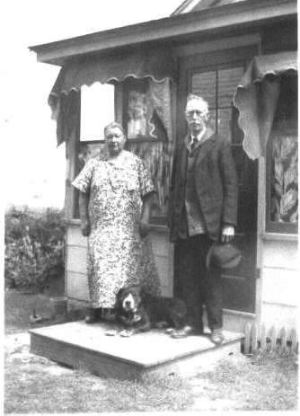
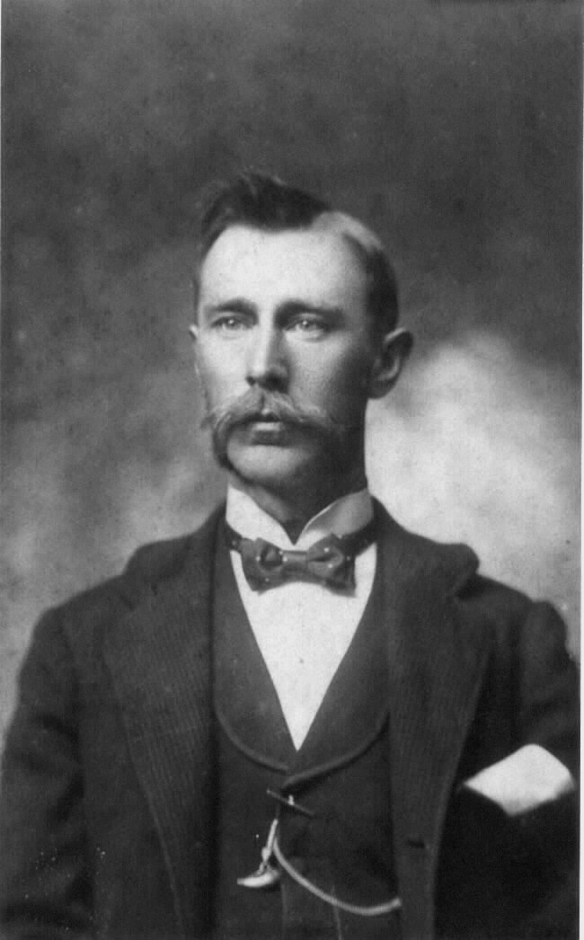
1946 Joe and Bena VanRaden
1897 Joe VanRaden

Slide 19
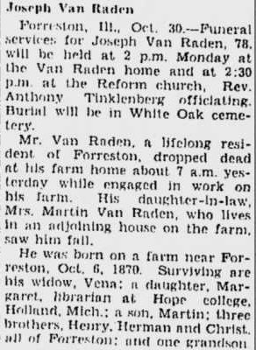
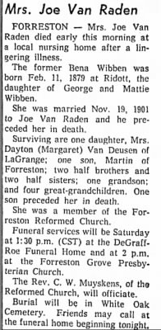
Joe VanRaden 1870-1948
Bena VanRaden 1879-1958

Slide 20
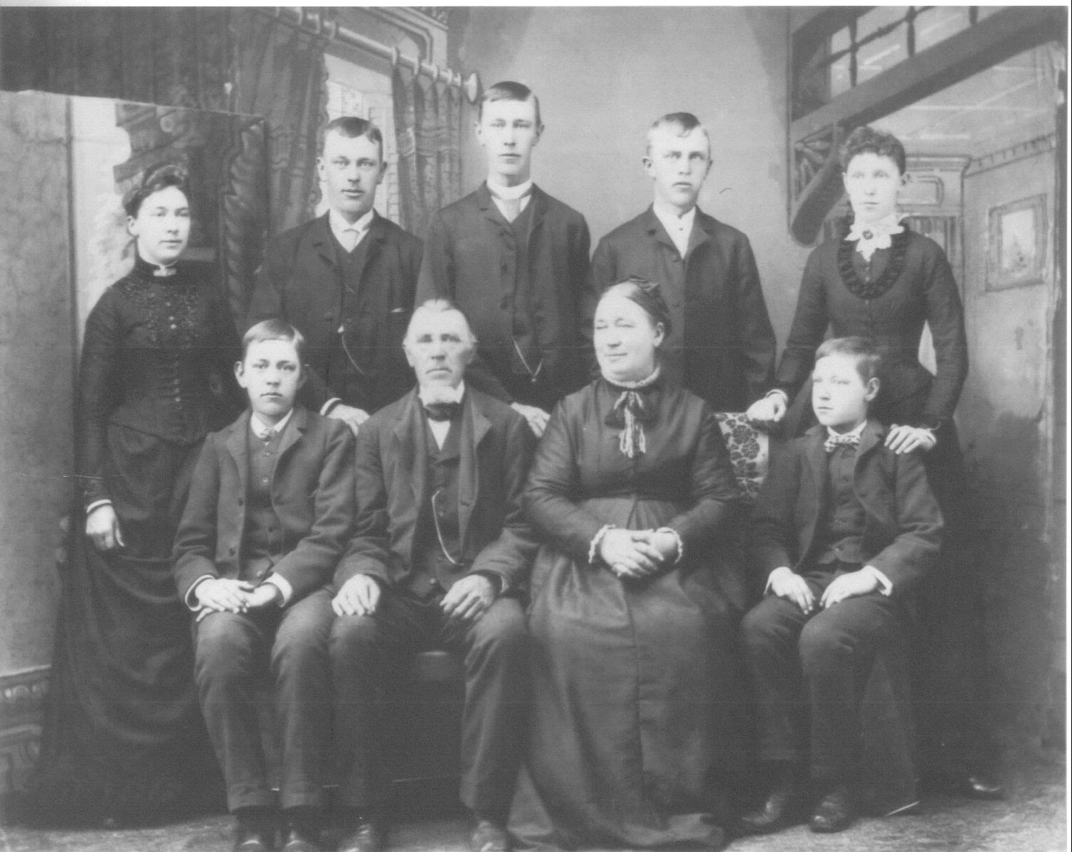
1888
Engelke and Aaltje VanRaden family
Joe: 2nd from right, back row

Slide 21
Jan (John) VanRaden, brother of Engelke VanRaden
Civil War Record: Grant’s Army of the Tennessee,
Company C 46th IL Infantry
Year | Date | Location | Event
1839 | Sep 13 | Germany | Born in Neermoor
1851 |  | Forreston, IL | Immigrated to USA
1861 | Sep 10 | Freeport, IL | Joined Union army
1861 | Dec 28 | Camp Butler | Training
1862 | Feb 14 | Ft Donelson, TN | 1,634 men killed, 15,822 wounded
1862 | Apr 26 | Shiloh, TN | 3,482 men killed, 16,420 wounded, > half of 46th IL
1862 | May | Corinth, MS | One-month siege, >2,000 casualties
1862 | Oct 4 | Matamora, MS | Jan’s Colonel and Lieutenant killed
Year | Date | Location | Event
1862 | Nov 30 | Tallahatchie River, MS | Winter camp
1863 | May 15 | Vicksburg, MS | 3-month siege, 8,037 casualties
1863 | Sep 1 | Louisiana | Expedition to guard trains and ferry
1864 | Jan 4 | Freeport, IL | Furloughed, with a hero’s welcome
1867 ~ |  | Allison, IA | Moved, but left his rifle in Forreston, IL
1899 | Mar 3 | Allison, IA | Died, age 59
After1900 | 4 gen-erations | Forreston, IL | Joe, Martin, Walter, Paul inherited rifle

Slide 22
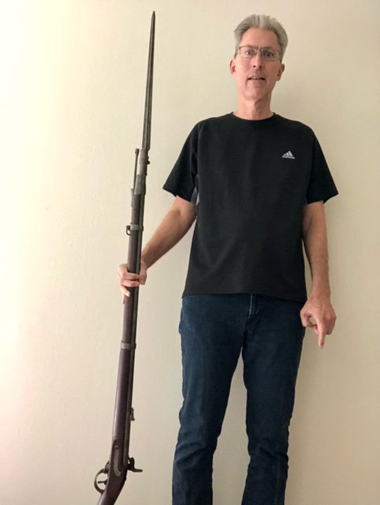
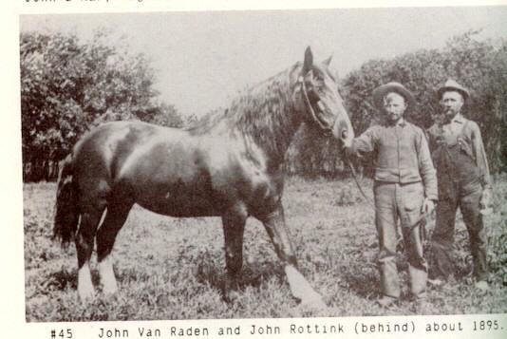
Civil War rifle carried 1861-64 by Jan (John) VanRaden
Paul VanRaden with rifle, 2024

Slide 23
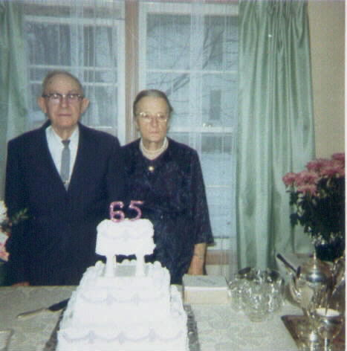
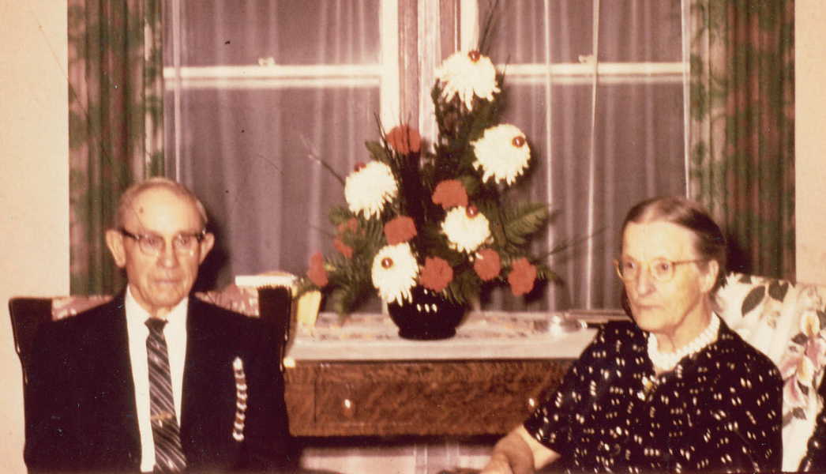
Edward and Elizabeth Ratmeyer
65th Anniversary 1966, 59th Anniversary 1960

Slide 24
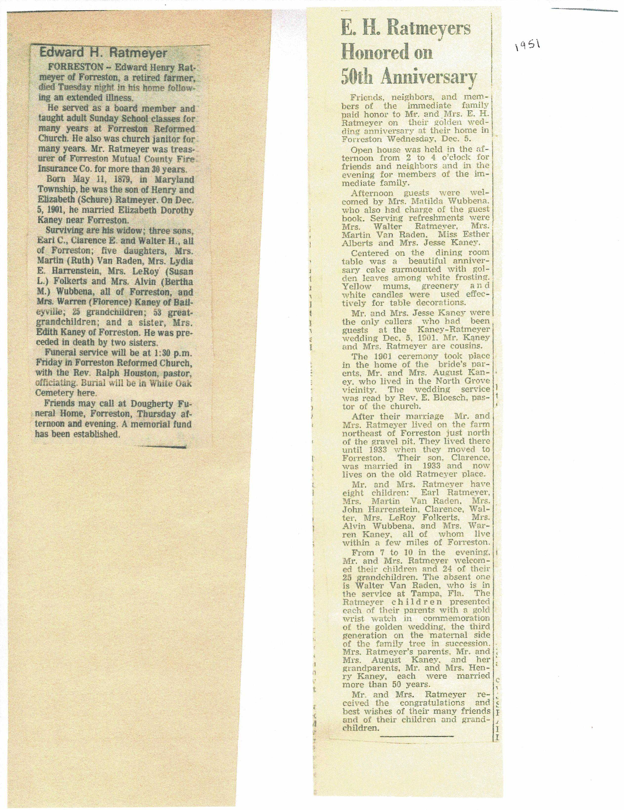
Edward Ratmeyer
1879-1972

Slide 25
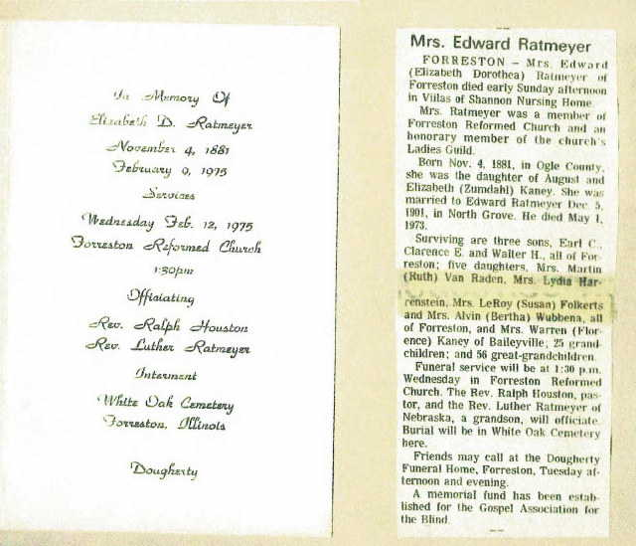
Elizabeth (Kaney) Ratmeyer
1881-1975

Slide 26
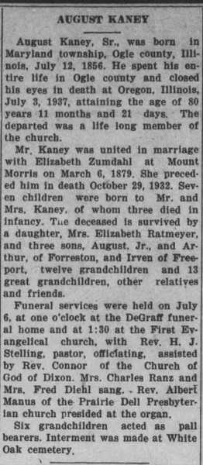
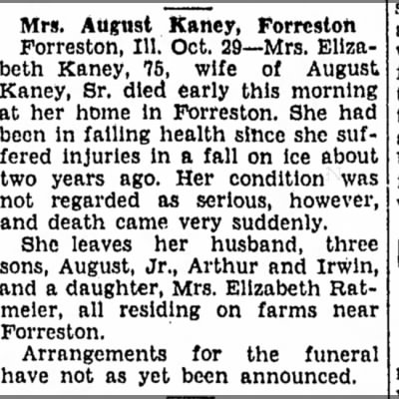
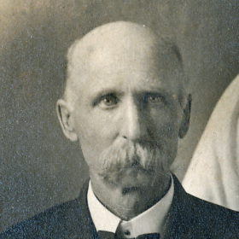
August Kaney 1856-1937
Elizabeth Kaney 1857-1932
(parents of Elizabeth Ratmeyer)

Slide 27
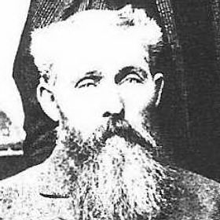

Left: Heinrich (Henry) Ratmeyer 1844–1921
Father of Edward Ratmeyer
Right: Heinrich Kohne (Henry Kaney) 1817-1899
Father of August Kaney

