Slide 1
VanRaden Family Vacations 1999-2017
Cheryl, Paul, Charlee, Angel, etc.
For more slides see http://www.paulvanraden.com/InteractingWithFamily.htm

Slide 2
Miami to Rome
Trans-Atlantic Cruise
April 1999
Cheryl, Paul, and Angel VanRaden
To:
Bahamas, Dominican Republic, Virgin Islands, Guadeloupe,
5 days east, then
Casablanca, Barcelona, Genoa, Rome

Slide 3
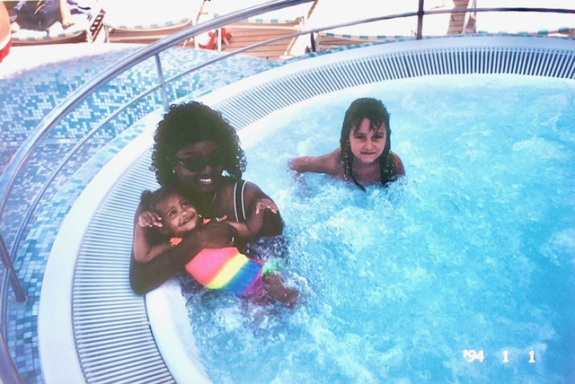
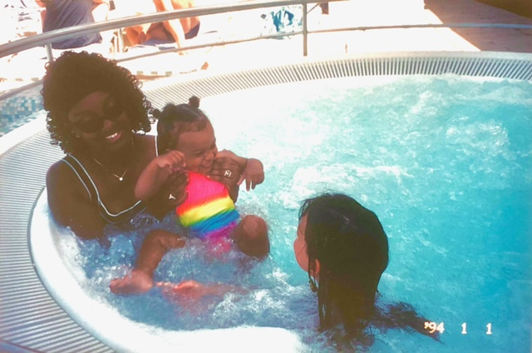
Swimming across the Atlantic

Slide 4
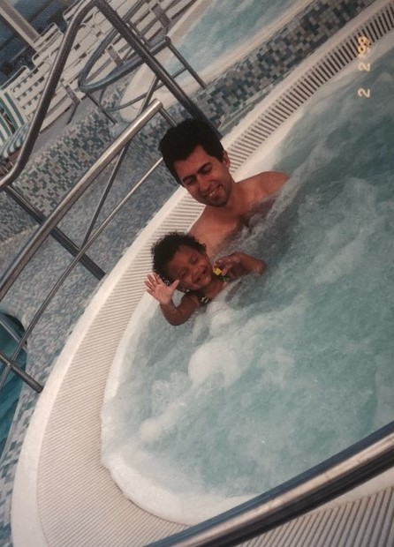
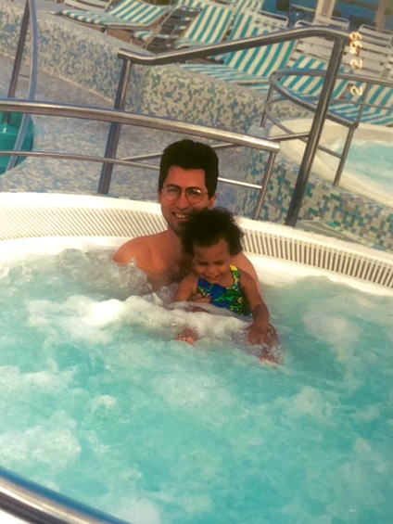
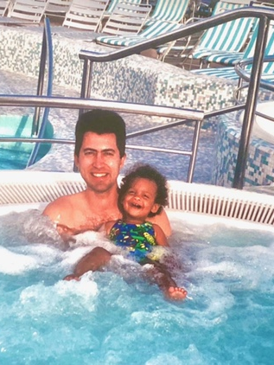
Swimming across the Atlantic

Slide 5
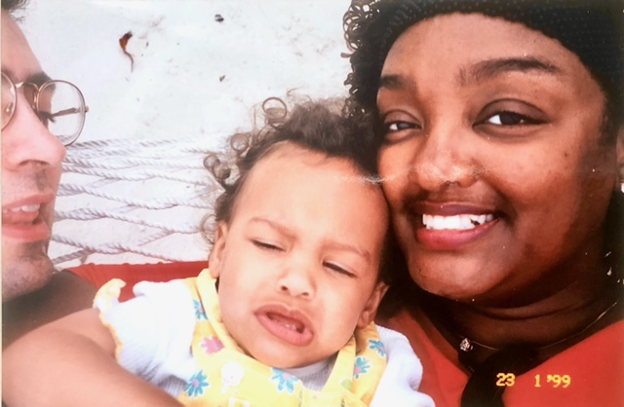
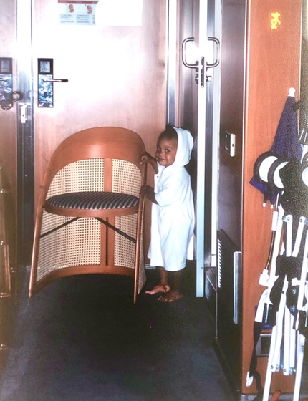
Time for a nap in the cabin. After the nap

Slide 6
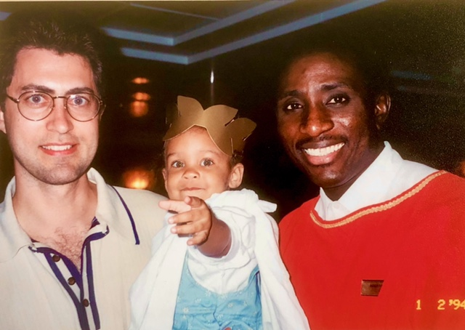
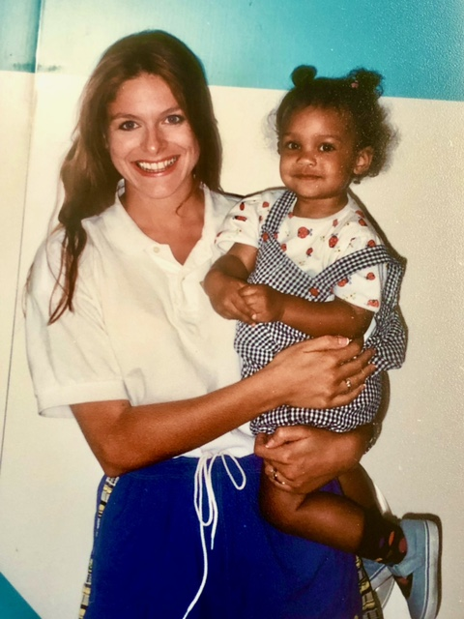
Angel posing with the crew

Slide 7
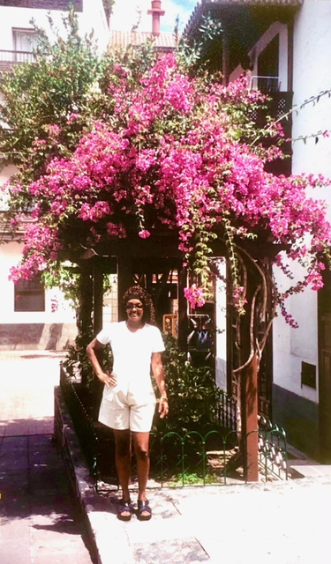
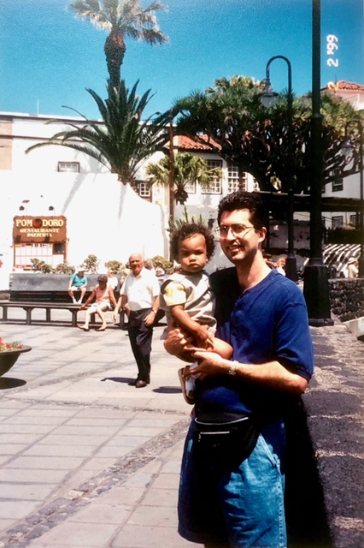
Canary Islands

Slide 8
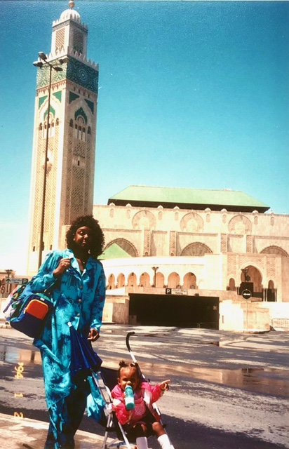
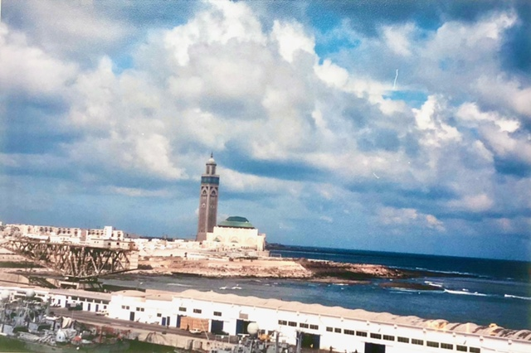
Strolling thru Casablanca

Slide 9
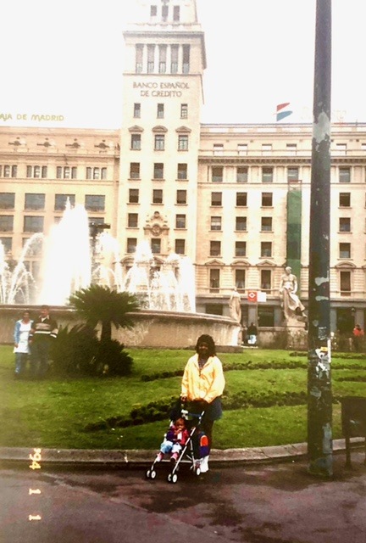
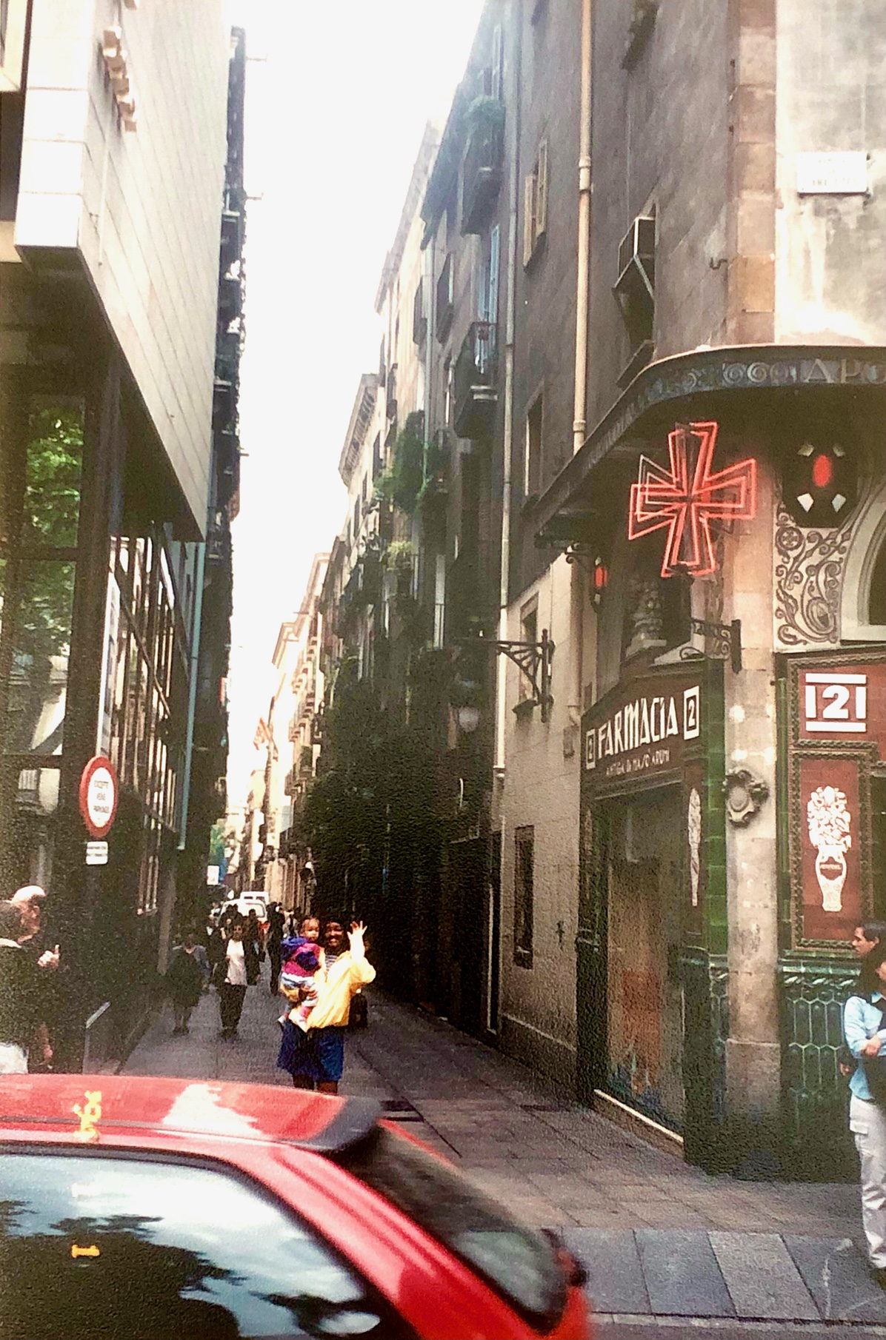
Barcelona

Slide 10
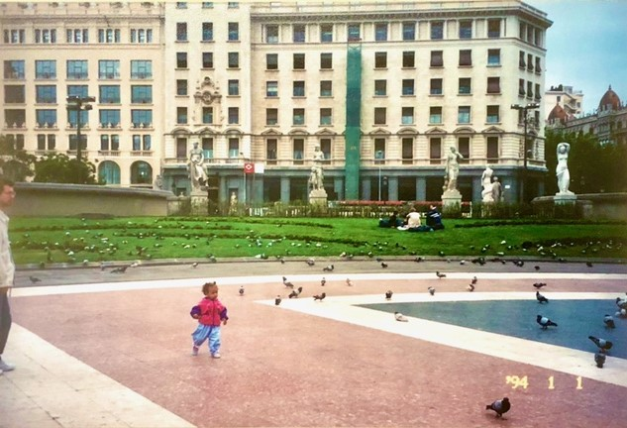
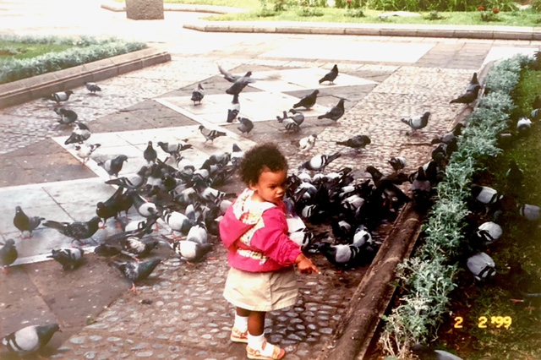
Chasing pigeons in Barcelona

Slide 11
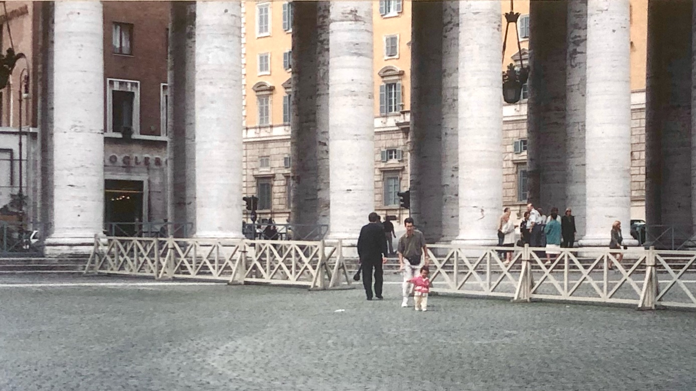
Trying to find the Pope

Slide 12
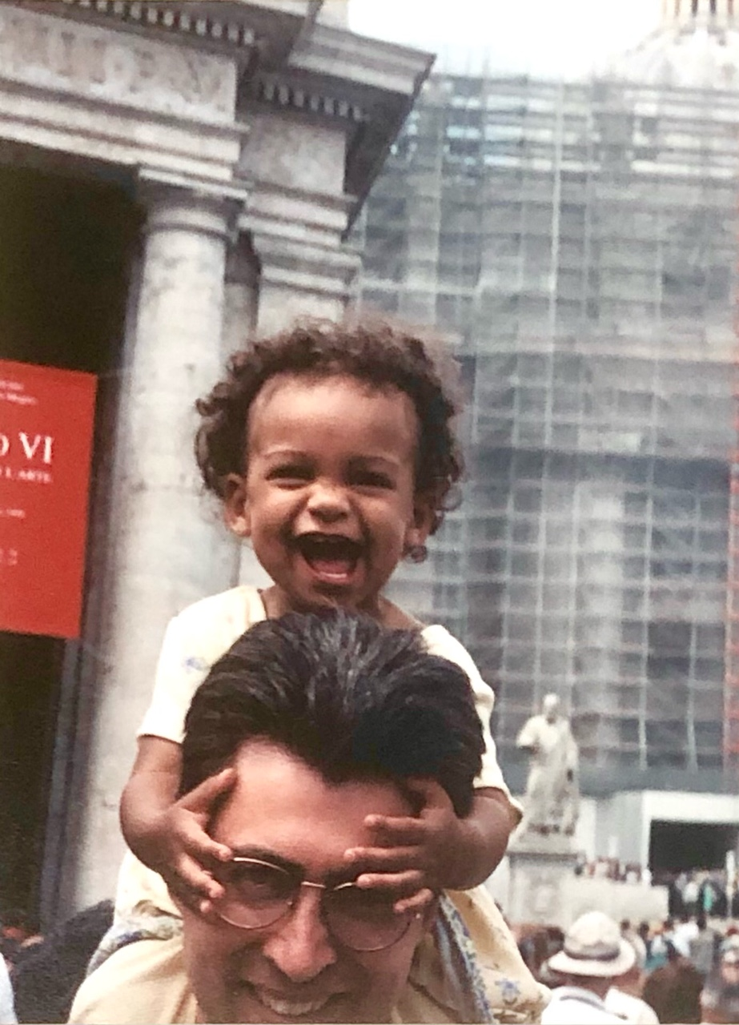
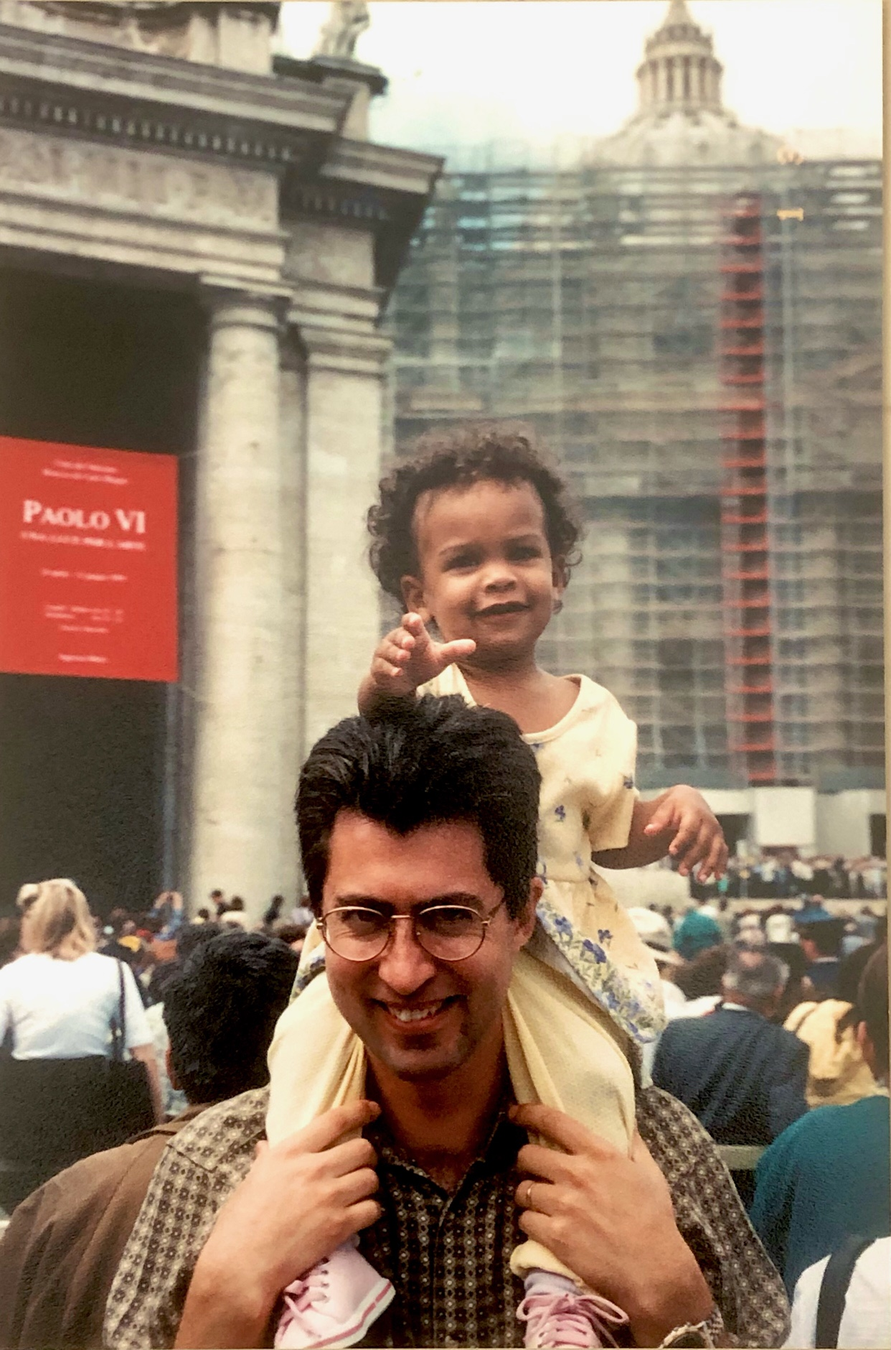
Not afraid of the Pope

Slide 13
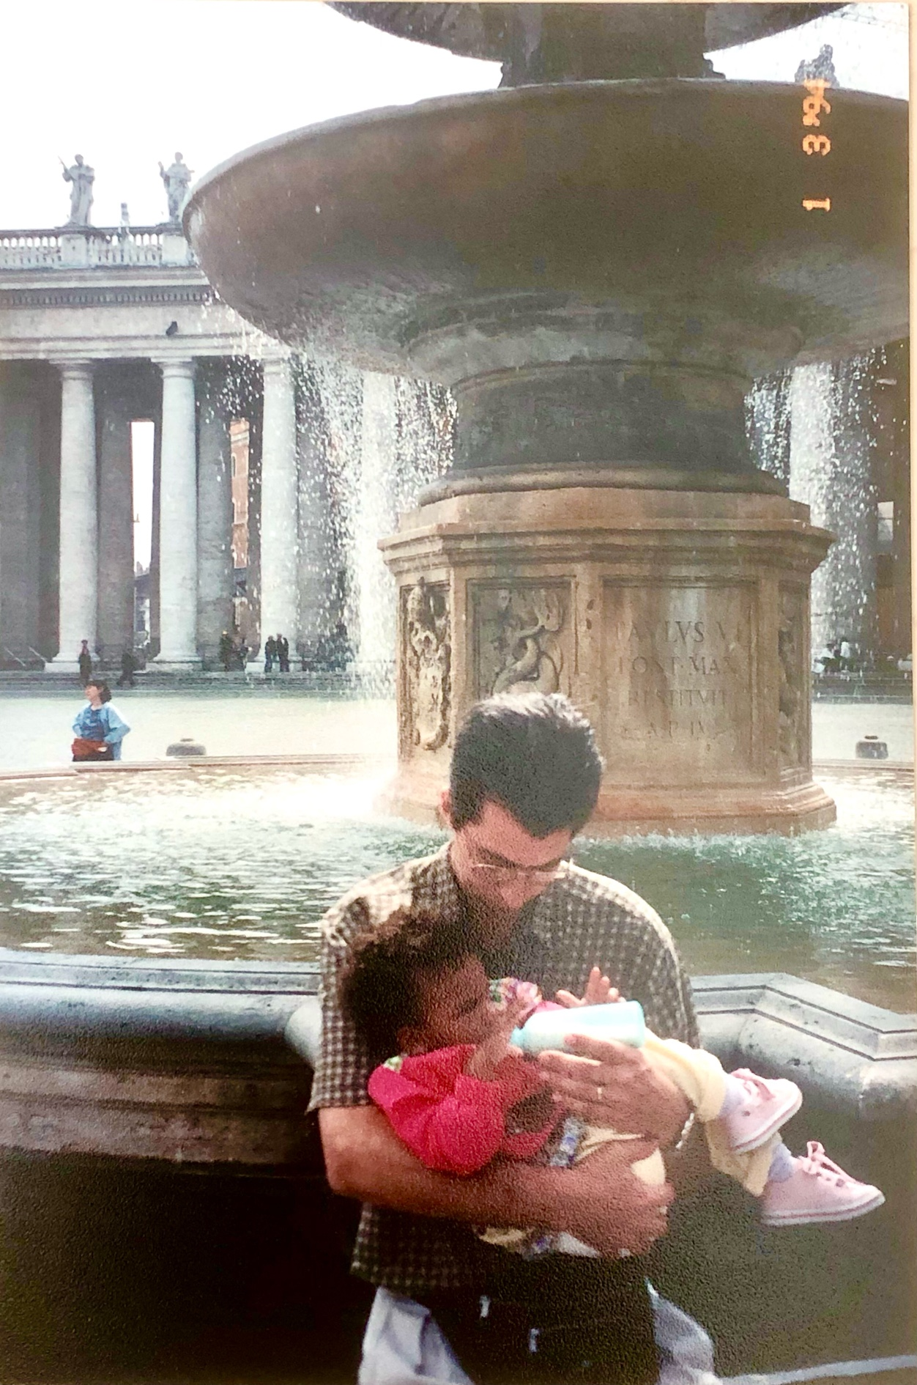
Stopping for one last drink of American milk in Rome.
Then flying back home to Maryland.
April 1999

Slide 14
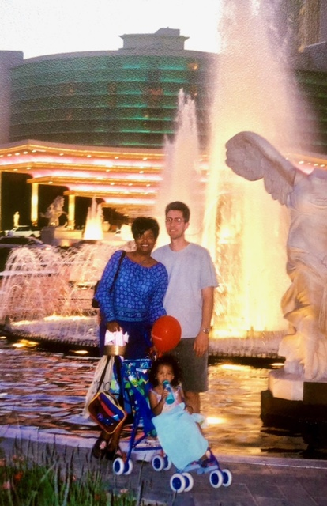
Las Vegas
May 2000

Slide 15
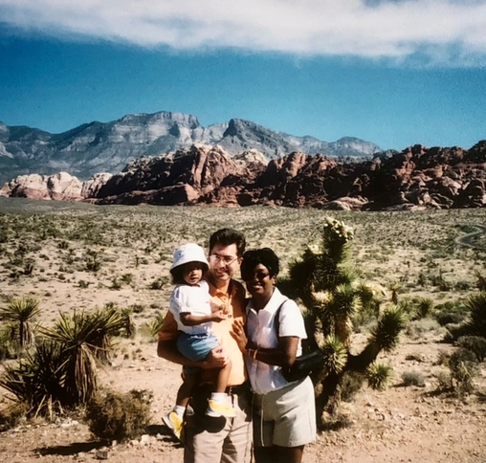
Las Vegas desert
2000

Slide 16
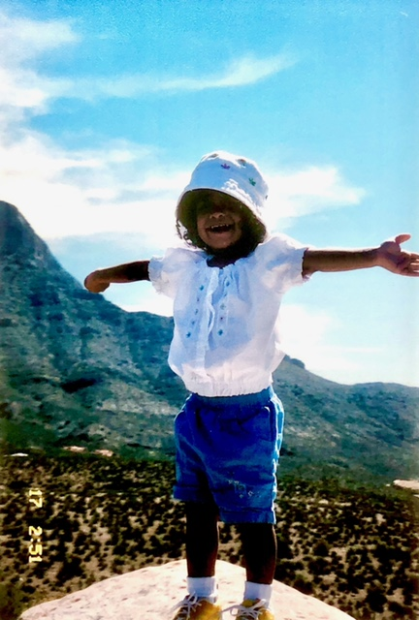
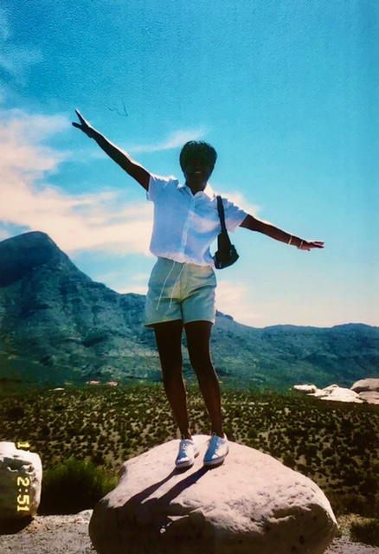
Mommy:
This desert is FUN !!!

Slide 17
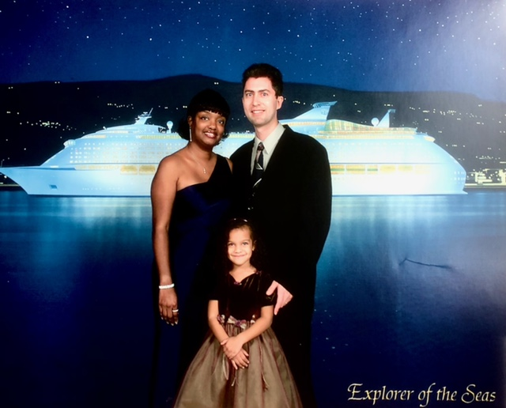
Cruise to:
Haiti
Bahamas
Puerto Rico
St Thomas
Feb 2002

Slide 18
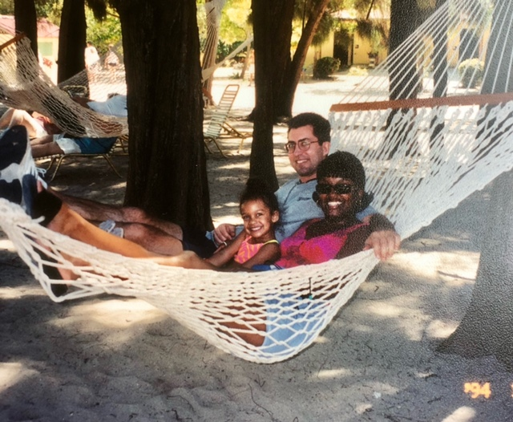
Hanging out in Haiti
(Labadee)

Slide 19
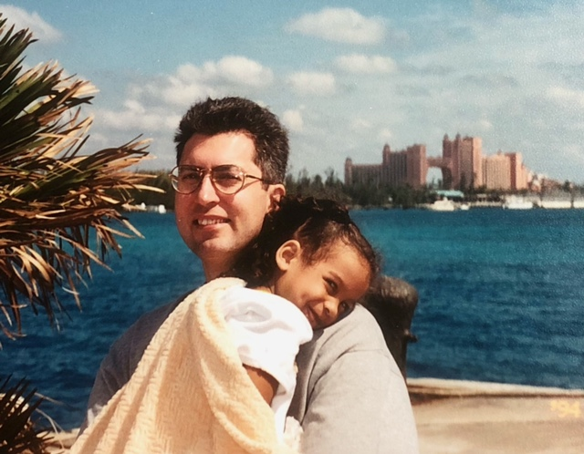
Bahama was Grand

Slide 20
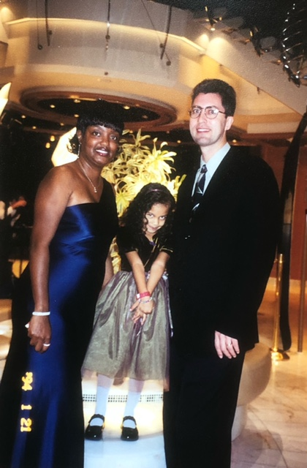
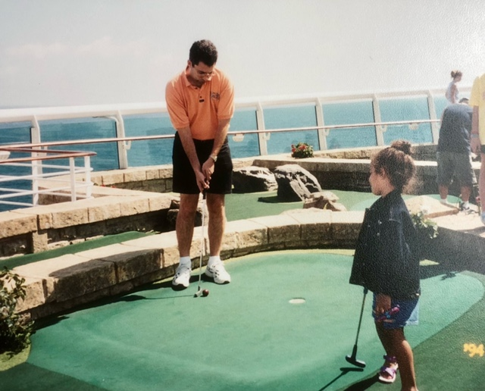
Some golf, then dinner

Slide 21
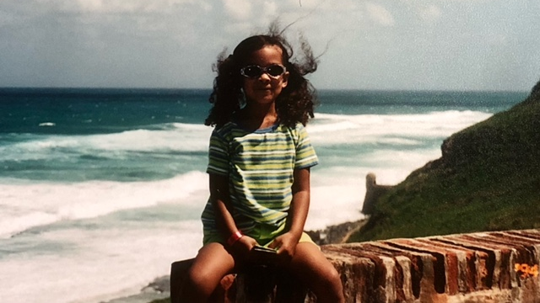
Puerto Rico 2002

Slide 22
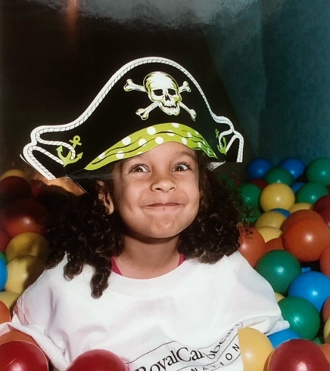
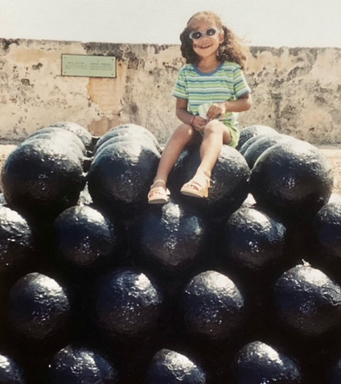
Beware of Pirates
2002

Slide 23
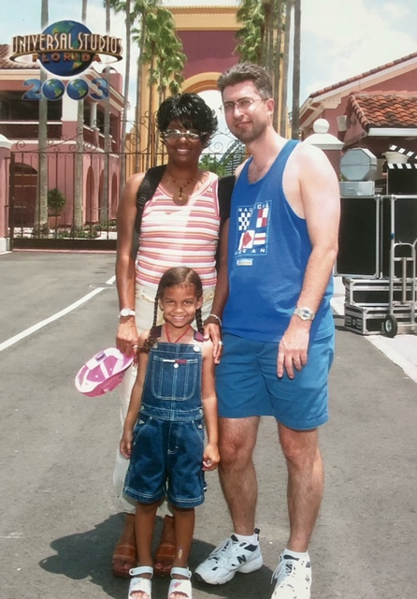
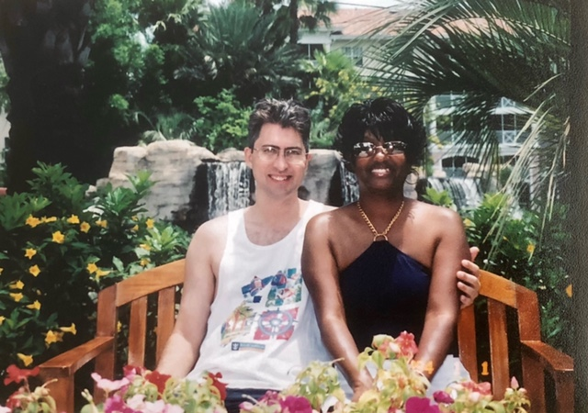
Orlando, FL, May 2003

Slide 24
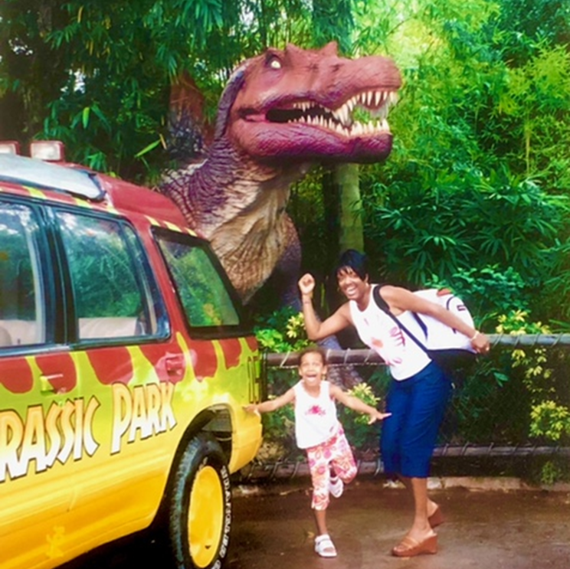
RUN!!!

Slide 25
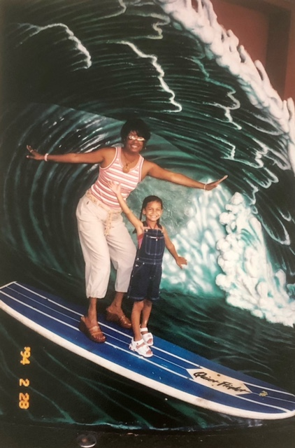
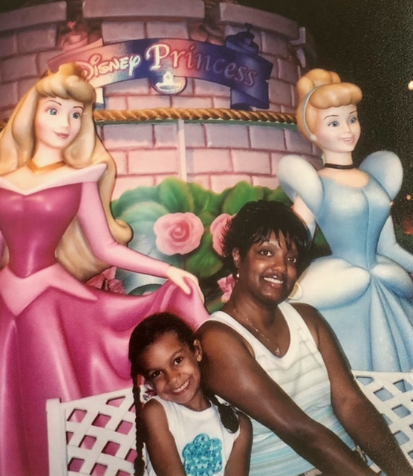
Waves and
Dolls

Slide 26
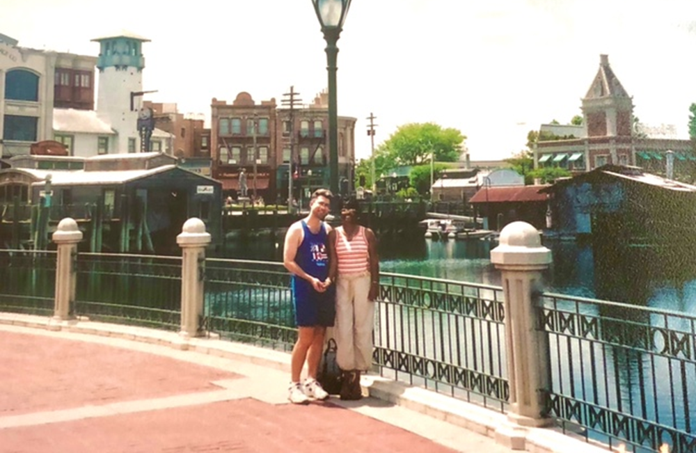
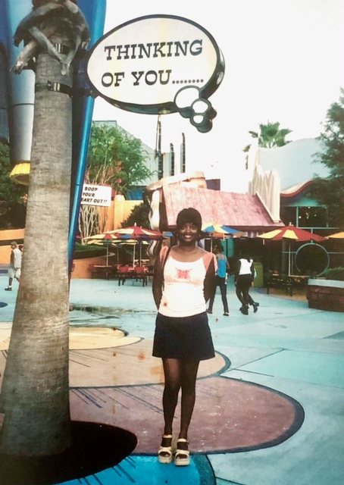

Slide 27
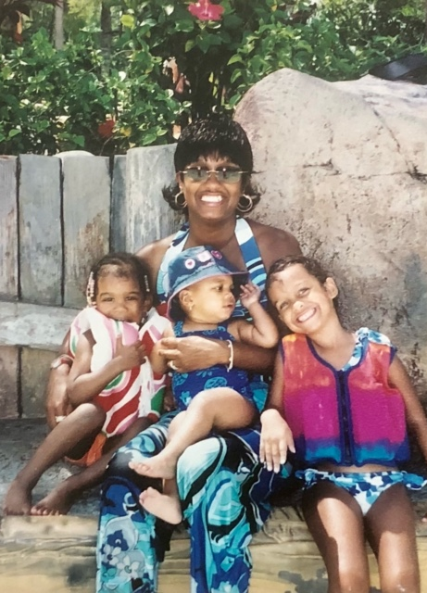
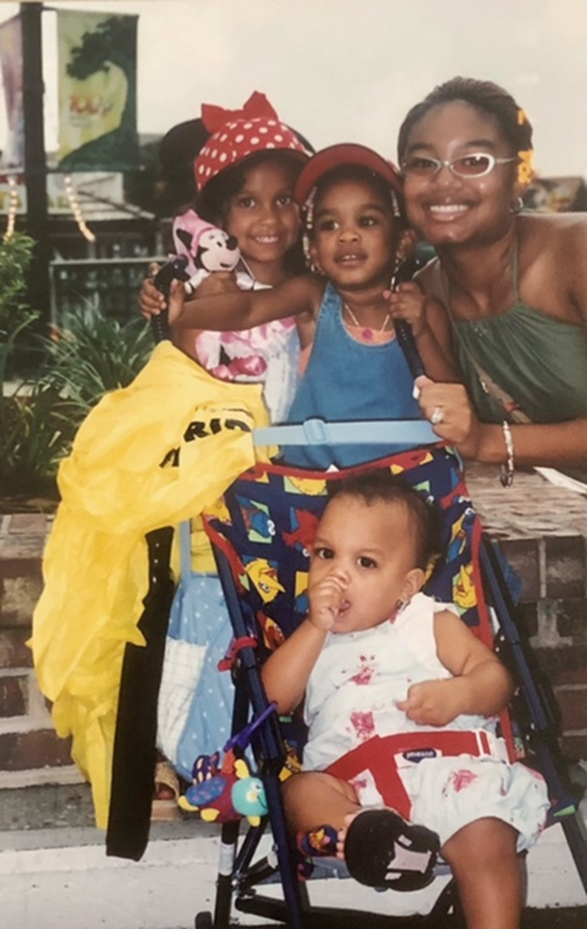
Orlando, FL
June 2005

Slide 28
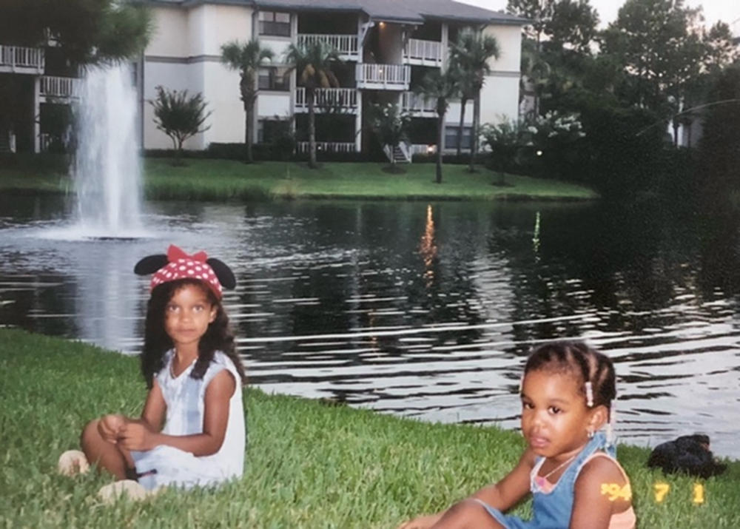
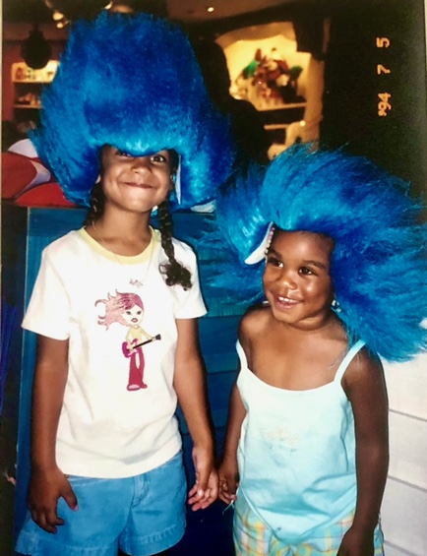
Angel and Elexys

Slide 29
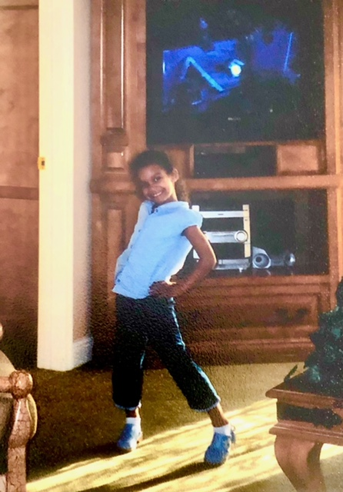
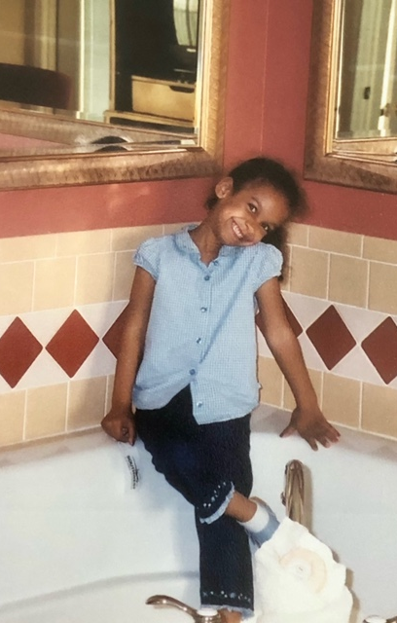
Practicing poses,
2005

Slide 30
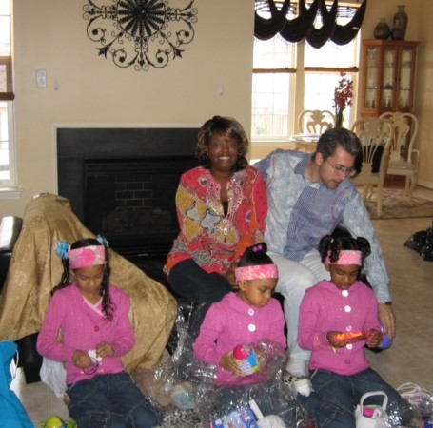
Easter 2007

Slide 31
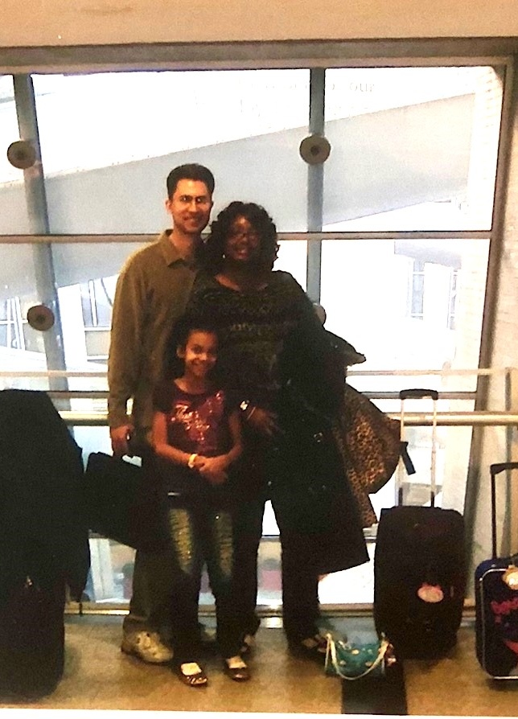
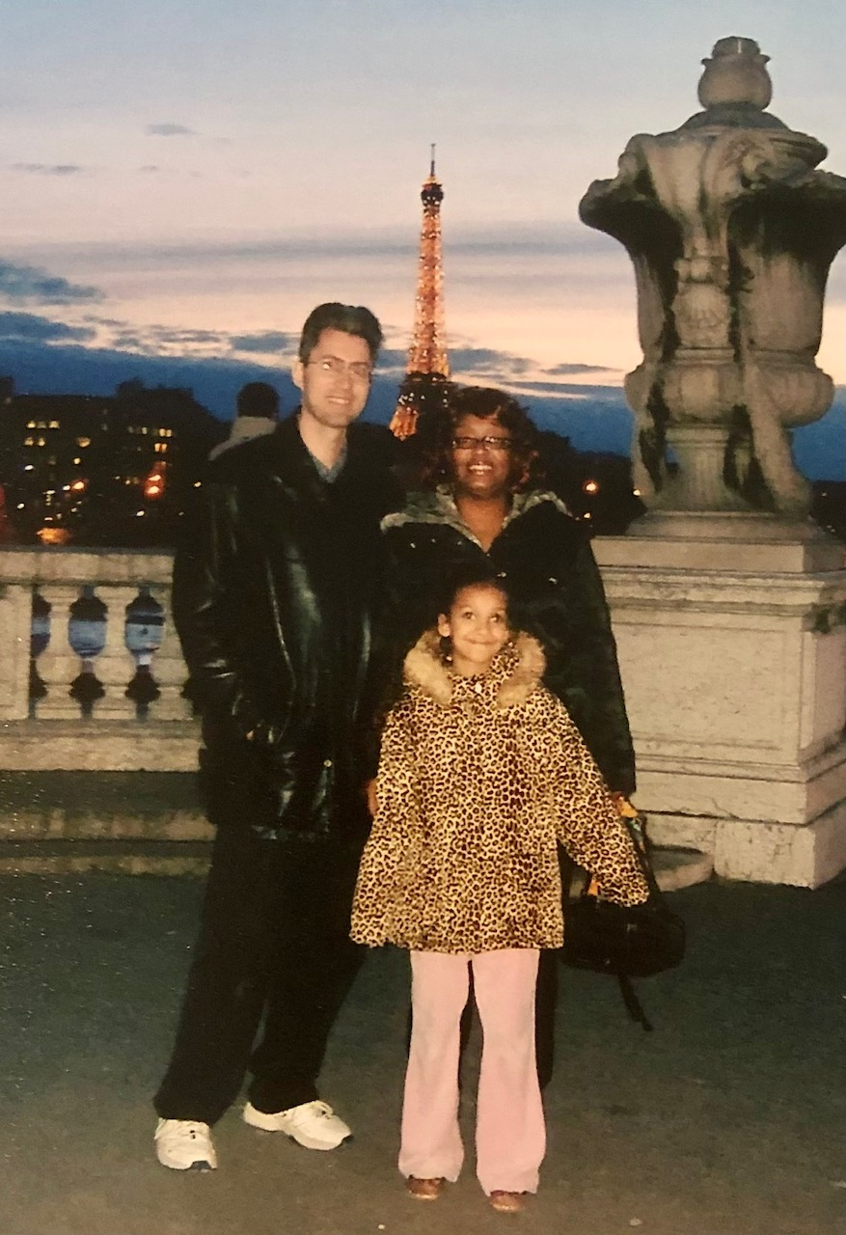
Paris
Dec 2008

Slide 32
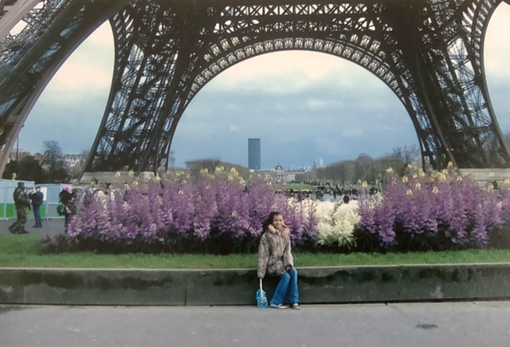

Eiffel’s tower, with flowers

Slide 33


Disneyland
Paris

Slide 34


Disneyland Paris

Slide 35


Puerto Rico, St. Thomas, Dominican Republic, Haiti
Nov 2010

Slide 36


Enjoying the ride, 2010

Slide 37

Bahamas
2011

Slide 38


Disney 2017

Slide 39
The End
For later, earlier, or other related pictures and stories see: http://www.paulvanraden.com/InteractingWithFamily.htm

Slide 40

The End.
See Big Honeymoon for 1995 vacation http://www.paulvanraden.com/Big%20Honeymoon.pptx

