Slide 1
David VanRaden
1962-1992

Slide 2
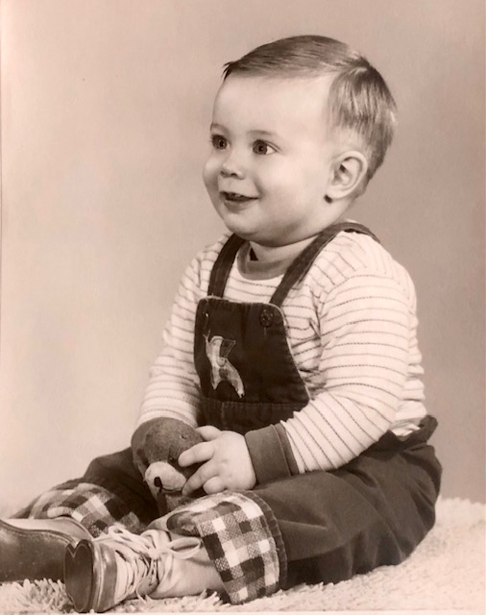
1962 birthday poem from Mom
(family planning)
We’re as proud
as we can be,
With number six
of our family;
Since we don’t plan
for any more,
We’re glad this guy
has evened the score!!
(3 girls and 3 boys)

Slide 3
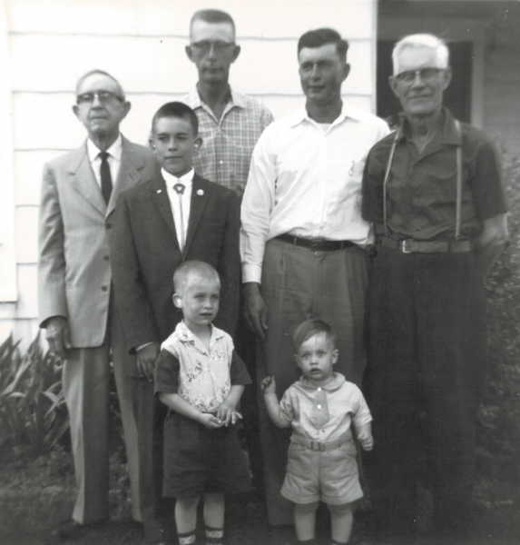
Easter, 1963
Back Row: Ed Ratmeyer, Martin Van Raden ,Walter Van Raden, Clarence Ellis Children in Front Row: Mark, Paul & David Van Raden

Slide 4
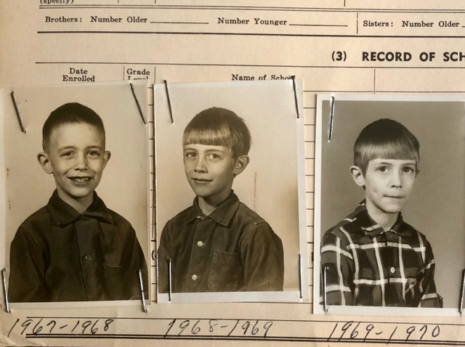
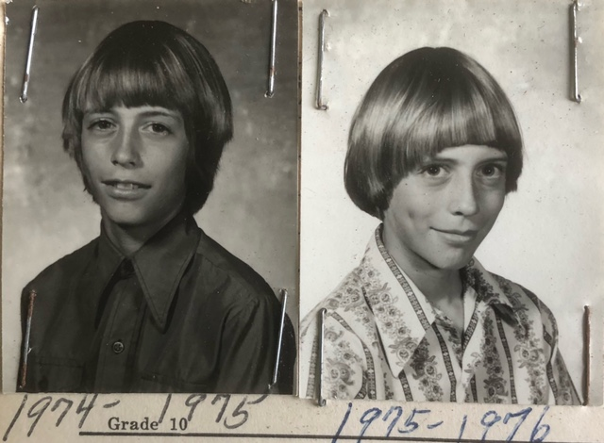
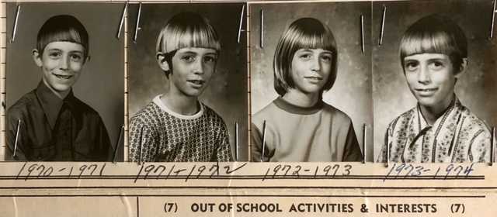
Grade school photos Forreston, IL

Slide 5
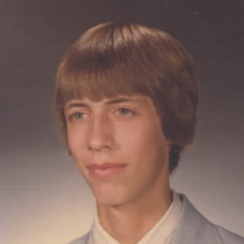
High school senior, 1980

Slide 6
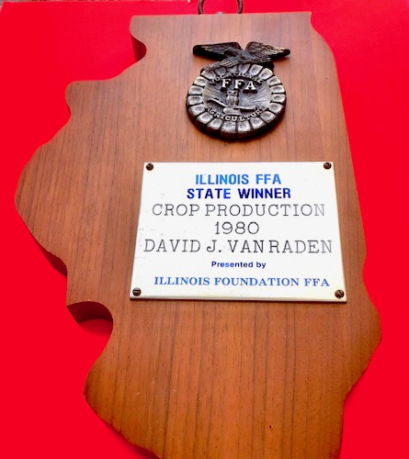
1980
Illinois FFA
State Winner
Crop Production

Slide 7
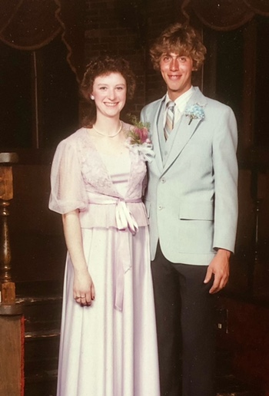
Prom 1980

Slide 8
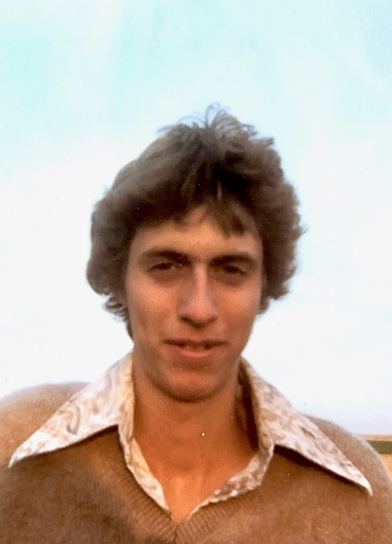
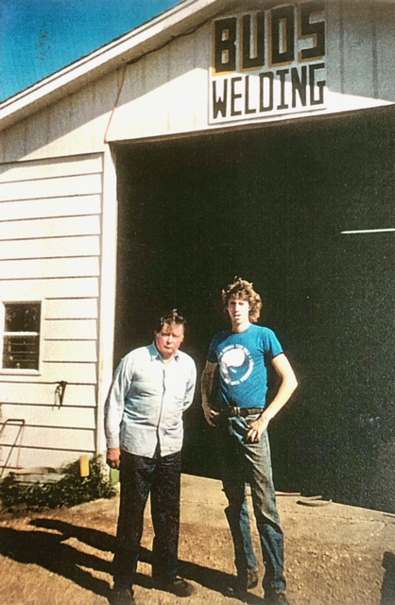
Helping Bud weld

Slide 9
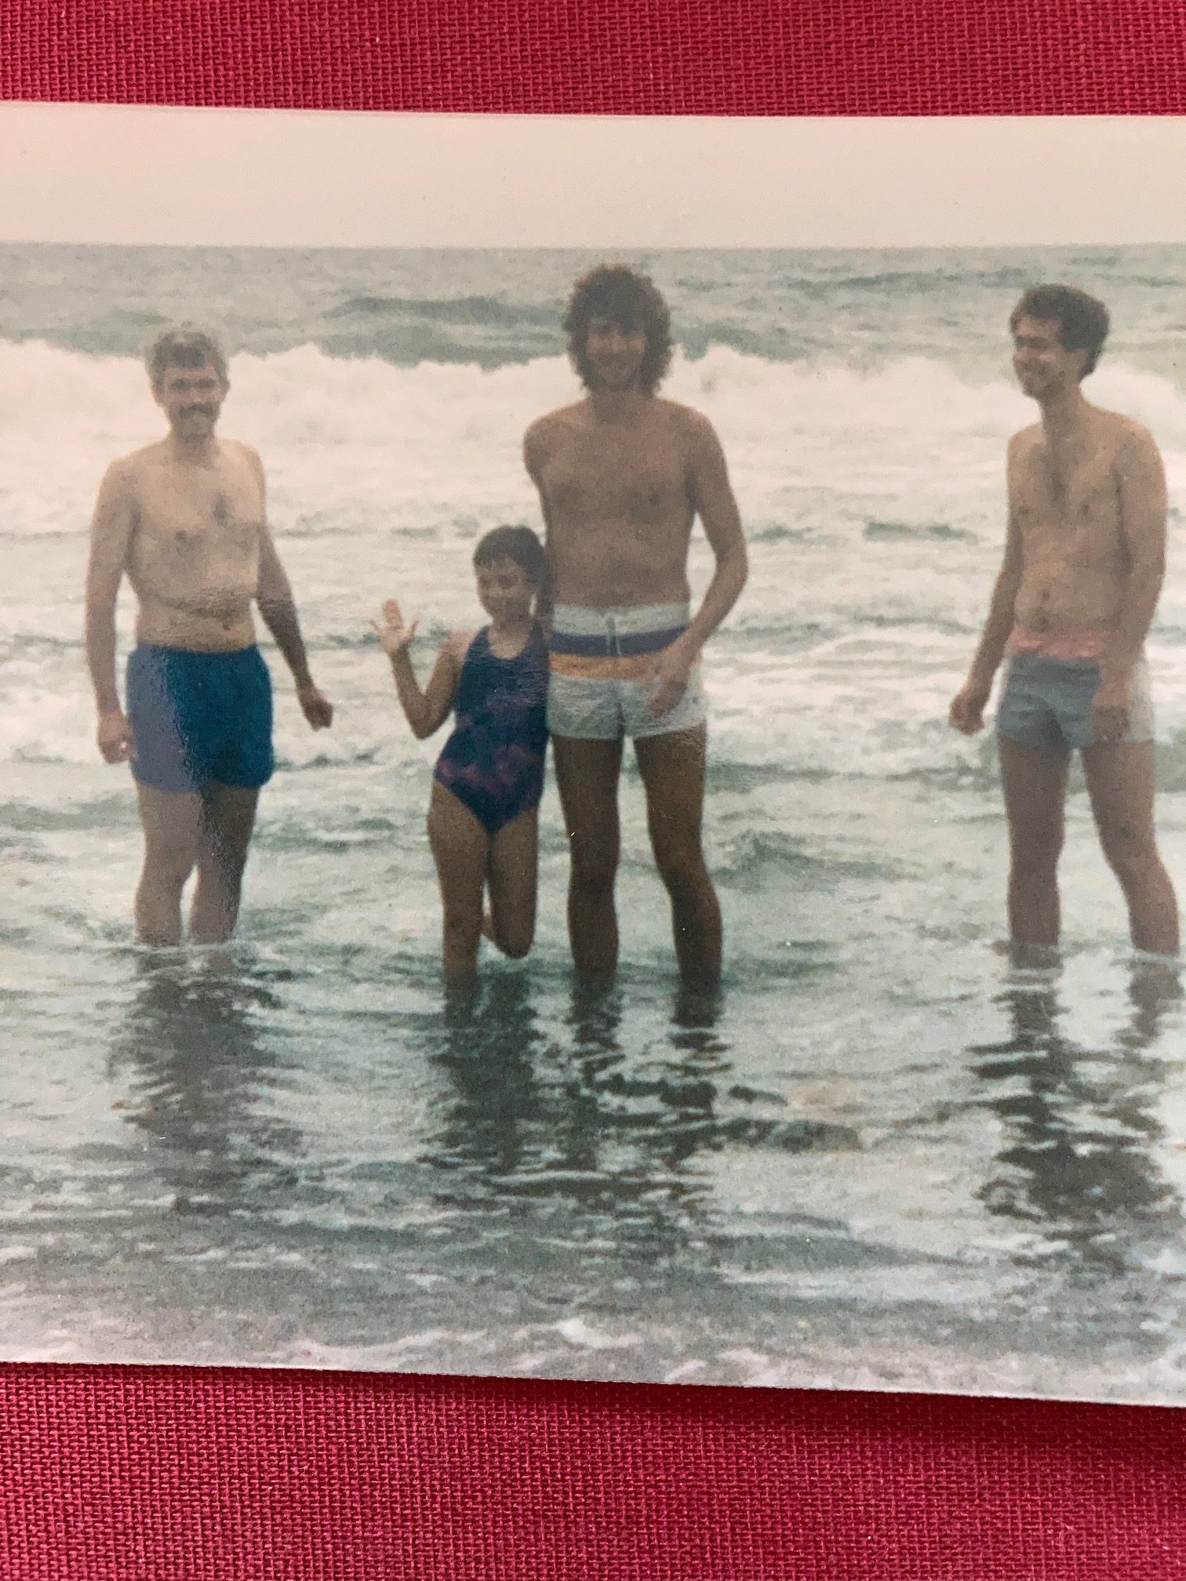
Mark,
Gwynneth,
Dave, and
Paul on beach at
Chincoteague, VA
1990

Slide 10
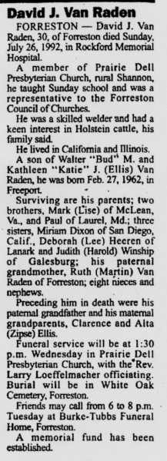
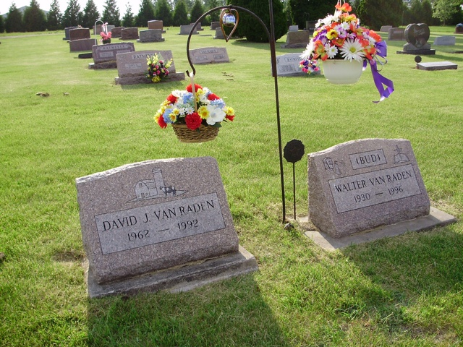
David VanRaden
1962-1992

Slide 11
Farewell letter and Paul’s reply http://www.paulvanraden.com/David_VanRaden_farewell_letter.pdf
Brother Dave
By Paul VanRaden
August 16, 1992
Dear Dave:
I’m replying too late
to what you wrote but didn’t date.
You’ve concluded your time
to read my reason and rhyme.
You found less joy than pain
in your bright but broken brain.
When it failed, you deep-sixed
what you felt you couldn’t fix.
Me and my parts still go.
If I break, then send a tow.
(If I brake, then send a toe.)
Sorry Dave, I can’t rescue
or even send my poem to you.
I will honor your name
just doing more of the same
and telling truths so clear
you’d slightly smile if you were here.
With love, Paul

