Slide 1
Clarence Ellis and Alta Zipse
1886-1979
And their ancestors

Slide 2
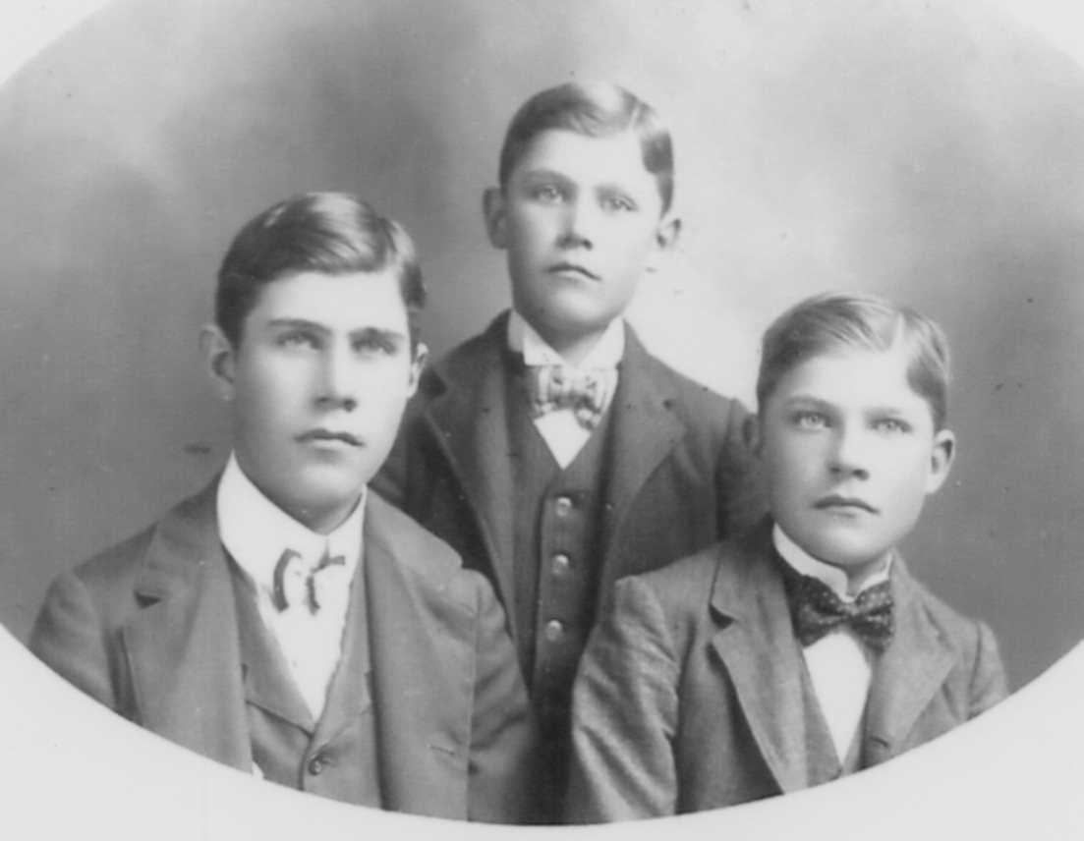
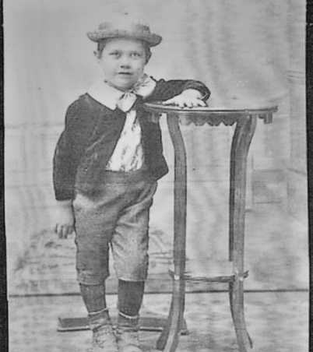
Clarence, Theodore A., and Edgar Ellis, 1898
Clarence Ellis ~1890

Slide 3
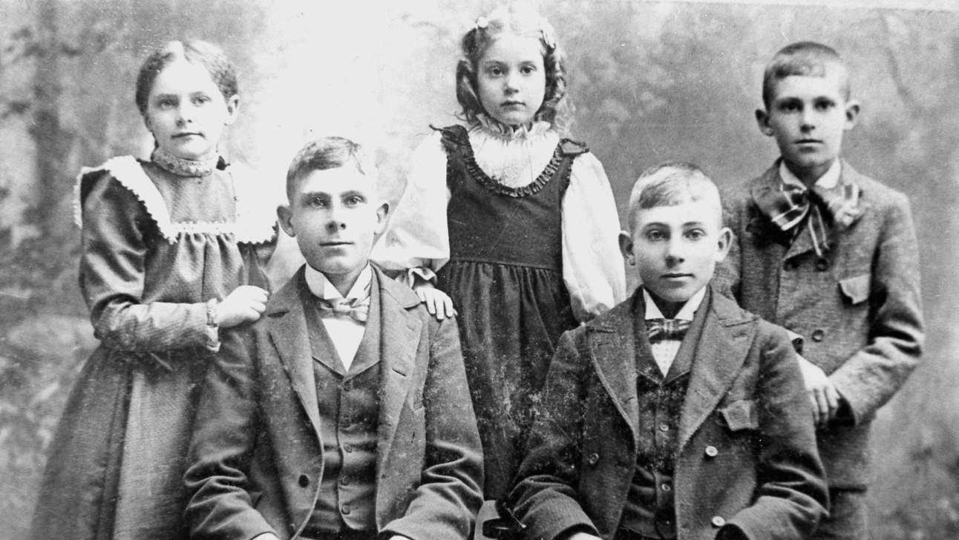
Left to Right: Alta Zipse with sibs Marshall, Grace, Ben, Wesley - 1898

Slide 4
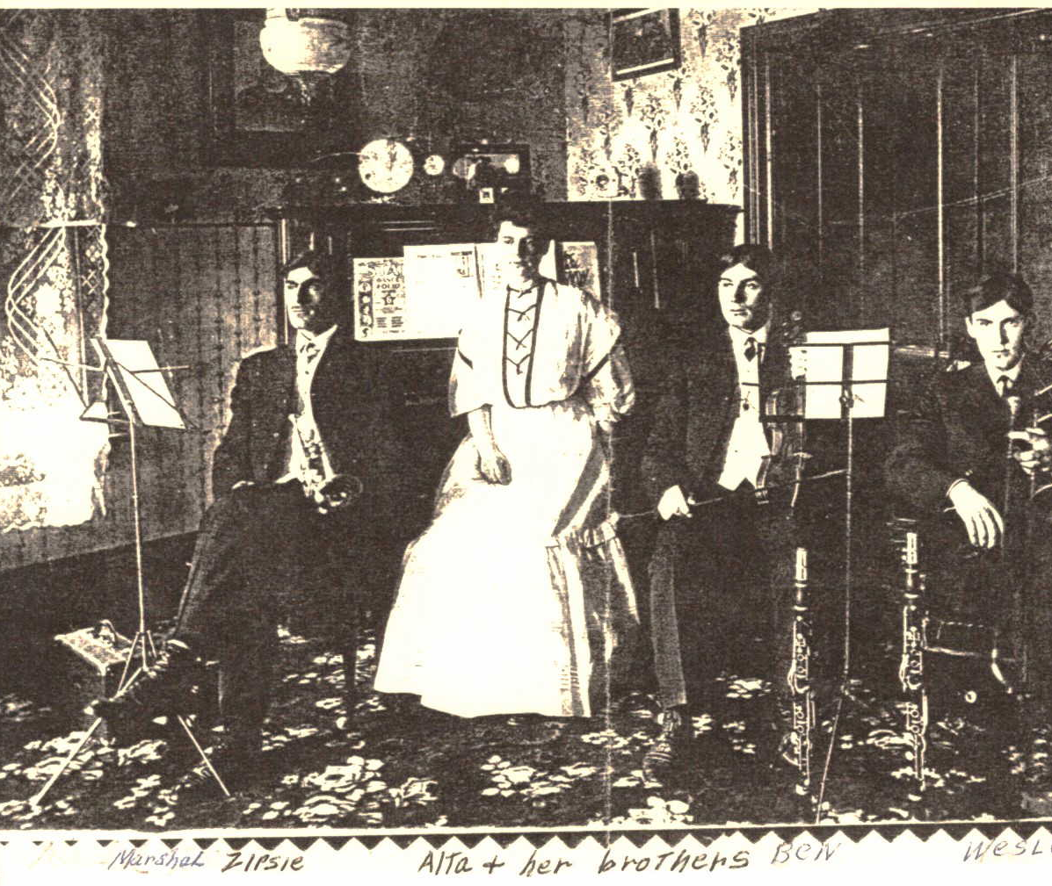
Zipse sibling band, ~1910
Marshall, Alta, Ben, Wesley

Slide 5
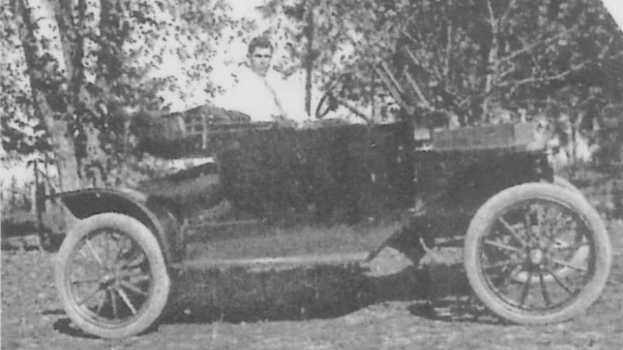
1913 Clarence in his first car: a Model T Ford

Slide 6
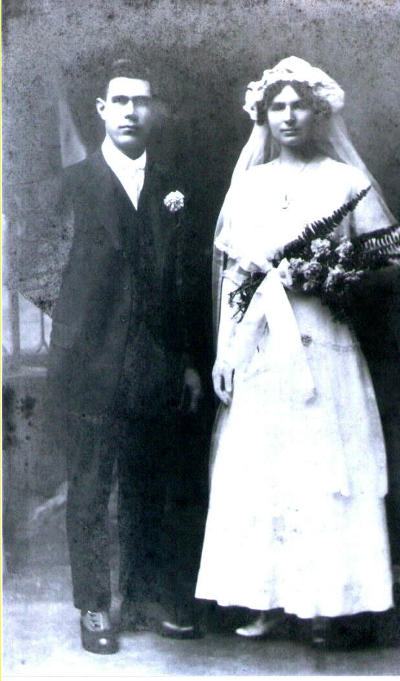
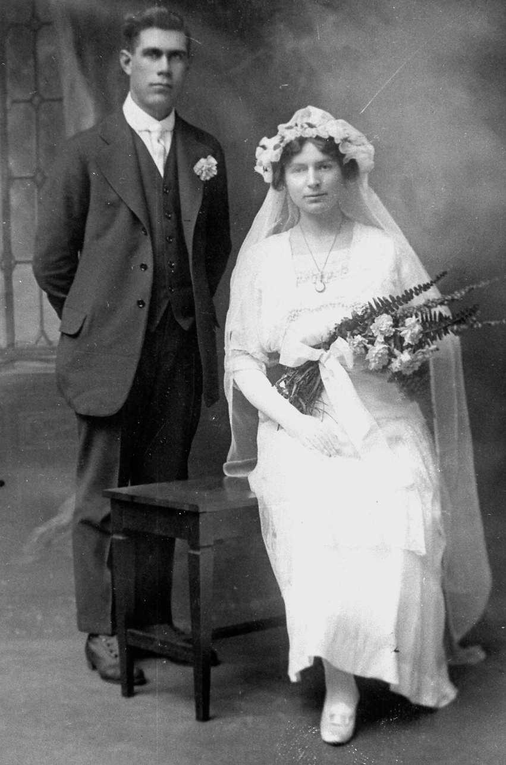
1915
Clarence Ellis and Alta Zipse wedding

Slide 7
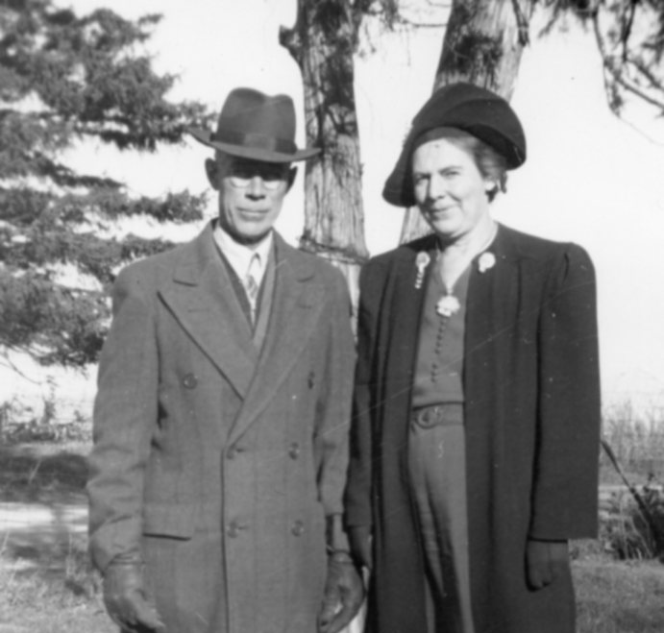
1933
Clarence and Alta Ellis

Slide 8
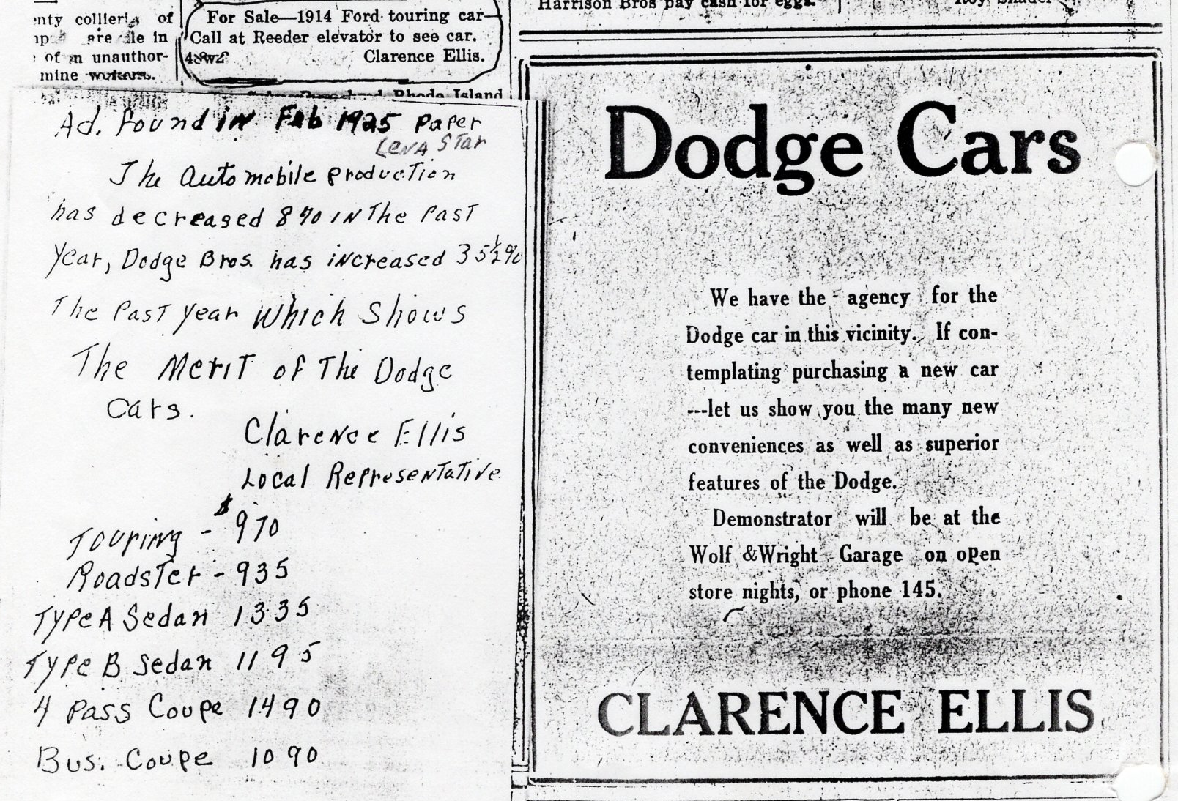
1925 Clarence sold Dodge cars (ad in Lena Star paper)

Slide 9
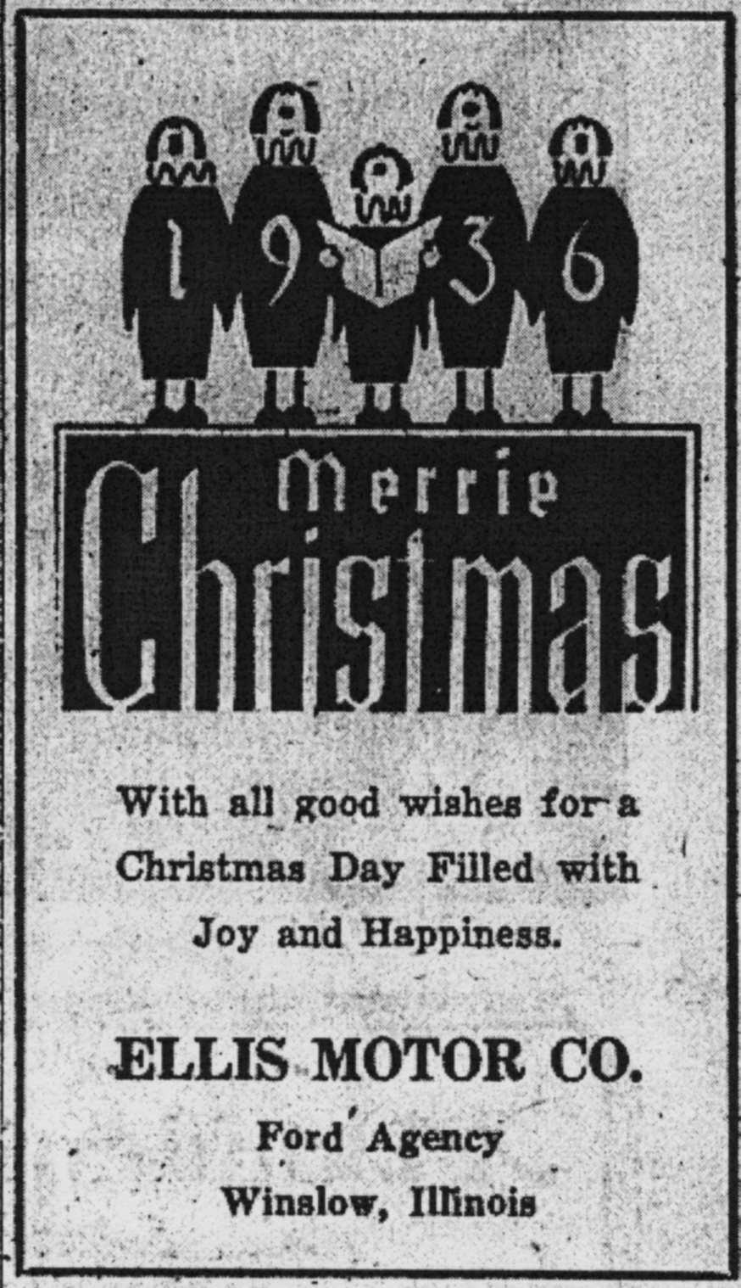
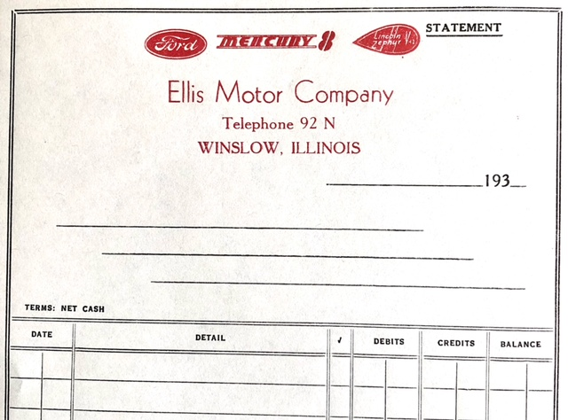
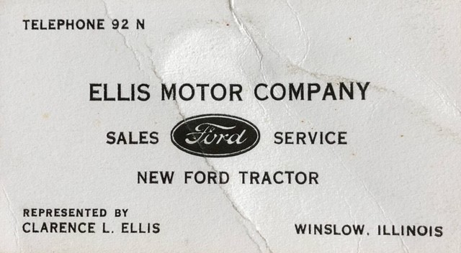
1936
Clarence sold Ford cars and tractors

Slide 10
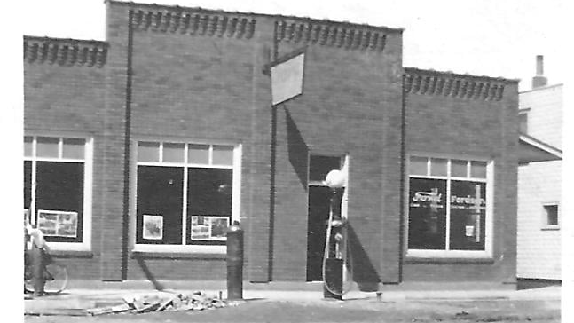
Kennedy / Ellis Ford Dealership, Winslow, IL

Slide 11
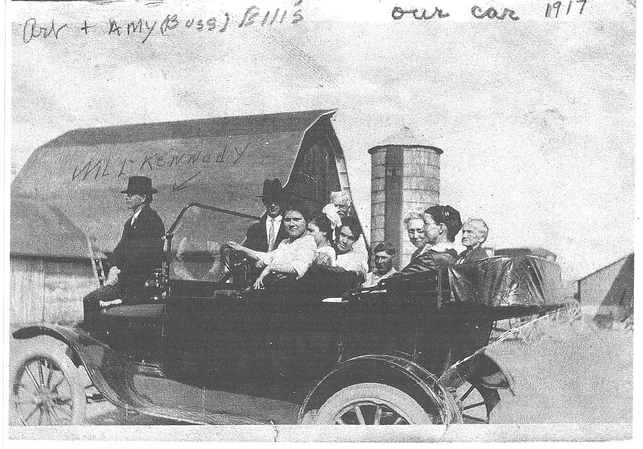
1917
Back seat, far right:
Nettie (Lincoln) Ellis and Loduskey (Kennedy) Lincoln
Mother and grandmother of Clarence Ellis

Slide 12
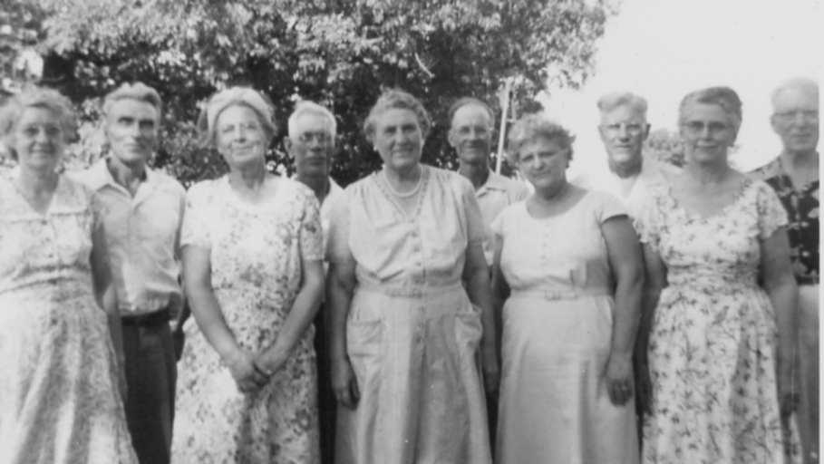
1955 Zipse siblings and spouses: Edith (Sweeney) Zipsie, Floyd Zipsie, Alta Mae (Zipse) Ellis, Clarence Ellis, Grace (Zipse) Stewart, Homer Stewart, Mildred (Dysslin) Zipsie, Wesley Zipsie, Edith (Lied) Zipse, Benjamin Zipse

Slide 13
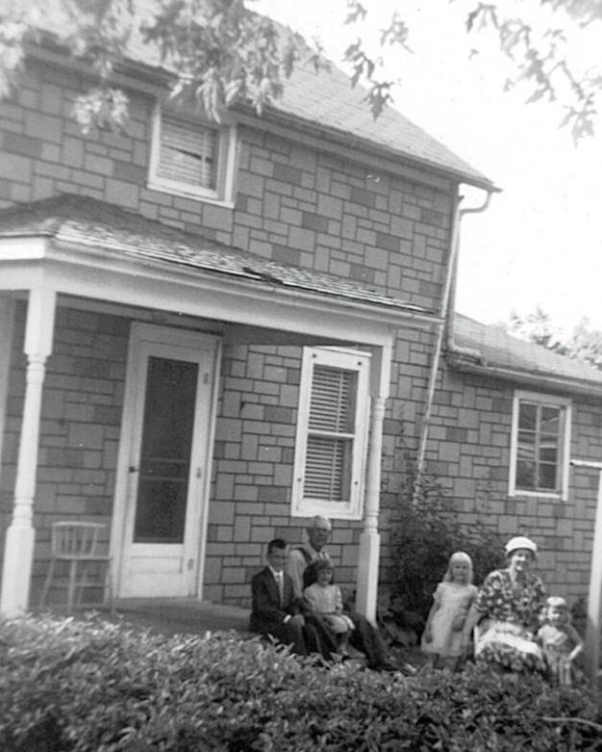
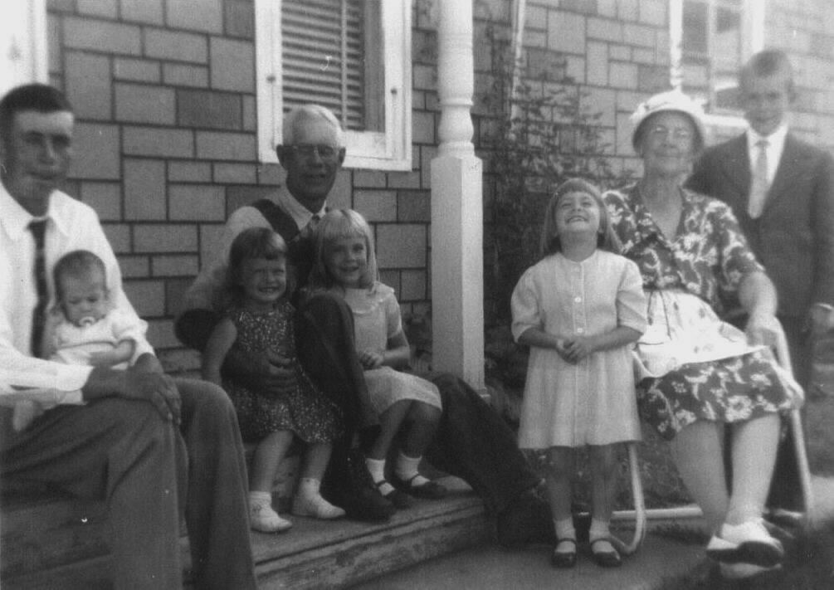
1960
Walter VanRaden & kids with Clarence & Alta Ellis, Haldane, IL

Slide 14
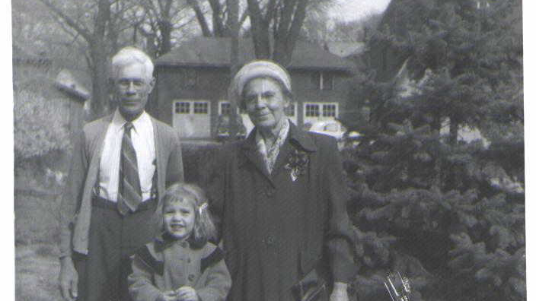
Clarence and Alta Ellis

Slide 15
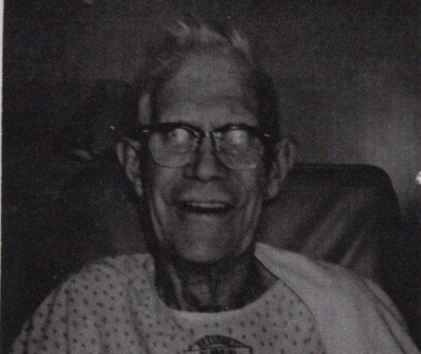
Clarence’s
92nd birthday, 1978

Slide 16
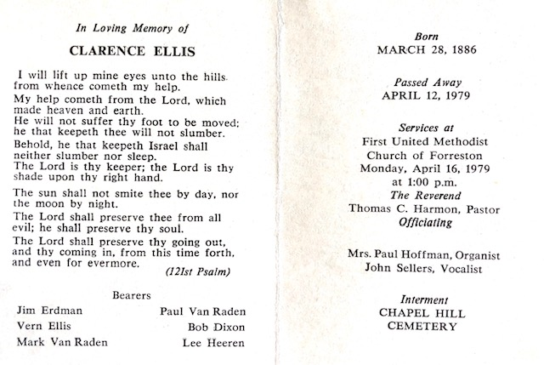
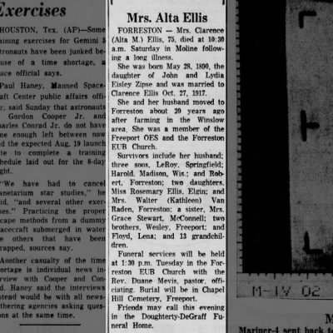
Clarence Ellis 1886-1979, Alta Ellis 1890-1965

Slide 17
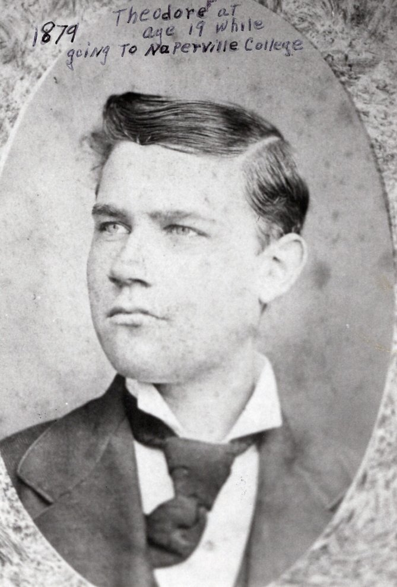
Theodore F. Ellis (father of Clarence)
1879, age 19
Naperville College

Slide 18
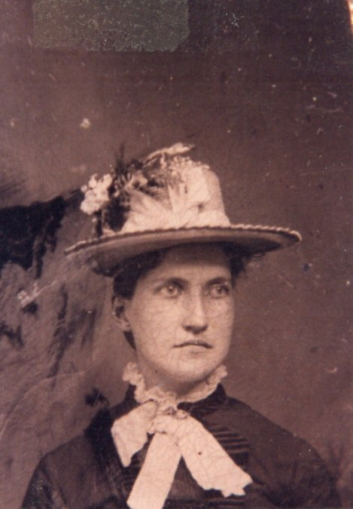
Nettie May Lincoln
(mother of Clarence Ellis) ~1880

Slide 19
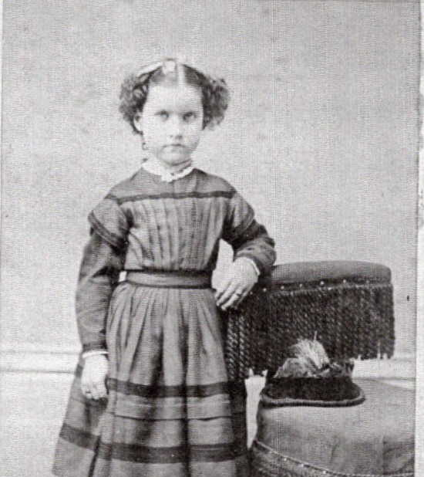
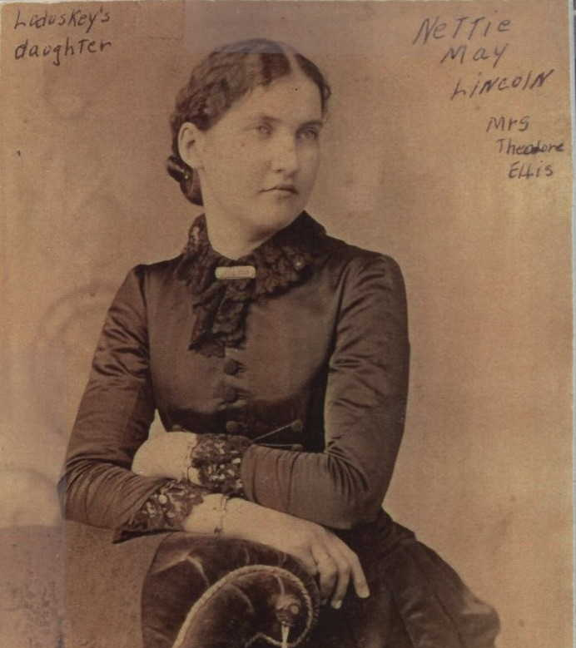
Nettie May Lincoln

Slide 20
Poem from Theodore Ellis to Nettie Lincoln
Miss Lincoln,
Say not welcome when I come,
Nor farewell tell me when I go,
For I come not when I come,
And I go not when I go.
I am always, ever with you,
Always will be as I pray,
I would never welcome give you,
And farewell would never say.
Home's not merely roof and room
It needs something to endear it
Home is where the heart can bloom
Where there's some kind voice to cheer it
What is home with none to meet us,
None to welcome, none to greet us?
Home is sweet, and only sweet
Where there's one we love to meet us.
Theodore F. Ellis

Slide 21
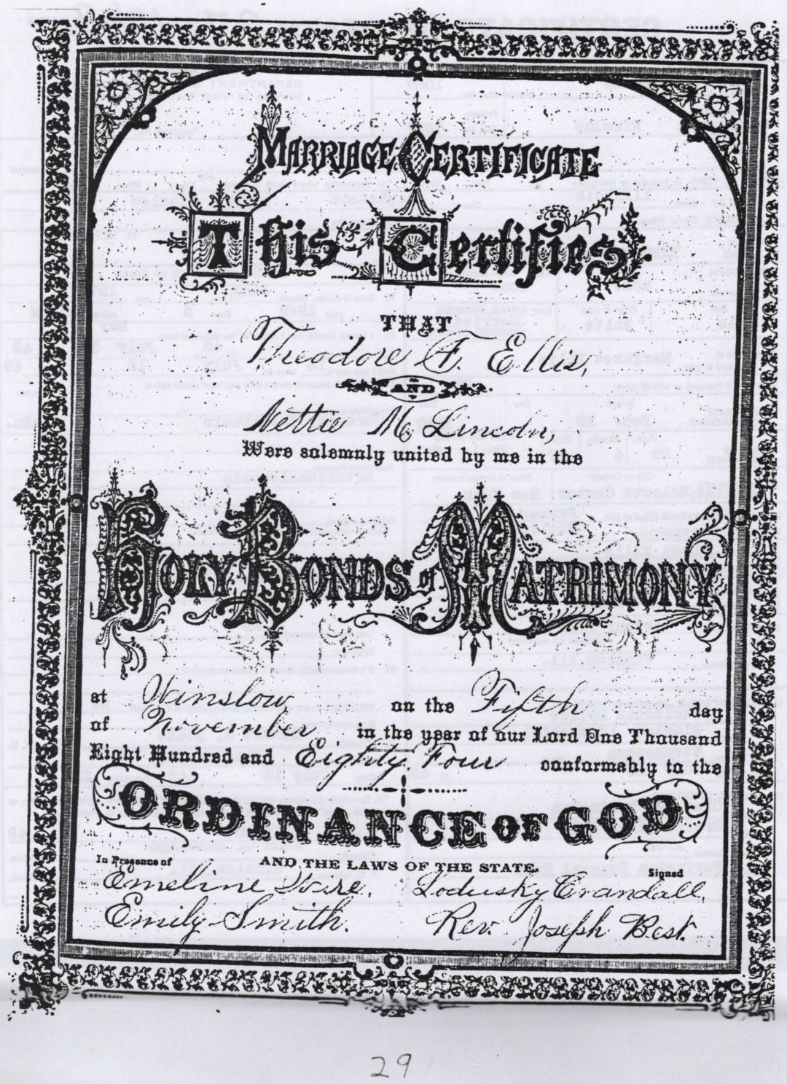
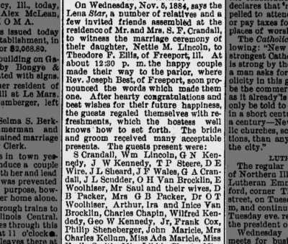
1884
Theodore Ellis marries Nettie Lincoln

Slide 22
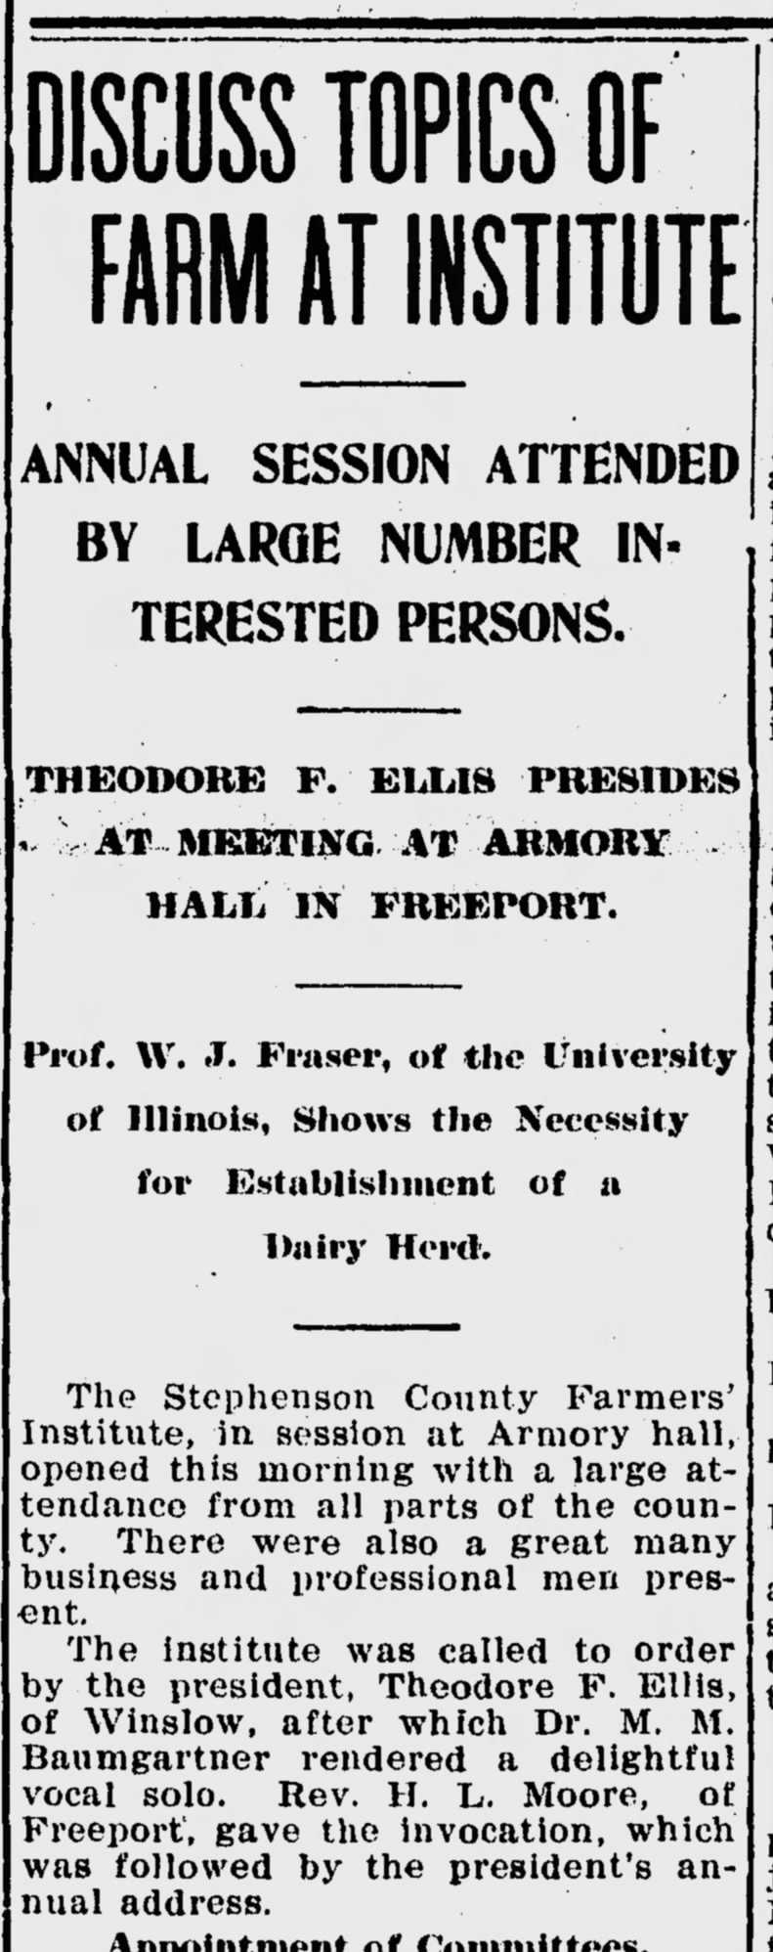
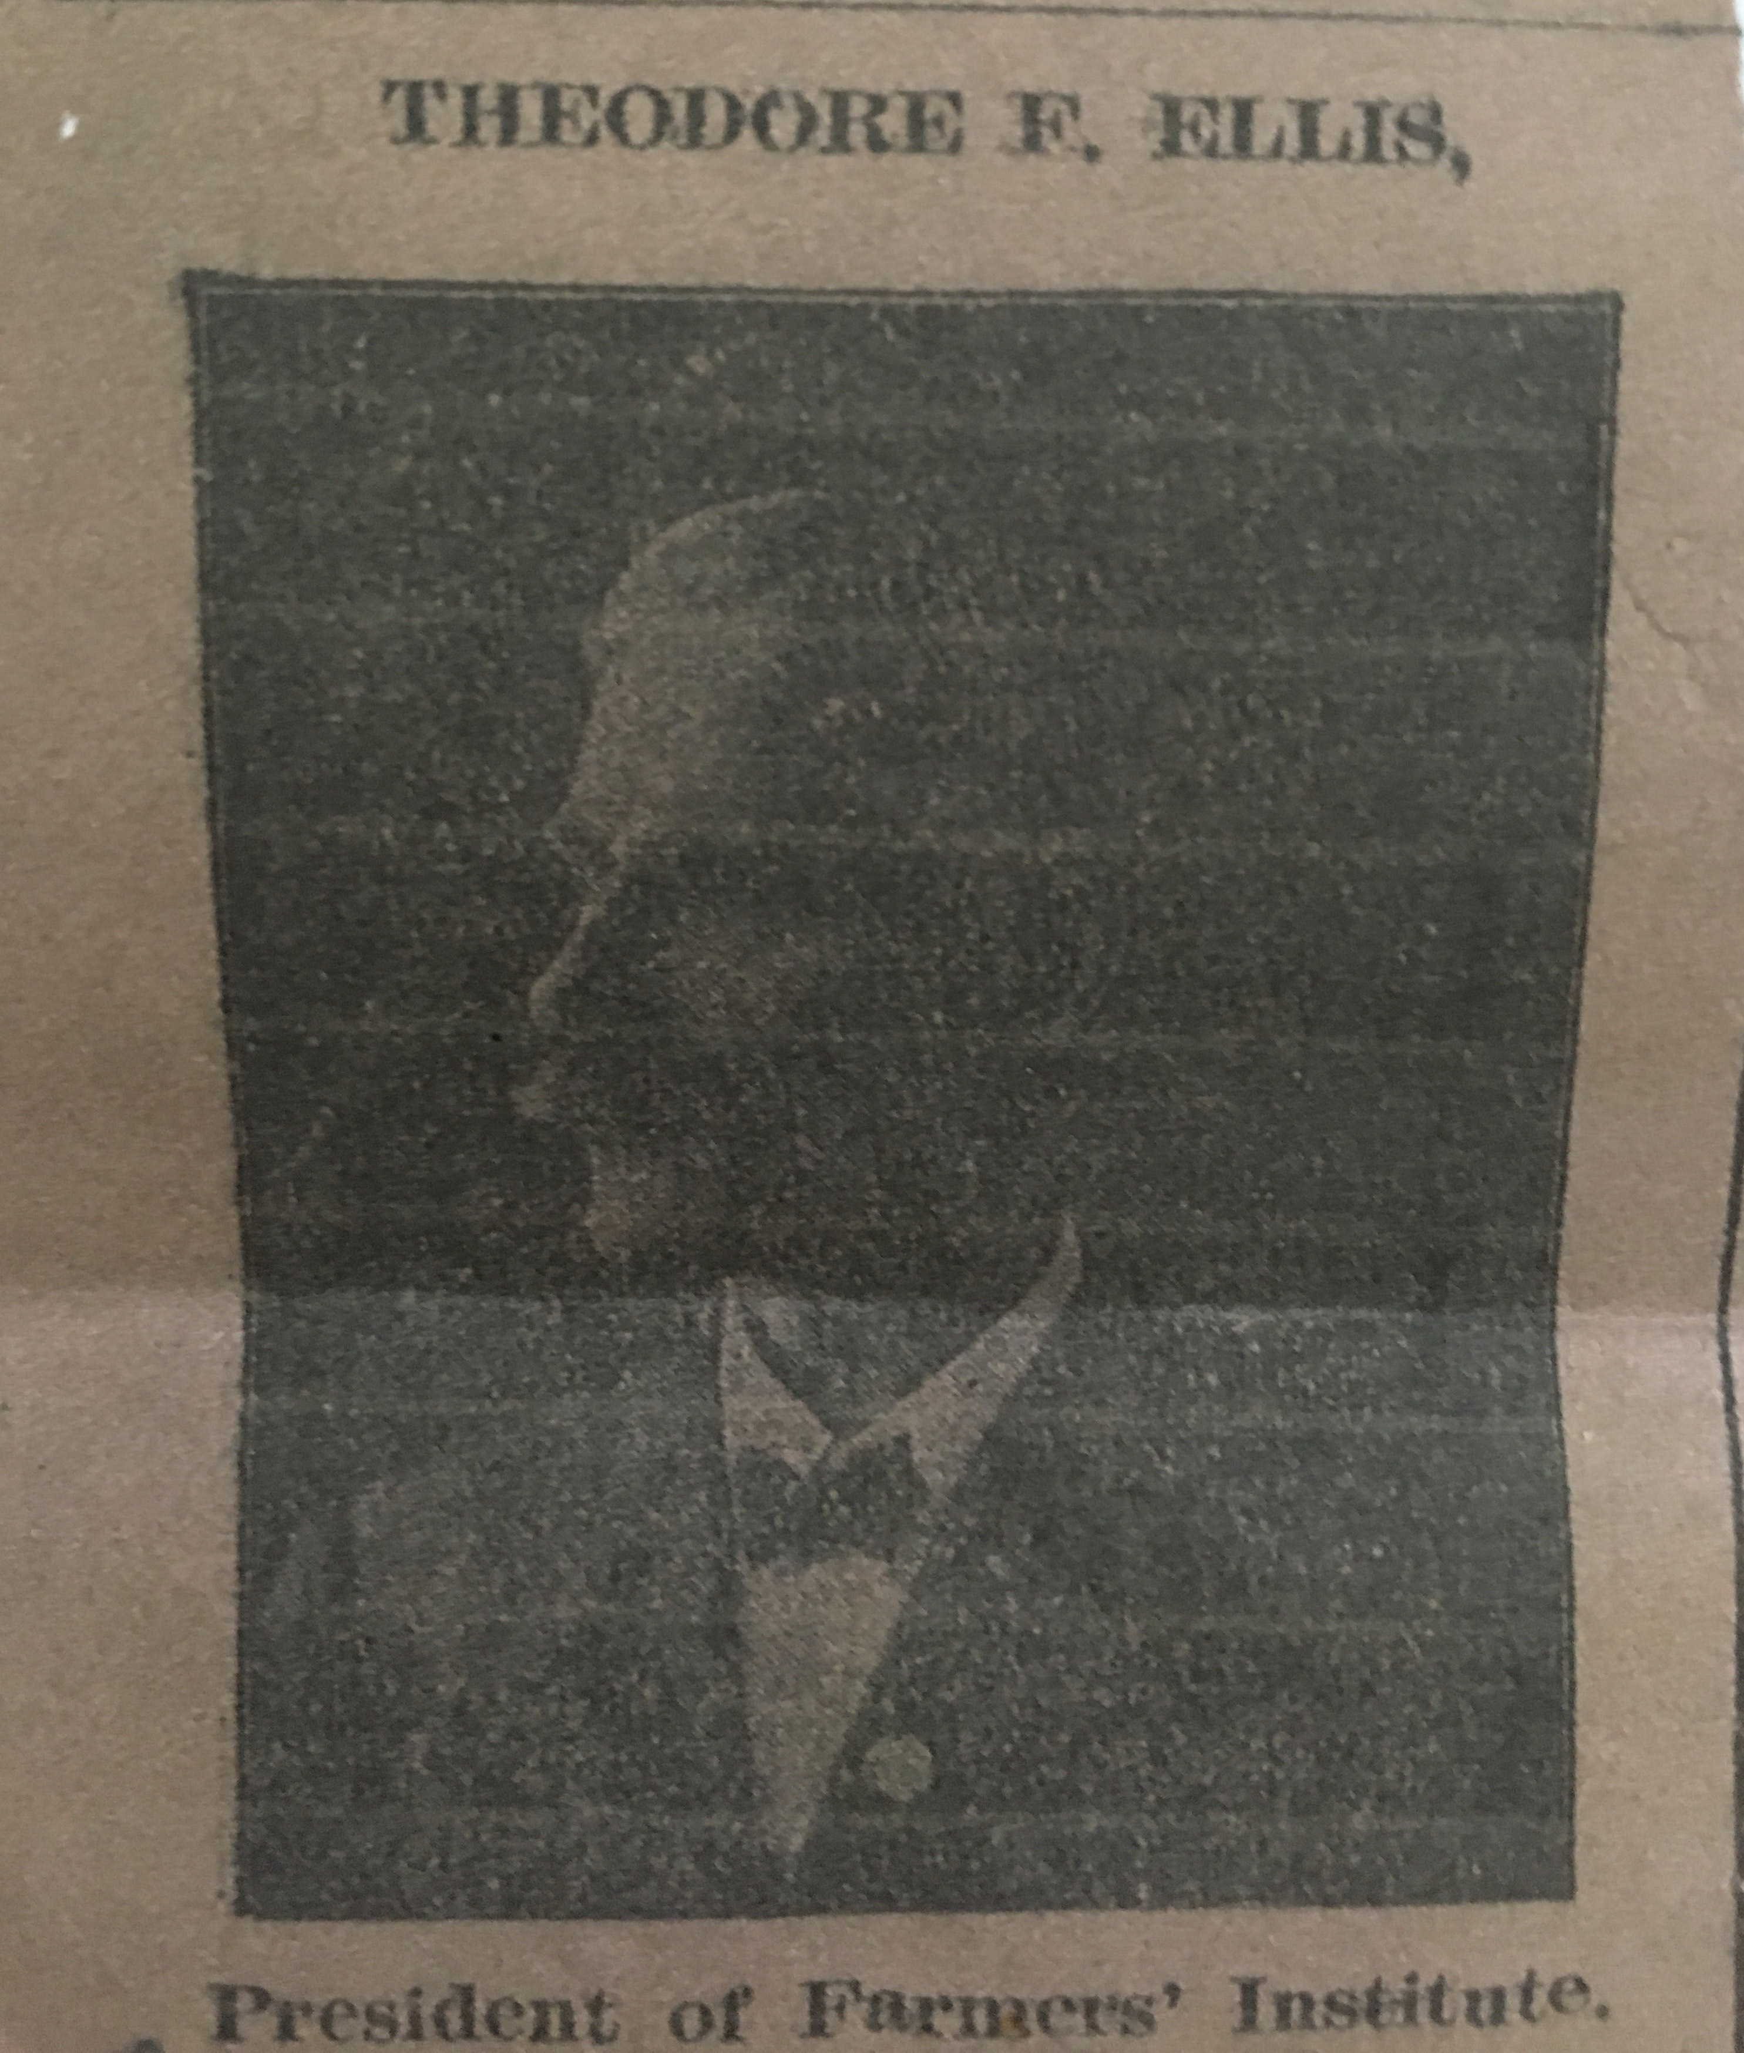
1909
Theodore Ellis presides over Farmer’s Institute
Freeport, IL

Slide 23
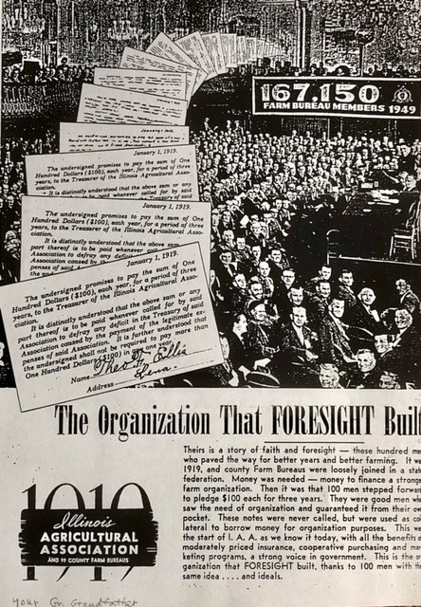
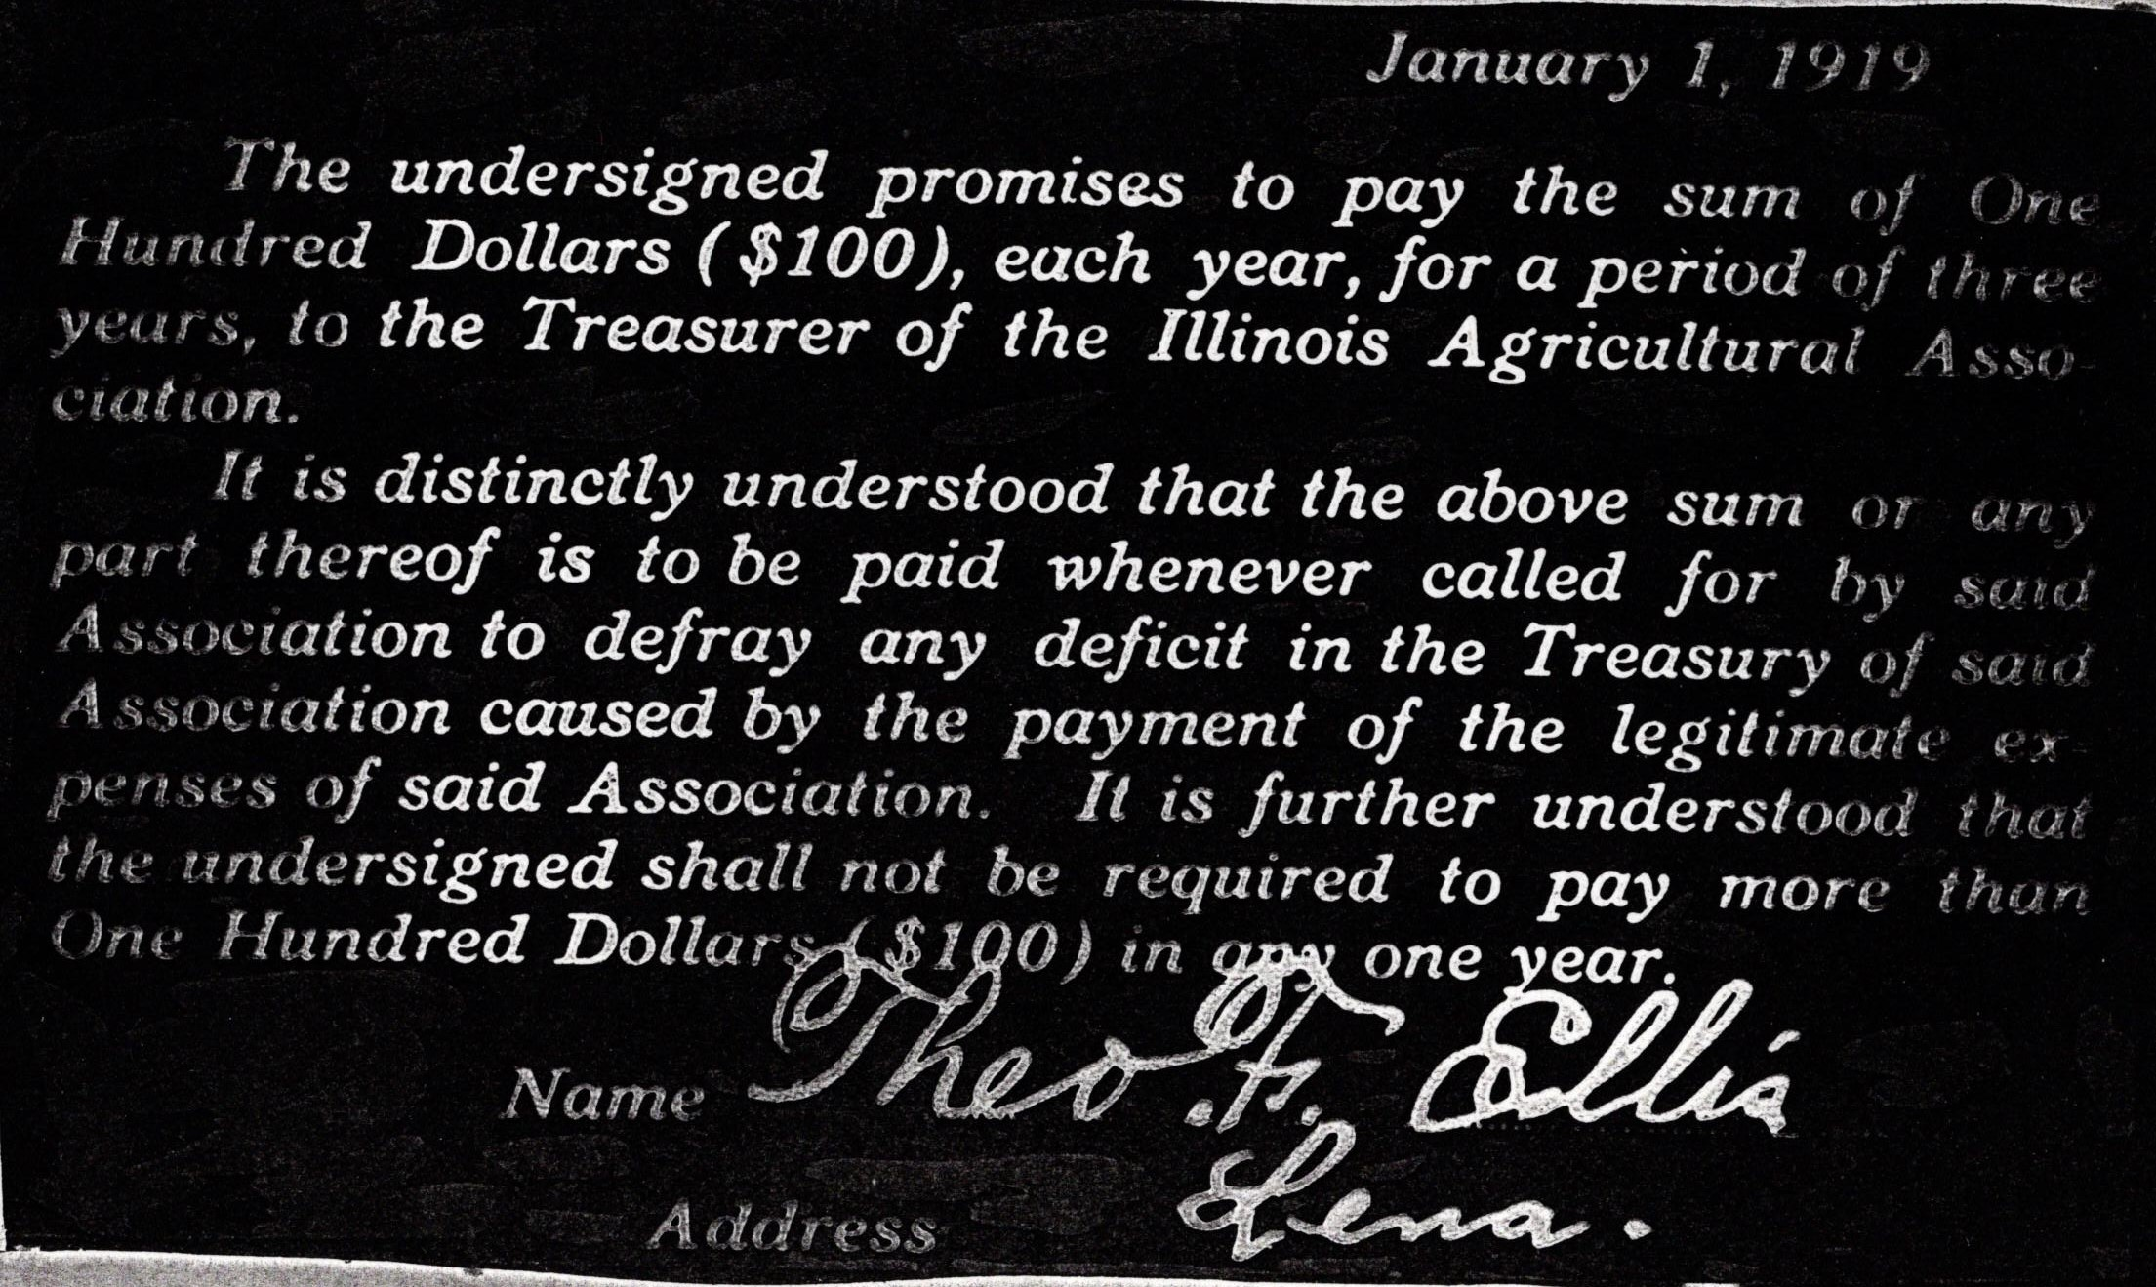
1919
Theodore was first to join the IL Agr. Assoc. (Farm Bureau)

Slide 24
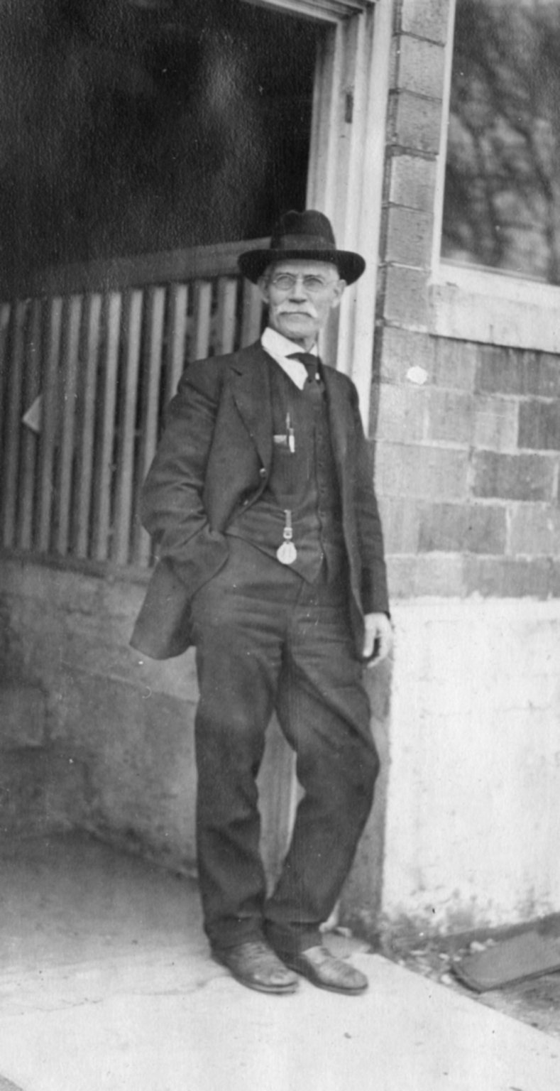
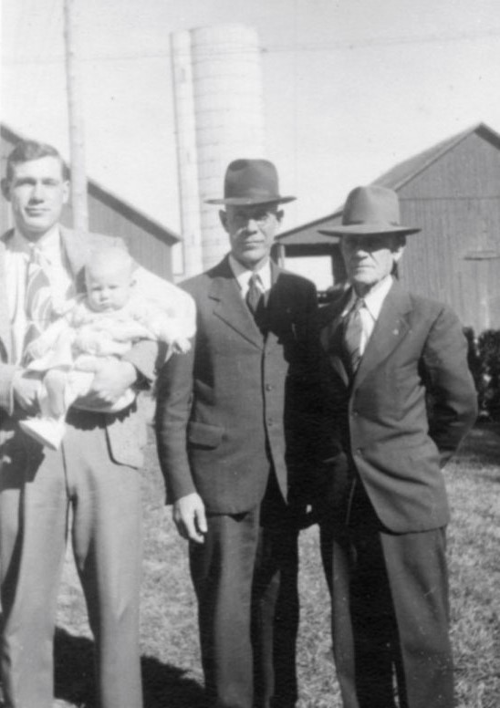
Theodore
Ellis with
Clarence,
Robert, & baby Rick (4-generation photo, 1948)

Slide 25
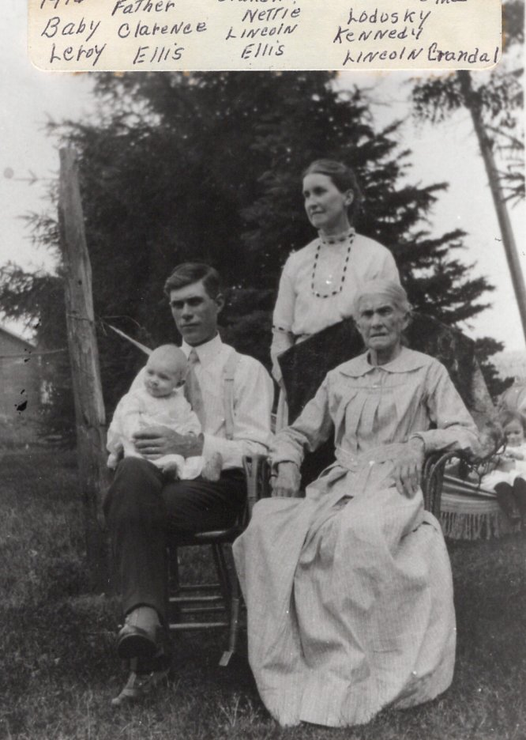
4-generation photo, 1917: baby Leroy Ellis father Clarence Ellis grandma Nettie Ellis great-grandma Loduskey Lincoln

Slide 26
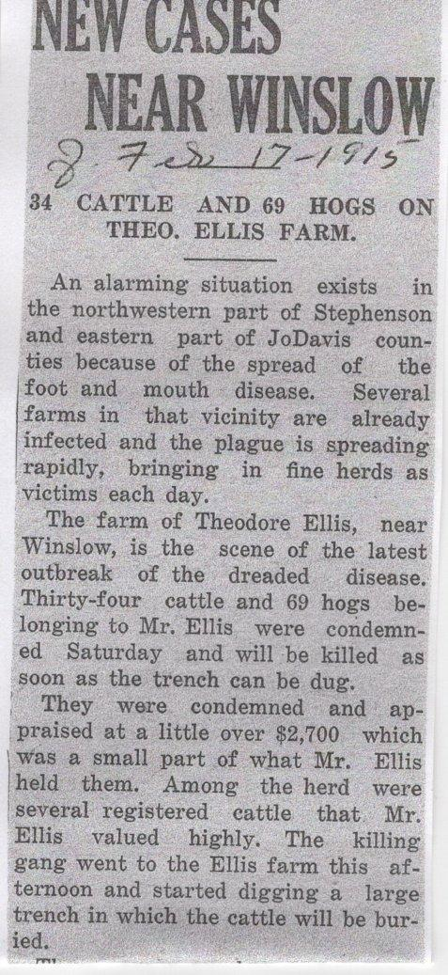
1915
Foot and mouth disease outbreak on Ellis farm, Winslow, IL

Slide 27
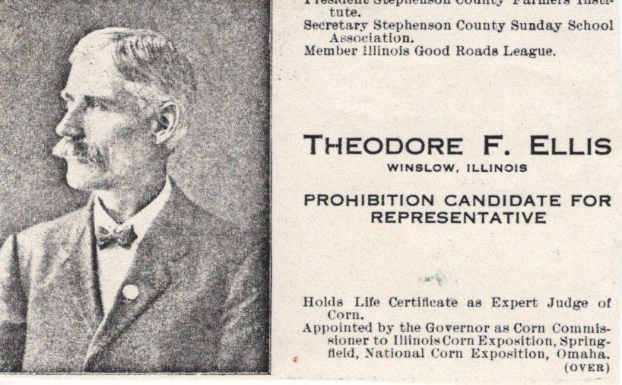
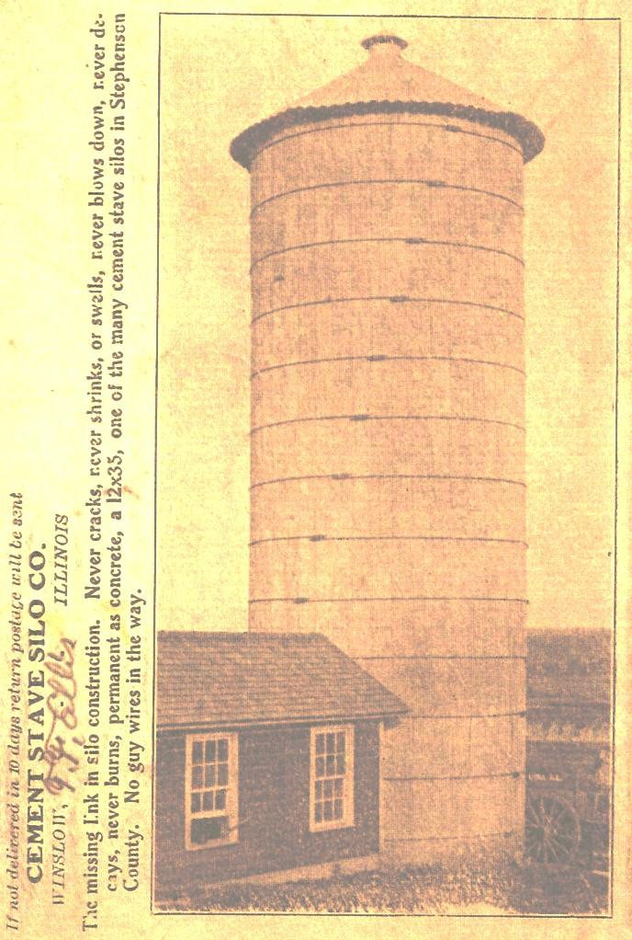
Theodore F. Ellis: ~1918 political advertisement,
1921 patented new design for concrete stave silos https://patentimages.storage.googleapis.com/6d/2c/aa/4cc2272a05d0d9/US1399546.pdf

Slide 28
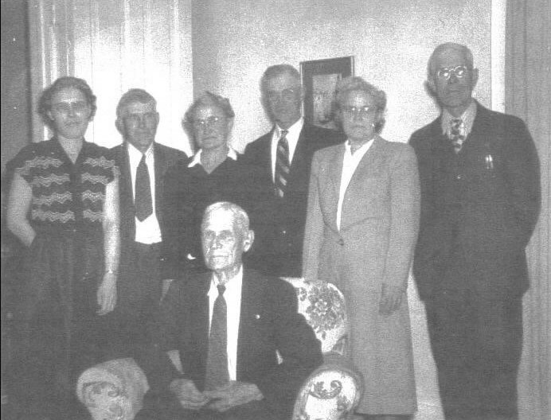
Theodore Ellis (seated) and children
Clarence (on right)

Slide 29
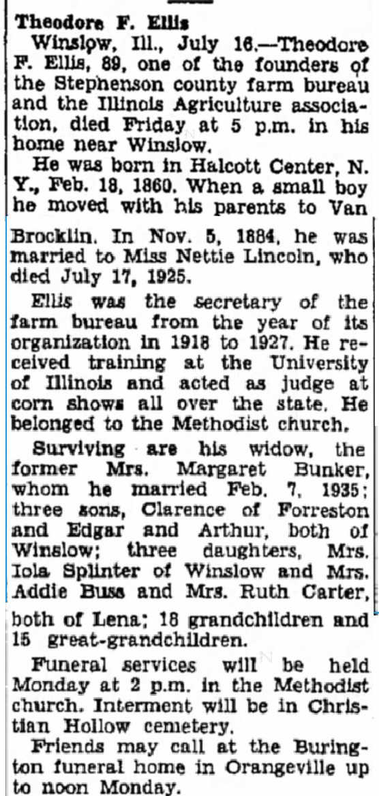
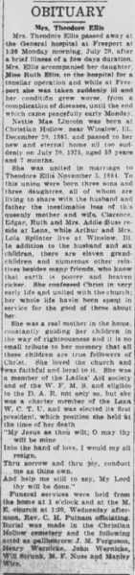
Obituaries
1860-1949
Theodore Ellis
1865-1925
Nettie Ellis

Slide 30
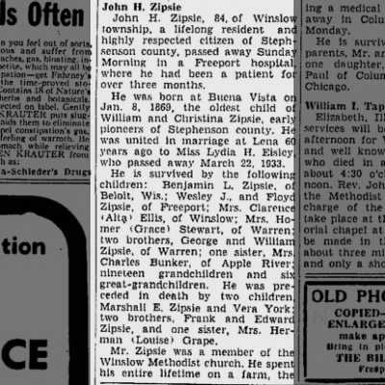
1869-1944 John H. Zipse, father of Alta Zipse Ellis

Slide 31
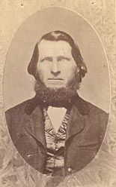
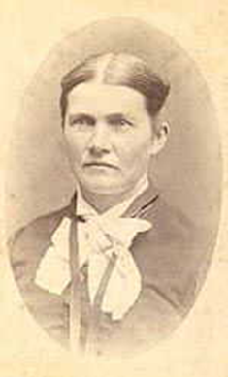
Jonathan Lincoln Jr.
1827-1877
Loduskey (Kennedy) Lincoln
1832-1921
Parents of
Nettie Lincoln Ellis

Slide 32
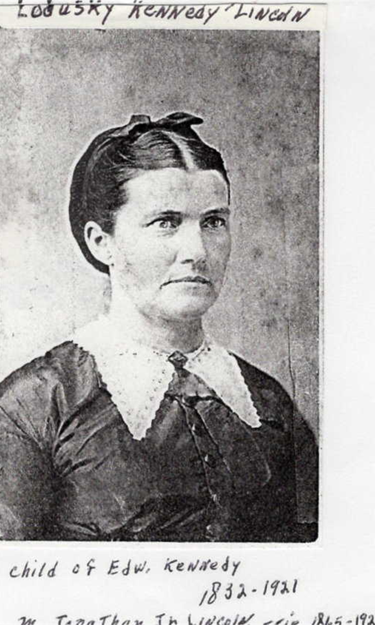
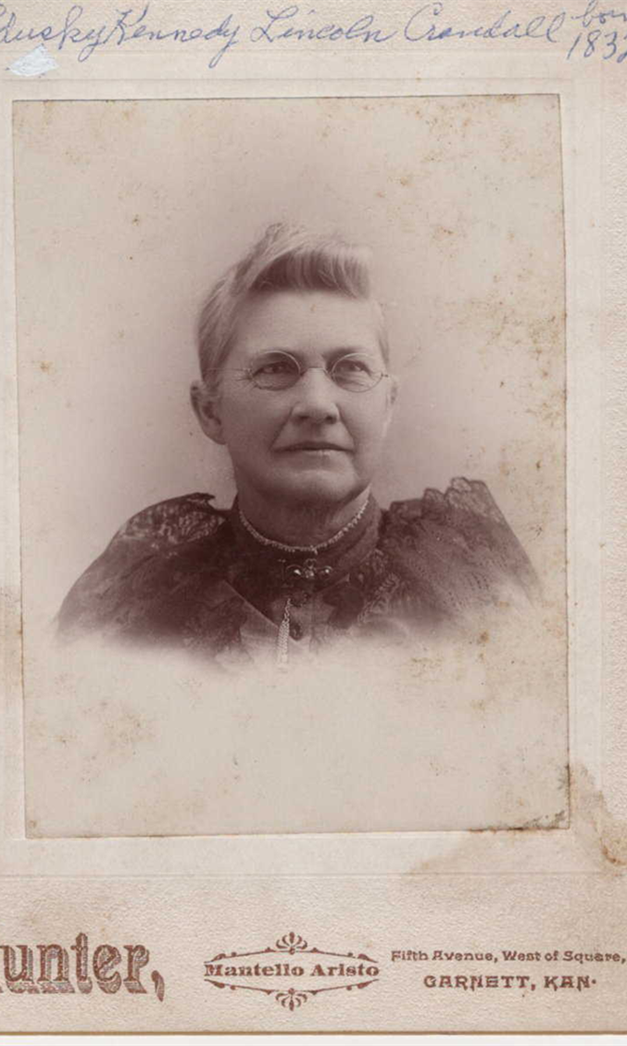
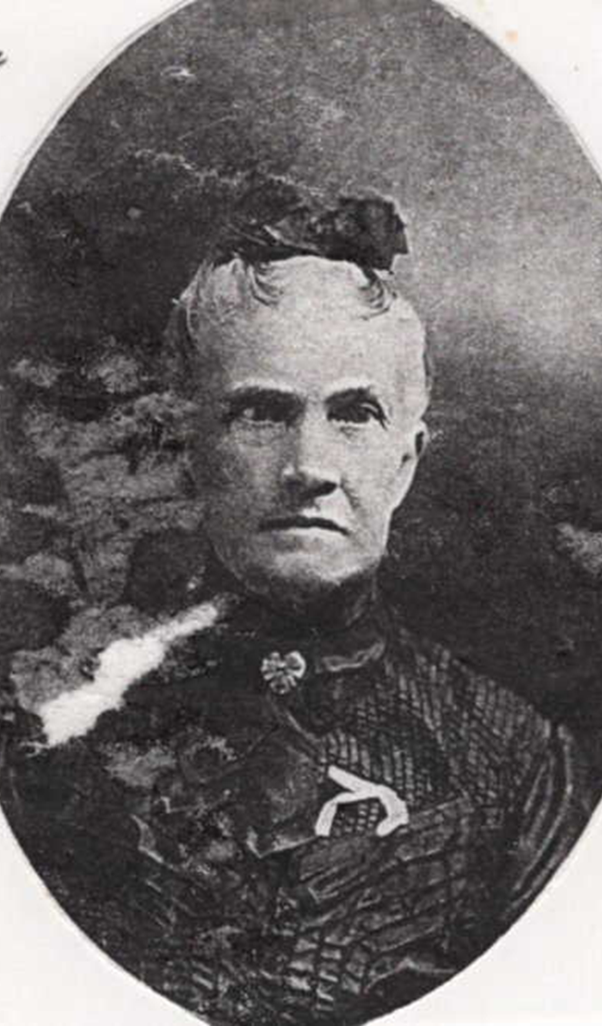

Slide 33
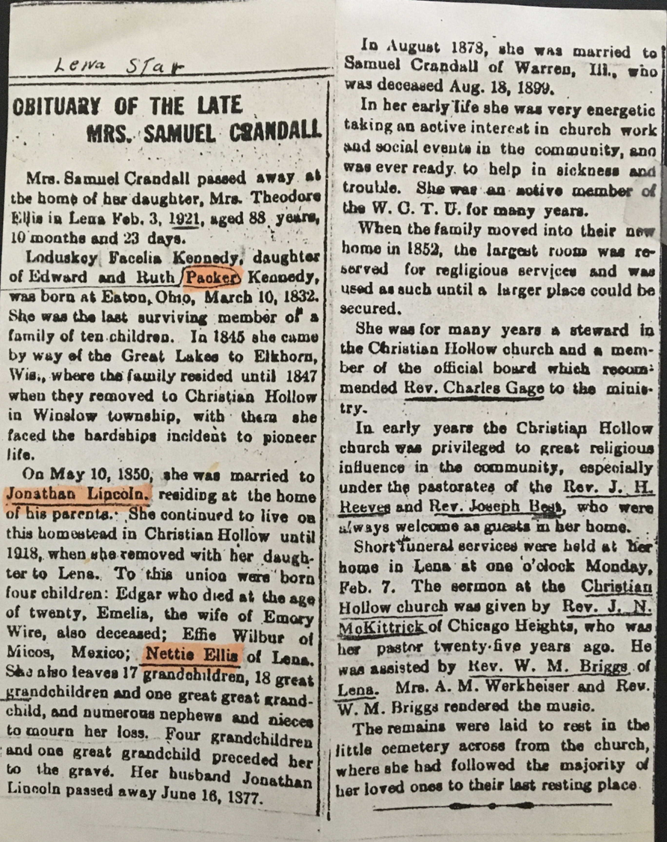
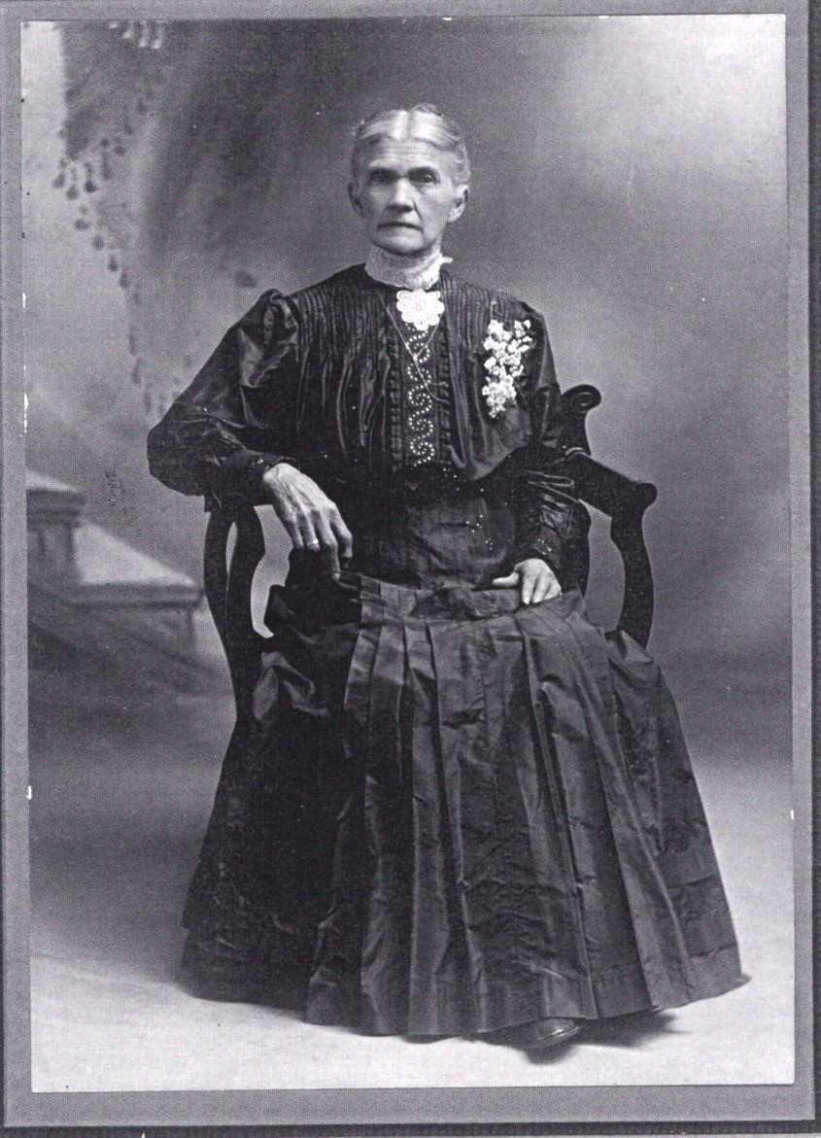
Loduskey (Kennedy) Lincoln (Crandall)
1832-1921

