Slide 1
Cheryl and Paul - early photos
Cheryl and Paul VanRaden 1994-97
See also 1995 slides http://www.paulvanraden.com/Big Honeymoon.pptx

Slide 2
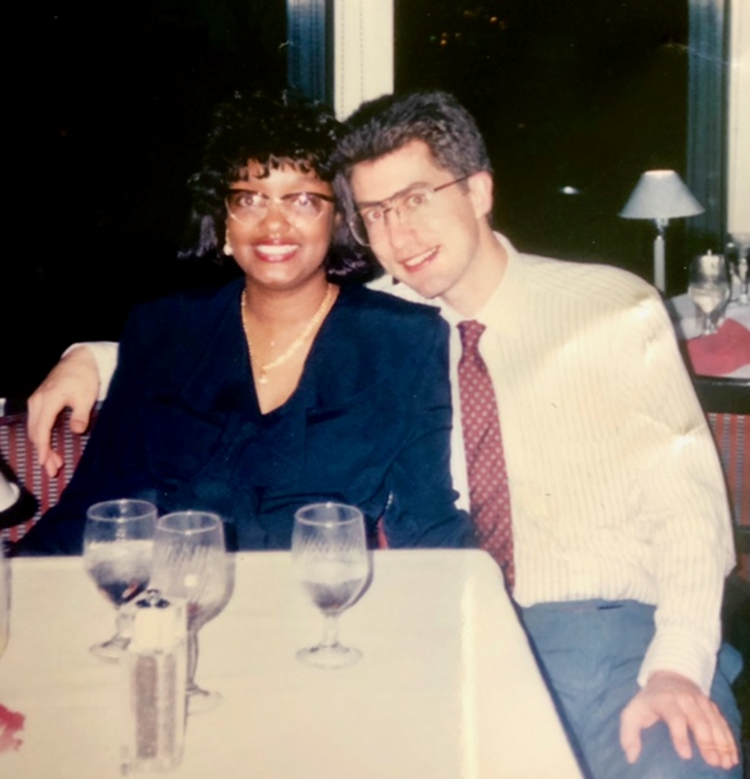
First date – Saturday, March 5, 1994
Inner Harbor, Baltimore, MD

Slide 3
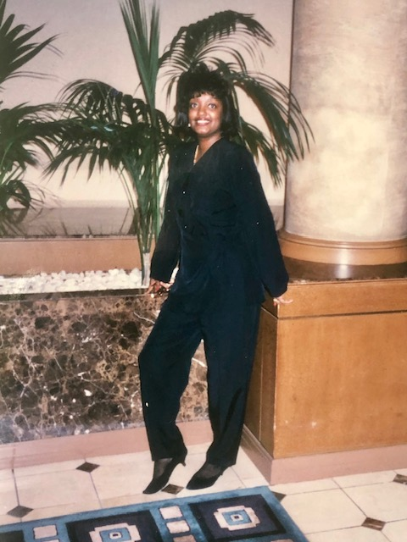
Love at first sight:
Saturday,
March 5, 1994
Inner Harbor, Baltimore, MD

Slide 4
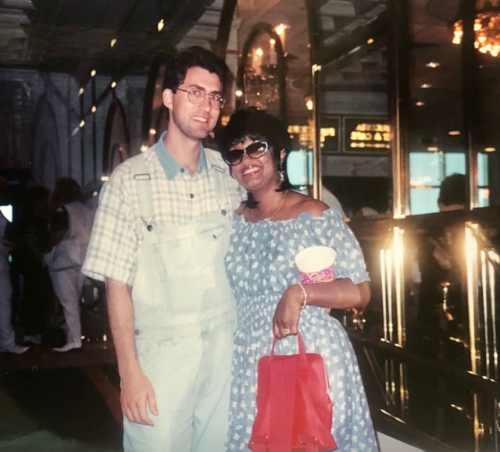
With Cheryl at Atlantic City, NJ
1994

Slide 5
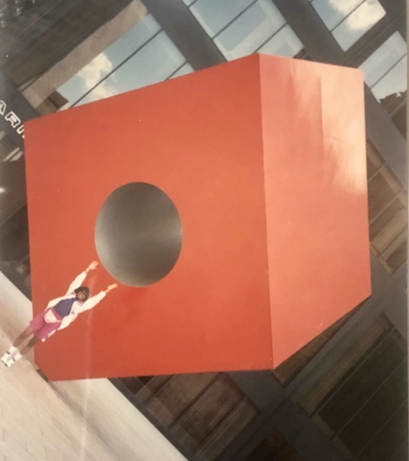
Cheryl seeing
New York City from all angles 1994

Slide 6
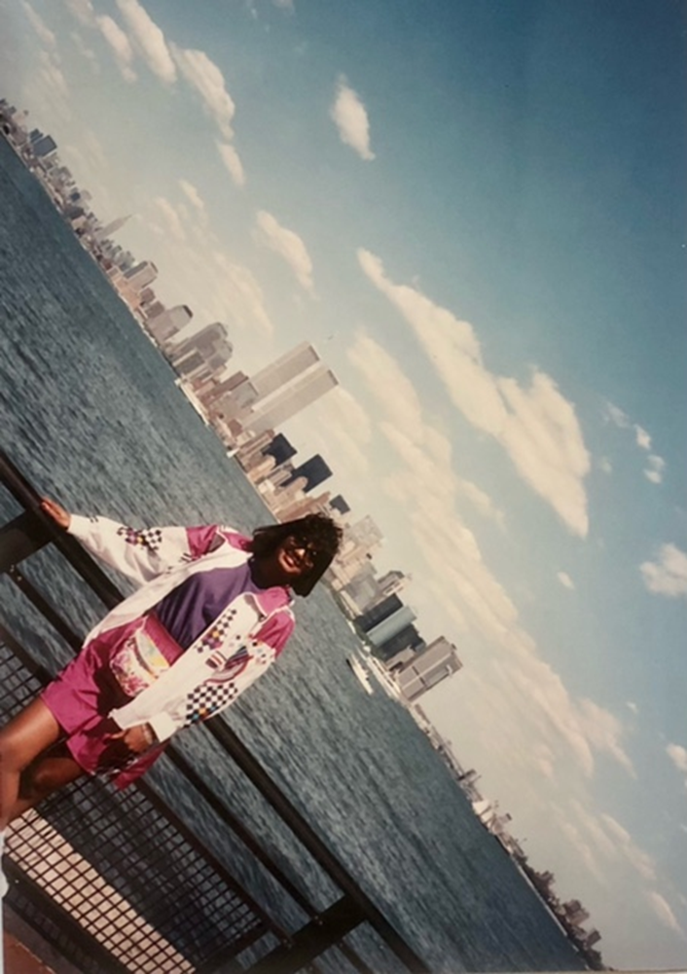
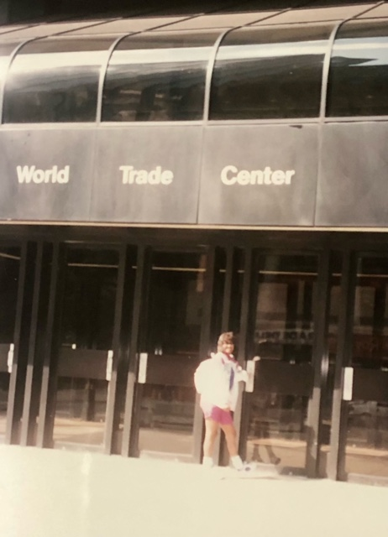
World Trade Center: at a distance and up close

Slide 7
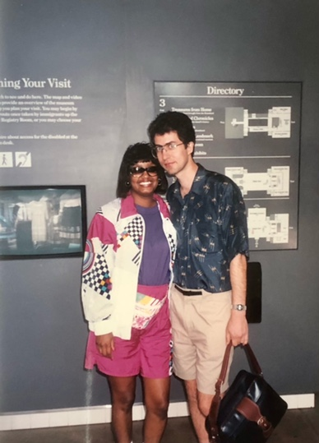
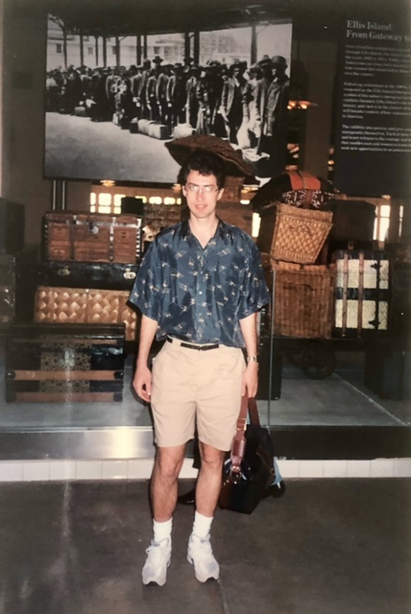
Ellis Island
1994

Slide 8
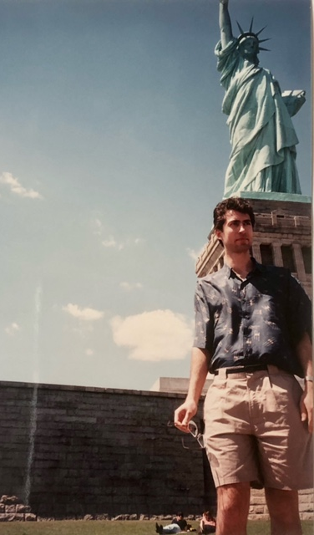
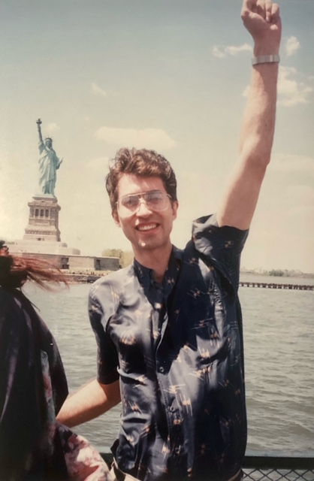
Helping Lady Liberty greet immigrants

Slide 9
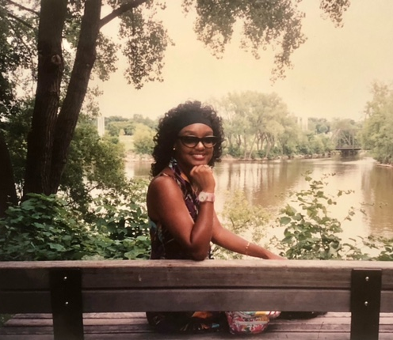
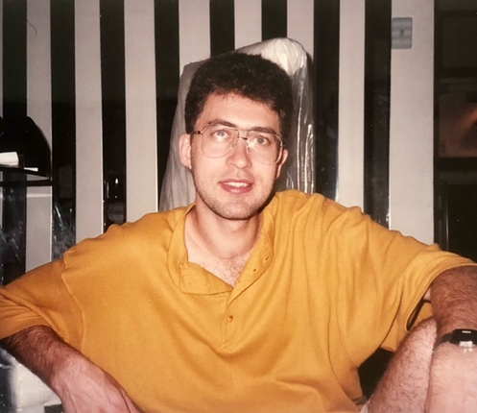
To Minneapolis, July 1994

Slide 10
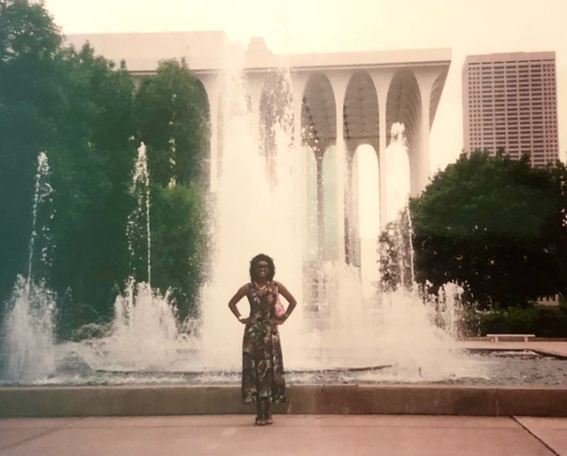
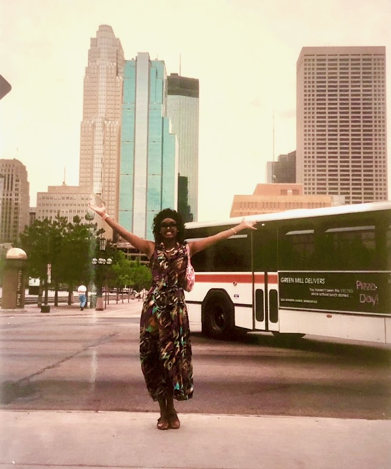
St Paul, MN, July 1994

Slide 11
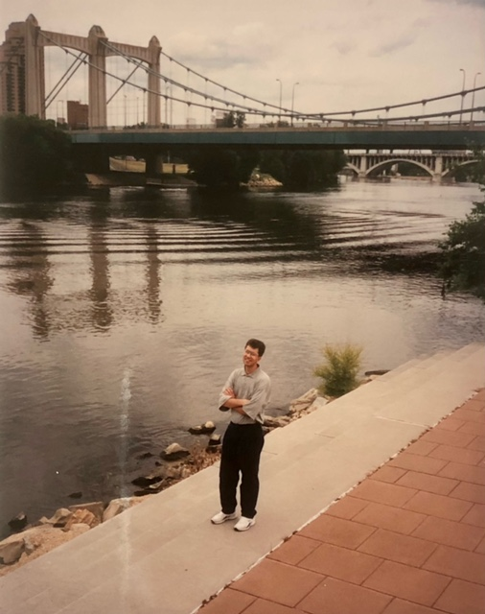
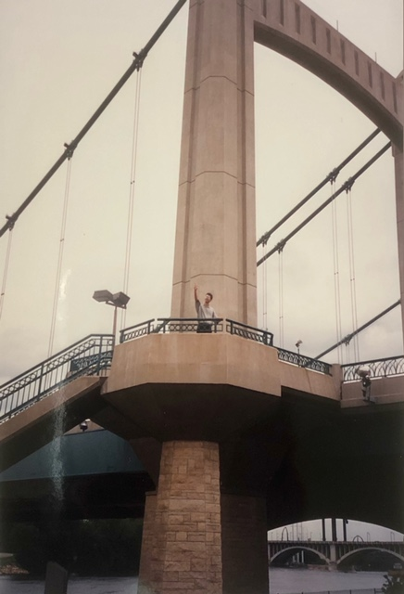
Build bridges, not walls.
St Paul, MN 1994

Slide 12
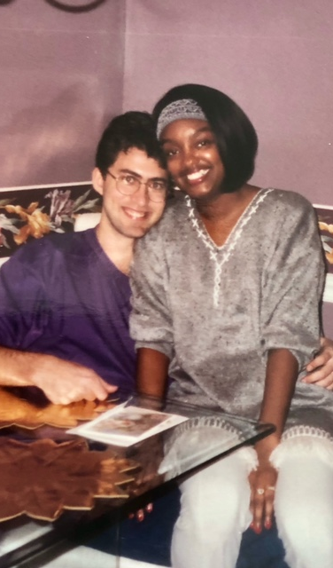
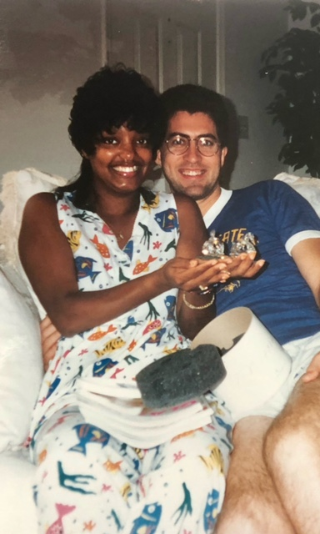
1995
After moving to Odenton

Slide 13
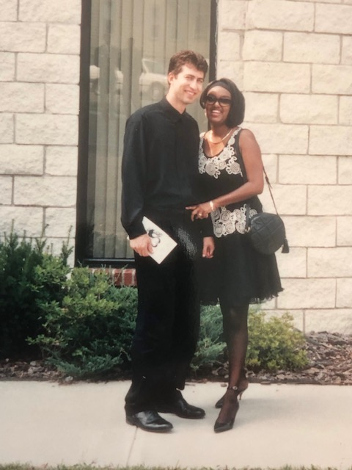
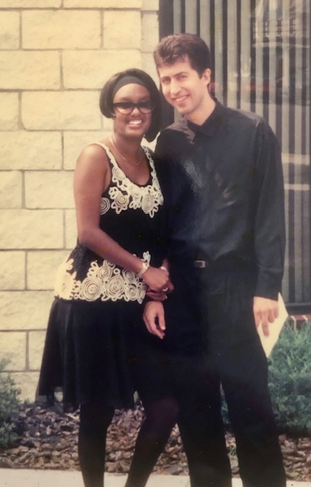
At a wedding in New Jersey

Slide 14
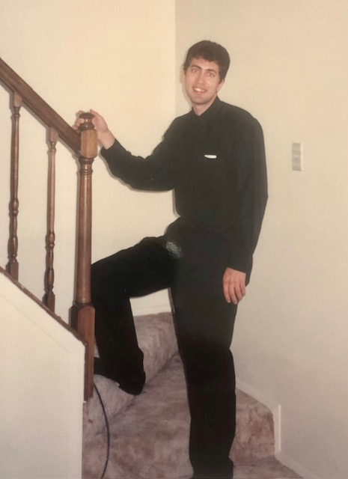
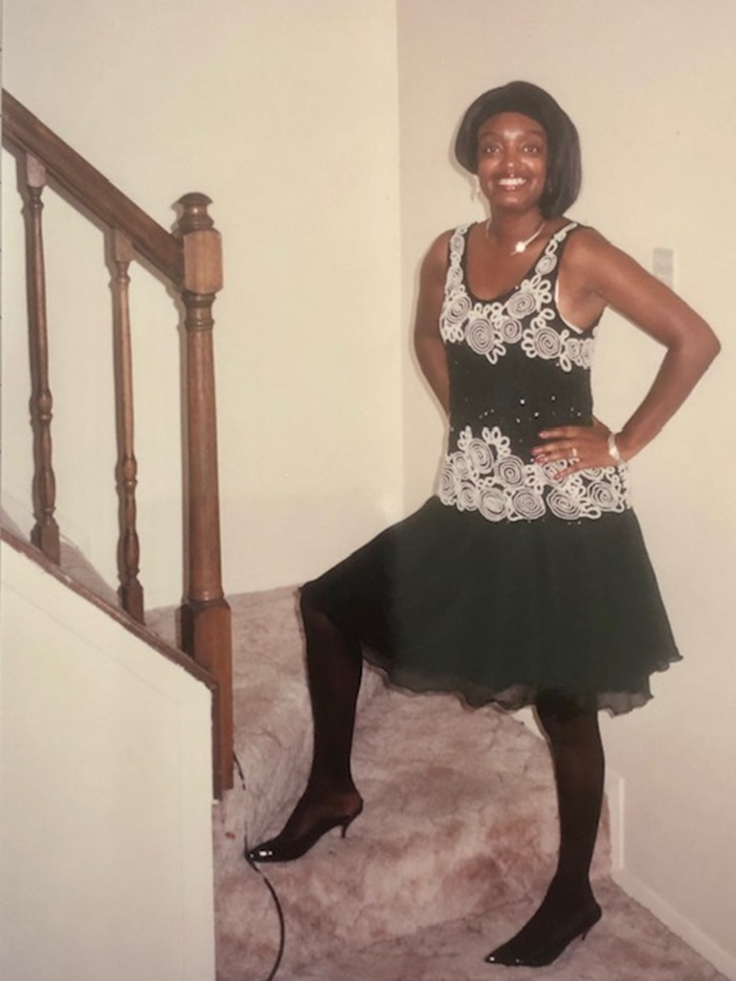

Slide 15
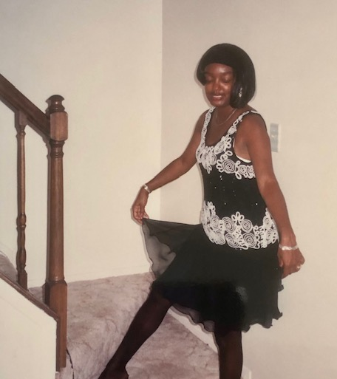
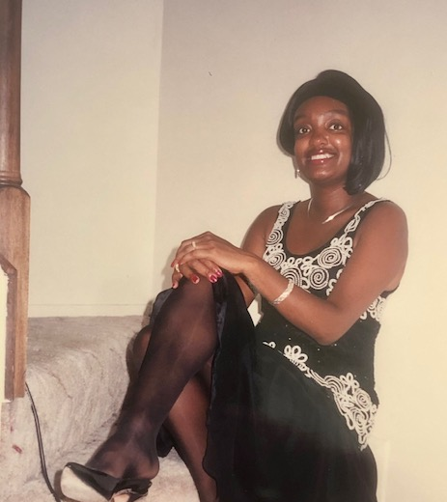

Slide 16
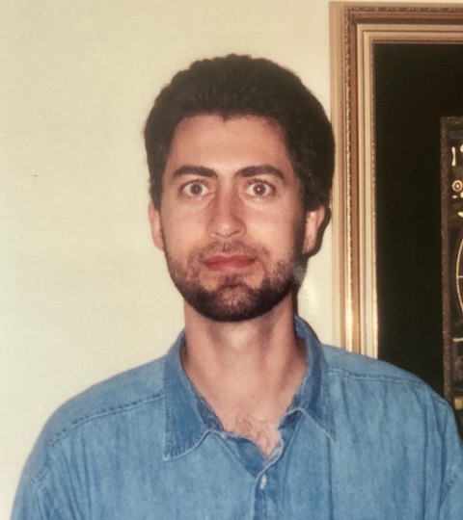
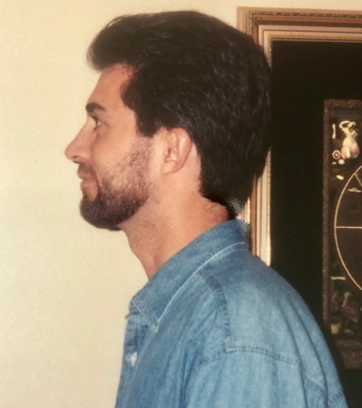

Slide 17
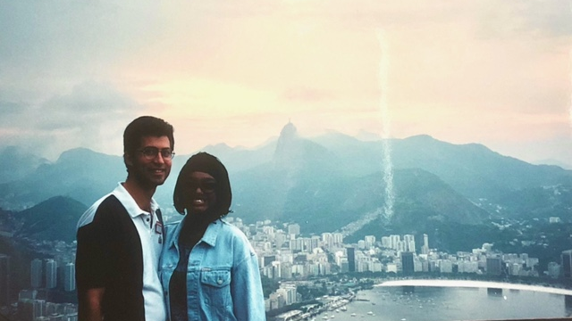
Rio de Janeiro, 1996

Slide 18
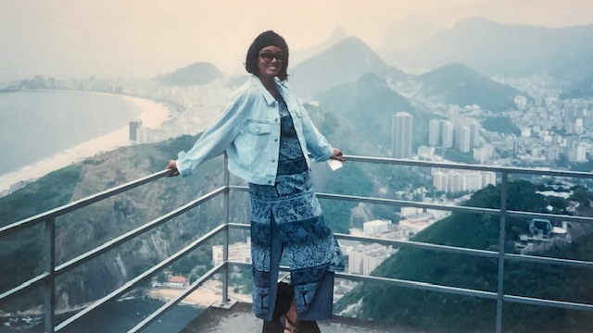
Cheryl in Rio

Slide 19
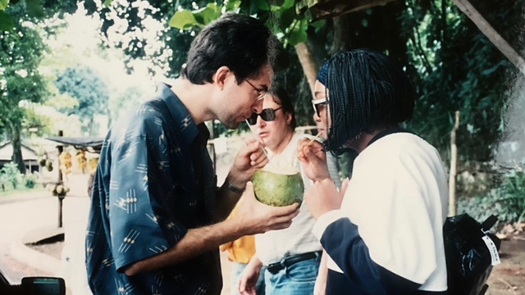
Paul and Cheryl with Jose Valente, Brazil 1996

Slide 20
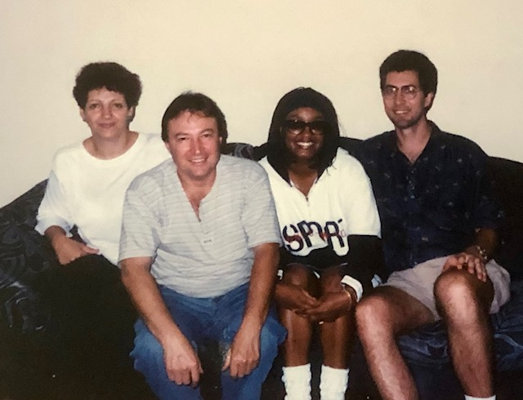
With: Maureen and Jose Valente
Brazil 1996

Slide 21
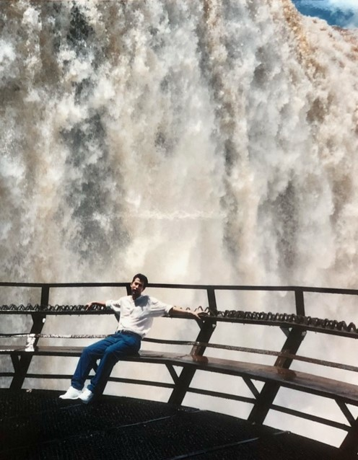
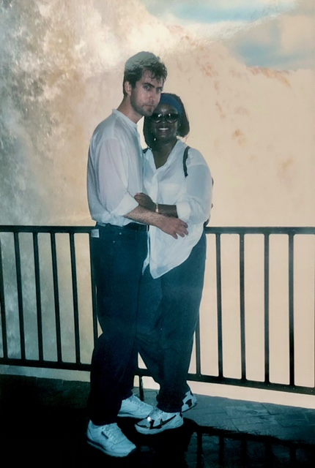
Iguazu
Falls
1996

Slide 22
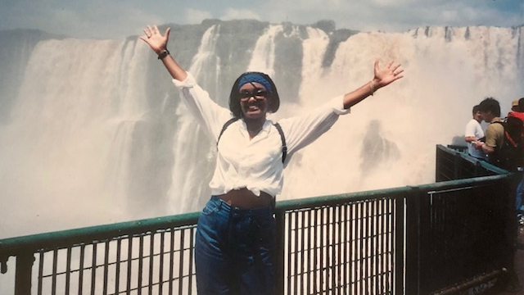
Cheryl at Iguazu Falls, 1996

Slide 23
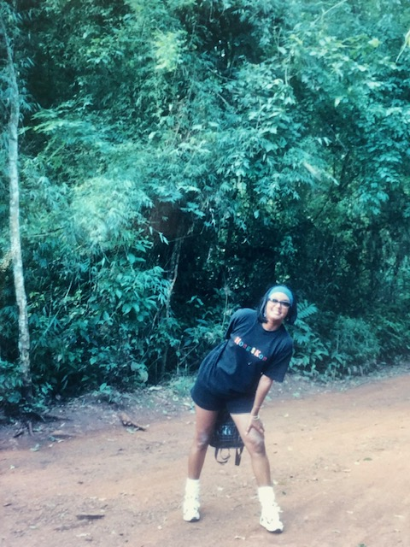
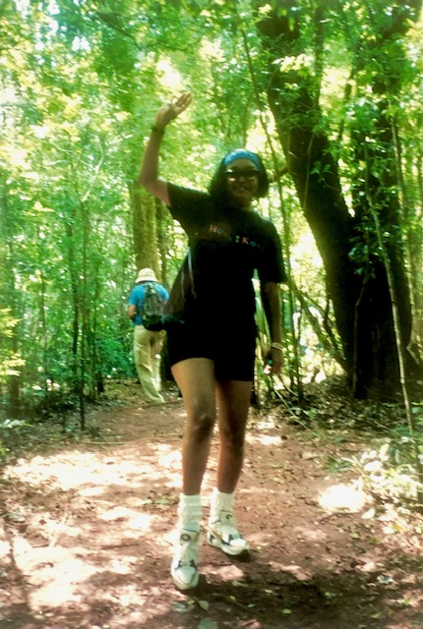
Exploring the South American jungle, 1996

Slide 24
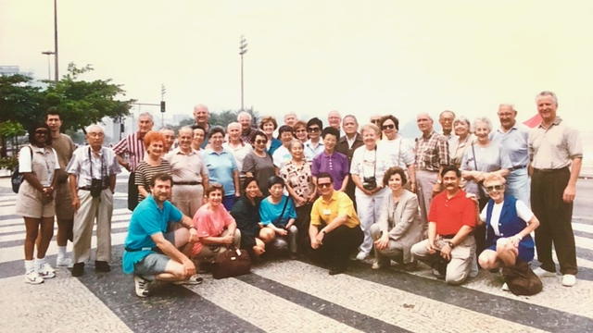
South America tour group (Brazil, Argentina, Chile, Peru), Nov 1996
Cheryl and Paul on left

Slide 25
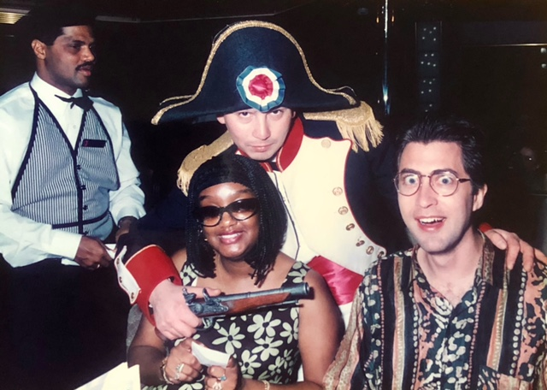
We skipped Peru because it was not safe

Slide 26
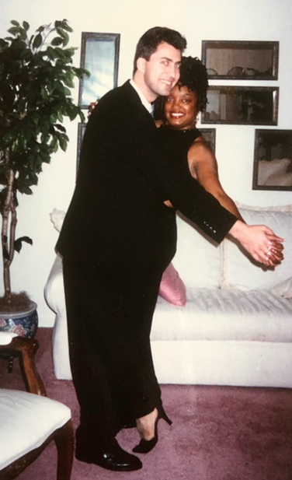
Attending inaugural ball, Jan 1997

Slide 27
See related content (photos, poem, etc.) at:
Solutions To Personal Problems, by Paul VanRaden

