Slide 1
Better Beliefs for Nonbelievers
Paul VanRaden
Presented at University of Maryland, College Park
November 18, 1996
5pm in the Student Union

Slide 2
Explanation
The University of Maryland – College Park had an Atheist Student Association that started in 1995.
Their club had about 60 members, but fewer than 20 attended my talk.
November 18, 1996 was the only time I spoke on Atheism.
I was not trying to convert them, instead I was “preaching to the choir” so to speak.

Slide 3
Topics
Can you prove that Santa does not exist?
Belief theory
Our place in the universe
Values and goals
Student categories | Believers in God
English majors | 67%
Economics majors | 84%
Blacks | 90%
Whites | 64%
Statistics on belief in God from U.S. News and World Report, April 12, 1993

Slide 4
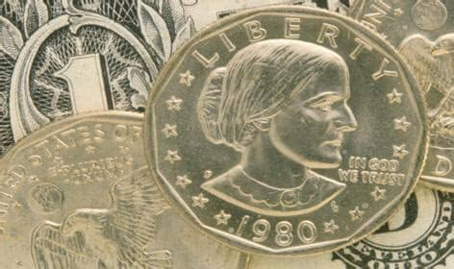
Separation of Church and State
Thomas Jefferson, 1786:
“To compel a man to furnish contributions of money for the propagation of opinions which he disbelieves, is sinful and tyrannical.”
Susan B Anthony was an agnostic.
Why is she saying IN GOD WE TRUST?

Slide 5
$ $ Win The Lottery $ $
(St. Petersburg Paradox)
Pick a Prize | Probability | Payoff
No gain | 1 / 1 | $ 1
Small gain | 1 / 100 | $ 100
Huge gain | 1 / 1,000,000 | $ 1,000,000
Infinite gain | 1 / ∞ | $ ∞
Solution: The infinite prize does not exist.

Slide 6
Please explain to me:
What Does God Do?
Create the universe
Provide souls for babies
Keep the souls in heaven happy
Forgive your sins
Battle with the devil
Heal the sick, comfort the poor
OR, NOTHING
Where Might God Be?
Roaming our universe
Hiding in a 5th or 6th dimension
Disguised as an angel
Appearing as himself
Vacationing with other gods
Sleeping or deceased
OR, NOWHERE

Slide 7
How Big is the Universe?
Finite
In the beginning, God created the heavens and the earth [Genesis 1:1]
The universe began with a big bang
God is a mathematician [Albert Einstein]
Infinite
The universe has 4 infinite dimensions
X: North-South
Y: East-West
Z: Up-Down
T: Past-Future
No end in any direction (Cartesian)

Slide 8
View of the Universe
Masses circle, collide, explode
Edward R. Harrison, Cosmology
Objects | Visibility
Local (earth, sun, moon) | Visible
Distant (Pluto, etc.) | Invisible
Big Bang | Bright, local
Matter far away | Dim, distant

Slide 9
Bibles vs. Knowledge
Old Testament
“God knows very well that the instant you eat [the fruit] you will become like him, for your eyes will be opened – you will know good from evil” [the serpent, Genesis 3:5]
“It was there [Babel] that Jehovah confused them by giving them many languages.” [Genesis 11:9]
New Testament
“Don’t get involved in arguing over unanswerable questions.” [Titus 3:9]
“But if you cause one of these little ones who trusts in me to fall into sin, it would be better for you to have a large millstone tied around your neck and be drowned in the depths of the sea.” [Matthew 18:6]

Slide 10
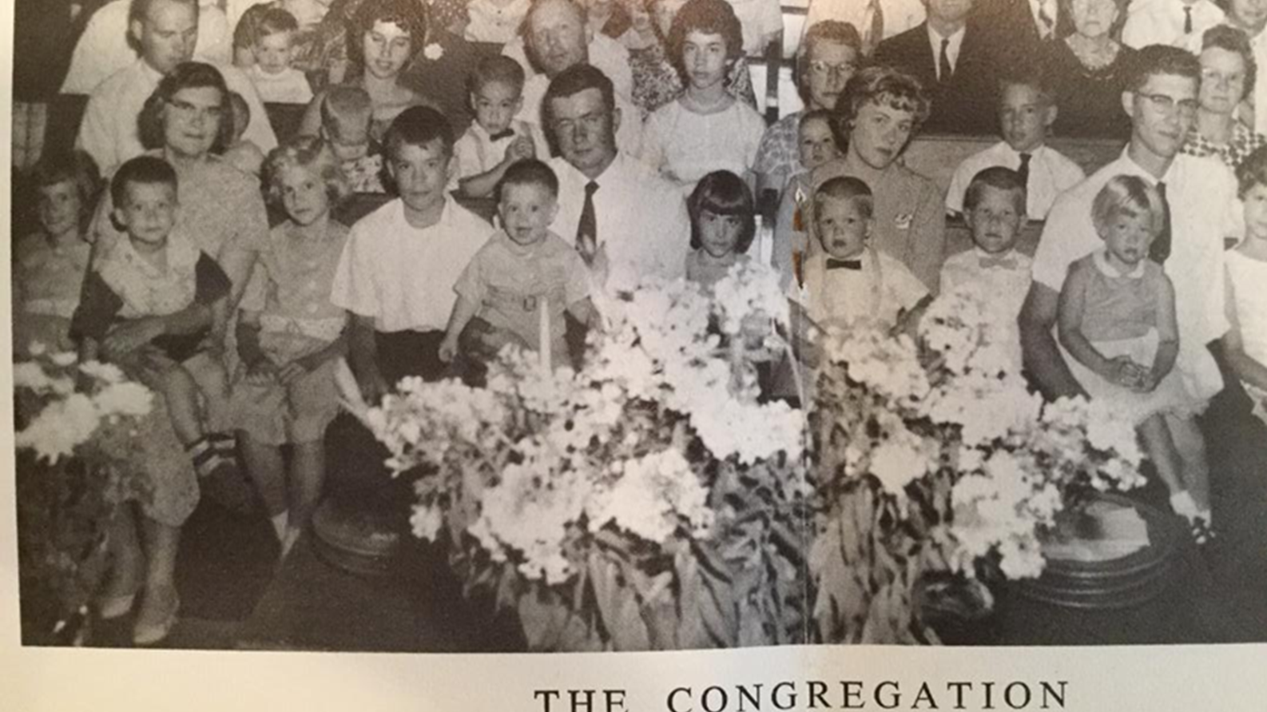
Paul VanRaden (left) on Mommy’s lap in front row at church, 1963

Slide 11
Have You Sold Your Soul?
What was it worth?
  How old was it?
  Where was it before?
  Is it recyclable?
  What is its function?
  Is it useful without a body?
  Does body or soul go to heaven?
“Jesus then began rising into the sky, and went on to heaven” [Luke 24:15]

Slide 12
Atheism Lets You
Discover new truths | Charles Darwin
Exceed old limits | John Lennon
Be more accepting | Paul VanRaden
Have more fun | Ted Turner
Do more good | Thomas Paine
Do more evil | Joe Stalin
Play God | Adolf Hitler

Slide 13
My Goals
Establish the right to migrate
  (Desegregate the world)
Make atheism respectable and popular
Help people to choose better genes for their children

Slide 14
Conclusions
An infinite universe requires no creation, no God, no Santa, no doubt.
Knowledge and truth are better than faith
Good Christians are better than bad atheists
Good atheists are the best…
until better atheists evolve

