Slide 1
Winship Family Audio from 1986
Christmas hosted by Judy and Harold Winship.
From Ruth VanRaden’s tape recorder given to her
as a 1986 Christmas gift by Mark VanRaden family

Slide 2
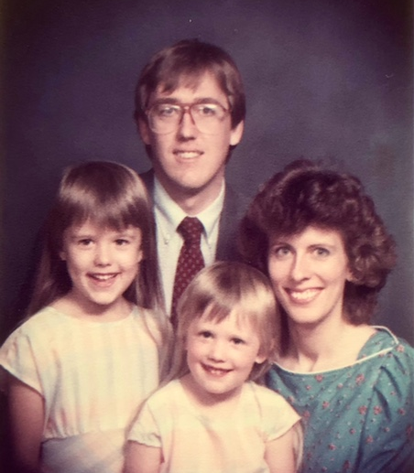

Harold and Judy Winship with
Andrea and Gabriele
Christmas hosts –
1986
1986 photo

Slide 3
Judy Winship – Christmas 1986

Slide 4
Andrea and Gabriele
Winship –1986
1986 photo

Slide 5
For VanRaden family pictures see: paulvanraden.com/InteractingWithFamily.htm

