Slide 1
Walter (Bud) VanRaden
Audio from 1986
From Ruth VanRaden’s tape recorder given to her
as a 1986 Christmas gift by Mark VanRaden family

Slide 2
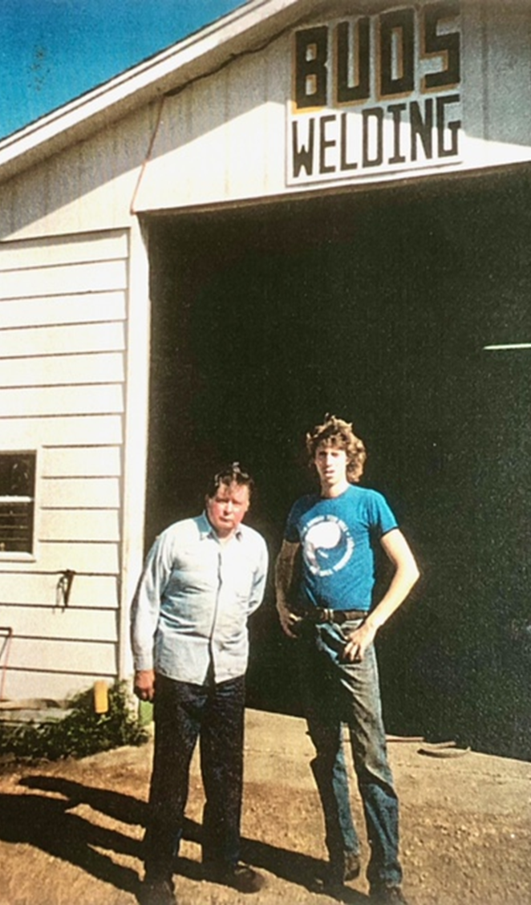

Walter (Bud) VanRaden with Dave
~1990

Slide 3
For VanRaden family pictures see: paulvanraden.com/InteractingWithFamily.htm

