Slide 1
VanRaden Family Audio from 1986, with Pictures
From Ruth VanRaden’s tape recorder given to her
as a 1986 Christmas gift by Mark VanRaden family

Slide 2
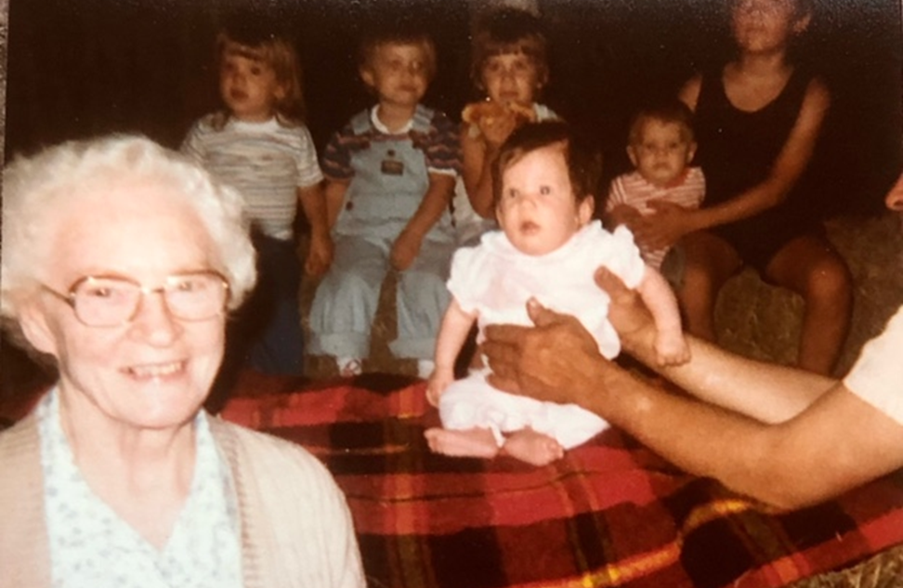
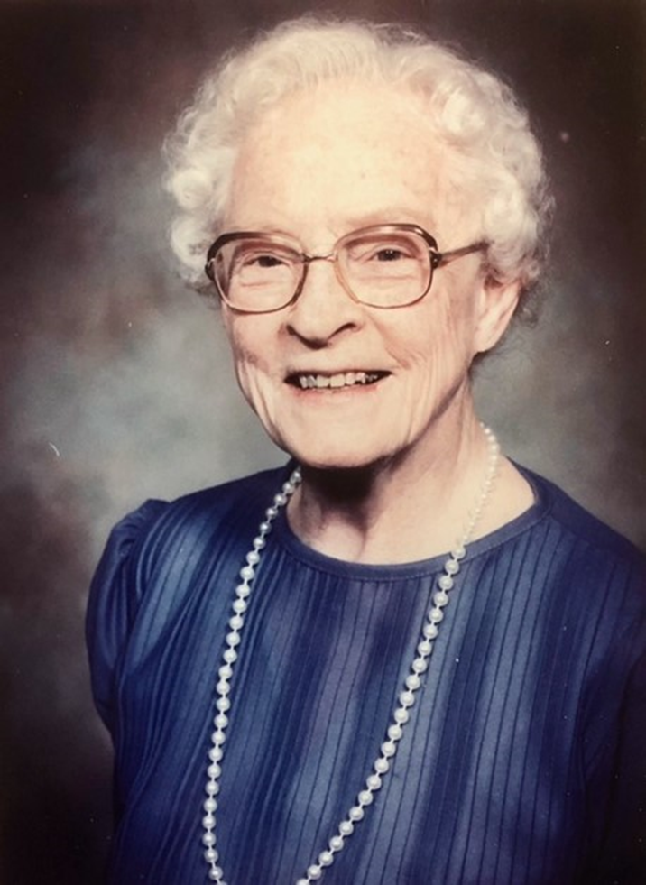

Ruth VanRaden + great grandkids,
1983

Slide 3
Great grandkids singing, 1986

Slide 4
For more pictures of Ruth VanRaden see: http://www.paulvanraden.com/Martin_Ruth_VanRaden.pptx

