Slide 1
Paul_VanRaden_Audio from 1986
Christmas hosted by Judy and Harold Winship.
From Ruth VanRaden’s tape recorder given to her
as a 1986 Christmas gift by Mark VanRaden family

Slide 2
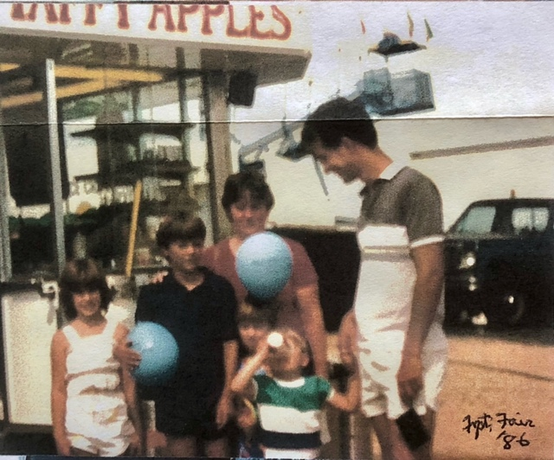

Paul VanRaden, Lise Levie,
Joel, Tonya, Gwynneth,
& Josh drinking. Freeport, IL fair, 1986

Slide 3
For VanRaden family pictures see: paulvanraden.com/InteractingWithFamily.htm

