Slide 1
Miriam (VanRaden) McKenna Audio from 1986
Christmas hosted by Judy and Harold Winship.
From Ruth VanRaden’s tape recorder given to her
as a 1986 Christmas gift by Mark VanRaden family

Slide 2

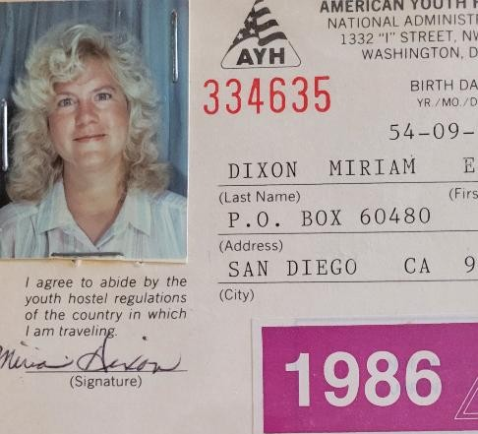
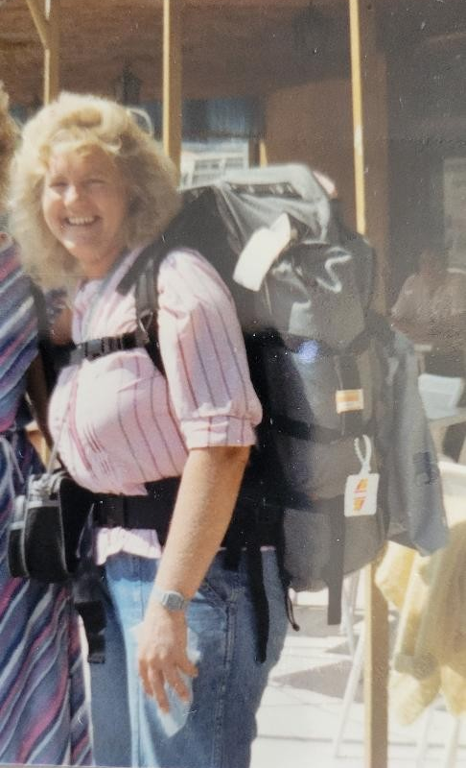
Miriam
1986
Backpacking thru Europe

Slide 3
Miriam
1986
Backpacking thru Europe

Slide 4
Miriam
1986
Backpacking thru Europe

Slide 5
For VanRaden family pictures see: paulvanraden.com/InteractingWithFamily.htm

