Slide 1
Martin VanRaden funeral, 1979
From Forreston Reformed church service
by Reverend C. W. Muyskens

Slide 2
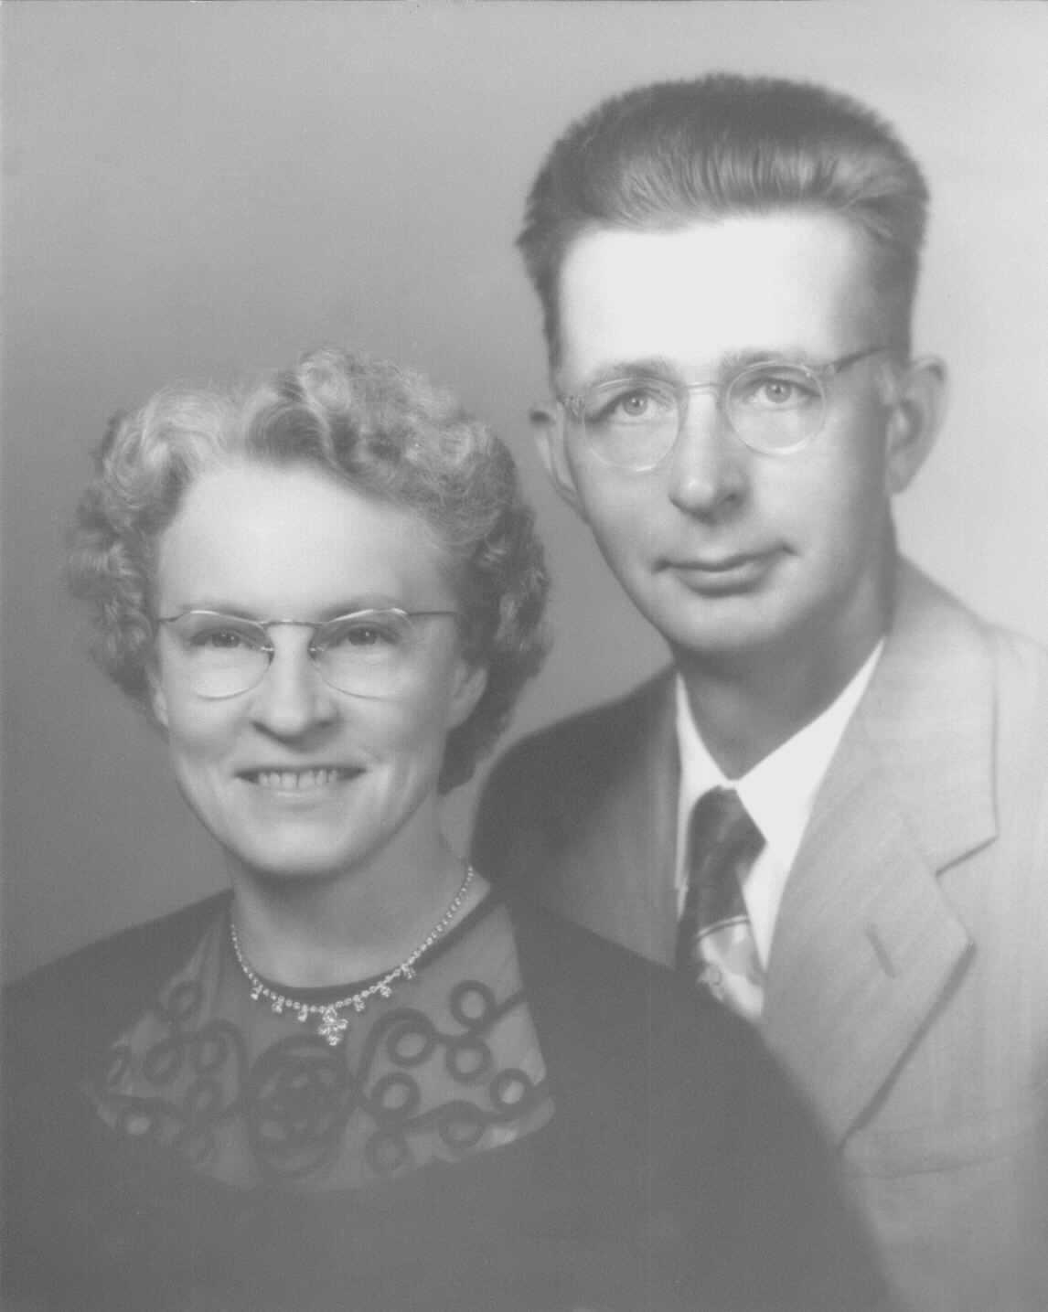
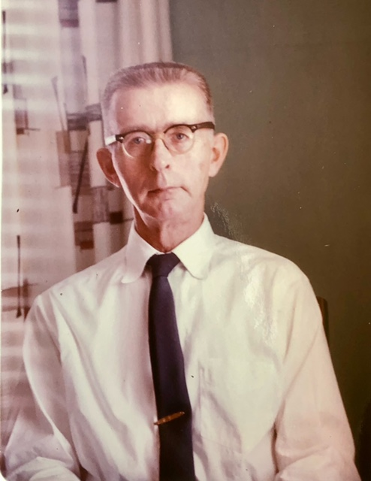

Ruth & Martin

Slide 3
Ruth & Martin

Slide 4
Martin VanRaden

