Slide 1
Mark VanRaden Family
Audio from 1986
From Ruth VanRaden’s tape recorder given to her
as a 1986 Christmas gift by Mark VanRaden family

Slide 2

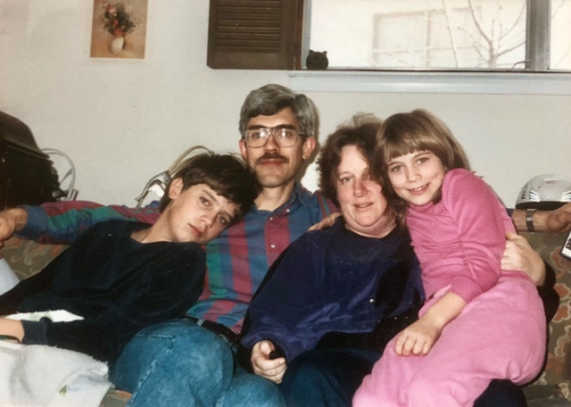
Mark
VanRaden family – 1989
Joel,
Lise,
Gwynneth

Slide 3
Mark
VanRaden family – 1989
Joel,
Lise,
Gwynneth

Slide 4
Mark
VanRaden family – 1989
Joel,
Lise,
Gwynneth

Slide 5
Mark
VanRaden family – 1989
Joel,
Lise,
Gwynneth

Slide 6
Mark
VanRaden family – 1989
Joel,
Lise,
Gwynneth

Slide 7
For VanRaden family pictures see: paulvanraden.com/InteractingWithFamily.htm

