Slide 1
Katie VanRaden
Audio from 2000
From Ruth VanRaden’s tape recorder given to her
as a 1986 Christmas gift by Mark VanRaden family

Slide 2
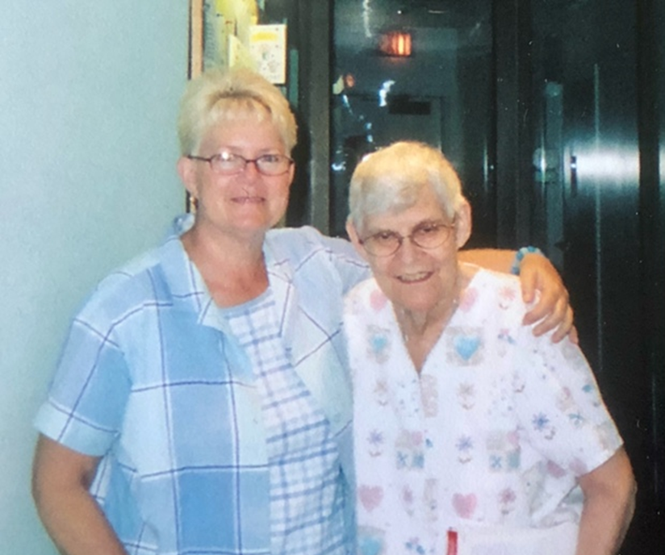
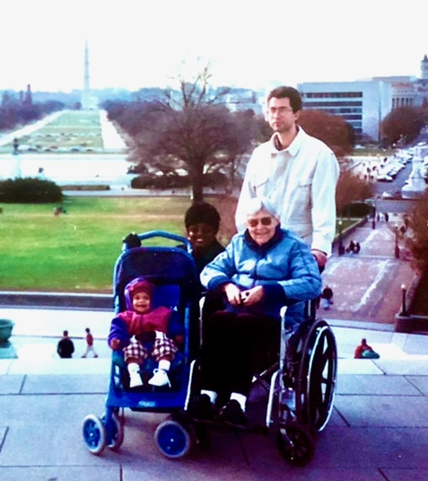

Katie VanRaden – Audio added in 2000 photos with Miriam and Paul’s family in DC

Slide 3
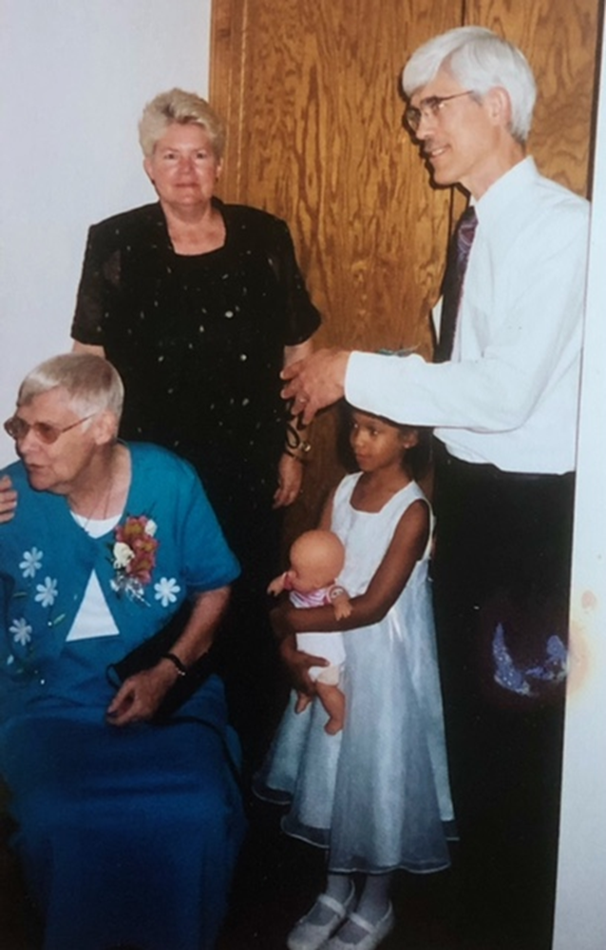
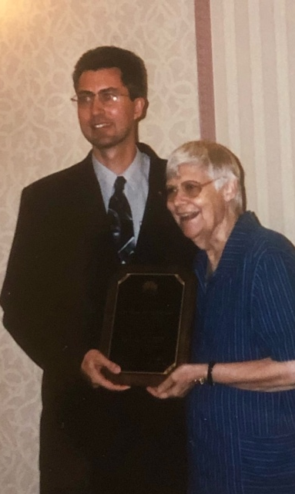
Katie VanRaden with Miriam, Mark, and Angel, and with Paul in 2000

Slide 4
For VanRaden family pictures see: paulvanraden.com/InteractingWithFamily.htm

