Slide 1
Katie VanRaden
Audio from 1986
From Ruth VanRaden’s tape recorder given to her
as a 1986 Christmas gift by Mark VanRaden family

Slide 2
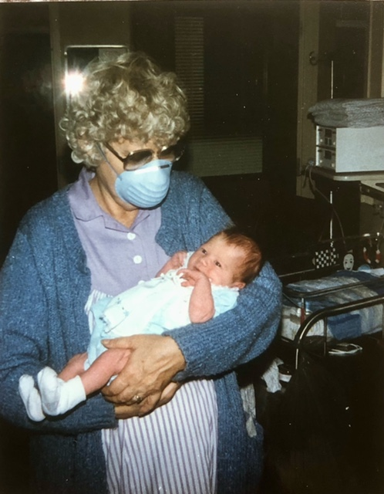

Katie VanRaden – 1987 with Hillary Winship

Slide 3
For VanRaden family pictures see: paulvanraden.com/InteractingWithFamily.htm

