Slide 1
Deb’s Family Audio from 1986
Christmas hosted by Judy and Harold Winship.
From Ruth VanRaden’s tape recorder given to her
as a 1986 Christmas gift by Mark VanRaden family

Slide 2
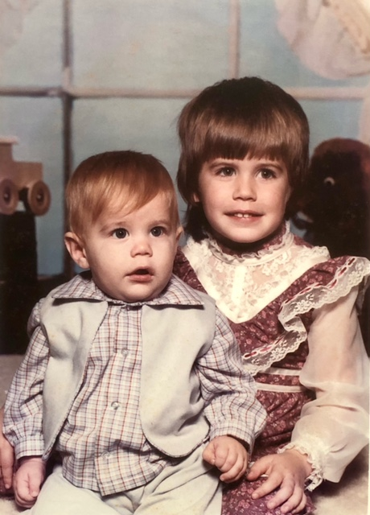

Josh and Tonya Heeren - 1986

Slide 3
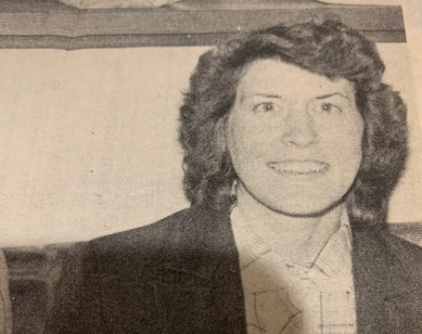
Deb Noordhoff - 1986

Slide 4
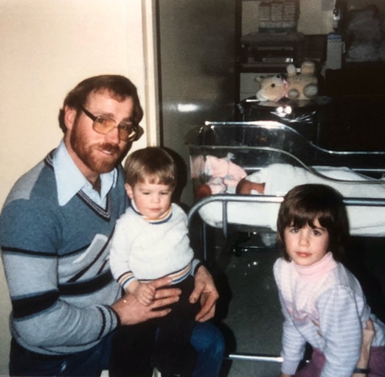
Lee Heeren with Josh, Tonya, and newborn Tiffany - 1985

Slide 5
For VanRaden family pictures see: paulvanraden.com/InteractingWithFamily.htm

