Slide 1
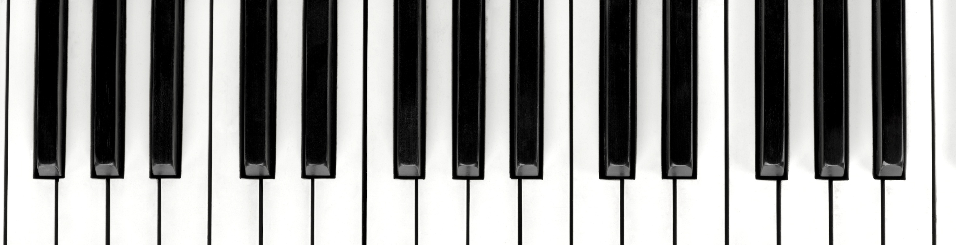
Experiments with Standard Piano
Paul VanRaden
©2025

Slide 2
Introduction
Research in this report used the standard piano keyboard with standard tuning
Goals were to play the 7 white and 5 black keys per double as if they were simply numbered 1 to 12
  Except for some scales played only on black keys
Most of my other piano research focused on:
  Better math for setting tones (tuning systems)
  Evenly-spaced piano keyboards to easily use the math

Slide 3
Experiments
Music using all 12 keys whether black or white
Scales using every other or every third key (black or white)
Scales using different numbers (8, 4, 2, and 1) of evenly spaced tones per double
Scales using only black keys
Do-Re-Mi as a marching song
Scales to accompany Happy Birthday and Beethoven’s 9th

Slide 4
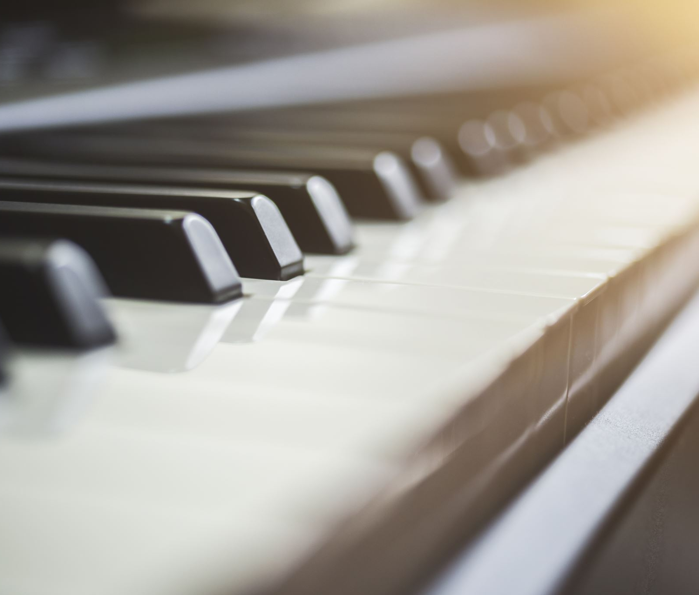
Warning !
Sound quality is poor due to powerpoint audio compression of music
This is a well-known issue that .pptx will not solve
See: Powerpoint's audio recording quality is terrible : r/powerpoint
The scales sound great on my piano speakers

Slide 5

Music using all 12 keys whether black or white
Some percussion to start
Lead part using piano keys 0 to 12 (0 = C1, 12 = C2):
  0 12 10 11 12 9 8 9 7 8 9 6 5 6 4 5 6 3 2 0 4 8 12
Then ascending using all 12 keys in a row while descending using every 2nd key every 3rd beat
  [0 12] 1 [2 10] 3 [4 8] 5 6 7 4 8 9 2 10 11 [12 0]
Base part using every 4th key, then every other key
  0 12 0 8 0 4 4 0 0 12 10 8 6 4 2 0

Slide 6
Scales using every other or every third key
Some percussion to set the mood
Piano descending 8-tone scales skipping every 4th key (counting white and black keys), 12 10 9 8 6 5 4 2 1 0
Harpsicord descending 6-tone scales skipping every other key (counting white and black keys) and following one measure behind, 12 10 8 6 4 2 0
Both parts sound like running down the steps
Cello part using just a few notes

Slide 7
Scales using 8, 4, 2, and then 1 tone per double
Some percussion to get started
Lead part doubling the width of its scale 4 times
  First using 8 tones per double, then returning to its base tone
  Beginning scale with relative frequencies 8, 9, 10, 11, 12
  Next scale with relative frequencies 8, 10, 12, 14, 16
  Next scale with relative frequencies 8, 12, 16, 24, 32
  Last scale with relative frequencies 8, 16, 32, 64, 128
Bass part also doubling the width of its scale 4 times

Slide 8
Scales using only black keys
Some percussion to set the mood
Two lead scales going up and then down 5 black notes in a row
One reacting part going down 4 black notes in a row
One base part going up and down 8 black notes in a row
Very simple to play, but pleasing

Slide 9
Do-Re-Mi as a marching song
A song teaching the standard 7 tones per double you are supposed to use
Do-Re-Mi-Fa-So-La-Ti and then the next “Do” with twice the frequency
From the 1965 movie The Sound of Music
Reimagined as a marching song
Played here with just percussion and piano

Slide 10
Happy Birthday hearing the 9 beats/measure
The Happy Birthday song has 3 main beats per measure and triplets within those for 9-beat measures.
Scales with 3 keys per double and repeated 3 times accompany the song to better hear the 9-beat music timing.

Slide 11
Beethoven’s 9th symphony
First song I learned to play during piano lessons when 9 years old.
Added a repeating scale using 4 notes per double.
Starting 2 doubles above the melody, descending to 1 double above, then ascending back to 2 doubles above.
Harmony scale played at twice the speed (half the note duration) of the main melody.
Many different songs harmonize well with similar repeating scales.

Slide 12
Jukebox Hero
Jukebox Hero by Foreigner in 1981 was my favorite song when I began this research
The best sounding chord I could find on my keyboard had relative frequency ratios 1:2:4:8:16:32:64:128 using keys C0, C1, C2, C3, C4, C5, C6, and C7 all played together
Most guitars have 6 strings, but 2 guitars together could play that chord
The audio vocals use several tones, but the guitar chords and sequences only use the C tones (8 doubles, or 2 to the power n where n = 0 to 7)

Slide 13
Conclusions
These early experiments gave me confidence that evenly spaced keys and scales would be better
Using letters A-G for white notes, and using sharps, flats, and naturals for black notes in music notation is unnatural and hard on your brain
Using repeating patterns of keys 1-12 is easier
This research was mostly done around year 2000 after first purchasing an electronic keyboard
Return to Music and Math in Harmony

