Slide 1
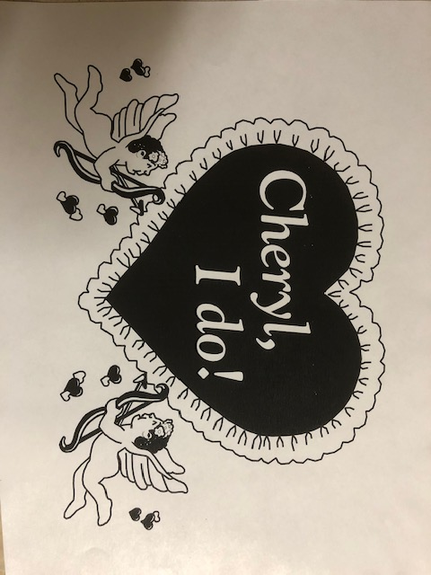
Little Wedding
By Cheryl and Paul VanRaden
May 18, 1995
Towson, MD

Slide 2
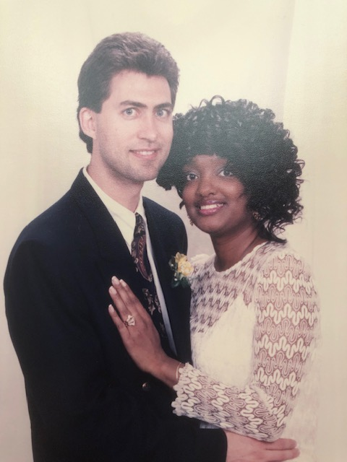
Welcome to the wedding of Paul and Cheryl

Slide 3
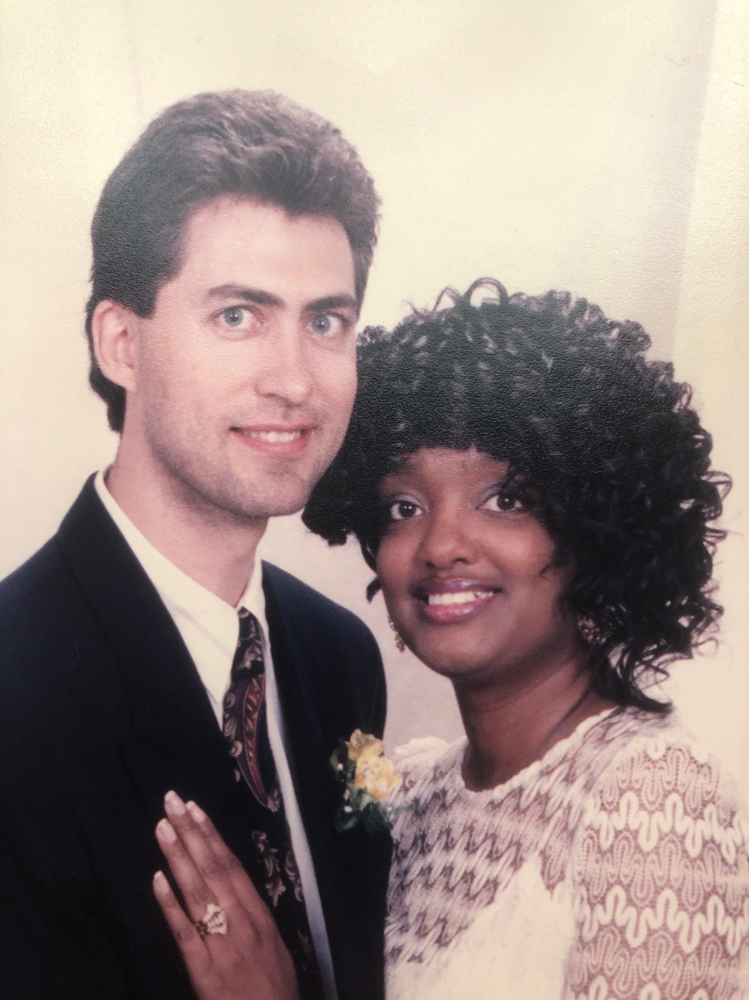
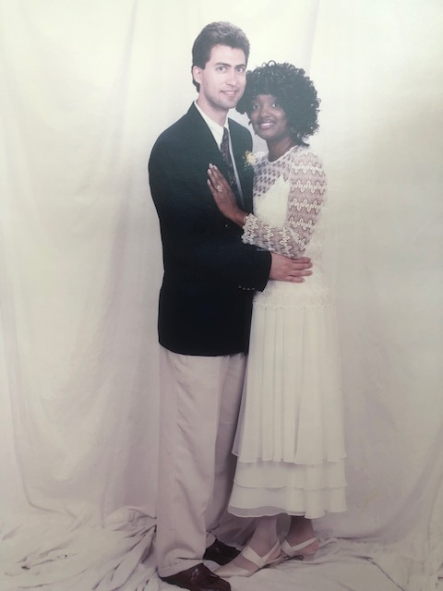

Slide 4
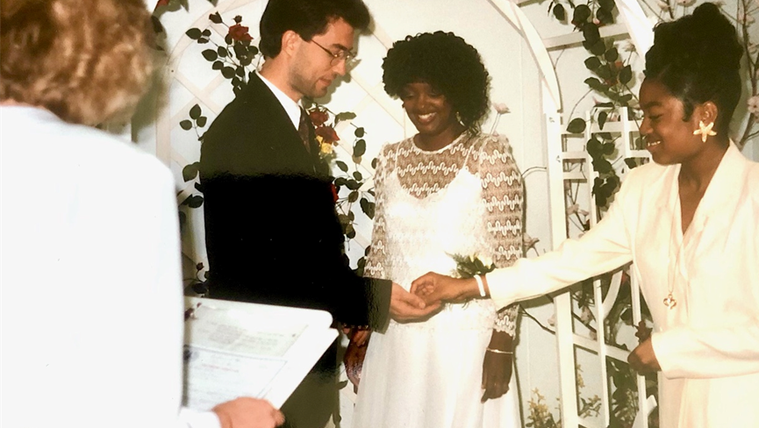
Maid of Honor, Ringbearer, Daughter Charlee

Slide 5
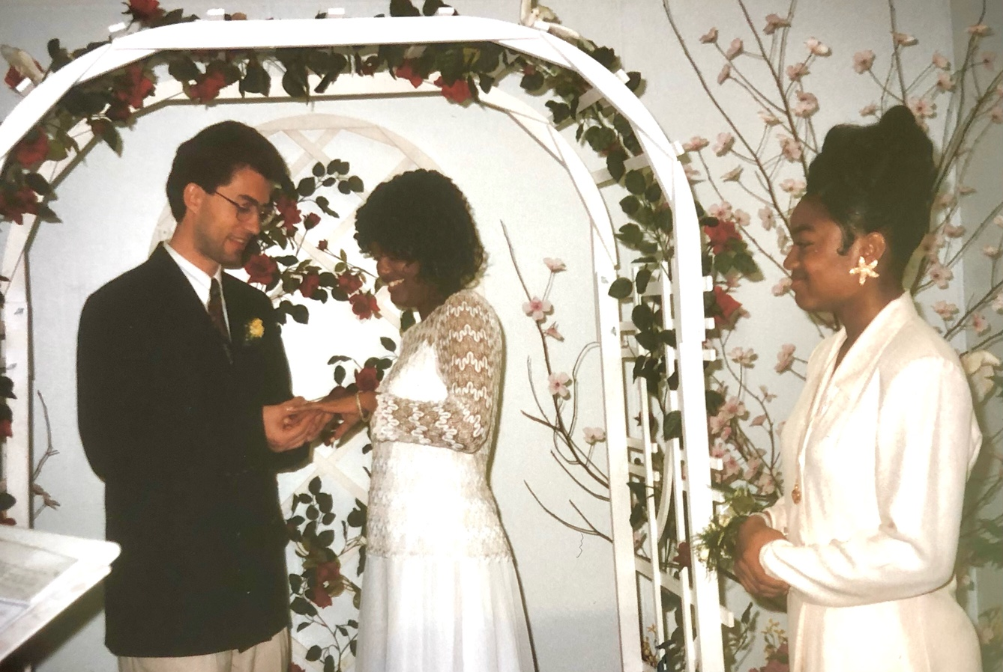
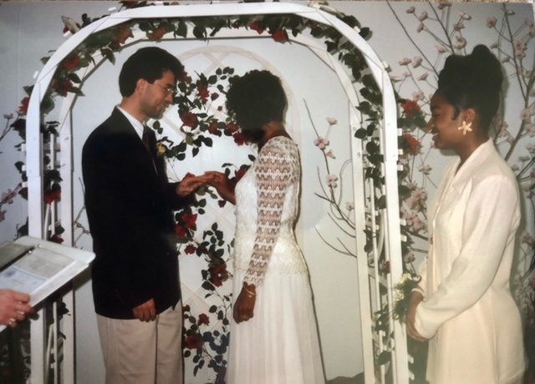
With this ring…

Slide 6
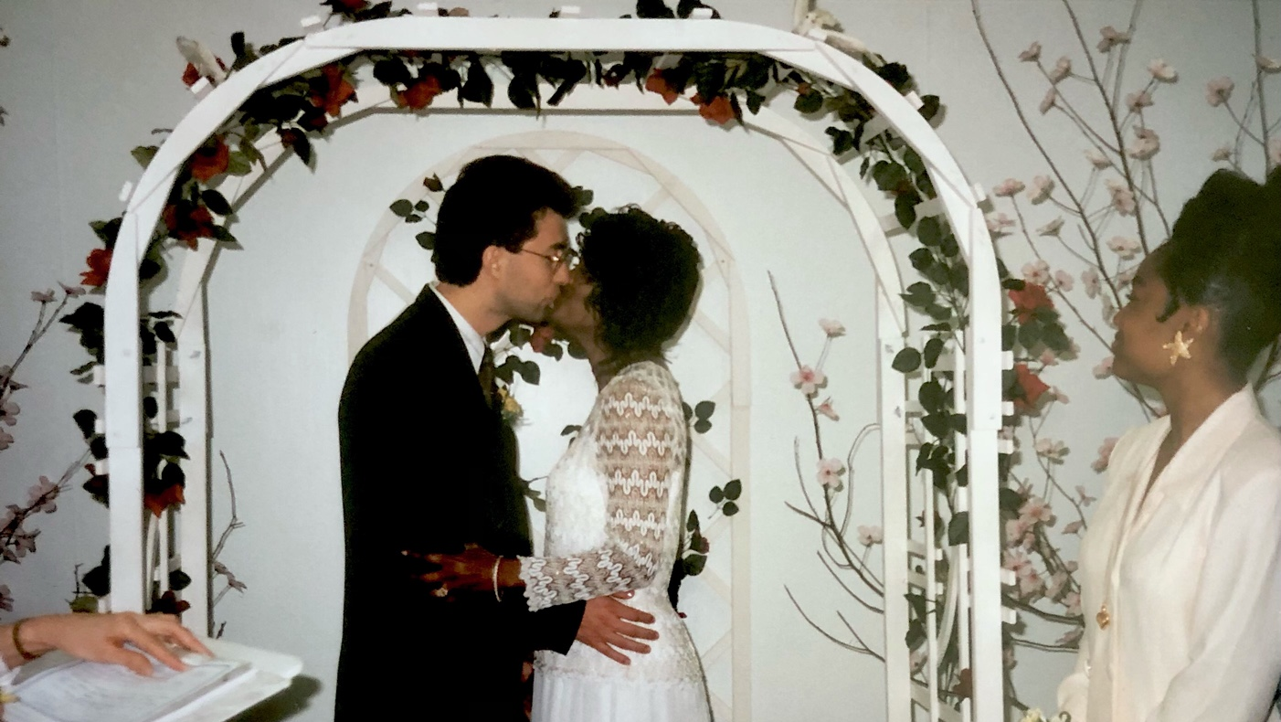
You may kiss the bride

Slide 7
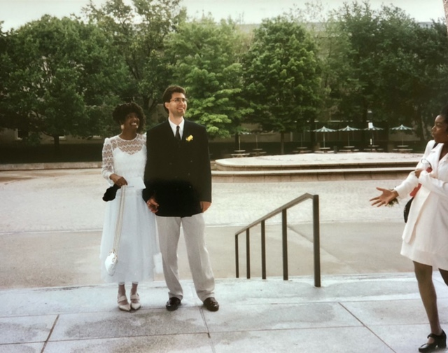
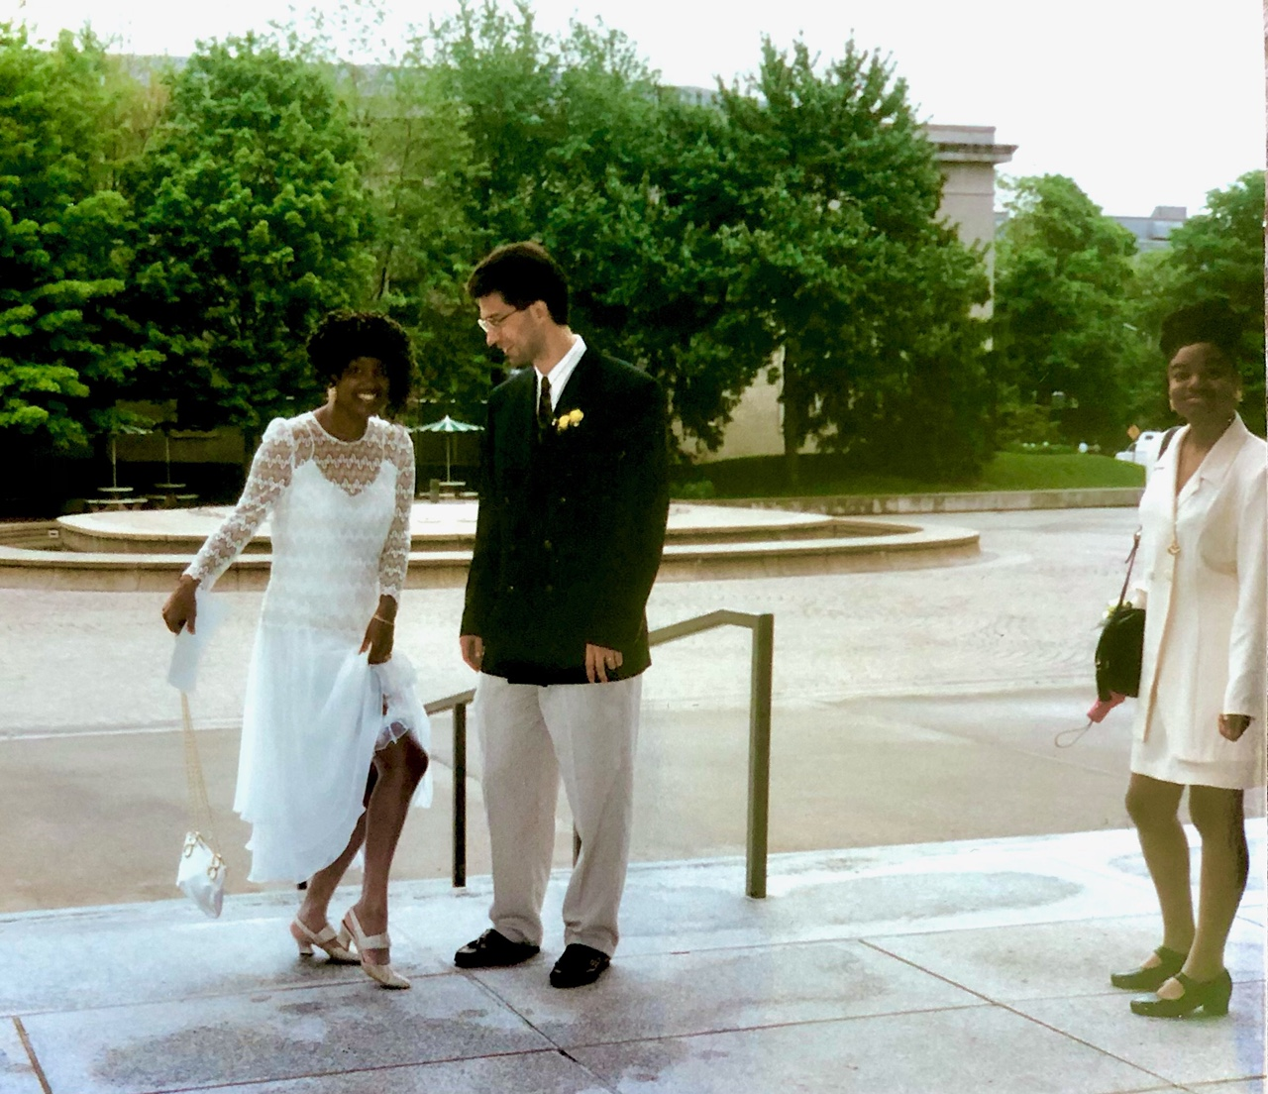
Throwing some rice and showing some leg

Slide 8
All of our wedding guests

Slide 9
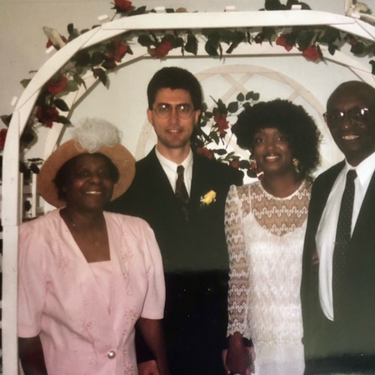
Dora Brice (bride’s Mom), newlyweds, and John Brice (best man)

Slide 10
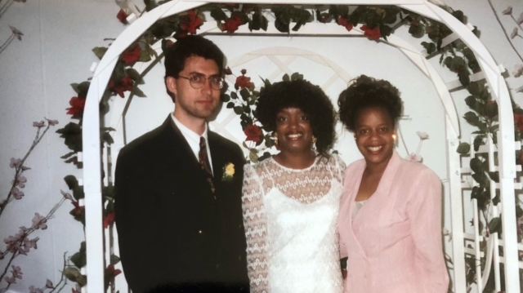
With sister of bride (also the photographer): Annette Brown

Slide 11
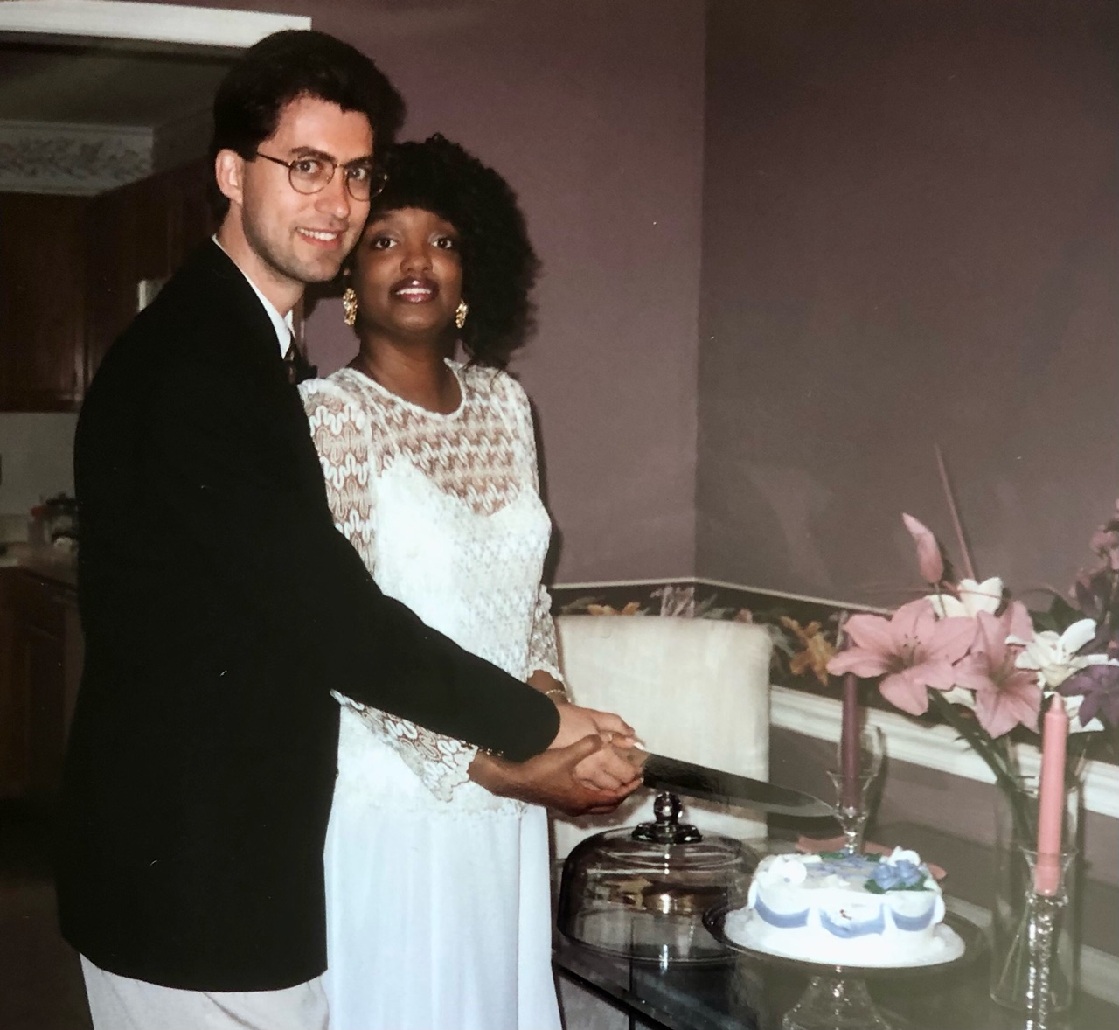
Time for some wedding cake

