Slide 1
Keyboards and Tuning
Paul VanRaden
©2023

Slide 2
Topics
Theory of harmony (sound wave frequencies and ratios)
Key spacing options for the keyboard
Repeating patterns for front and back row keys
Even vs. uneven spacing of keys
Reason that the current keyboard has survived 650 years
Tuning of the keys
Improving harmony with linear instead of log₂ tuning
Setting tones using (1 + n/w) instead of 2^{(n/w)}
Improving tone spacing using jointed linear segments
Half-linear: 6 steps of 1/15 followed by 6 steps of 1/10
Applying flexible tuning to electronic keyboards

Slide 3
Theory of harmony
A single tone has a very simple repeating pattern like a sine wave
Multiple tones combine into more complex patterns
Tones with very complex ratios have long repeat lengths
Ears can easily recognize short, simple, repeating cycles
Tones 1, 2, 4, 8, etc. (doubles or octaves) combine simply
Repeat length is short and equals the highest individual tone
Next slide shows wavelengths 4, 2, 1 and how those combine (bottom)
Y axis shows the air pressure waves that enter your ears

Slide 4
Harmony from combining 3 doubles

Slide 5
Combining 2, 3, or 4 doubles (octaves)

Slide 6
Harmony from combining frequencies 1, 2, and 3

Slide 7
Wave peaks that are synchronized or offset
Even when exactly in tune, the timing of 2 pressure waves can differ
The peaks for 2 tones can be exactly synchronized or offset
The shape of waves is affected by when the 2 patterns reach your ears
Sound travels at about 1100 feet/second, more in warm or less in cold air
Distance between waves is 2.5 feet for standard A with 440 waves/second
Perfect harmony can match both frequency and timing of pressure peaks
Synchronized or offset wave combinations are in next slide (top, bottom)

Slide 8
Tone waves synchronized or offset

Slide 9
Which ratios sound best or worst?
All frequency ratio choices between 1 and 2 can be rated and graphed
Rating: Divide the shorter of the two wavelengths by the wave repeat length
For example, tone frequencies 2 and 3 have a repeat length of 6
Frequency 3 has a shorter wavelength than 2
Dividing wavelength 3 by repeat length 6 gives ratio = .5
Then take log base 2 of that ratio and add 4
For example, -1 + 4 = 3 is the rating for combining wavelengths 2 and 3
Tone ratio 2 with 3 is equivalent to playing note C with the G above it
Other tone ratios with longer repeat lengths get poorer ratings
See rating graph on next slide

Slide 10
Harmony of 2 tones with ratios from 1 to 2

Slide 11
Observations about harmony graph
Best harmony ratios are 2/1, then 3/2, then 4/3, 5/3, then 5/4, 7/4
Poorest harmony choices are near the best choices
Frequency ratio 1.03 is the poorest choice and gets the poorest rating
Ratios such as 1.01 closer to 1.0 sound almost like a single tone
Only about 10 precise ratios sound better than a single tone
Most random combinations of 2 tones sound worse than a single tone
A solo sounds better than a duet with poor harmony
Precise harmony sounds better than a solo

Slide 12
Reciprocal harmony ratios
The previous graph showed harmony choices above a standard tone
The best harmony choice between 1 and 2 was 1.5 (harmony ratio 3:2)
But you may want to choose a lower instead of higher tone
The best harmony choice between 0.5 and 1 is 0.66667 (harmony ratio 2:3)
If the standard tone is C, the G above it has ratio 1.5 with ratio 3:2
The best tone below C is the next F with ratio 2:3, not the G!
Reciprocal tone ratios are not symmetrical above or below the standard
The next graph includes harmony choices below the standard tone

Slide 13
Harmony of 2 tones with ratios from 0.5 to 2

Slide 14
The standard keyboard from year 1350: Unevenly spaced keys with 7 in front + 5 in back = 12
C C# D D# E F F# G G# A A# B C C# D D# E F F# G G# A A# B

Slide 15
Linear vs. log₂ tuning with 12 tones per double Half-linear uses 6 steps of 1/10 and 6 of 1/15
 | Note Letter | C | D | E | F | G | A | B | C
 | Note Number | 0 | 2 | 4 | 5 | 7 | 9 | 11 | 12
Freq | Log₂ | 1 | 1.122 | 1.260 | 1.335 | 1.498 | 1.682 | 1.888 | 2
Freq | Half-linear | 1 | 1.125 | 1.25 | 1.333 | 1.5 | 1.667 | 1.833 | 2
Freq | Linear | 1 | 1.167 | 1.333 | 1.416 | 1.583 | 1.75 | 1.917 | 2
Ratio | Half-linear | 1 | 9/8 | 5/4 | 4/3 | 3/2 | 5/3 | 11/6 | 2
Ratio | Linear | 1 | 7/6 | 4/3 | 17/12 | 19/12 | 7/4 | 23/12 | 2

Slide 16
Frequencies across 2 doubles using lines within each double, half-double, or with log₂ tuning

Slide 17
Reciprocal, linear, log₂ and tuning frequencies across doubles (w = 4 notes per double)
Tuning | n | -4 | -3 | -2 | -1 | 0 | 1 | 2 | 3 | 4
 | Formula: |  |  |  |  | Base Note
Linear | 1 + n/w | 0 | 0.25 | 0.5 | 0.75 | 1 | 1.25 | 1.5 | 1.75 | 2
Log2 | 2^{(n/w)} | 0.5 | 0.595 | 0.707 | 0.841 | 1 | 1.189 | 1.414 | 1.682 | 2
Recip. | 2w/(2w-n) | 0.667 | 0.727 | 0.8 | 0.889 | 1 | 1.143 | 1.333 | 1.6 | 2
Linear | Ratio | 0 | 1/4 | 1/2 | 3/4 | 1 | 5/4 | 3/2 | 7/4 | 2
Log2 | Ratio | 1/2 | * | √(1/2) | * | 1 | * | √2 | * | 2
Recip. | Ratio | 2/3 | 8/11 | 4/5 | 8/9 | 1 | 8/7 | 4/3 | 8/5 | 2
* Ratios for log tuning include the n/w root of 2 (the ¼ root or ¾ root)

Slide 18
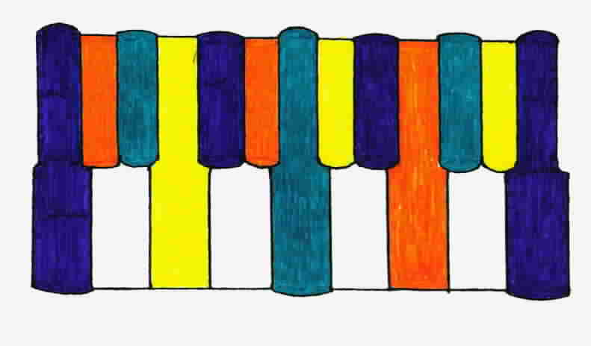
Evenly spaced keys with 2 in front, 3 in back

Slide 19
Evenly spaced keys with 4 in front, 3 in back

Slide 20
Equivalent notes with 4 keys in front, 3 in back to standard keyboard
C#
D# C# D#
G
A
F#
G#
A#
B
C
D
E
F
B
C D E F

Slide 21
Evenly spaced keys with 3 in front, 4 in back

Slide 22
Evenly spaced keys with 4 in front, 3 in back, slightly different color scheme

Slide 23
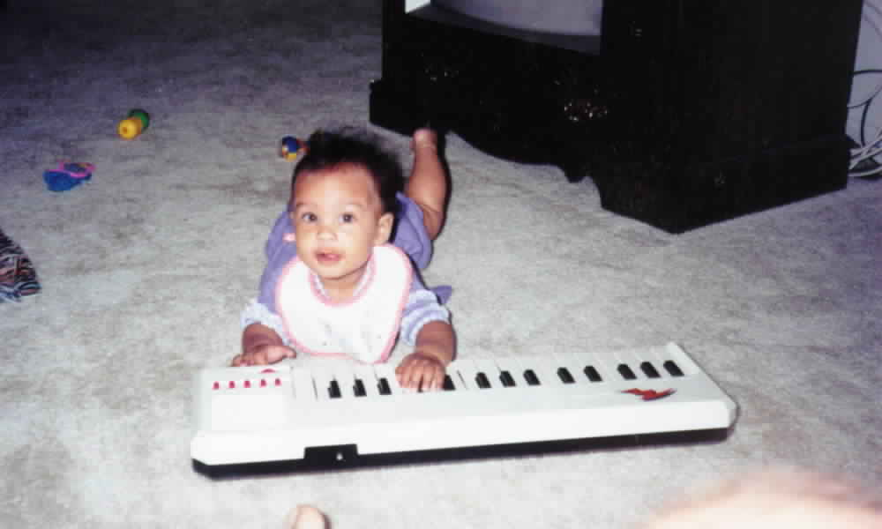
Angel VanRaden wanted a new keyboard

Slide 24
Conclusions
Ears detect harmony by repeating air pressure waves
Linear tuning functions give more precise harmony than log tuning
Much easier to put evenly spaced tones onto an evenly spaced keyboard
Current 12 piano keys per double also fit onto an evenly spaced keyboard
Electronic piano can be rescaled for beginners or professionals
Several new tuning options are available
Just need to build a new keyboard

