Slide 1
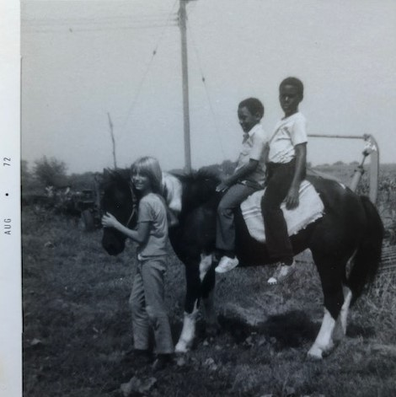
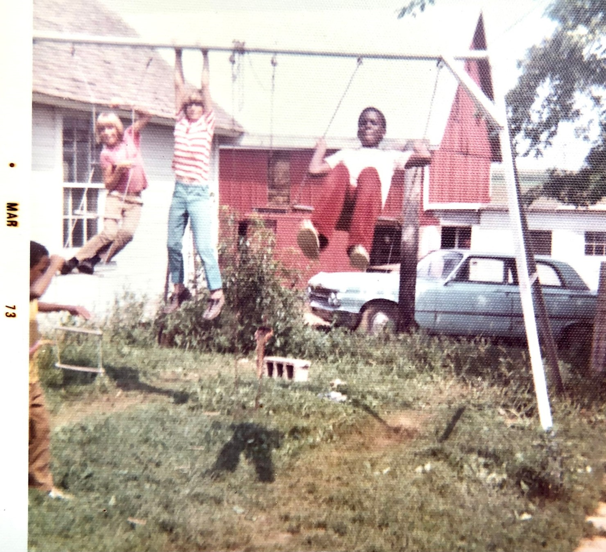
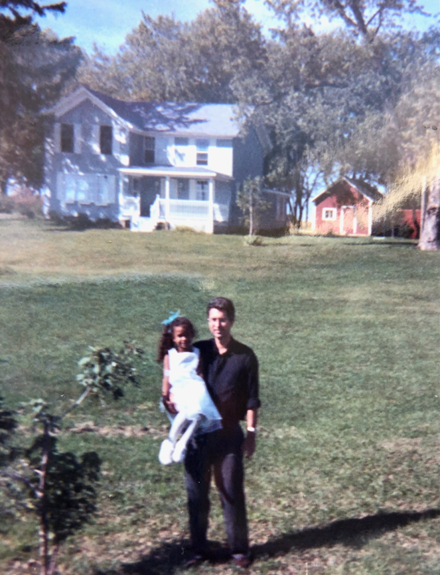
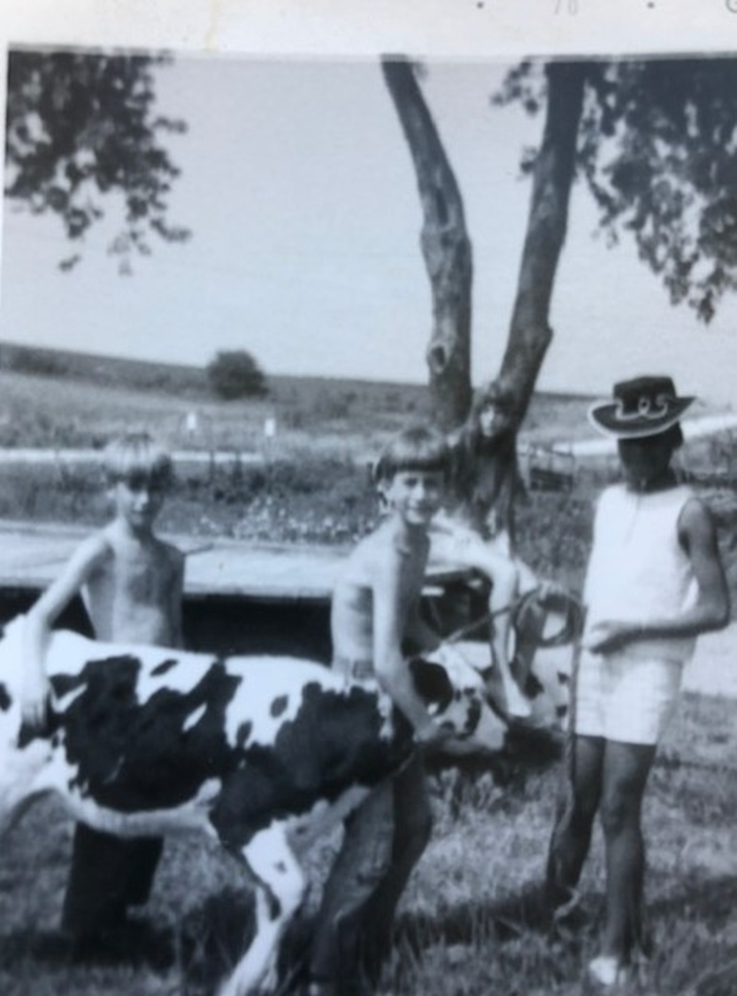
Desegregation on the Farm 1955-1973
16760 W. Townline Road
Forreston, IL 61030
Compiled by Paul VanRaden,
former resident 1960-1978

Slide 2
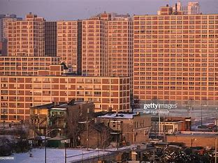
Examples of city to farm exchanges
Kids from low-income housing in Chicago visited Forreston in northwest IL during early 1970s.
The visits expanded for a few years to include perhaps 2 vans full of Chicago kids for about 2-week visits to host families each summer.
Forreston host kids later returned the visit and went for a few days to their Chicago neighborhood to get some city experience.
Earl and Nancy Simler, Ralph and Dorothy Boomgarden, Walter and Katie VanRaden of Forreston initiated and arranged the first visits.
Desegregation was initially controversial but was not too difficult.

Slide 3
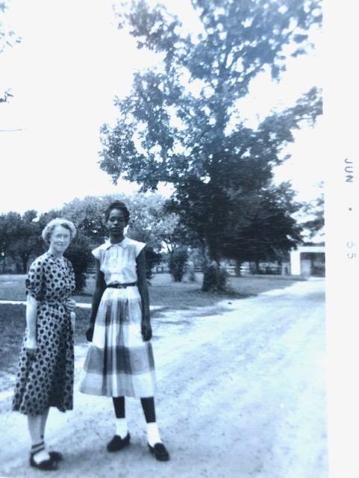
Ruth VanRaden and friend, 1955

Slide 4
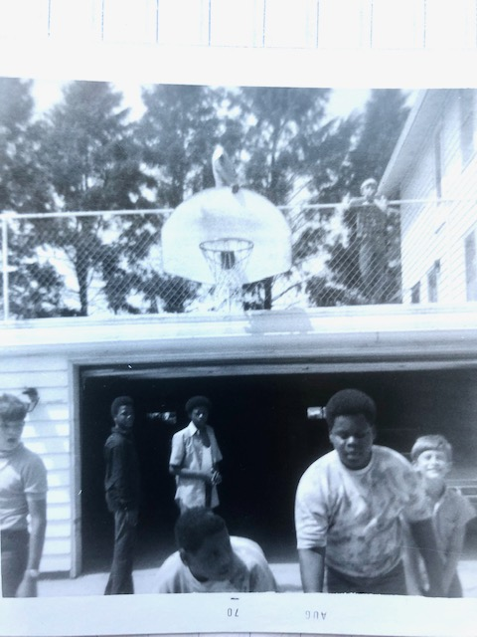
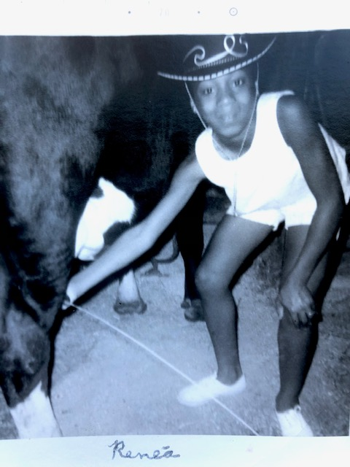
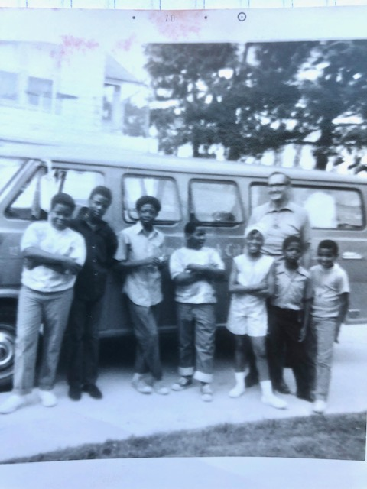
From Chicago to Forreston, IL – 1970 Middle picture, right side: Paul

Slide 5
VanRaden farm 1970
Dave, Paul, and Renea,
Deb in background,
Paul’s first 4-H calf Spottie
in foreground

Slide 6
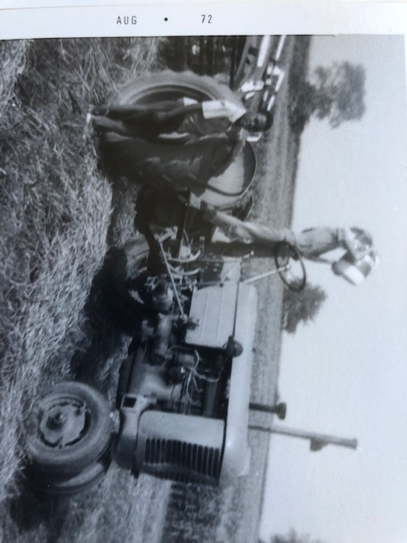
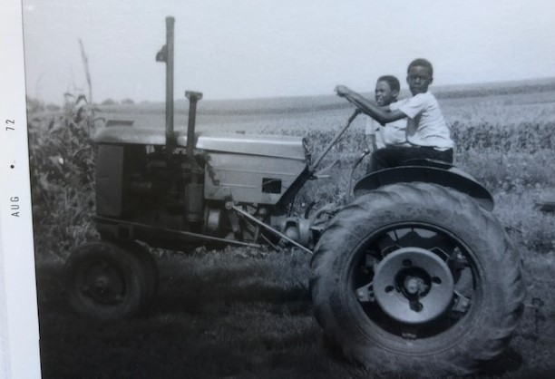
VanRaden farm, Forreston, IL – August 1972

Slide 7
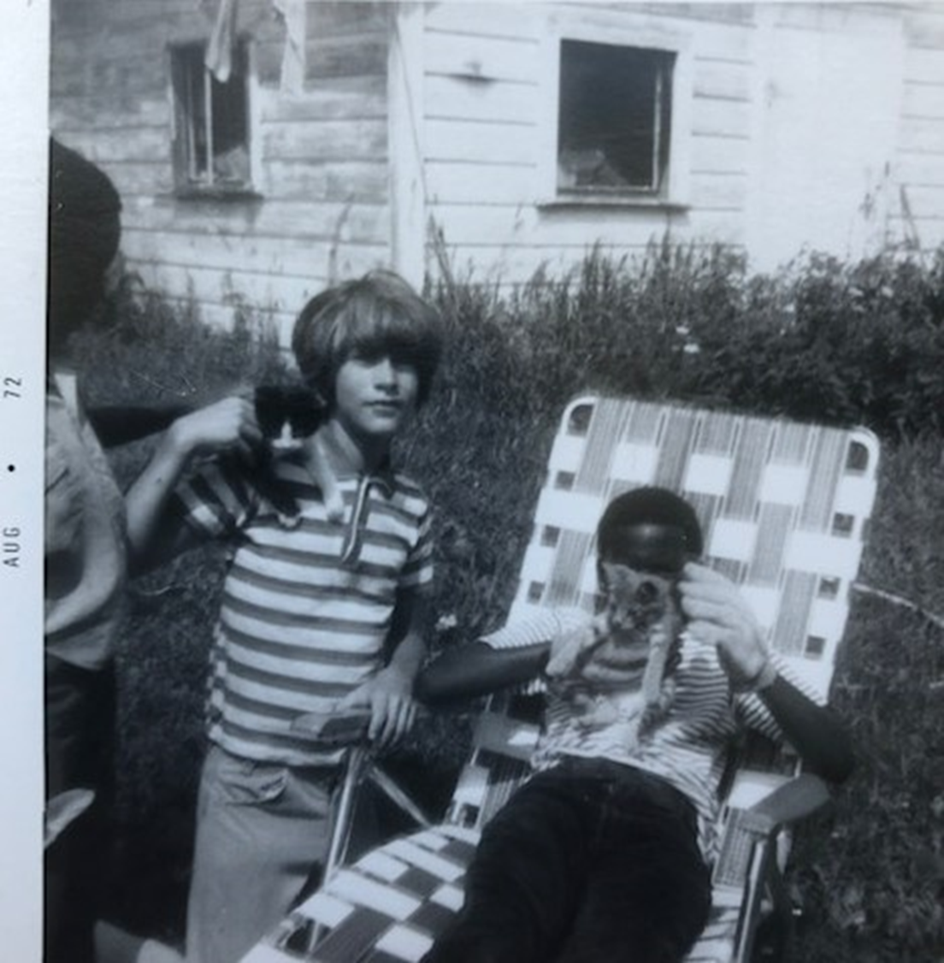
VanRaden farm - 1972 (left: Dave, right: Paul)

Slide 8
VanRaden farm 1973
Dave, Paul, and friends

Slide 9
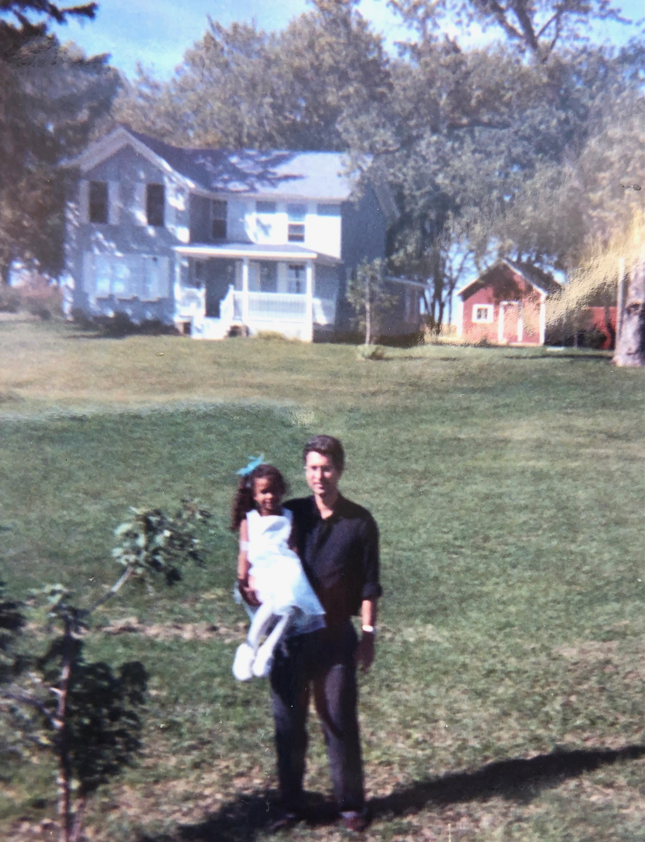
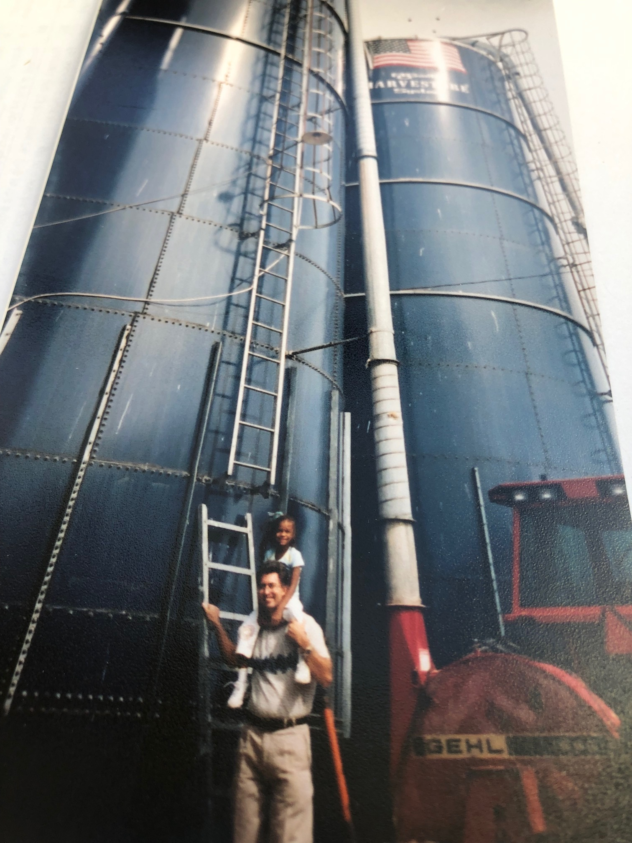
Next generation at Forreston, Lanark IL farms Sep 2003
Angel and Paul

Slide 10
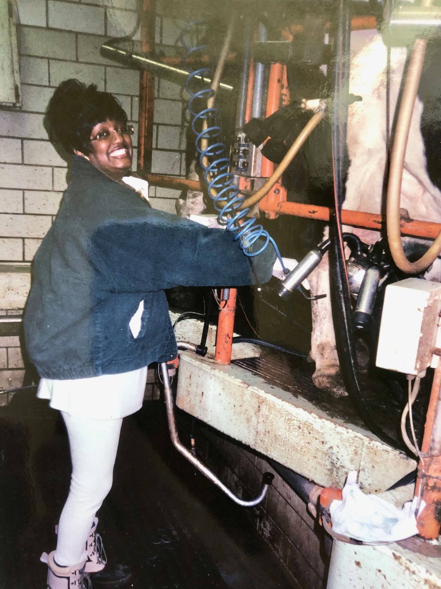
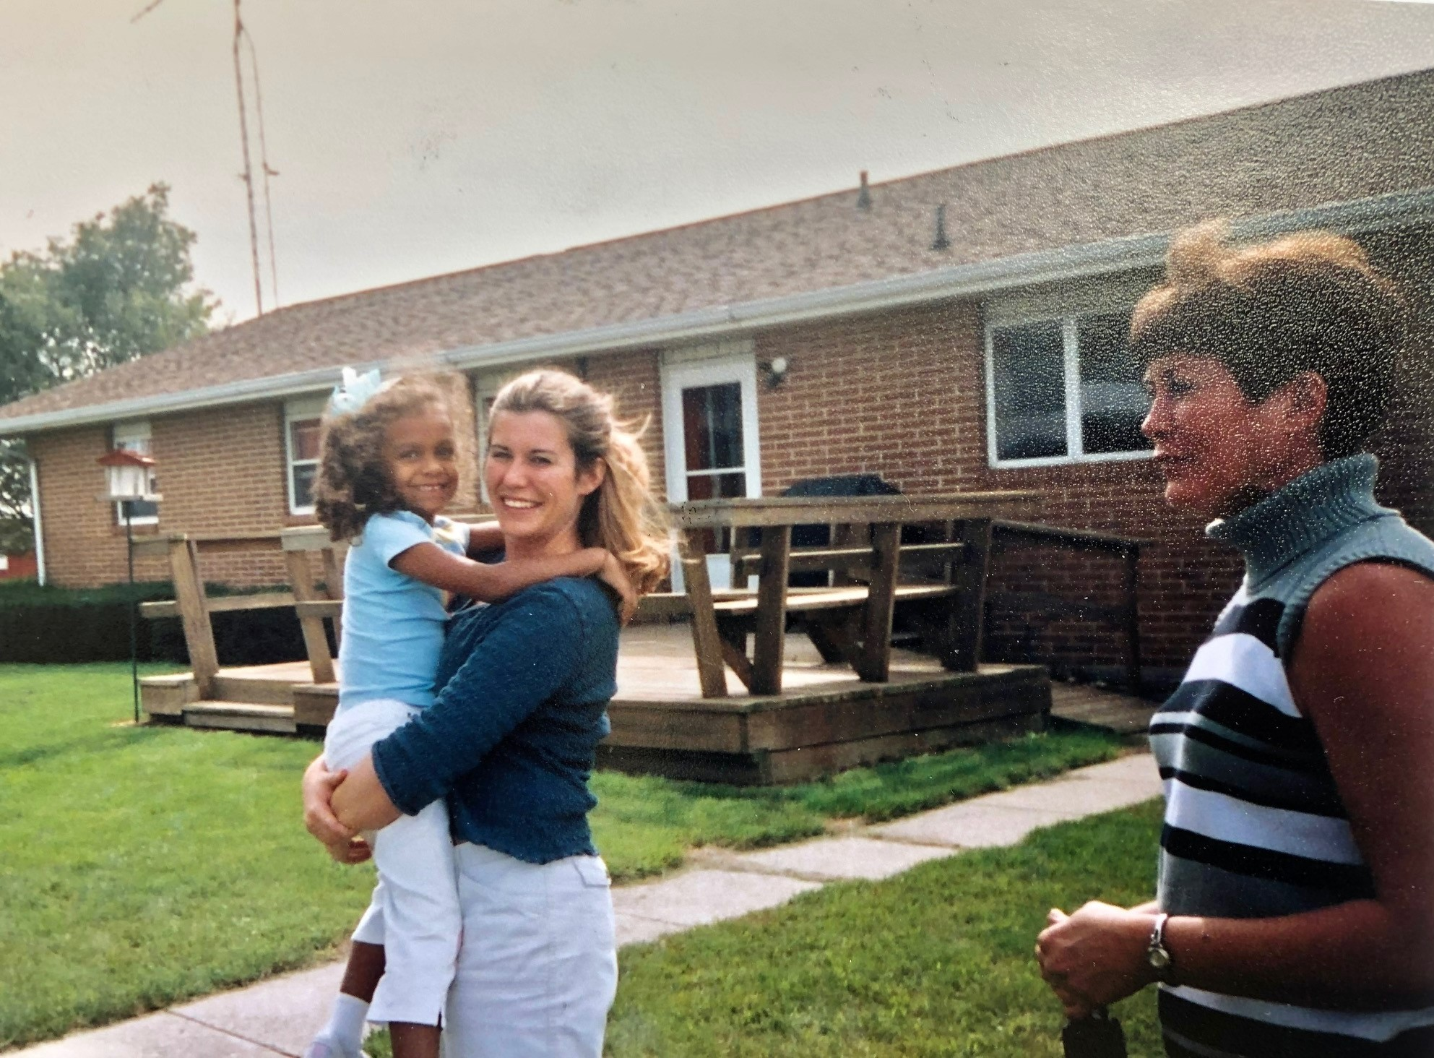
Desegregation at Lanark, IL Angel, Tonya, Deb, Cheryl – Sep 25 2003

Slide 11
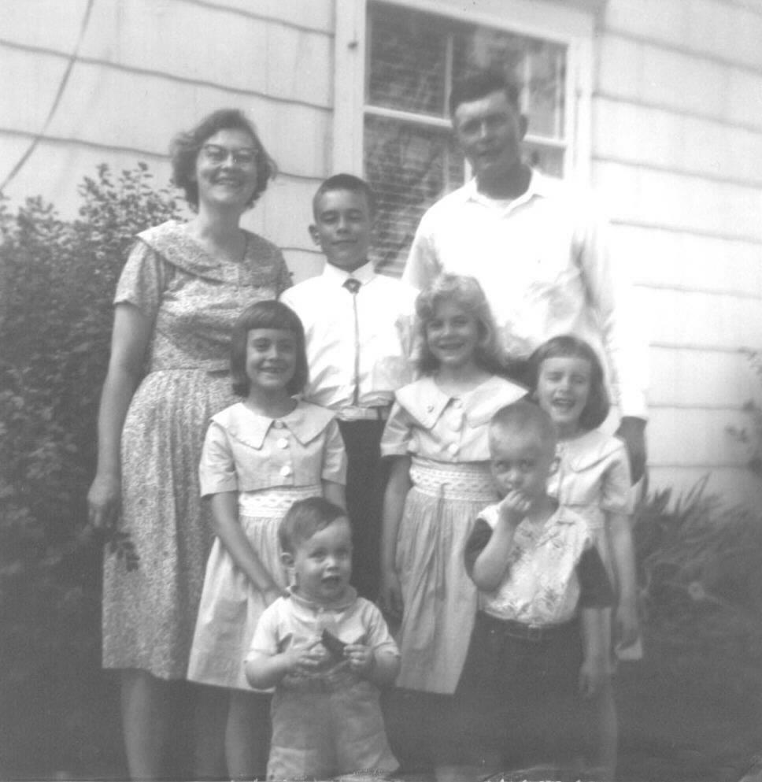
Background for this research
Dr. Mark VanRaden in Feb 2023 asked these questions:
How did our parents come to be so decidedly anti-racist?
I have a sense that Dad identified one source for himself, namely having an African roommate during his year at Hope College. Did his roommate or faculty or students at Hope weigh in directly on this?
Did he have any sudden realization or was there a gradual turning? Did he decide it pretty much by himself, or were Mom and/or others involved?
Did he see early on that some in the Forreston Reformed Church were in opposition to these beliefs?
Why did neither Dad nor Mom talk about the history of their beliefs (not that I can recall, at least)? I sure wish I could have a discussion with each (or both) of them because I think it's the case that Dad & Mom had a clear influence on our beliefs!

