Slide 1
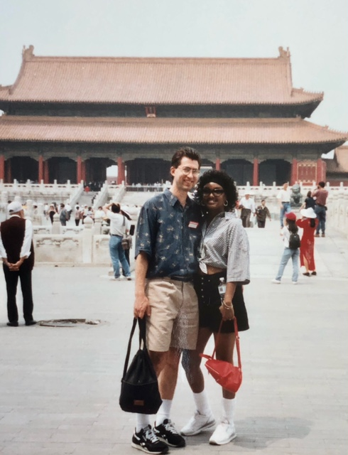
Big Honeymoon
By Cheryl and Paul VanRaden
May 19-June 3, 1995
Tokyo, Beijing, Bangkok, Singapore, Hong Kong
$7,852 for 2
Photo in Beijing’s Forbidden City

Slide 2
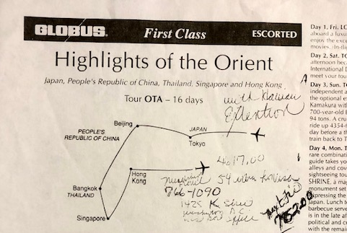
16-day guided tour of 5 major Asian cities

Slide 3
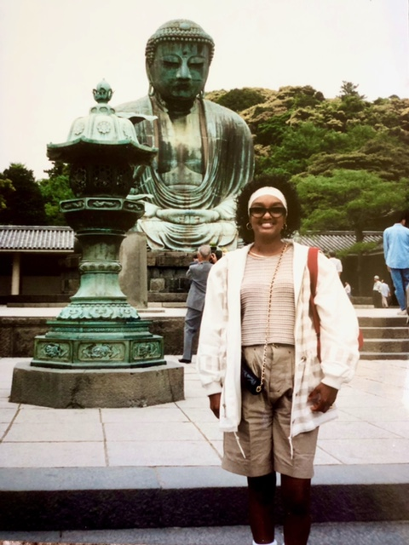
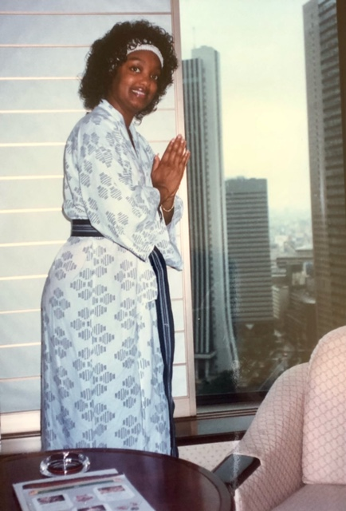
First stop Tokyo

Slide 4
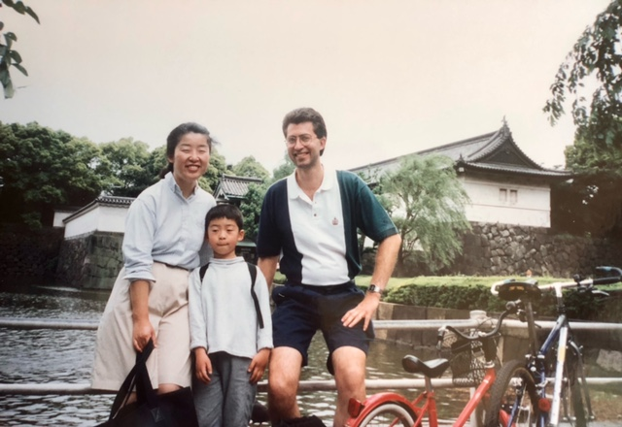
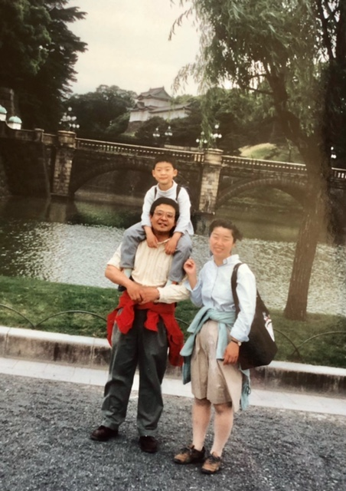
Visiting Hiroshi Takahashi and family Riding bikes at Emperor’s Palace

Slide 5
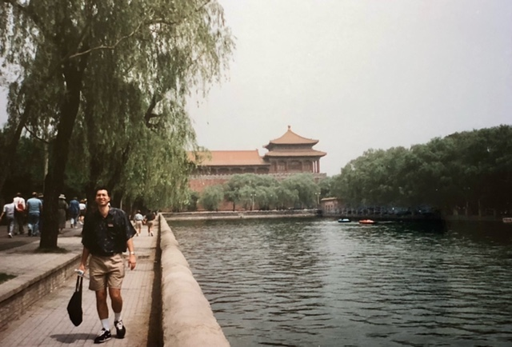
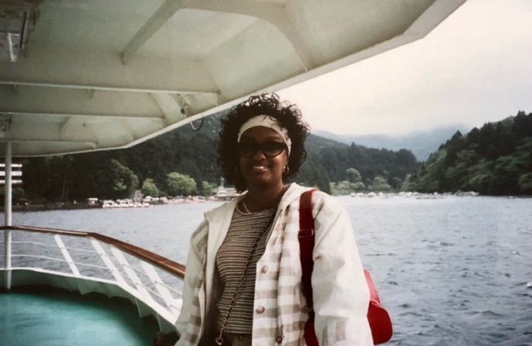
Sightseeing and cruising Lake Hakone

Slide 6
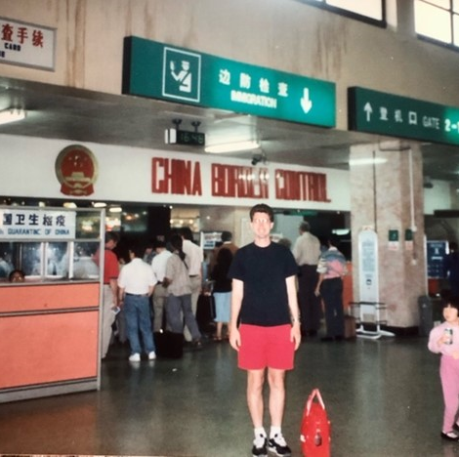
Second stop: Beijing Airport border control

Slide 7
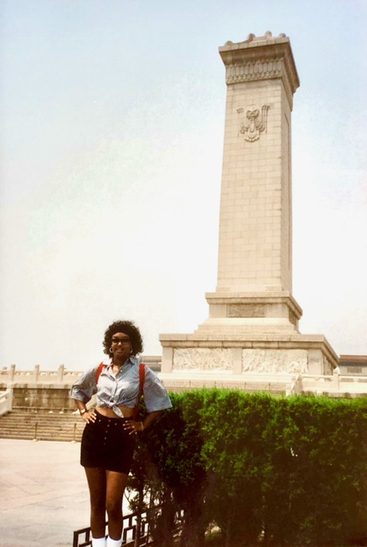
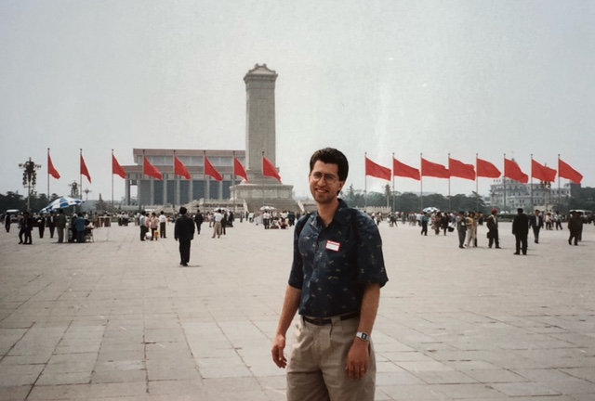
Tiananman Square

Slide 8
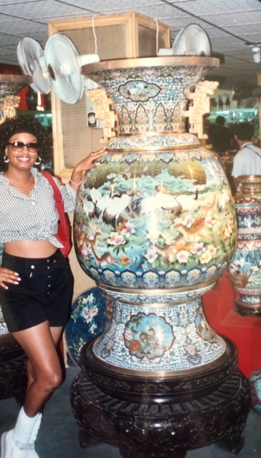
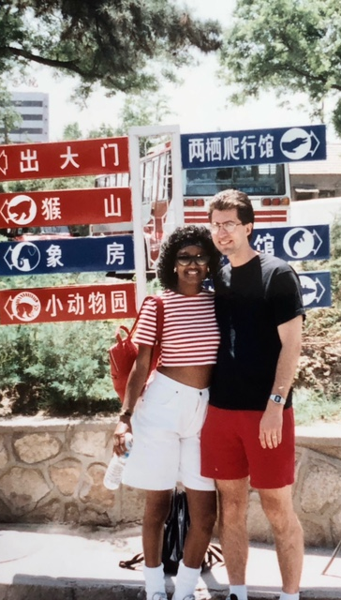
Shopping for a vase Getting directions at the zoo

Slide 9
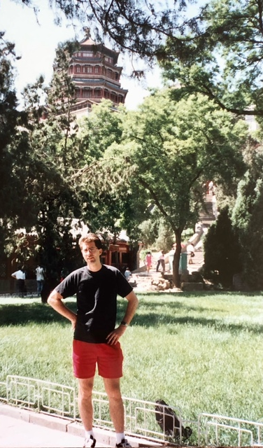
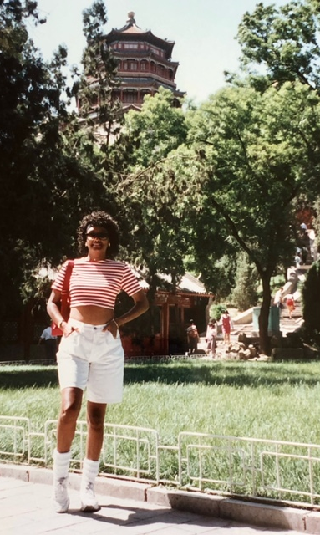
Seeing the sights

Slide 10
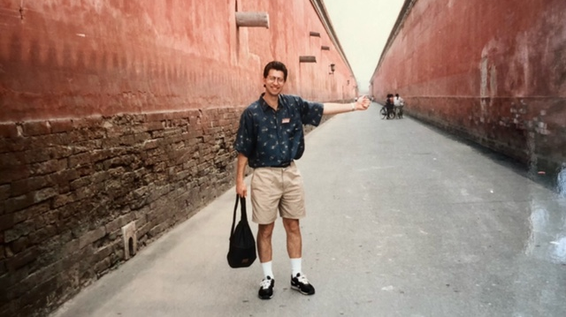
Into the Forbidden City

Slide 11
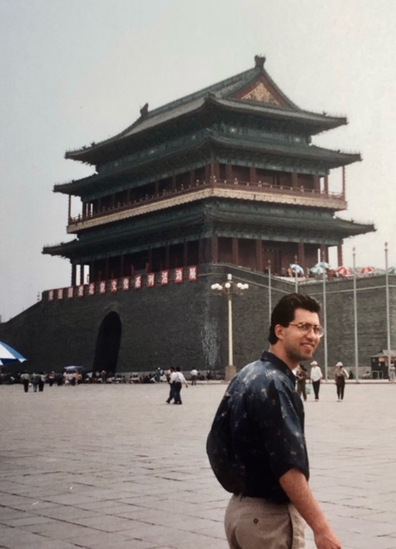
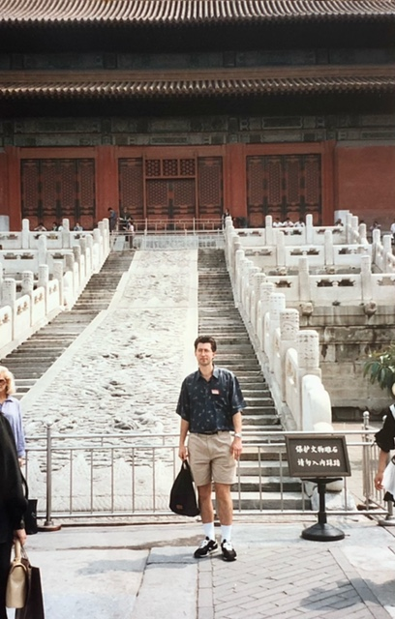
They have long history here

Slide 12
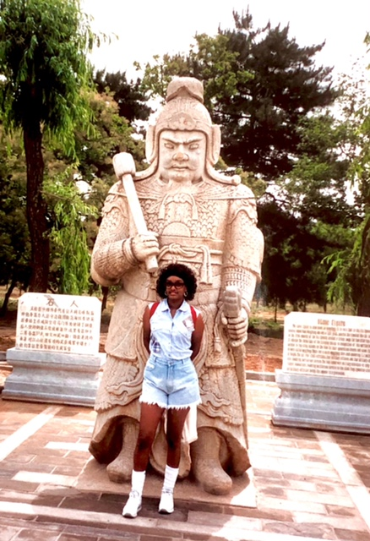
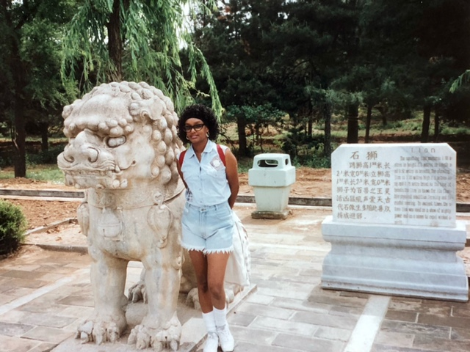
Not afraid of statues

Slide 13
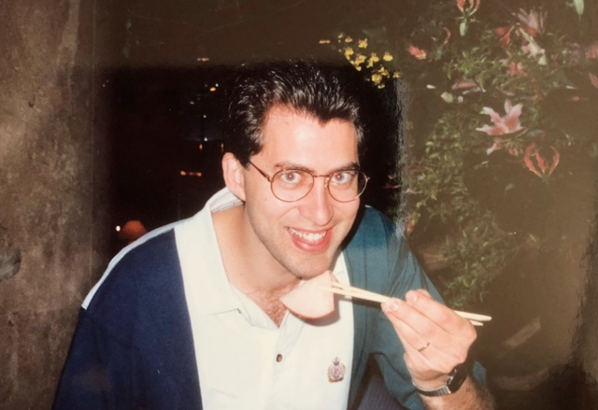
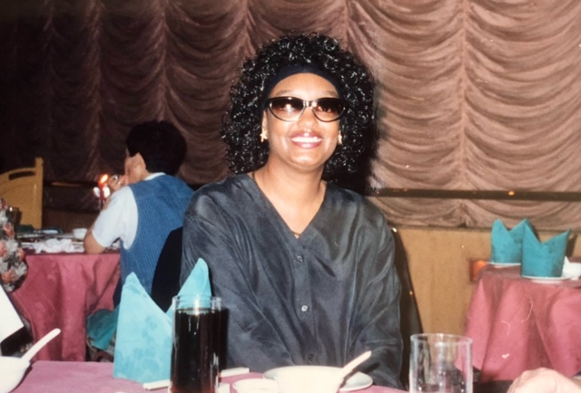
Stopping for some Chinese food

Slide 14
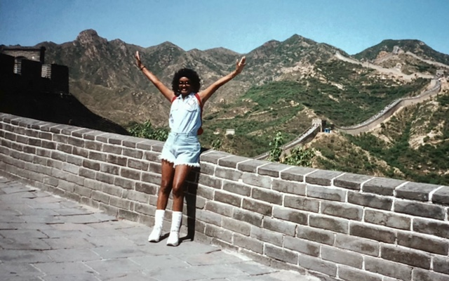
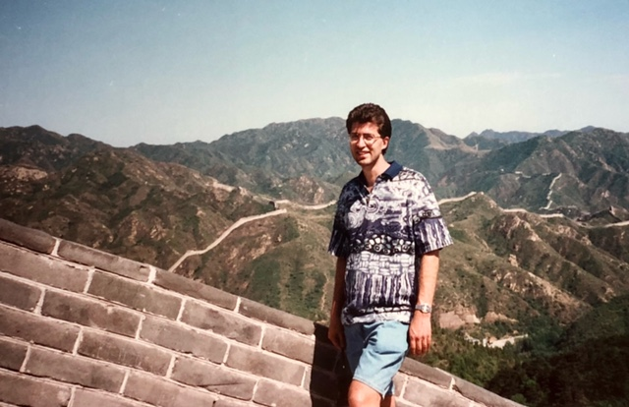
The Wall was Great! But we got into China easily.

Slide 15
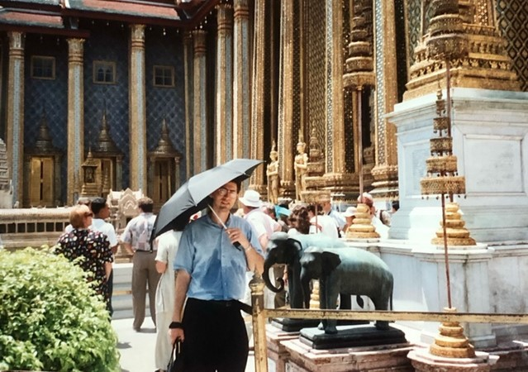
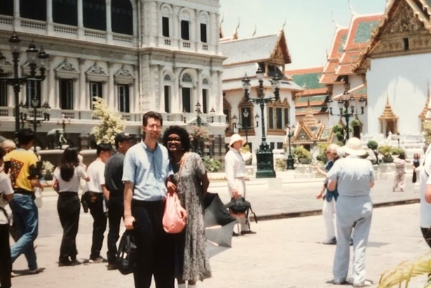
Third stop: Thailand It was hot!

Slide 16
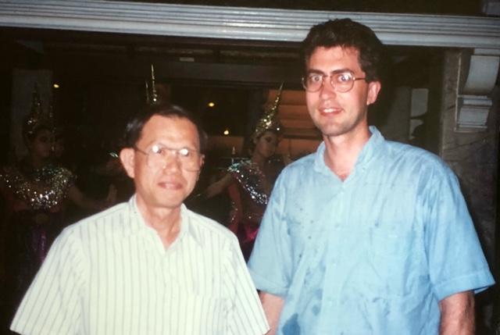
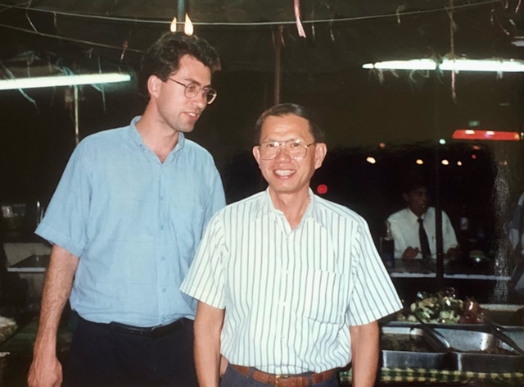
Visiting friend Sompop Kassumma

Slide 17
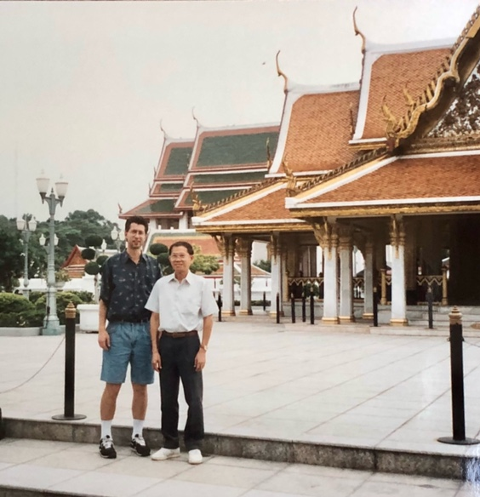
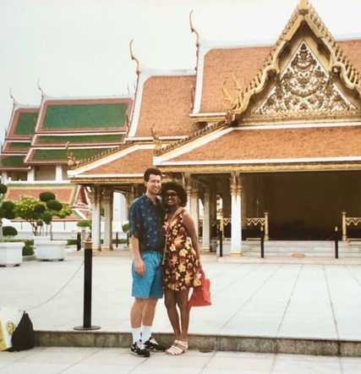
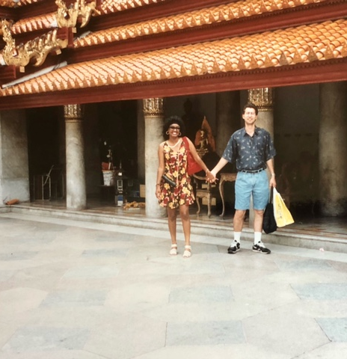
Guided tour by Sompop

Slide 18
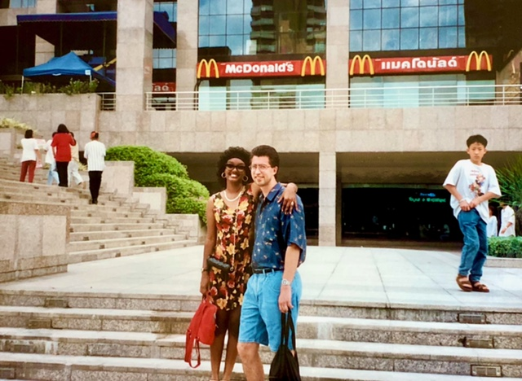
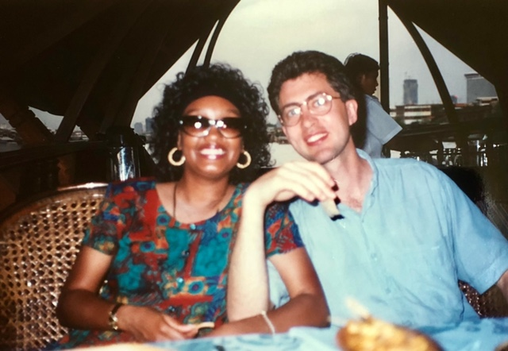
Lunch at McD, dinner on cruise

Slide 19
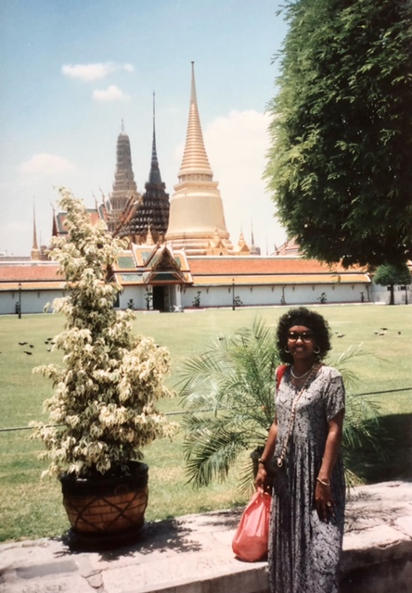
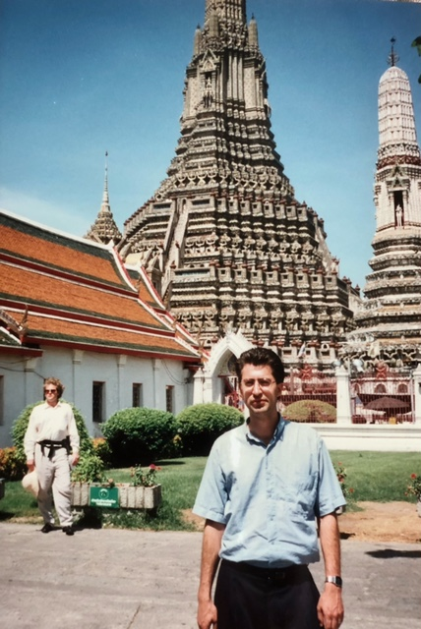
Admiring the Buddhist Temples

Slide 20
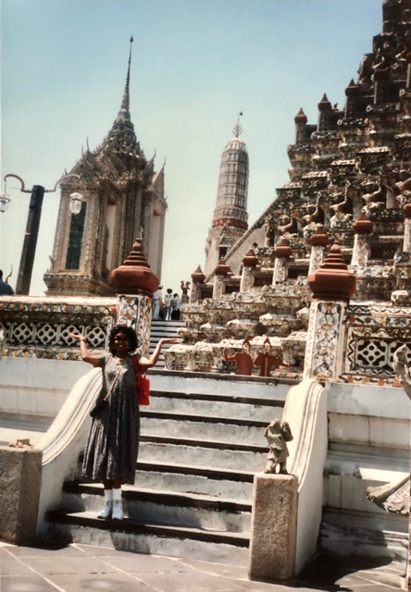
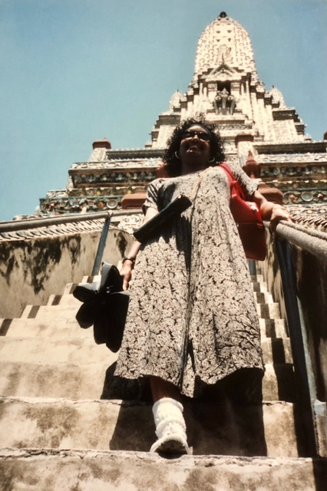
Climbing the Temples

Slide 21
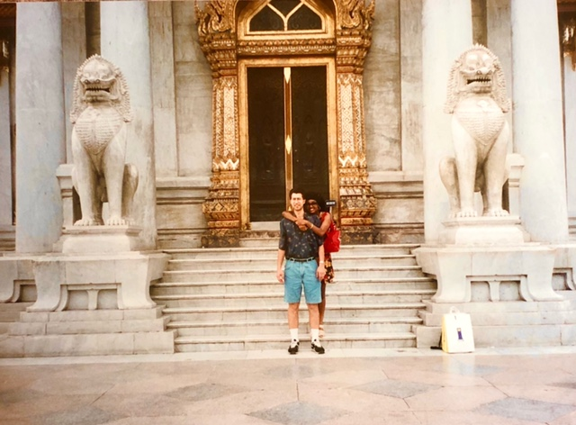
Bye Bye Thai

Slide 22
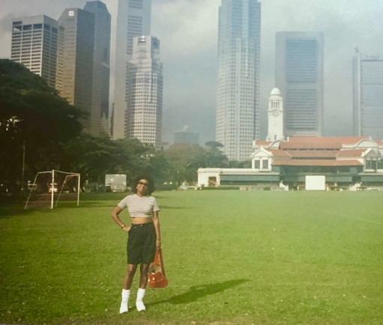
Next stop Singapore / Malaysia

Slide 23
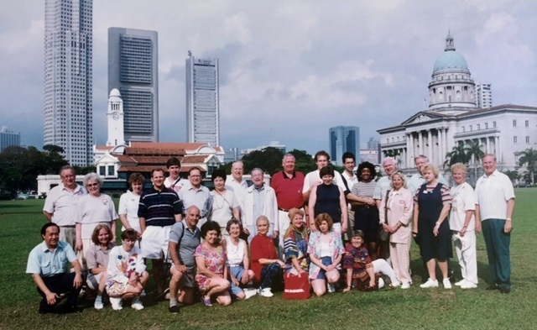
Fellow Tourists on our Honeymoon – pictured in Singapore

Slide 24
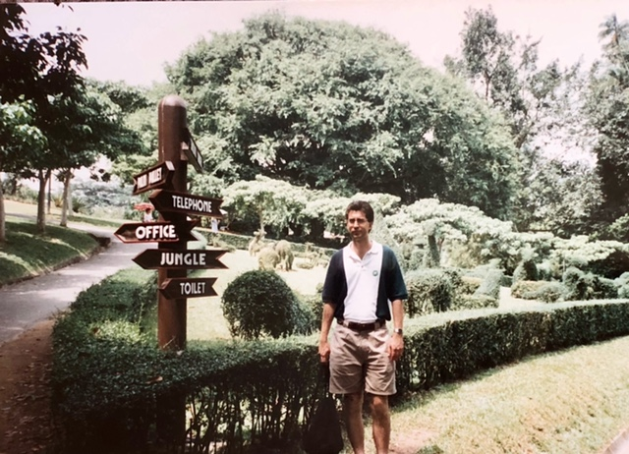
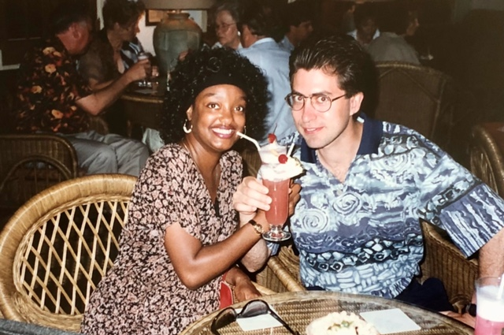
Getting directions and a drink

Slide 25
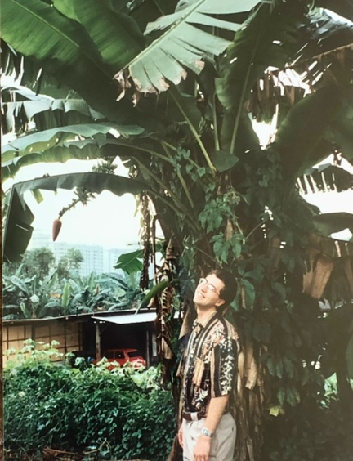
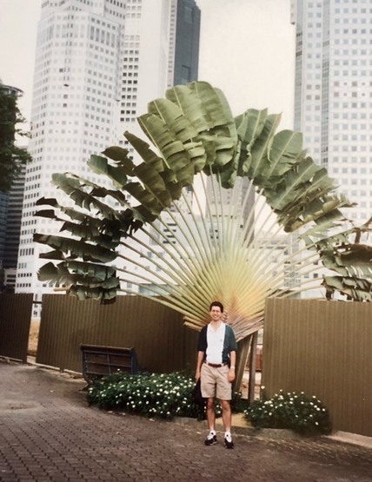
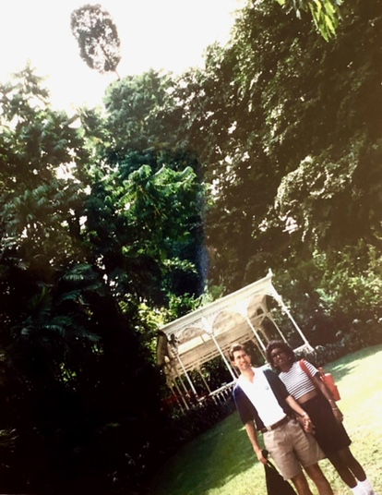
Finding fancy foliage

Slide 26
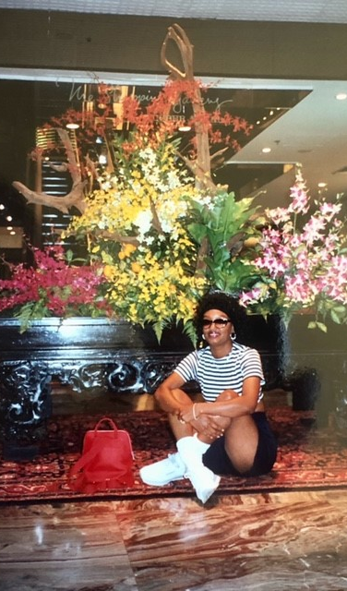
Finding fancy flowers

Slide 27
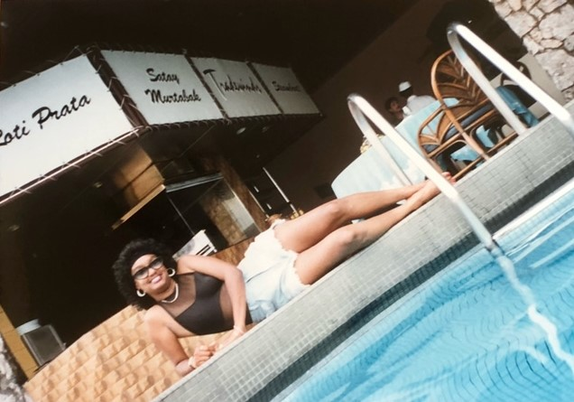
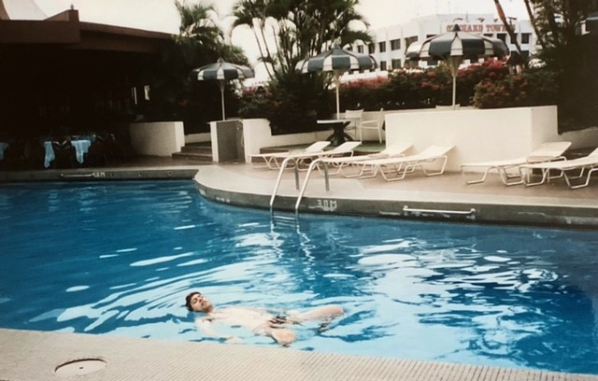
Cooling off

Slide 28
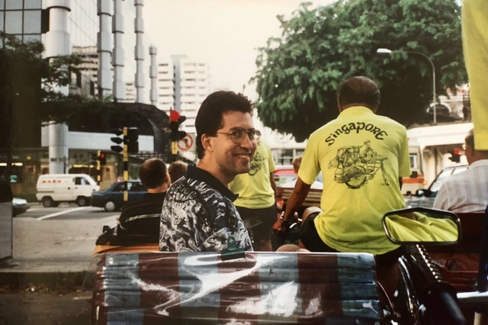
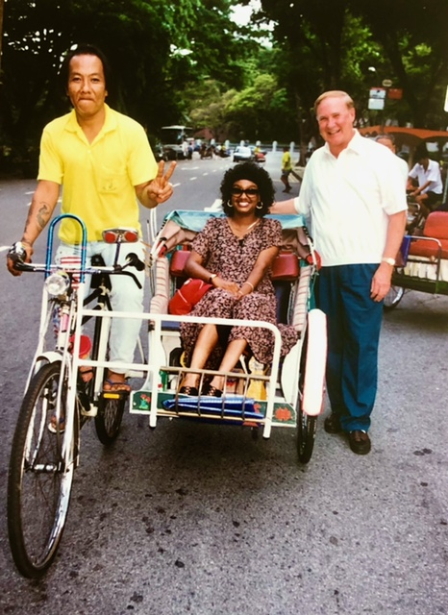
To the airport! Step on it!

Slide 29
Last stop Hong Kong / Macao

Slide 30
Shopping for a hat and some food

Slide 31
Seeing the sights

Slide 32
Finding nice seashells

Slide 33
Hong Kong was the most fun!

Slide 34
Big Honeymoon is done. Then back to Maryland.

Slide 35
Hosts for 3 of our visits
Tokyo
Dr. Hiroshi Takahashi, Global Pig Farms, Fukushima, Japan, PhD in Animal Breeding from Iowa State U., 1993.
Beijing
Dr. You-chun Chen, Asian Network for Biotechnology in Animal Production and Health, Malianwa Haidian, visiting scientist at Iowa State U., 1984.
Bangkok
Dr. Sompop Kassumma, Dept. of Livestock Development, Thailand Ministry of Agriculture, PhD in Animal Breeding from Iowa State U., 1985.

